Slide 1
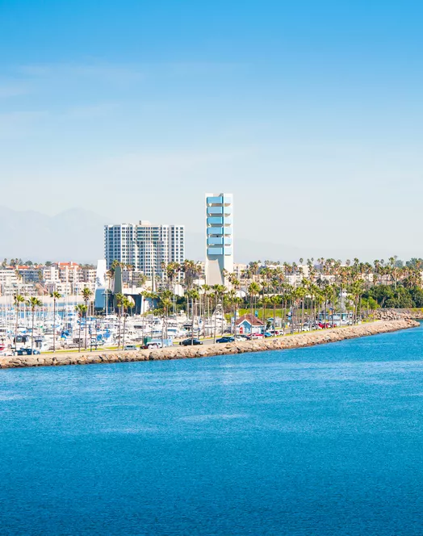
Analyzing Interview Data
Module 1.3
AISciComm | Module 1.3 Analyzing Interview Data
Notes:
Link to Module 1.3 Lesson Plan
BEFORE YOU START TEACHING
Review the Teacher Facilitation Guide for an overview of content and the curriculum as well as helpful facilitation suggestions.
Decide whether you will have students sort the interview themes onto a physical poster board or onto a virtual document.
If you choose to physically sort, make sure to set up the poster boards for each in advance. Color-code each theme using colored markers, and then physically write the name of each theme on the poster board.
The science journal is intended to be a digital notebook. However, if you decide to print copies for students, they may need a writing instrument (pen, pencil, etc.).
Open the slideshow to Slide 1 and introduce lesson 1.3.

Slide 2
Interview Recap
Now that you have conducted an interview, share your experiences with the class.
Who did you interview?
What was your experience with the interviews?
What did you notice? What stood out to you?
What questions do you still have?
Module 1.3 Analyzing Interview Data Slide 2
Notes:
Advance the slideshow to Slide 2, and as a class, ask students to share their team’s experience with conducting an interview.
Who did you interview?
What was your experience with the interviews?
What did you notice? What stood out to you?
What questions do you still have?

Slide 3
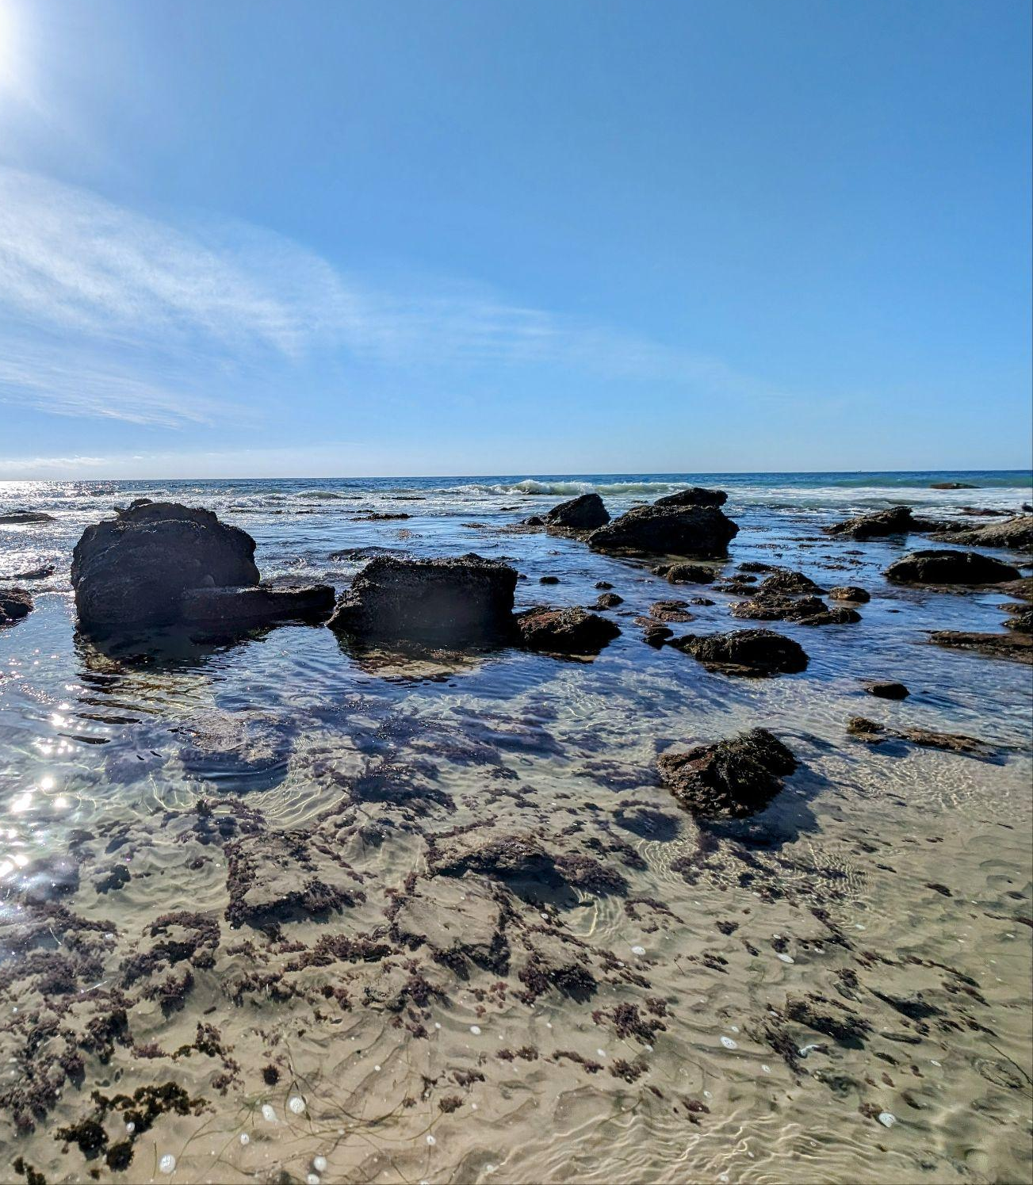
Module Overview
During module 1.3, you will:
Analyze your interview notes to categorize them into themes.
Identify patterns in the interview notes to explore what values your community members place on the ocean.
Module 1.3 Analyzing Interview Data Slide 3
Crystal Cove State Park
Newport Beach, California
Notes:
Advance the slideshow to Slide 3 and give students an overview of the day. Inform students that now that they have conducted interviews, their next step is to analyze their interview data to make sense of it. Some goals of Lesson 1.3 will be to:
Analyze your interview notes to categorize them into themes.
Identify patterns in the interview notes to explore what values your community members place on the ocean.
Tell students that now that we’ve had a chance to interview community members to learn more about their experiences with the ocean, our next step is to analyze our interview notes to look for patterns.

Slide 4
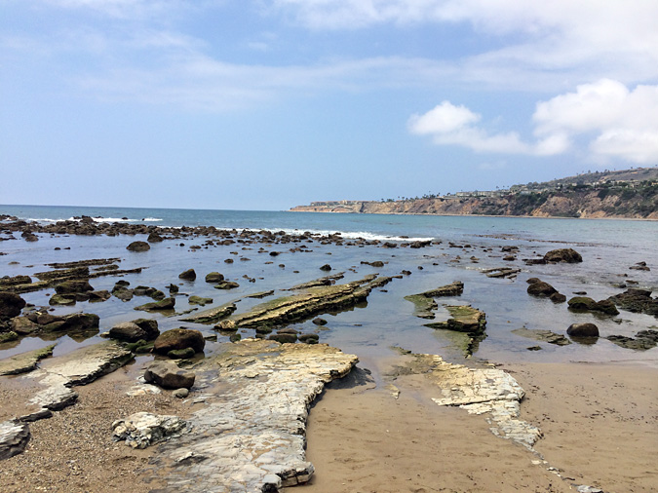
Interview Analysis
As a class, discuss the following questions after you’ve conducted your interview.
Why did you conduct a community interview?
What information did you want to gather from the community interview?
How might you analyze your interview notes to find out how climate change is affecting Southern California’s ocean?
Abalone Cove Shoreline Park. Source: https://daytripsla.com/abalone-cove-shoreline-park-tidepools/
Module 1.3 Analyzing Interview Data Slide 4
Notes:
Move on to Slide 4 and invite students to share their initial ideas as a class:
Why did you conduct a community interview?
What information did you want to gather from the community interview?
How might you analyze your interview notes to find out how climate change is affecting Southern California’s ocean?
Give students a chance to share their initial ideas out loud.
Once students have shared their initial ideas, inform them that now that they have collected interview data, they need to analyze the responses to see why community members might care about the ocean.

Slide 5
Review Your Interview Notes
After an interview, social scientists often have to make sense of the data, they can do this by categorizing the responses.
With your team, you will categorize your interview response into three different categories.
Past experiences with the ocean
Reasons the interviewee cares about the ocean
Ideas about how the ocean is changing
Before you categorize your responses with your team, let’s practice with a few examples on the following slides.
Module 1.3 Analyzing Interview Data Slide 5
Notes:
Advance to Slide 5, tell students that following an interview, social scientists often have to make sense of the data. One way that they do this is by categorizing the responses of the interviews into categories of themes.
Share with students that they will work with their teams to categorize their data into themes, just like social scientists do. However, they will have three categories
Category #1: Past experiences with the ocean
Category #2: Reasons the interviewee cares about the ocean
Category #3: Ideas about how the ocean is changing
Inform students that before they work on their interview notes, they will have a chance to practice with some examples.

Slide 6
Example #1
Which theme(s) is the following quote an example of?
Interview Quote: “I grew up visiting the state parks and going to tidepools with my siblings.”
Interview Response Categories
Past experiences with the ocean.
Reasons the interviewee cares about the ocean.
Ideas about how the ocean is changing.
Module 1.3 Analyzing Interview Data Slide 6
Notes:
Advance to Slides 6-8 where students will have examples of interview responses to categorize. As a class, work together to identify which category each response will fit under, if it fits under more than one.
Example 1: “I grew up visiting the state parks and going to tidepools with my siblings.”
Category #1: Past experiences with the ocean
Category #2: Reasons the interviewee cares about the ocean
Category #3: Ideas about how the ocean is changing

Slide 7
Example #2
Which theme(s) is the following quote an example of?
Interview Quote: “We used to not have as many intense storms.”
Interview Response Categories
Past experiences with the ocean.
Reasons the interviewee cares about the ocean.
Ideas about how the ocean is changing.
Module 1.3 Analyzing Interview Data Slide 7
Notes:
Advance to Slides 6-8 where students will have examples of interview responses to categorize. As a class, work together to identify which category each response will fit under, if it fits under more than one.
Example 2: “We used to not have as many intense storms.”
Category #1: Past experiences with the ocean
Category #2: Reasons the interviewee cares about the ocean
Category #3: Ideas about how the ocean is changing

Slide 8
Example #3
Which theme(s) is the following quote an example of?
Interview Quote: “Food is the first thing that I think of. I love seafood, particularly octopus salad.”
Interview Response Categories
Past experiences with the ocean.
Reasons the interviewee cares about the ocean.
Ideas about how the ocean is changing.
Module 1.3 Analyzing Interview Data Slide 8
Notes:
Advance to Slides 6-8 where students will have examples of interview responses to categorize. As a class, work together to identify which category each response will fit under, if it fits under more than one.
Example 3: “Food is the first thing that I think of. I love seafood, particularly octopus salad.”
Category #1: Past experiences with the ocean
Category #2: Reasons the interviewee cares about the ocean
Category #3: Ideas about how the ocean is changing

Slide 9
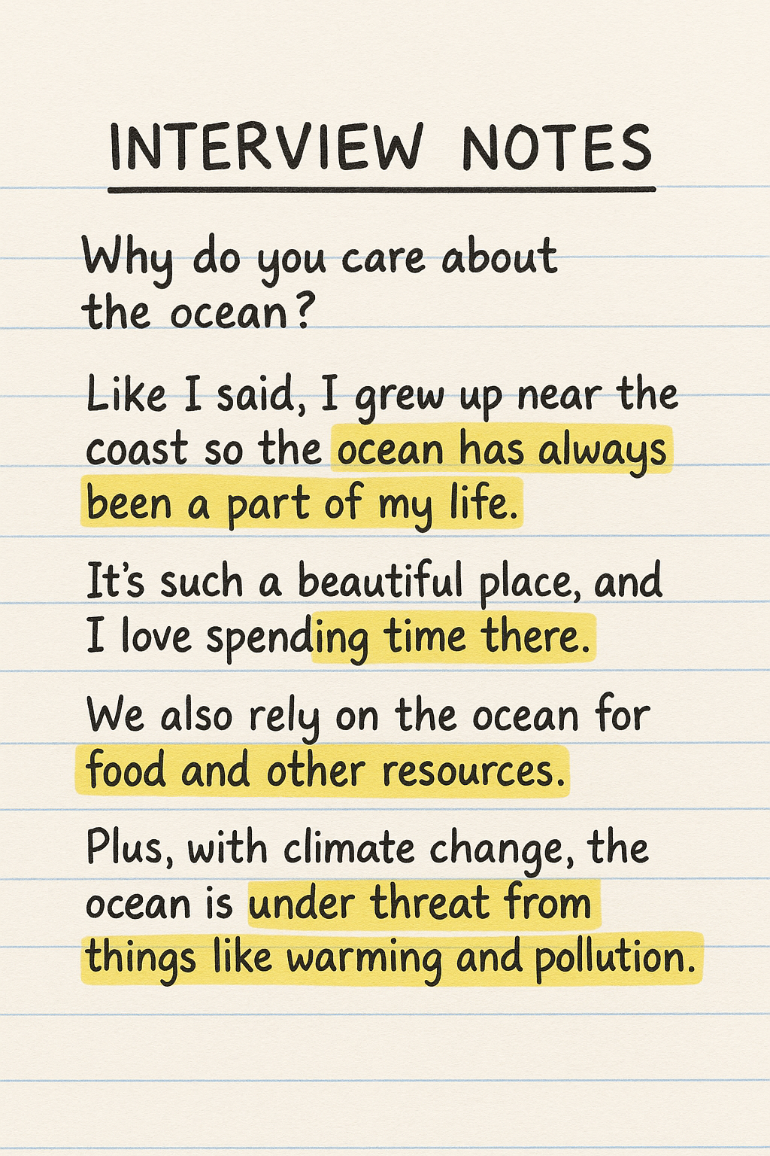
Now it is Your Turn!
With your research team, review your interview notes and highlight any responses that fit under the three interview themes.
Interview Response Categories
Past experiences with the ocean.
Reasons the interviewee cares about the ocean.
Ideas about how the ocean is changing.
Image created with ChatGPT Prompt: Generate an image of interview notes with some highlighted text of why a community member might care about the ocean.
Module 1.3 Analyzing Interview Data Slide 9
Notes:
Once the class has had a chance to practice with the examples, advance to Slide 9. Have the students work with their teams to review their community interview notes (refer to Module 1.2 Part 2: Conducting Community Interviews (Student Task: Optional Interview Notes) in the Science Journal) to highlight or underline any ideas related to the three categories. If something does not fit into one of the three categories, they should not highlight it.
As students do so, move between the groups to answer questions and provide support on questions they may have.
After student teams have had an opportunity to highlight their ideas, tell them that their next step is to categorize these ideas.

Slide 10
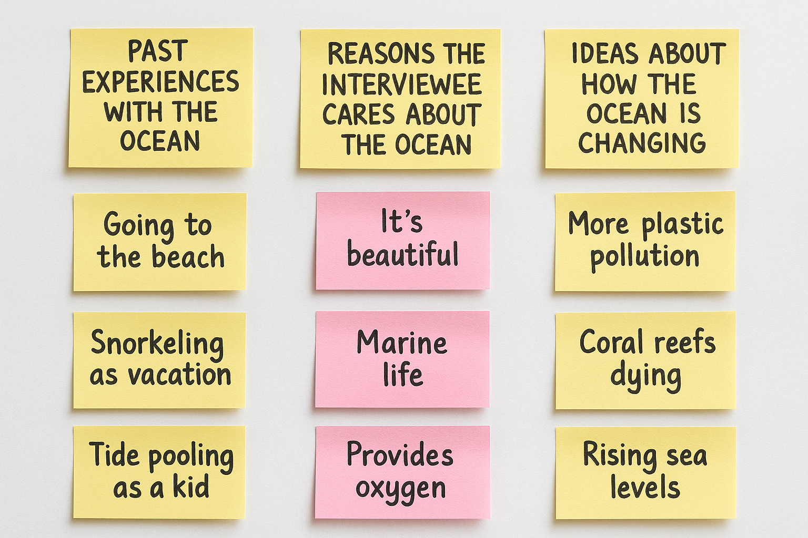
Categorizing Your Data
With your research team, you will now categorize each idea into its appropriate category.
To categorize your ideas, follow these steps:
Write each category on a post-it note.
Write each idea on their own individual post-it note.
Place each idea within the appropriate category.
Image created with ChatGPT Prompt: Generate an image containing post-it notes that categorize ideas under three categories.
Category #1: Past experiences with the ocean
Category #2: Reasons the interviewee cares about the ocean
Category #3: Ideas about how the ocean is changing
Module 1.3 Analyzing Interview Data Slide 10
Notes:
Advance to Slide 10 and ask students to create three category piles and place their post-it notes under the appropriate category.
Category #1: Past experiences with the ocean
Category #2: Reasons the interviewee cares about the ocean
Category #3: Ideas about how the ocean is changing
Note: If you have three different color post-it notes, it might be helpful to have students use a different post it note color for each category.

Slide 11

Identify Patterns in Your Data
Now that your team has categorized the community interview responses, you will now identify patterns within your data.
To identify patterns in your data, sort your idea into themes on a posterboard. These themes can be centered around values, or why an individual may feel connected to the ocean.
Examples of themes include:
Emotional
Wellbeing & feelings
Financial
Tradition
Module 1.3 Analyzing Interview Data Slide 11
Notes:
Once students have finished categorizing their responses from their community interview, advance to Slide 11. Tell them that our next step is to look for patterns in the responses that our interviewees shared and place these ideas on a poster around the classroom.
To do this, we’ll sort the post-its into themes. These themes can be centered around values, or why an individual may feel connected to the ocean any may include:
Emotional
Wellbeing & feelings
Financial
Tradition

Slide 12
Gallery Walk
As a class, conduct a gallery walk to see how other community members value the ocean. Afterwards, you will gather as a class to discuss your experience.
As you conduct your gallery walk, keep the following questions in mind.
What patterns or themes did you identify that are similar than the patterns or themes your team identified?
What patterns or themes did you identify that are different than the patterns or themes your team identified?
What changes might you make to your own poster after seeing other posters?
Module 1.3 Analyzing Interview Data Slide 12
Notes:
When student posters are ready, place them around the classroom and advance to Slide 12. Tell students that they will be participating in a gallery walk to see how other community members place value on the ocean.
Inform students that they will first conduct a gallery walk and then return as a class to discuss their findings. To structure the gallery walk, provide students the following questions to get them started.
What patterns or themes did you identify that are similar than the patterns or themes your team identified?
What patterns or themes did you identify that are different than the patterns or themes your team identified?
What changes might you make to your own poster after seeing other posters?

Slide 13
Share
As a class, share your experience on conducting the gallery walk.
Are there any common themes you noticed during the gallery walk?
What is a theme or pattern that you found interesting or different from your own?
How might you use these patterns to identify why the community cares about the ocean?
Module 1.3 Analyzing Interview Data Slide 13
Notes:
After the gallery walk, bring the class back together and advance to Slide 13. As a whole class, discuss the following:
Are there any common themes you noticed during the gallery walk?
What is a theme or pattern that you found interesting or different from your own?
How might you use these patterns to identify why the community cares about the ocean?

Slide 14

Reflect
Reflect on what you learned in your science journal (p. 8) for Module 1.3:
What did you learn from analyzing your interview responses? How has your thinking about why people value the ocean or how it is changing been affected?
Why is it important to analyze responses to interview questions? What can this tell us about how communities value the ocean?
How will you use what you learned in Module 1 to build your model of how climate change is impacting Southern California’s ocean? For example, what information will you add or show to explain these impacts?
Image created with ChatGPT Prompt: Create an image about SoCal beaches.
Module 1.3 Analyzing Interview Data Slide 14
Notes:
As a final task, advance to Slide 14 and give students some time to reflect on Module 1.3: Analyzing Interview Data (Student Reflection), page 8 of their Science Journals.
What did you learn from analyzing your interview responses? How has your thinking about why people value the ocean or how it is changing been affected?
Why is it important to analyze responses to interview questions? What can this tell us about how communities value the ocean?
How will you use what you learned in Module 1 to build your model of how climate change is impacting Southern California’s ocean? For example, what information will you add or show to explain these impacts?

Slide 15




Thank you!
If you have any questions, please feel free to reach out.
Erick Valdez
Inside the Outdoors
evaldez@ocde.us
Ha Nguyen, Ph.D.
Assistant Professor, UNC
ha.nguyen@unc.edu
Module 1.3 Analyzing Interview Data Slide 15
Notes:
Advance to Slide 15. As the time wraps up for the day, thank students for their time. Inform students that this concludes module 1. In the module 2 students will step into the next step in the process, using their information to create a model.

