Slide 1
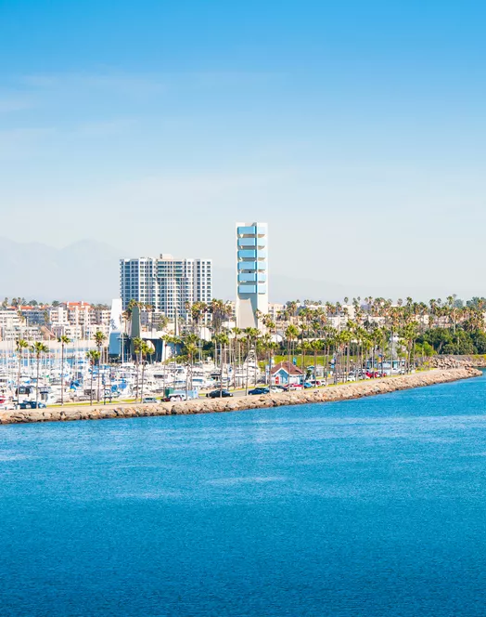
Building a Model
Module 2.1
AISciComm | Module 2.1 Building a Model
Notes:
Link to Module 2.1 Lesson Plan
BEFORE YOU START TEACHING
Review the Teacher Facilitation Guide for an overview of content and the curriculum as well as helpful facilitation suggestions.
Review Student SageModeler Instructions to be able to model or support students.
Include a numbered list of general steps to set up the investigation before students arrive.
This can also include other things that educators should do or think about before starting the lesson, such as checking for safety concerns.
Open the slideshow to Slide 1 and inform students that today is the beginning of module 2. Tell students that in module 2, they will work on transferring the information gathered in module 1 to create a model on how communities value the ocean.

Slide 2
Reflecting on What We’ve Done
As a class, take a moment and reflect on what you have accomplished in module 1.
What did you do in module 1? What kind of information did you gather?
Module 2.1 Building a Model Slide 2
Notes:
Advance the slideshow to Slide 2 and invite the class to reflect on what they have accomplished in the last module
What did you do in module 1?
What kind of information did you gather?

Slide 3
Reflecting on What We’ve Done
As a class, take a moment and reflect on what you have accomplished in module 1.
What did you do in module 1? What kind of information did you gather?
In Module 1 you:
Considered how the ocean is changing.
Conducted research on how climate change will impact Southern California’s beaches.
Interviewed community members to see how changes to the ocean will impact what we value.
Module 2.1 Building a Model Slide 3
Notes:
Advance to Slide 3 to support student responses and review that in the previous module. In Module 1 you:
Considered how the ocean is changing
Conducted research on how climate change will impact Southern California’s ocean
Interviewed community members to see how changes to the ocean will impact what we value

Slide 4
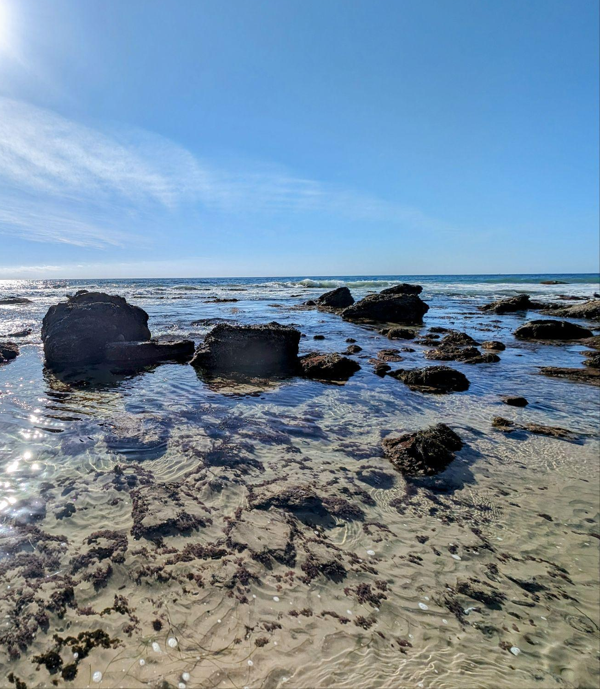
Module Overview
During module 2.1, you will:
Brainstorm the components and processes that make up the ocean and how humans interact with the ocean system.
Create a model to share why community members care about Southern California’s ocean.
Use your model to explore how climate change can impact the ocean system.
Module 2.1 Building a Model Slide 4
Crystal Cove State Park
Newport Beach, California
Notes:
Move forward to Slide 4 to share with the class the lesson 2.1 overview.

Slide 5
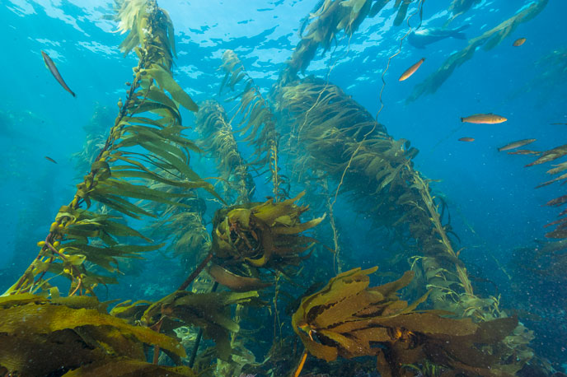
Peer Discussion
With your team, take a moment to reflect on how individuals value the ocean. Then share as a class.
How do you interact with the ocean? Why do you value it?
How does your community interact with the ocean? Why do they value it?
What impact do you think climate change will have on the way communities interact with the ocean?
Kelp forest. Source: https://www.nps.gov/chis/learn/nature/kelp-forests.htm
Module 2.1 Building a Model Slide 5
Notes:
When you’re ready, advance to Slide 5 ask students to think back to their personal values connected to the ocean, as well as the reasons that community members care about the ocean that were shared during the interviews.
Have student groups reflect on the following questions:
How do you interact with the ocean? Why do you value it?
How does your community interact with the ocean? Why do they value it?
What impact do you think climate change will have on the way communities interact with the ocean?
When student groups are done discussing, invite the class back together and have students share out.
Inform students that today, they will take the information that they gathered and develop a model using their initial ideas of how climate change will affect Southern California’s ocean.

Slide 6
Brainstorming
What are the components and processes that make up the ocean? With your team, create a list and add them to your brainstorming document.
Components | Processes
Individual elements that make up the ocean system, which can include both living (biotic) and non-living (abiotic) elements. Examples could include: Organisms like fish, kelp, etc. Water Oxygen Nutrients | Actions in the ocean system that occur over time, such as: Tidal shifts Storm events Photosynthesis
Module 2.1 Building a Model Slide 6
Notes:
Ask student teams from module 1 to get together for a brainstorming session. Advance to Slide 6, and invite students to think about the following question: What are the components and processes that make up the ocean?
Ask student teams to open up their Science Journal to Module 2.1: Building a Model (Student Task: Brainstorming Components, Processes, & Interactions) (p.9) where they will see a brainstorming document.
Provide students time to think about only the components and processes that they think make up the ocean and add their ideas onto the brainstorming document.
Components: Individual elements that make up the ocean system, which can include both living (biotic) and non-living (abiotic) elements, such as organisms like fish or kelp, water, oxygen, and nutrients.
Processes: Actions in the ocean system that occur over time, such as tidal shifts, storm events, or photosynthesis.

Slide 7
Brainstorming
Next, with your team, start thinking about the different interactions humans may have with the ocean system. Add these interactions as the last category in the document.
Interactions
The ways in which humans and different components of the ocean system engage with one another. These interactions could be positive, negative, or neutral, such as: beach clean-ups emitting carbon surfing
Module 2.1 Building a Model Slide 7
Notes:
After students have had time to brainstorm their components and processes, advance to Slide 7 and guide students to start thinking about the different interactions humans may have with the ocean system:
Interactions: The ways in which humans and different components of the ocean system engage with one another. These interactions could be positive, negative, or neutral, as beach clean-ups, emitting carbon, or surfing.
Give student teams time to brainstorm their interactions and add them onto their brainstorming document in their science journal.

Slide 8
Identifying a Value for Your Model
With your research teams, select ONE value connected to the ocean that was important to you and community members. Consider the community interview analysis questions to help you select a value.
Answer question in Science Journal (p. 9-10):
What evidence shows why people care about the ocean? Include specific quotes or examples from your interview to support your answer (reference Module 1.2 Part 2: Conducting Community Interviews notes).
How did your team categorize these values or themes?
Which value from your interviews will your team include in your model, and how does this value connect to the ocean system or the impacts of climate change?
Module 2.1 Building a Model Slide 8
Notes:
Once students have their brainstormed list of components, processes, and interactions, advance to Slide 8. Tell students that their next step in the modeling process is to select a value that is connected to the ocean. Invite them to think back to when they analyzed the community interviews and respond in their Science Journal to Module 2.1: Building a Model (Student Task: Brainstorming Components, Processes, & Interactions), p. 9-10.
Based on your interview responses, what evidence shows why people care about the ocean? Include specific quotes or examples from your interview to support your answer (reference Module 1.2 Part 2: Conducting Community Interviews notes).
How did your team categorize these values or themes?
Which value from your interviews will your team include in your model, and how does this value connect to the ocean system or the impacts of climate change?

Slide 9
Identifying a Value for Your Model
With your team identify a value. Your chosen value could be:
An emotional attachment (eg. mental health).
A reason why you and your community likes going to the beach (spending time with friends, going on vacation, surfing).
Culturally or socially significant. (eg. a means of transportation, livelihood, etc.)
Tied to food or tradition (enjoying seafood, ceviche, etc.).
An overall appreciation of the ocean system (such as wanting to protect marine mammals).
Module 2.1 Building a Model Slide 9
Notes:
Advance to Slide 9 and give students a few minutes to choose a value to focus on. Their chosen value could be an emotional attachment (such as mental health), a reason why they like going to the beach (such as spending time with friends, going on vacation to the beach, or surfing), cultural or societal significance, tied to food or tradition (such as enjoying ceviche or seafood), or an appreciation of the ocean system (such as wanting to protect marine mammals).

Slide 10
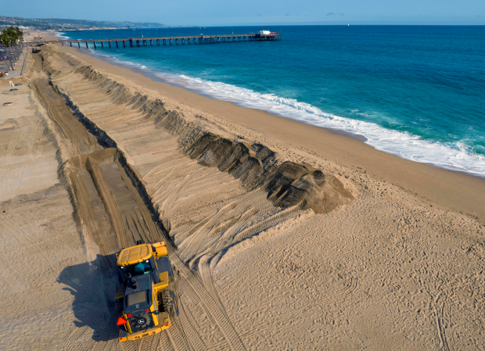
Refining Your Team’s List
Which of your team’s components, processes, and interactions are most connected to your chosen value?
With your team choose 10-12 items from your team’s original list of components, processes, and interactions that are the most connected to the value your team chose and highlight them.
These items will be the items you prioritize putting in your model.
Beach nourishment in Orange County beaches. https://www.ocregister.com/2022/03/15/two-massive-oc-sand-projects-funded-to-add-a-beach-buffer-to-battle-erosion/
Module 2.1 Building a Model Slide 10
Notes:
Once students have chosen their value they want to model, advance to Slide 10 and give them their next task, which is to refine their list of components, processes, and interactions. Ask students to choose 10 - 12 items from their original list that are most connected to their value.
They will prioritize including these items in their model.

Slide 11
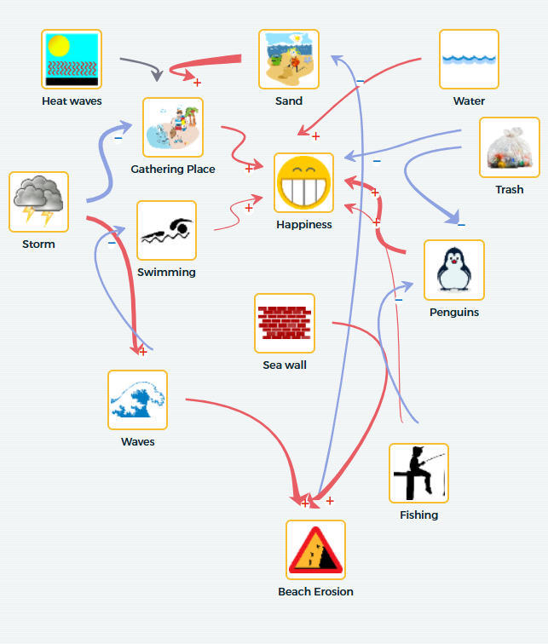
Building Our Model
Get your computers ready! With your research team you will create a model on SageModeler.
You will answer the following modeling question:
How will climate change impact the reason why you care about Southern California’s ocean?
Module 2.1 Building a Model Slide 11
Notes:
Advance to Slide 11 and tell students that their next task is to build a model that centers their chosen value and includes the 10 - 12 items from their original list that are most closely connected to their value.
Student models will be made in SageModeler and will answer the modeling question: How will climate change impact the reason why you care about Southern California’s ocean?
Tip for Facilitator: Before having students make their own model, open up the SageModeler template and demonstrate the process by adding a value, and one or two items. Condensed steps are included on Slide 12 and modeled more in depth in student instructions and/ or on slides 12-22 but the modeling process is as follows:
Modeling Process:
Begin by opening the SageModeler template.
Click on the New Image icon in the upper right corner and search for an image to represent your chosen value. Add it into your picture break, and then drag it into the modeling window. Make sure to and label it with your chosen value into your model.
Search for photos to represent the other components, processes, and interactions that you want to include in your model. Add in the components, processes, and interactions into your model and label them.
Begin connecting the parts of your model together by defining their relationship. To do so, you’ll need to click on one icon, and then drag the arrow to the second icon that you want to connect to. You’ll then be able to double-click on the arrow to define the relationship, which could be:
Positive relationship: As one factor increases, the second factor also increases.
Negative relationship: As one factor increases, the second factor decreases.
Varied relationship: As one factor increases, the second factor can increase or decrease depending on different conditions
As you make connections in your model, click on the arrow one last time to add a text box section and describe the relationship using words.

Slide 12
Getting Started with SageModeler
See Science Journal p. 11-18
Choose one member of your team to create a copy of the SageModeler template or visit https://tinyurl.com/AISciModel.The whole team will work on one model together.
To start your model, click on the new Image icon at the top-left corner of the screen. Choose an image to represent your chosen value and then drag it into the modeling window. Make sure to and label it with your chosen value into your model.
Next, search for images to represent the other components, processes, and interactions that you want to include in your model, making sure to label all of them.
To connect two items in your model, hover over the first item. An arrow will appear. Click and drag that arrow over to the item you want to connect it to. Creating a causal relationship.
To describe the relationship between two items, double click on the arrow that connects them. Then choose which descriptions best represent the relationship between the two items.
Repeat steps 3 - 5 to add components, processes, and interactions from your list to the model.
Save your model when you’re done.
Module 2.1 Building a Model Slide 12

Slide 13

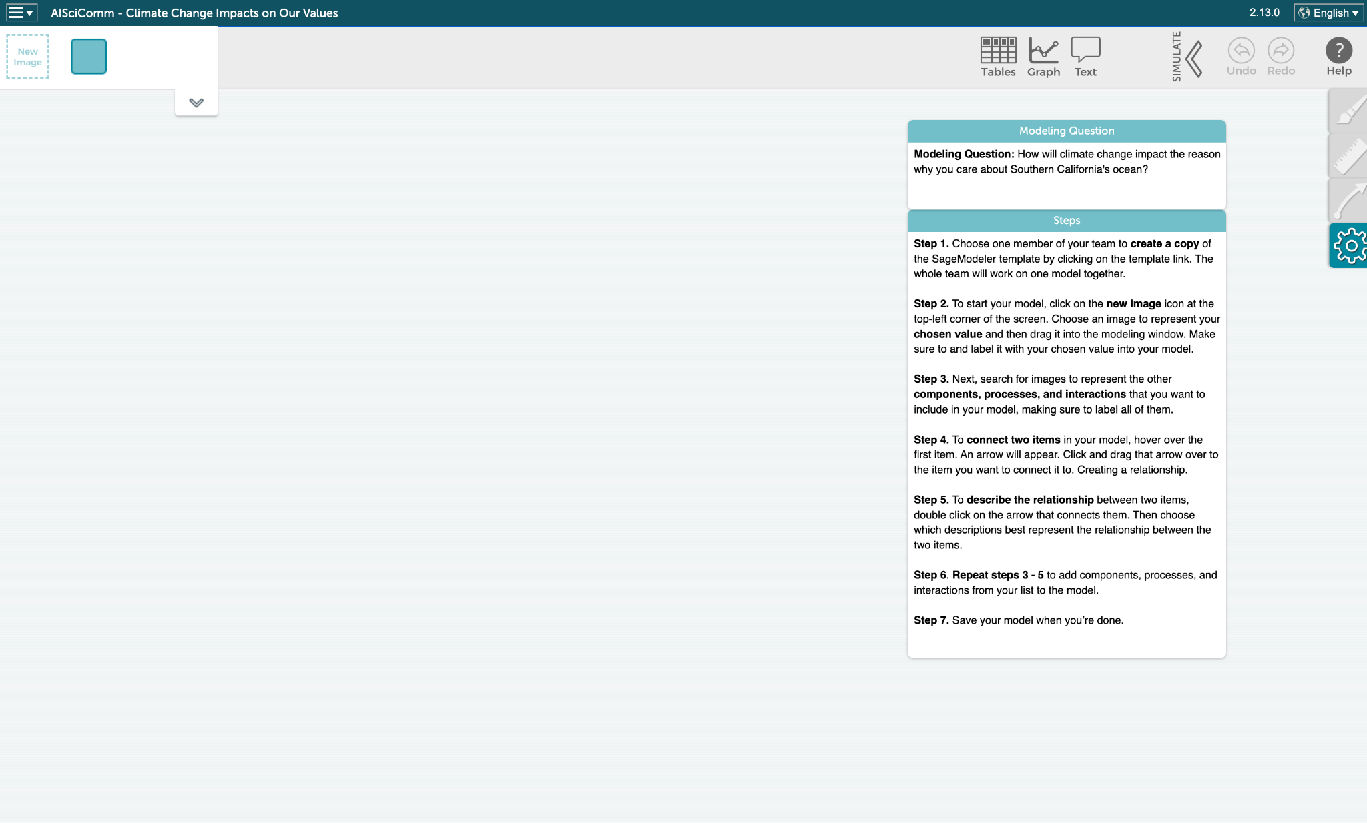
Student SageModeler Instructions
Choose one member of your team to create a copy of the SageModeler template or visit https://tinyurl.com/AISciModel.
The whole team will work on one model together.
Module 2.1 Building a Model Slide 13
Notes:
Students may reference the modeling process described in the following Student SageModeler Instructions (Slides 13-20; in Science Journal p.11-18):
Slide 13 (hidden slide): Choose one member of your team to create a copy of the SageModeler template or visit https://tinyurl.com/AISciModel.The whole team will work on one model together.

Slide 14
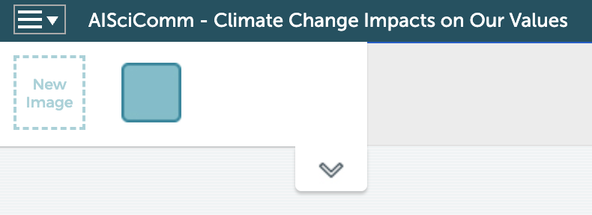
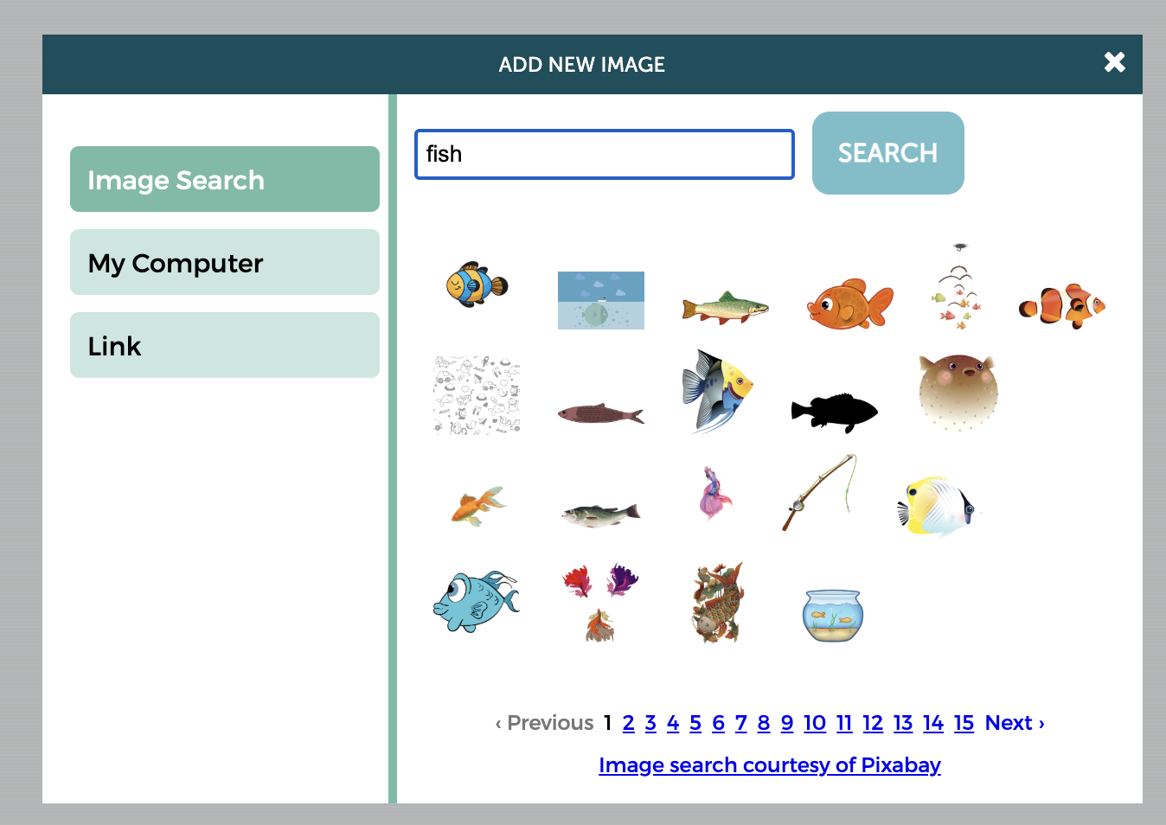
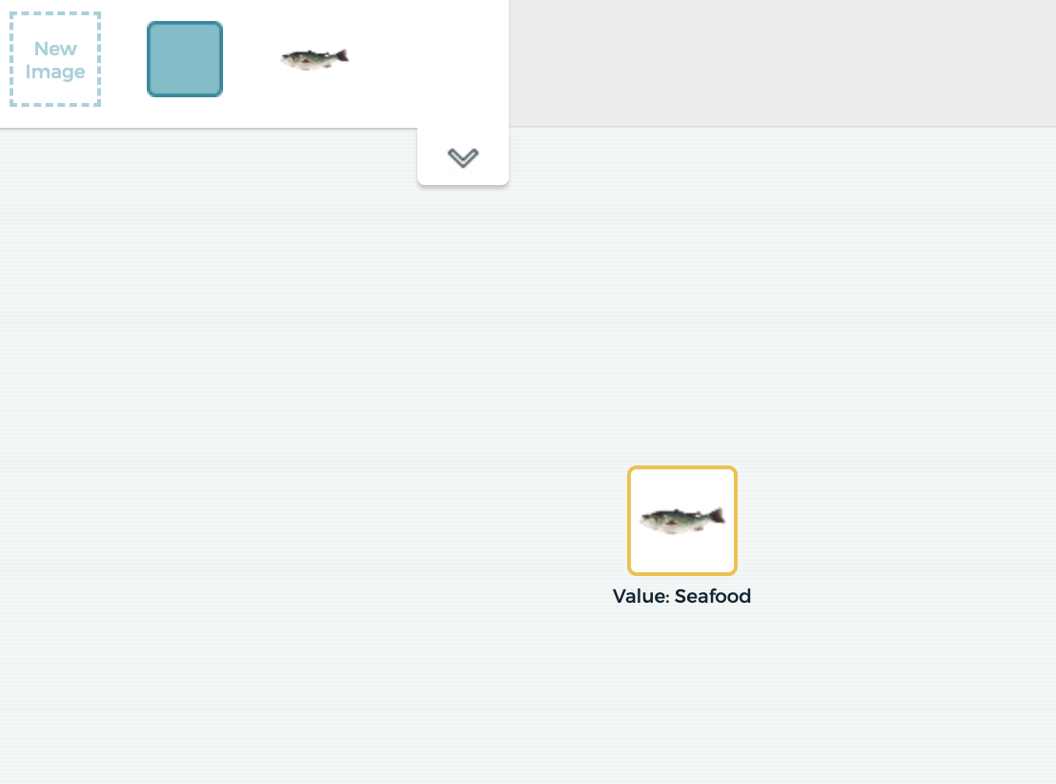
Student SageModeler Instructions
To start your model, click on the new Image icon at the top-left corner of the screen.
Choose an image to represent your chosen value. Press “Add Image.”
Example: Search “fish” for the value seafood.
Drag image into the modeling window.
Make sure to label it with your chosen value in your model.
Module 2.1 Building a Model Slide 14
Notes:
Slide 14: To start your model, click on the new Image icon at the top-left corner of the screen. Choose an image to represent your chosen value and then drag it into the modeling window. Make sure to and label it with your chosen value into your model.

Slide 15
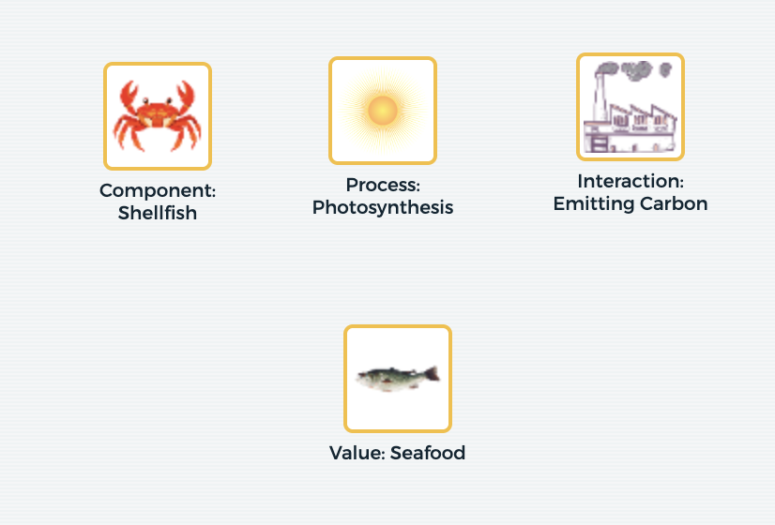
Student SageModeler Instructions
Search for images to represent the other components, processes, and interactions that you want to include in your model.
Label all of them.
Example:
Module 2.1 Building a Model Slide 15
Notes:
Slide 15 (hidden slide): Next, search for images to represent the other components, processes, and interactions that you want to include in your model, making sure to label all of them.

Slide 16
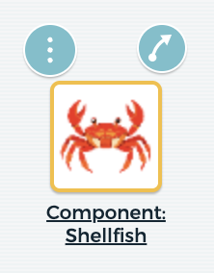
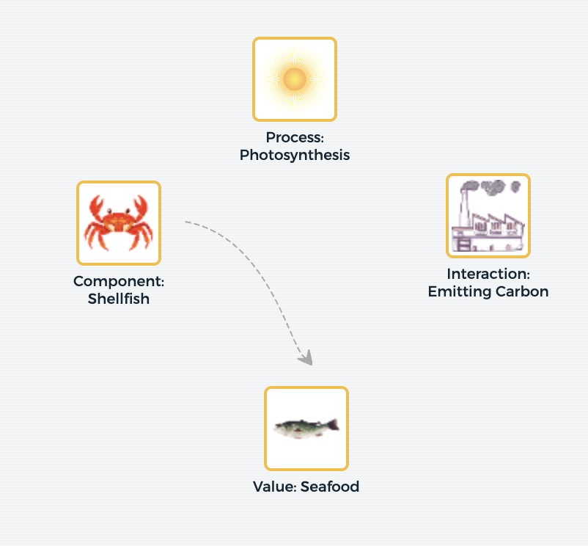
Student SageModeler Instructions
To connect two items in your model, hover over the first item. An arrow will appear.
Click and drag that arrow over to the item you want to connect it to. Creating a causal relationship.
Module 2.1 Building a Model Slide 16
Notes:
Slide 16: To connect two items in your model, hover over the first item. An arrow will appear. Click and drag that arrow over to the item you want to connect it to. Creating a causal relationship.

Slide 17
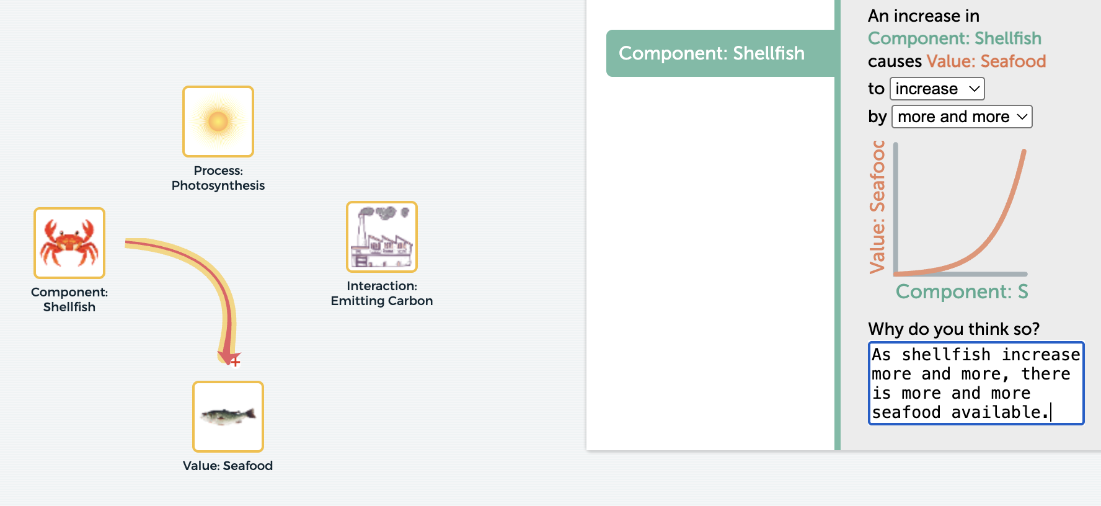
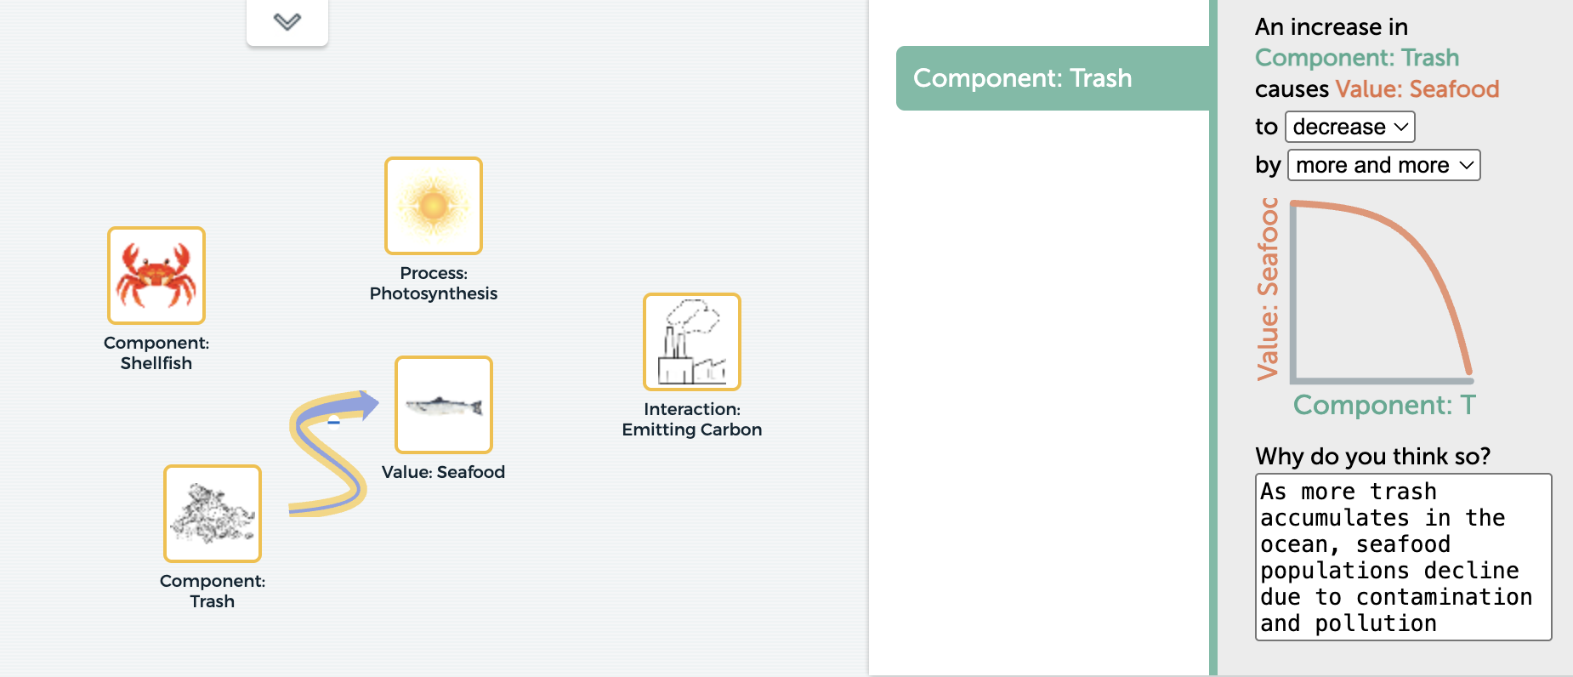
Student SageModeler Instructions
To describe the relationship between two items, double click on the arrow that connects them.
Positive relationship: As one factor increases, the second factor also increases.
Negative relationship: As one factor increases, the second factor decreases.
Varied relationship: As one factor increases, the second factor can increase or decrease depending on different conditions
How do human activities that drive climate change affect different types of value—and how can one activity cause value to go up, go down, or depend on the situation?
Example:
Module 2.1 Building a Model Slide 17
Notes:
Slide 17: To describe the relationship between two items, double click on the arrow that connects them. Then choose which descriptions best represent the relationship between the two items.
Positive relationship: As one factor increases, the second factor also increases.
Negative relationship: As one factor increases, the second factor decreases.
Varied relationship: As one factor increases, the second factor can increase or decrease depending on different conditions
Ask students to brainstorm: How do human activities that drive climate change affect different types of value—and how can one activity cause value to go up, go down, or depend on the situation?

Slide 18
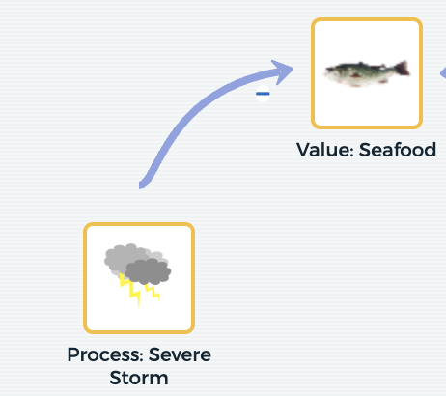
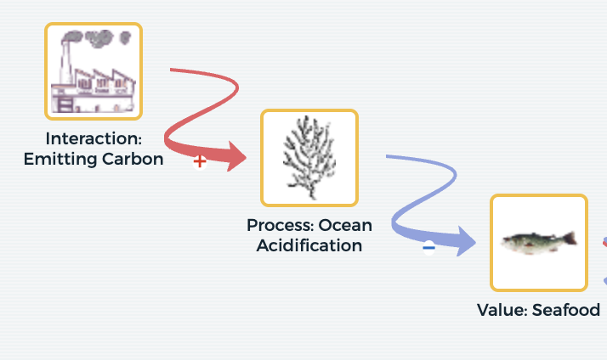
Different Types of Causal Relationships
Linear Chain (A → B)
Causal Chain (A → B → C)
Concept: A direct cause-and-effect relationship where one element or process directly impacts another.
Concept: A multi-step sequence where an initial event triggers an intermediate change, which then leads to a final outcome.
B
A
A
B
C
A heavy storm (A) physically prevents fishing vessels from leaving port, directly reducing the immediate supply of fresh seafood (B).
When factories release carbon dioxide into the air (A), the ocean absorbs it and becomes acidic (B), dissolving oyster shells and reducing seafood yields for farmers (C).
Module 2.1 Building a Model Slide 18
Notes:
Slide 18-19: This slide provides students with examples of different causal relationships that they can model:
Linear: A direct cause-and-effect relationship where one element or process directly impacts another.
Causal: A multi-step sequence where an initial event triggers an intermediate change, which then leads to a final outcome.

Slide 19
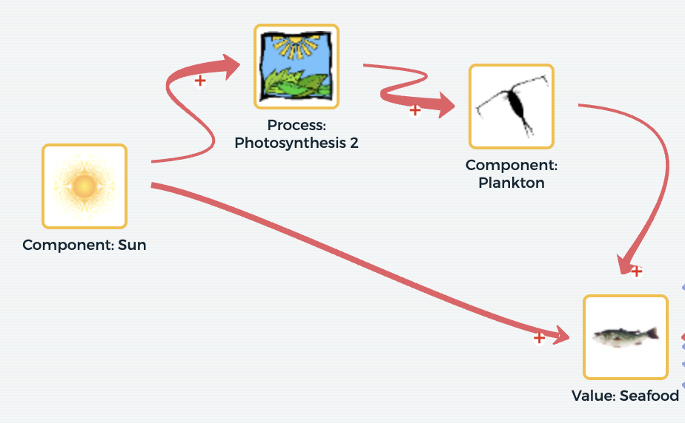
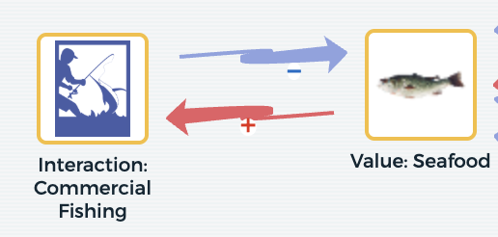
Different Types of Causal Relationships
Feedback Loop (A → B; B → A)
Indirect Link (A → B; B → C; A → C)
Concept: A circular relationship where the outcome of a process feeds back into the original cause, amplifying (positive feedback) or reducing (negative feedback) the effect over time.
Concept: A variable (A) influences an outcome (C) both indirectly through an intermediate variable (B) and through a separate direct pathway.
A
B
B
A
C
Intense fishing (A) drives down wild fish populations (B), creating market scarcity that raises prices and incentivizes companies to fish even harder (A), driving stocks into a deeper decline.
Indirect Pathway (A → B; B → C): : Increased sunlight boosts phytoplankton growth (A → B), which feeds small marine life and ultimately builds up commercial fish populations (B → C).
Direct Pathway (A → C): Sunlight directly warms surface waters and alters fish migration routes (A → C), changing where fish gather and affecting local seafood availability and prices.
Module 2.1 Building a Model Slide 19
Notes:
Slide 18-19: This slide provides students with examples of different causal relationships that they can model:
Feedback Loop: A circular relationship where the outcome of a process feeds back into the original cause, amplifying (positive feedback) or reducing (negative feedback) the effect over time.
Indirect Loop: A variable (A) influences an outcome (C) both indirectly through an intermediate variable (B) and through a separate direct pathway.

Slide 20
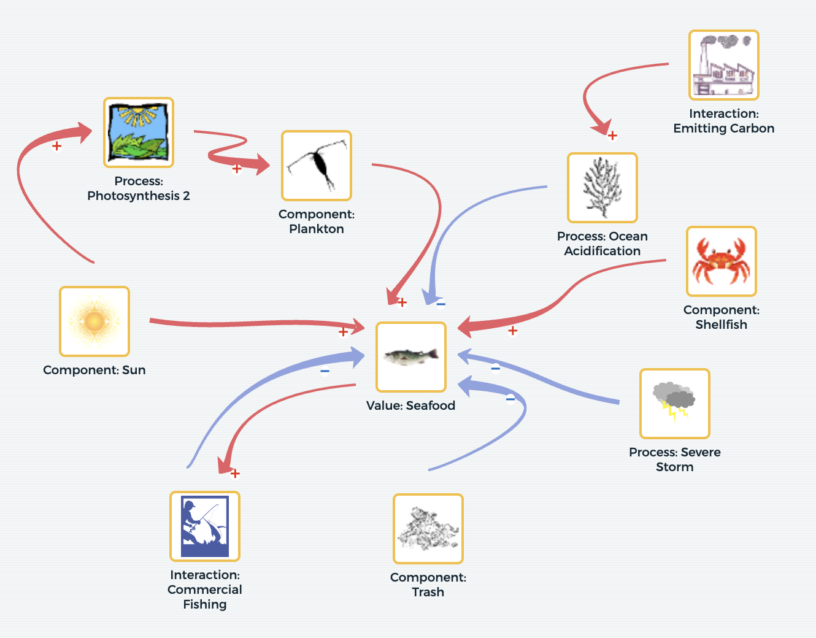
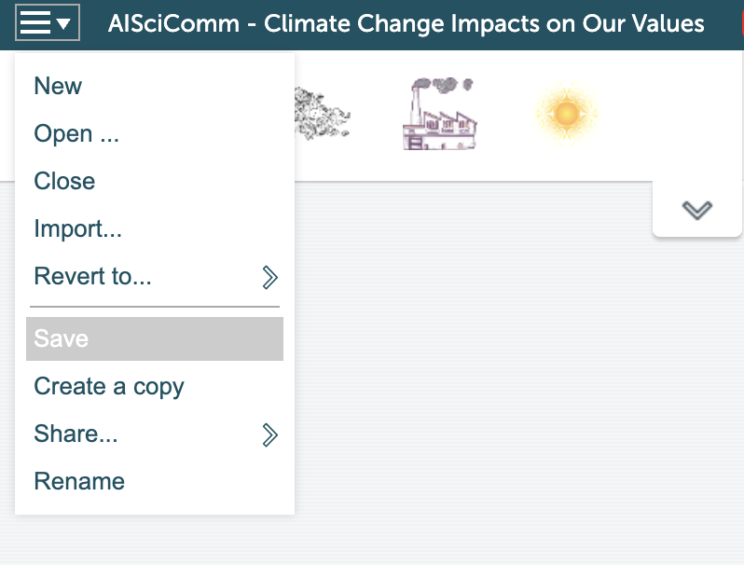
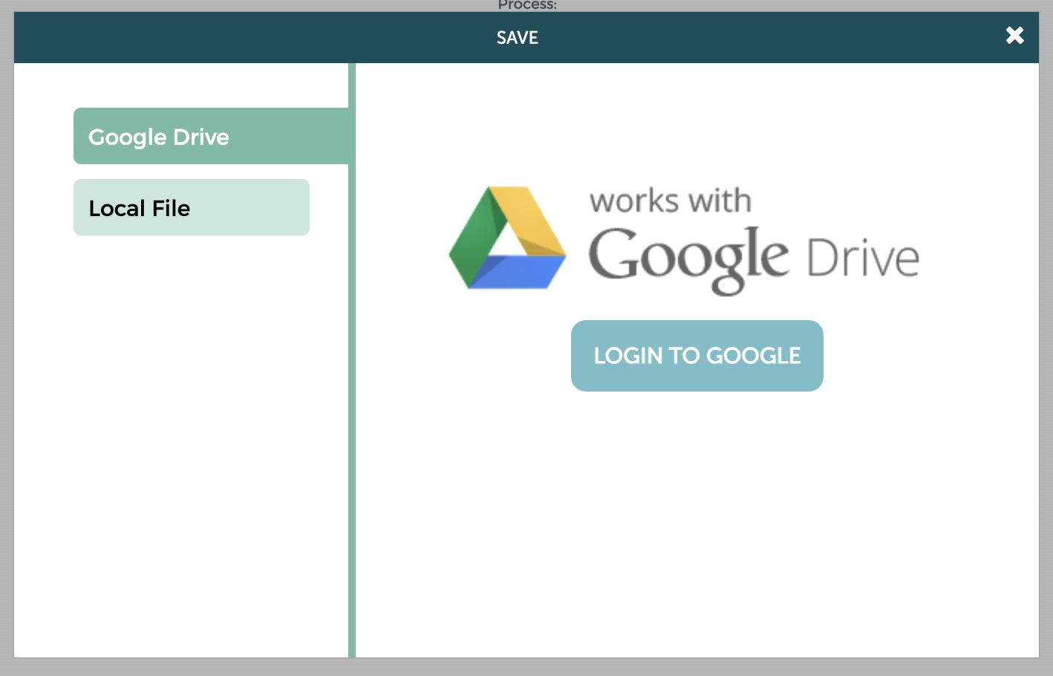
Student SageModeler Instructions
Continue to add components, processes, and interactions from your list to the model.
Create different causal relationships- linear chains, causal chains, feedback loops, and indirect links.
Save your model when you’re done.
Connect to Google Drive to save your model in a shareable location.
Module 2.1 Building a Model Slide 20
Notes:
Slide 20 (hidden slide): Continue to add components, processes, and interactions from your list to the model. Save your model when you’re done.

Slide 21
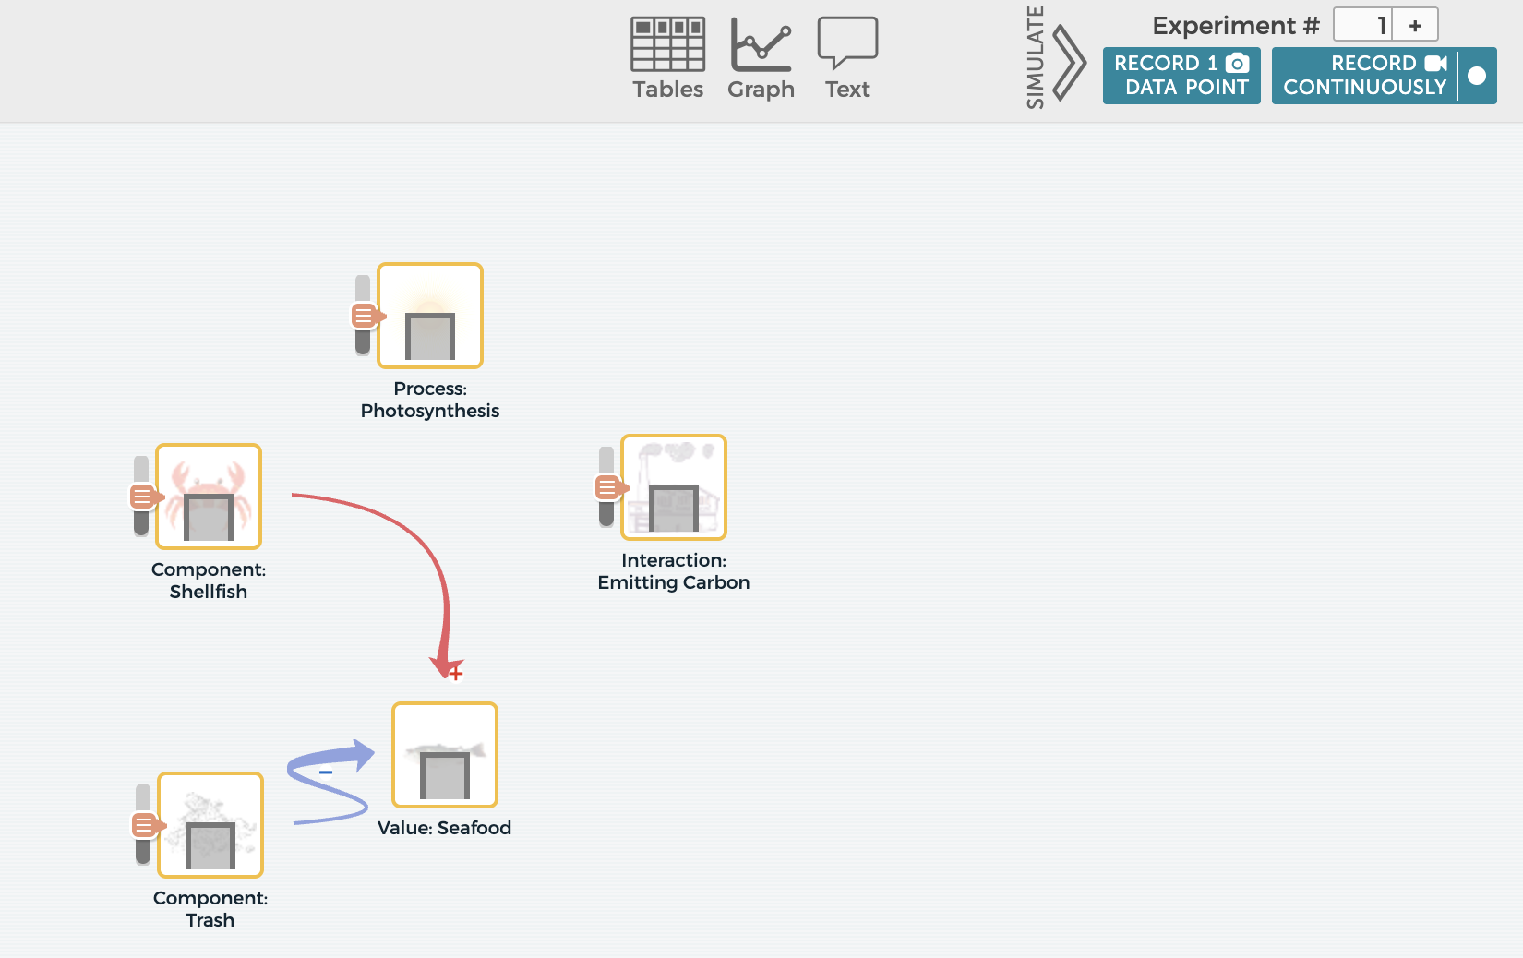
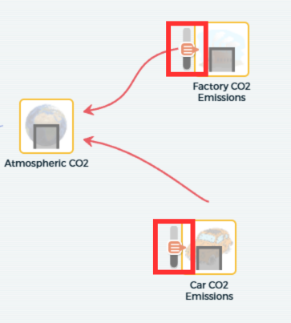
Simulating Changes with SageModeler
Now that your team has a complete model, take a moment to simulate change to see how changes in portions of your model impact your chosen value.
Click on the Simulate icon in the upper right-hand corner of SageModeler to simulate change on different factors within your model.
As you test your simulations, think about the following:
How does a change in a component, process, or interaction within your model affect your team’s chosen value?
Module 2.1 Building a Model Slide 21
Notes:
If there’s time once the model is complete, advance to Slide 21 and have students click on the Simulate icon in the upper right-hand corner of SageModeler to simulate change on different factors within your model. As you make simulations thing about the following:
How does a change in a component, process, or interaction within your model affect your team’s chosen value?

Slide 22
Take and Save a Snapshot of Your Chatbot Conversations
Now that your team has completed their model, take a moment to screenshot and save your chatbot conversations in your Google Drive. Save this snapshot as you will need it for module 4.4.
Devices will differ in ways to take a snapshot.
If on a Windows computer
Press Window + Shift + S at the same time
If on a Mac computer
Press Command (⌘) + Shift + 4 at the same time
If on a Chromebook
Press Ctrl + Shift + Show Windows at the same time
Module 2.1 Building a Model Slide 22
Notes:
Advance to Slide 22 and have students take a snapshot to save an image of the model that will be used in the next module lesson. Ask students to upload the images to your classroom Google Drive.
Depending on the type of device available, have students snap a picture. Below are a couple of the built in programs for taking a picture.
If on a Windows computer
Use the print screen button
Or use the built in snipping tool platform
If on a Mac computer
Press Command (⌘) + Shift + 4 at the same time
If on a Chromebook
Press Ctrl + Shift + Show Windows at the same time
As students finish up their models, let them know that their next step will be to conduct a gallery walk to compare their team’s model with the models created by other teams.

Slide 23
Gallery Walk
As a class, it is now time to conduct a gallery walk to your team’s model with models created by your classmates.
During the gallery walk, your team will provide feedback to other models created by your peers using post-it notes. Use one post it note per comment.
Consider the following questions as you visit each model:
Does this model include a variety of components, processes, and interactions? Is there anything that is missing that might help explain the system better?
Do the components, processes, and interactions help explain why that value is important and how it might be impacted by climate change?
What part of this model helped you understand how climate change is impacting the chosen value?
What suggestions do you have to make this model more complete or clear?
Module 2.1 Building a Model Slide 23
Notes:
Advance to Slide 23. Before students start conducting their gallery walk, inform them that as part of the gallery walk, you would like for them to provide feedback on the models of their peers on post-it notes. Each post-it note will represent one portion of feedback.

Slide 24
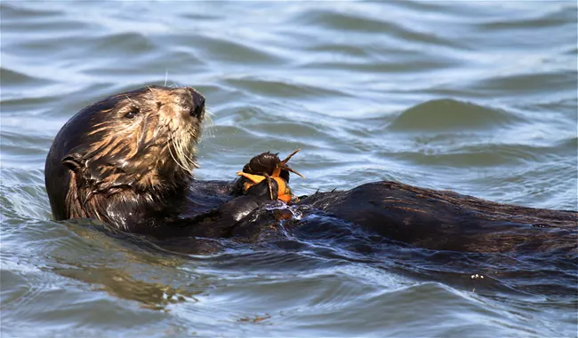
Discussion
Now that your team has seen other model examples, take a look back at your model and answer the following.
What patterns did you notice as you conducted your gallery walk?
Were there any ideas or aspects you saw in other models that you would like to incorporate in your own team’s model?
Sea otters. Source: https://www.nps.gov/chis/learn/nature/kelp-forests.htm
Module 2.1 Building a Model Slide 24
Notes:
On Slide 24, to help guide students through providing feedback, share the following questions that they should consider as they visit each model.
Does this model include a variety of components, processes, and interactions? Is there anything that is missing that might help explain the system better?
Do the components, processes, and interactions help explain why that value is important and how it might be impacted by climate change?
What part of this model helped you understand how climate change is impacting the chosen value?
What suggestions do you have to make this model more complete or clear?
As students finish up their gallery walk, invite them to take a look back at their model. Ask student teams to answer the following questions as a group.
What patterns did you notice as you conducted your gallery walk?
Were there any ideas or aspects you saw in other models that you would like to incorporate into yours?

Slide 25

Reflect
Reflect on what you learned in your science journal (p.19) for Module 2.1:
What did you learn about the components, processes, and interactions in the ocean while building your model?
How are these components, processes, and interactions connected to the value you chose?
Which parts of your model would you like to learn more about? How might you investigate or gather information to explore these areas further?
Image created with ChatGPT Prompt: Create an image about SoCal beaches.
Module 2.1 Building a Model Slide 25
Notes:
Bring the class back together as you finish up for the day. Tell the students that like before, you would like to take a moment for them to reflect in their Science Journals.
Advance to Slide 25 and ask student teams to reflect on Module 2.1 Building a Model (Student Reflection), p. 19 of their Science Journals.
What did you learn about the components, processes, and interactions in the ocean while building your model?
How are these components, processes, and interactions connected to the value you chose?
Which parts of your model would you like to learn more about? How might you investigate or gather information to explore these areas further?
As students wrap up their discussion, and if time allows, have teams share with the entire class.

Slide 26
Your Next Steps
In our next session, we’re going to take more time to refine and incorporate new ideas into your team’s model.
We’ll have a conversation with generative AI chatbots, to see if there are potential areas of improvement for your team’s model.
Module 2.1 Building a Model Slide 26
Notes:
Thank the students for their time today. Advance to Slide 26 and let students know that during the next session, they are going to take more time to refine and incorporate new ideas into their model. They have already incorporated ideas from their interviews, but next, they will have a conversation with a generative AI platform to identify potential areas for improvement on their model.

Slide 27




Thank you!
If you have any questions, please feel free to reach out.
Erick Valdez
Inside the Outdoors
evaldez@ocde.us
Ha Nguyen, Ph.D.
Assistant Professor, UNC
ha.nguyen@unc.edu

