Slide 1

Refining Your Model with Generative AI
Module 2.2
AISciComm | Module 2.2 Refining Your Model with Generative AI
Huntington Beach,
Los Angeles, CA
Notes:
Link to Module 2.2 Lesson Plan
BEFORE YOU START TEACHING
Review the Teacher Facilitation Guide for an overview of content and the curriculum as well as helpful facilitation suggestions.
Get acquainted with AI Chatbot Platform.
Review Student SageModeler Instructions to model or support students.
Include a numbered list of general steps to set up the investigation before students arrive.
This can also include other things that educators should do or think about before starting the lesson, such as checking for safety concerns.
__________
Open the slideshow to Slide 1 and welcome students into the class and tell them that today, they will continue working on their teams to refine the models that they constructed and got feedback on in the last session.

Slide 2
Reflecting On Your Model
With your team, take a moment to reflect on your model from module 2.1 and answer the following questions.
Are there areas of your model that you have questions or are unsure about?
Are there sections of your model that need more information?
How might your team gather this information?
Module 2.2 Refining Your Model with Generative AI Slide 2
Notes:
Before beginning, advance the slideshow to Slide 2 and ask student teams to reflect on their team’s model so far by answering the following questions.
Are there areas of your model that you have questions or are unsure about?
Are there sections of your model that need more information?
How might your team gather this information?
After student teams have reflected and written down their questions for their model, tell students that when scientists create models, they constantly look at ways to improve their models to make sense of the system. However, this means finding ways of gathering new information.

Slide 3
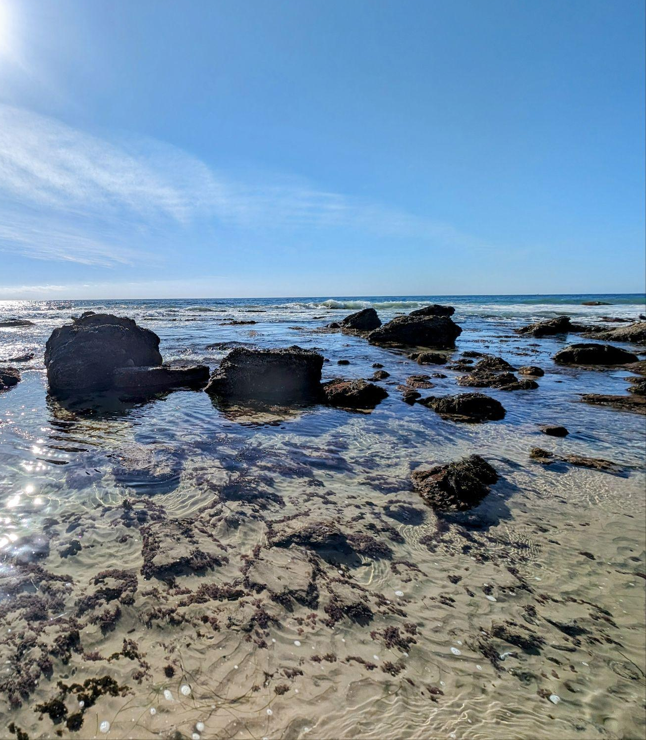
Module Overview
During module 2.2, you will:
Investigate what areas of your model you want to learn more about.
Make a plan to gather information to strengthen your model.
Communicate with Generative AI (GenAI) to gather information to strengthen your model.
Refine your model using information gathered by GenAI.
Module 2.2 Refining Your Model with Generative AI Slide 3
Crystal Cove State Park
Newport Beach, California
Notes:
Advance to Slide 3 to give students an overview of what they will do in lesson 2.2.

Slide 4
Class Discussion
As a class, take a moment to reflect and discuss on your experience gathering data so far.
How have you collected information for your models so far? How did this information contribute to your model?
How else may a scientist collect information?
Module 2.2 Refining Your Model with Generative AI Slide 4
Notes:
Afterwards, move on to Slide 4 and bring the whole class together as a group and discuss the following questions:
How have you collected information for your models so far? How did this information contribute to your model?
How else may a scientist collect information?
After students share their responses, reaffirm ideas that they have gathered information by searching for themselves and interviewing community members but today, they will investigate another method of information gathering, using AI.

Slide 5
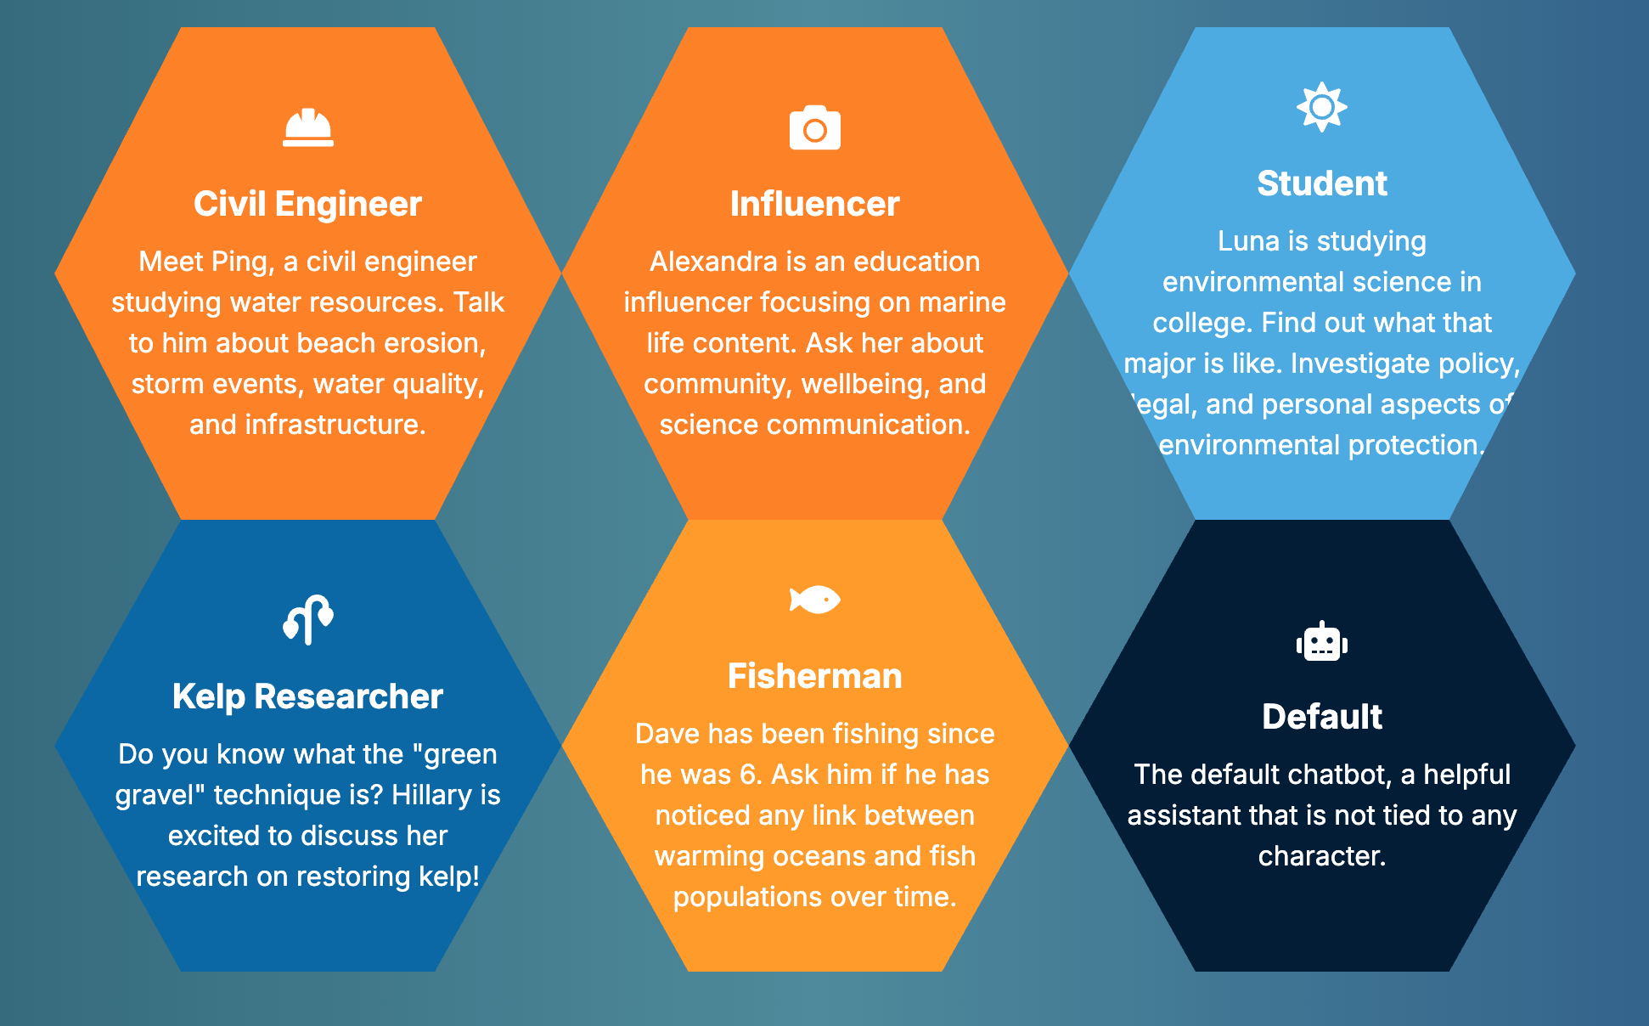
Our AI Chatbot Platform: AISciComm
Photo Space
Just like you interviewed community members, when creating the chatbots, so did we. Each individual chatbot character was created by feeding them information from interviews with several people, who identify with the characters.
Chatbot link: https://aiscicomm.vercel.app/
Module 2.2 Refining Your Model with Generative AI Slide 5
Notes:
Advance to Slide 5 where students will see an image of the AI chatbot platform (https://aiscicomm.mylusd.org/) with the 5 AI chatbots that are available to chat with plus a default, ChatGPT.
Share with students that the chatbot characters they see on the screen were created by feeding them information that was gathered by conducting community interviews, just like they conducted.

Slide 6
Explore the Chatbots
Photo Space
With your team, take three minutes to explore the chatbots and the platforms.
After you explore discuss the following with the class:
What did you try asking or doing with the chatbots?
What types of questions did it seem to handle well?
What surprised you about how the chatbot responded?
Chatbot link: https://aiscicomm.vercel.app/
Module 2.2 Refining Your Model with Generative AI Slide 6
Notes:
Advance to Slide 6 and tell students that they will “interview” these chatbots to help them gather more information to strengthen their models, but just like a real interview, they will need to prepare.
Start by telling students that you would like for them to just explore the chatbots.
Once the time is up, bring the class together to explore the following questions
What did you try asking or doing with the chatbots?
What types of questions did it seem to handle well?
What surprised you about how the chatbot responded?

Slide 7
Preparing Your Chatbot Interview
With your team, think back to your model. What questions do you still have about your model? What would you like to learn more about?
Have each team member create a question to investigate and add the questions in your Science Journal, p. 20-21.
What questions do you have about your model? | Who can help you gather more information to answer your question? | After talking to the chatbots, what do you want to add to your model?
What can I measure to understand how ocean acidification affects fish populations? | Civil Engineer Influencer Student Kelp Researcher Fisherman
Module 2.2 Refining Your Model with Generative AI Slide 7
Notes:
Next, move on to Slide 7. To help the students prepare, ask students to open their Science Journal to Module 2.2: Refining your Model with GenAI (Student Task: Preparing your Chatbot Interviews) p.20-21, and tell them that just like before, they will have to prepare their interview questions in advance, but unlike last time, they will have five experts to chat with.

Slide 8
Conduct your Chatbot Interview
Now that each member of your team has a question to investigate, choose at least one or two chatbots to interview to gather more information.
When you’re ready, have each team member visit the AISciComm platform to interview their chosen chatbot
What questions do you have about your model? | Who can help you gather more information to answer your question? | After talking to the chatbots, what do you want to add to your model?
What can I measure to understand how ocean acidification affects fish populations? | Civil Engineer Influencer Student Kelp Researcher Fisherman
Module 2.2 Refining Your Model with Generative AI Slide 8
Notes:
Advance to Slide 8 and tell students that each member in their team will be responsible for investigating a question with 1-2 chatbots and bringing back the information to adjust their model, if students need support in writing questions, ask the following:
What parts of your model feel uncertain or incomplete?
Are there any relationships you are unsure about?
Are there other relationships between components that you want to learn more about?
Once students have their questions ready, tell students to select which chatbot may know more about their question.
Remind them that their interview with AI may be a little different than with a person.

Slide 9
Tips for Interviewing the Chatbots
Chatbot interviews are a little different than community member interviews. Here are some tips to keep in mind when interviewing the chatbots.
Give context to the chatbot and frame your questions clearly.
Avoid asking too many questions in one prompt.
Ask follow-up questions
Recognize that AI has boundaries and that it is not human
Module 2.2 Refining Your Model with Generative AI
Slide 9
Notes:
Advance to Slide 9 to share with students some tips to keep in mind when interviewing the chatbots.
Give context to the chatbot and frame your questions clearly.
Avoid asking too many questions in one prompt.
Ask follow-up questions
Recognize that AI has boundaries and that it is not human
Make sure that each student has a question that they want to investigate and a computer that they can participate with as they will be working individually to start.

Slide 10
Interviewing the Chatbots
Follow these steps to help you navigate the AISciComm platform and interview your chosen chatbots
Visit the AISciComm platform (https://aiscicomm.vercel.app) and choose the chatbot that you want to interview for your question.
Upload the snapshot of your teams model that you took back in module 2.1. If you haven’t done so yet, go back to your SageModeler model and take a snapshot.
When your image loads on the platform, give the chatbot context for what you are uploading.
Example: Hello, my team and I are [grade level] students in [class]. We are working on a model that demonstrates how changes to the climate impact ocean systems and affects [your chosen value]. Can you describe the model to me?
Share the question you are investigating. Make sure to use follow up questions.
If you identify other chatbots who may know more about your question, make sure to interview them too. Remember to take notes in your science journal (p.20-21)!
Notes:
When students are ready to begin, pull out the instructions on Slide 10 to conduct the chatbot interview.
Visit the AISciComm platform and choose the chatbot that you want to interview for your question.
Upload the snapshot of your teams model that you took back in module 2.1. If you haven’t done so yet, go back to your SageModeler model and take a snapshot.
When the image loads, give the chatbot context for what you are uploading. You can give the following prompt for students to fill out.
Hello, my team and I are [grade level] students in [class]. We are working on a model that demonstrates how changes to the climate impact ocean systems and affects [your chosen value]. Can you describe the model to me?
Share the question you are investigating with the chatbot. Make sure to use follow up questions.
If you have identified other bots that may know more about your question, make sure to interview them too.
Remember to take notes!
Once students are ready, give them time to individually chat with the chatbots to help them answer their questions.
As students converse with the chatbots, make sure that they are taking notes on the information that they want to share back with the group. Remind students to make sure they are filling the interview document in their Science Journal (p.20-21).

Slide 11
Sharing Your Findings
Now that you have had a chance to interview the chatbots, join back with your team and share your findings. Make sure to fill out the interview table in your Science Journal.
What questions do you have about your model? | Who can help you gather more information to answer your question? | After talking to the chatbots, what do you want to add to your model?
What can I measure to understand how ocean acidification affects fish populations? | Civil Engineer Influencer Student Kelp Researcher Fisherman | After chatting with the chatbots, I would like to add pH into my team’s model.
Module 2.2 Refining Your Model with Generative AI
Slide 11
Notes:
After students have had time to chat with the chabots, advance to Slide 11 and ask student teams to get back together to share their findings with their team and fill out the last section on their chatbot interview document together, if they haven’t done so already

Slide 12
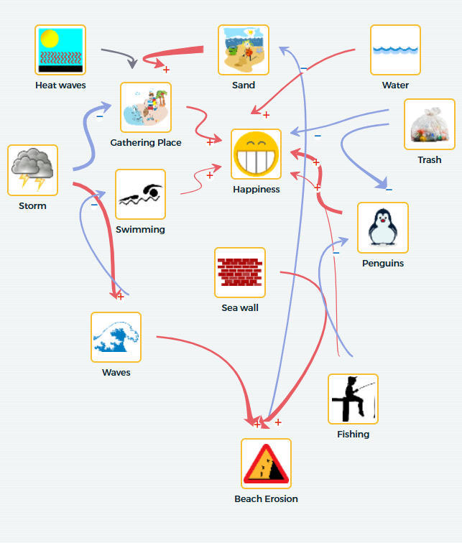
Revise Your Model
Now that your team has gathered more information, it is time to revise your model.
With your team, revisit your model from module 2.1 and make revisions based on the recommendations provided during the chatbot interviews.
Module 2.2 Refining Your Model with Generative AI
Slide 12
Notes:
Advance to Slide 12 and give students a moment to revisit their model from the previous session and make modifications to them based on their conversation with the chatbots.

Slide 13
Class Discussion
After you have completed your revisions to your model, come back together as a class.
As a class, discuss the following questions.
What were some of the most surprising findings you gained from your chatbot interviews?
Did the chatbots provide new ideas or connections that you hadn’t thought of before?
What revisions did you incorporate into your model?
Module 2.2 Refining Your Model with Generative AI Slide 13
Notes:
Advance to Slide 13. Once the student teams finish up the revisions to their model, bring the class back together for a class conversation. Ask students the following questions
What were some of the most surprising findings you gained from your chatbot interviews?
Did the chatbots provide new ideas or connections that you hadn’t thought of before?
What revisions did you incorporate into your model?

Slide 14
Class Discussion Continued
After you have completed your revisions to your model, come back together as a class.
As a class, discuss the following questions.
Looking at your current model, what specific data is still missing that could help you better understand the system you're modeling?
Where might we gather or collect this data?
Module 2.2 Refining Your Model with Generative AI Slide 14
Notes:
Advance to Slide 14. As students share their experiences, ask the following questions:
Looking at your current model, what specific data is still missing that could help you better understand the system you're modeling?
Where might we gather or collect this data?
Fill out the post-survey: https://unc.az1.qualtrics.com/jfe/form/SV_2uxJvUG3BwUchyC

Slide 15

Reflect
Reflect on what you learned in your science journal (p. 14) for Module 2.2 and your experience during AISciComm.
How did the AI chatbots help change your thinking and support the changes in your model?
Which areas of your model need more information? How might you explore them further?
Image created with ChatGPT Prompt: Create an image about SoCal beaches.
Module 2.2 Refining Your Model with Generative AI Slide 15
Notes:
Advance to Slide 15 and have student teams work together to answer the following questions together on Module 2.2: Refining your Model with GenAI (Student Reflection), p. 22 of their Science Journals.
How did the AI chatbots help change your thinking and support the changes in your model?
Which areas of your model need more information? How might you explore them further?
As students wrap up their discussion, and if time allows, have teams share with the entire class.
Thank the students for their time today. Let students know that during the next session, they are going to take more time to refine their models by exploring how to incorporate real-world data to validate the relationships within their models.
Provide more time for the the post-test for student completion.
___________________
Extend: Evaluate AI’s responses (15 minutes; take-home activity)
Students review their notes, and then reflect on (1) the prompts they sent to the chatbots and (2) the chatbots’ generated responses. Students answer the questions on Module 2.2: Refining your Model with GenAI (Optional: Reflecting on AI’s Responses to your Questions), p. 23-24 of their Science Journals:
Did your team ask questions that followed the CLEAR framework (Concise, Logical, Explicit, Adaptive, Reflective)? How did your questions reflect this? If not, why?
Did the chatbots provide answers that helped you learn more about your question? What kind of information or examples did they give? How did this connect to your community, social networks, local knowledge, or experiences?
Were the chatbot responses relevant to your question? Did you notice any inaccuracies or missing information? Give specific examples.
Generative AI chatbots learn by adjusting patterns from the data they are trained on, while traditional search engines retrieve existing information. How does understanding this difference change the way you use the chatbots? How did this influence your model updates?
What ideas would you give to improve the chatbots’ answers? How could the chatbots better support your learning about climate change and the ocean, while reflecting your community context and assets?

Slide 16




Thank you!
If you have any questions, please feel free to reach out.
Erick Valdez
Inside the Outdoors
evaldez@ocde.us
Ha Nguyen, Ph.D.
Assistant Professor, UNC
ha.nguyen@unc.edu

