Slide 1
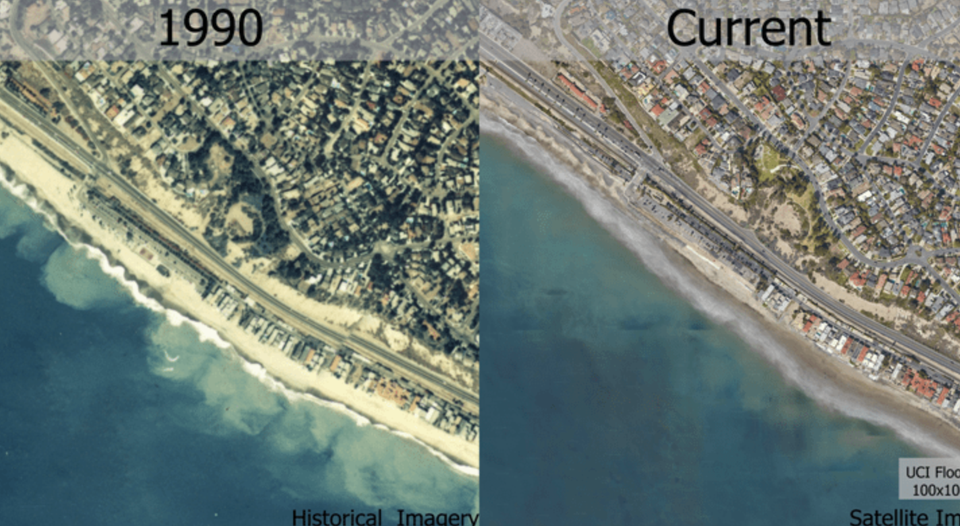
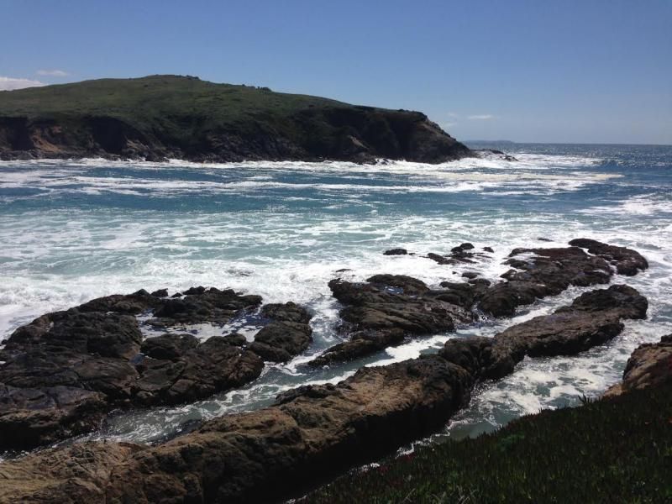
Exploring CO₂’s Impact
Aerial View of San Juan Capistrano,CA
Photo Credit: UC Irvine News
Module 3.3: CO₂ & Sea Level Rise/
Coastal Erosion
Module 3.4: Ocean Acidification &
Food Webs
California Coast, Photo Credit: Ken Caldeira
AISciComm | Module 3.3 and 3.4 Introduction
Notes:
Link to Module 3.3 Lesson Plan
Link to Module 3.4 Lesson Plan
BEFORE YOU START TEACHING
Review the Teacher Facilitation Guide for an overview of content and the curriculum as well as helpful facilitation suggestions.
For Lesson 3.3, review Student Our Coast Our Future Instructions (also in Science Journal, p. 36-43) to model or support students. Explore Our Coast Our Future Website.
Include a numbered list of general steps to set up the investigation before students arrive.
This can also include other things that educators should do or think about before starting the lesson, such as checking for safety concerns.
________
Lesson 3.3/3.4 Introduction Slides
Open the introduction slideshow to Slide 1 and welcome students into the class and tell them that today, they will continue to learn about how carbon dioxide can change the rate of natural processes and affect the values that they care about.

Slide 2
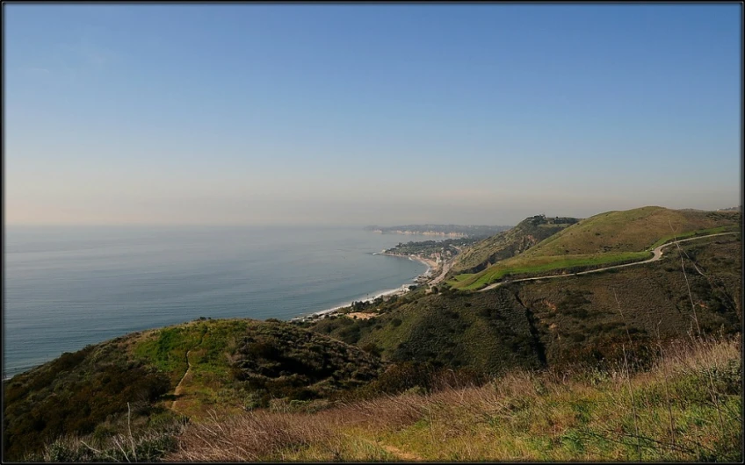
Reflect
How did an increase of carbon dioxide emissions impact processes like global warming?
How do these changes affect the values your group place on the ocean in your model?
Coral Canyon Park in Malibu, CA.
Module 3.3 CO₂ & Sea Level Rise/ Coastal Erosion Slide 2
Notes:
Advance the slideshow to Slide 2 and ask the class to take a moment and reflect on what they learned in lesson 3.2.
How did an increase of carbon dioxide emissions impact processes like global warming?
How do these changes affect the values your group placed on the ocean in your model?
As students share, emphasize and elevate ideas that include mention that increased levels of carbon dioxide emissions have an impact on the rate of change of global processes like global warming.
After student teams have reflected on the previous lesson, inform them that their next step is to find out what other processes might be impacted by increased carbon dioxide emissions.

Slide 3
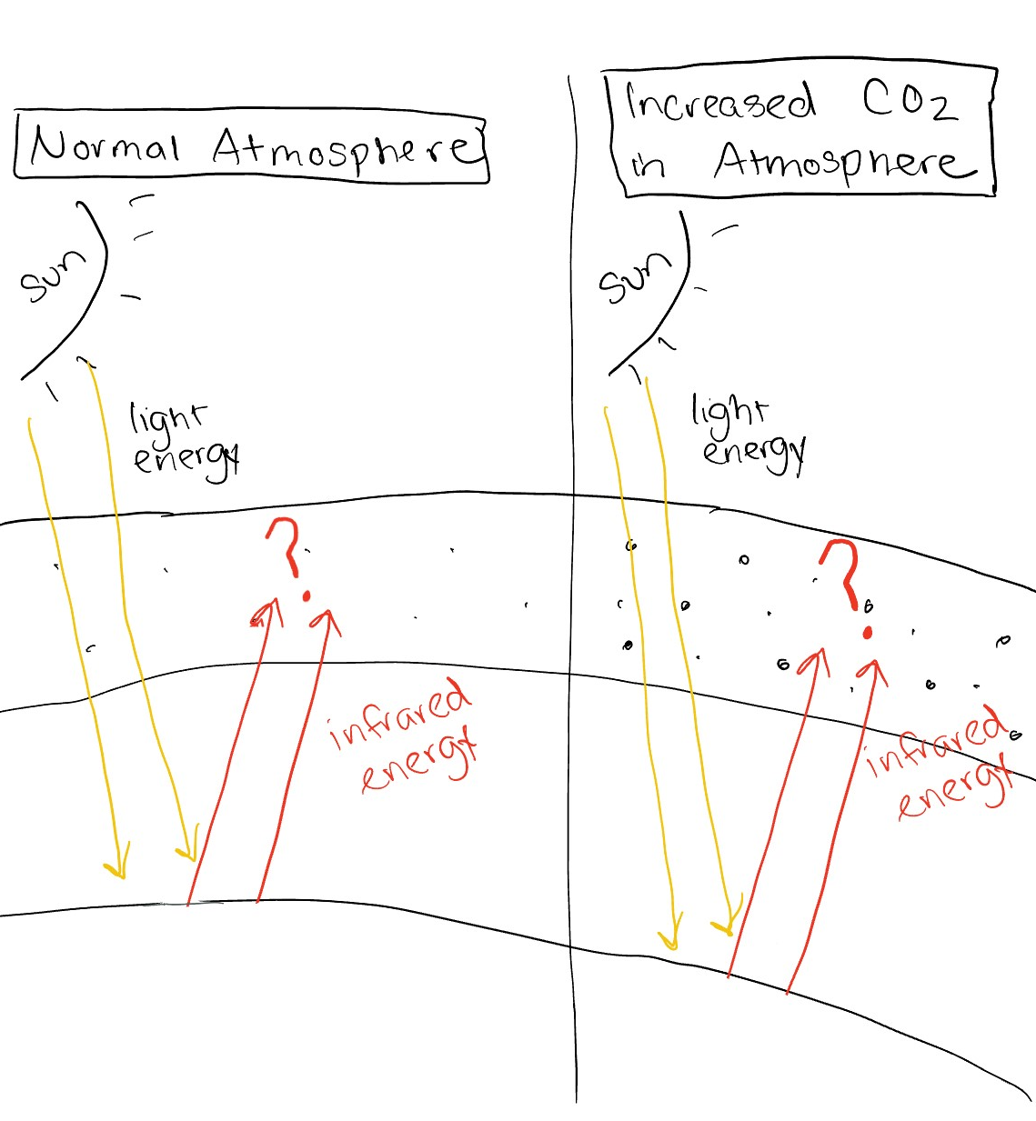
Reflect on Your Model
As a class, take a moment to look back and reflect on your model from Module 3.2.
How did an increase of CO2 emissions impact processes like global warming?
How do these changes affect the values your group placed on the ocean in your model?
Earth
Earth
Module 3.3 CO₂ & Sea Level Rise/ Coastal Erosion Slide 3
Notes:
Gather students in their teams from Module 2 and advance to Slide 3. Invite students to take a look at their team’s model and brainstorm other processes that may be impacted by increased carbon dioxide emissions.
How may increased carbon dioxide emissions impact other processes that you have included in your team’s model?
As students discuss with their teams, walk around and listen for conversations where you may support the student's brainstorming. Ask questions to guide students to choosing processes that we will investigate in lessons 3.3 and 3.4, sea level rise, coastal erosion, ocean acidification, and food web impacts.
What processes in your model have a large impact on the value your community cares about?
How might we investigate this process further?
After student teams have had a chance to review their models, invite the class back together to share some of their ideas.

Slide 4
Choose Your Path
Aerial View of San Juan Capistrano,CA coasts; Photo Credit: UC Irvine News
California Coast, Photo Credit: Ken Caldeira
Option 1: Sea Level Rise and Coastal Erosion
Good for Values: Mental health, well-being, recreation, financial, and biodiversity.
Option 2: Ocean Acidification and Food Web
Good for Values: Seafood, tradition, biodiversity, and cultural significance.
Module 3.3 CO₂ & Sea Level Rise/ Coastal Erosion Slide 5
Notes:
Advance to Slide 4 and tell students that for the next two sessions, they will embark on a student-led lesson, where they will learn more about particular processes that impact the value that their model centers on and ultimately update their team’s model with their newfound information. They will have two options.
Option 1: Sea level rise and coastal erosion - You may choose this path if your model centers around the values of mental health and wellbeing, recreation, financial, and biodiversity.
Option 2: Ocean acidification and food web - You may choose this path if your model centers around the values of seafood, tradition, biodiversity, and cultural significance.
To help guide students to choose a their option, ask students the following question:
Of the two options provided, which processes might affect the value that centers your model the most?
When students are ready, have them choose which investigation fits best with the value their community places on the Ocean.
Lesson 3.3 - Sea Level Rise and Coastal Erosion
Lesson 3.4 - Ocean Acidification

Slide 5
Share Your Experience
What did your group do today?
What were some of the most surprising findings you gained from today?
What specific data do you think is still missing to further your understanding?
Option 1: What might help strengthen your understanding of carbon dioxide’s impact on sea level rise?
Option 2: What might help strengthen your understanding of carbon dioxide’s impact on ocean acidification?
Where might you collect this data
Module 3.3 CO₂ & Sea Level Rise/ Coastal Erosion Slide 5
Notes:
As students wrap up for the day, send groups back to their Module 3.3 slideshow to reflect on the process of creating a model for sea level rise.

Slide 6
Share Your Experience
What value does your SageModeler model center on?
What investigation did you take part in? (sea level rise or ocean acidification)’
How do you want to update your SageModeler model as a result of your investigation? How does this impact connect with the value your model centers?
Module 3.3 CO₂ & Sea Level Rise/ Coastal Erosion Slide 6
Notes:
Once students have created their plan, bring the class back together (See Module 3.3 & 3.4 Introduction Slides, Slide 6) and have them share out with the class if time permits. Since different students will have different investigations and their models share different values, focus on the following question.
What value does your SageModeler model center on?
What investigation did you take part in? (sea level rise or ocean acidification)’
How do you want to update your SageModeler model as a result of your investigation? How does this impact connect with the value your model centers?
As students wrap up for the day, their final task for the day is to reflect on what they did. Return to Lesson 3.3 Slides (Slide 15)

Slide 7




Thank you!
If you have any questions, please feel free to reach out.
Erick Valdez
Inside the Outdoors
evaldez@ocde.us
Ha Nguyen, Ph.D.
Assistant Professor
ha.nguyen@unc.edu

