Slide 1
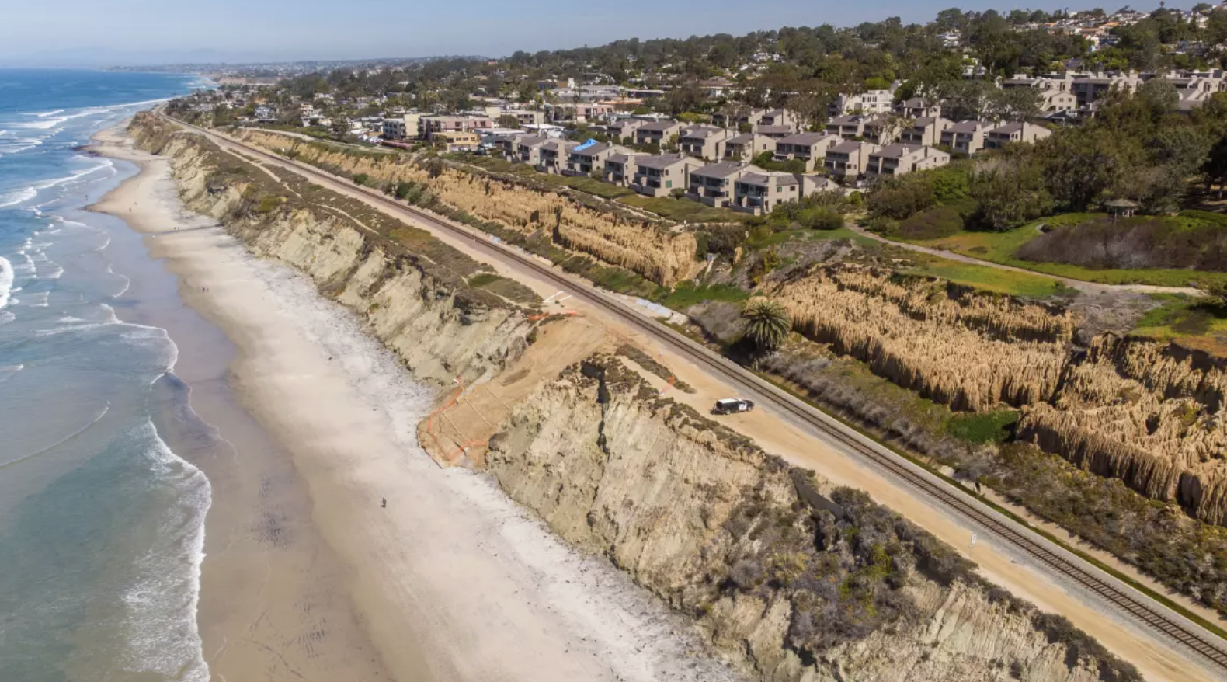
CO₂ & Sea Level Rise/ Coastal Erosion
Module 3.3 | Day 1
Del Mar, CA
Photo Credit: Los Angeles Times
AISciComm | Module 3.3 CO₂ & Sea Level Rise/ Coastal Erosion
Notes:
Link to Module 3.3 Lesson Plan
BEFORE YOU START TEACHING
Review the Teacher Facilitation Guide for an overview of content and the curriculum as well as helpful facilitation suggestions.
For Lesson 3.3, review Student Our Coast Our Future Instructions (also in Science Journal, p. 36-43) to model or support students. Explore Our Coast Our Future Website.
Include a numbered list of general steps to set up the investigation before students arrive.
This can also include other things that educators should do or think about before starting the lesson, such as checking for safety concerns.
________
Lesson 3.3 Slideshow: CO₂ & Sea Level Rise/ Coastal Erosion
Open the Sea Level Rise and Coastal Erosion slideshow to Slide 1 where students will see a notice that this lesson is a student-led lesson, meaning that they will move through it with their team within the next two sessions.

Slide 2
Lesson Overview
During this lesson, you will work with your team to build additional background knowledge on how CO₂ impacts sea level rise and shoreline positions.
During the lesson, you will:
Explore the Our Coast Our Future sea level rise simulation.
Use this information to create a plan to update your SageModeler model from Module 2.
Module 3.3 CO₂ & Sea Level Rise/ Coastal Erosion Slide 2
Notes:
Move on to Slide 2 where students will see the two day overview for module 3.3.

Slide 3
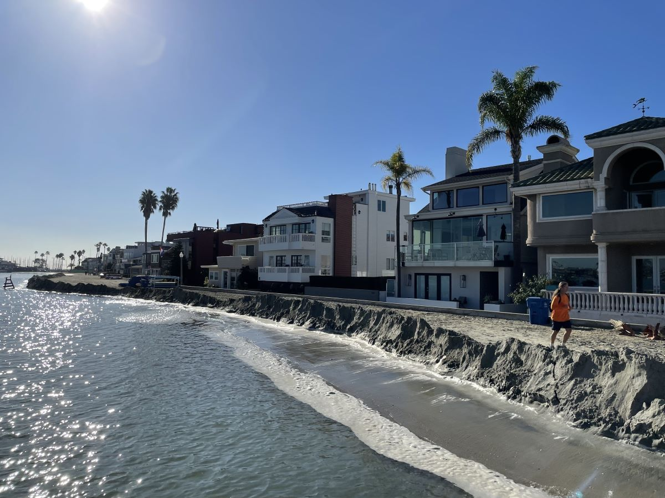
Make an Observation
With your team, take a moment to observe the image on the left.
What do you think is happening in this image?
Is what you are observing a natural occurrence? How often does this happen?
Why might communities what to understand this scenario?
Module 3.3 CO₂ & Sea Level Rise/ Coastal Erosion Slide 3
Notes:
When student teams are ready, advance to Slide 3 where they will see an image of houses by the coast. Students are then asked to take 5 minutes to discuss with their group and answer the following questions.
What do you think is happening in this image?
Is what you are observing a natural occurrence? How often does this happen?
Why might communities want to understand this scenario?
Gather the students as a class and ask students to share their responses with the class. At this point it is not important for them to be accurate with responses, you just want to gauge what they are noticing

Slide 4
Alamitos Bay - November 16, 2024
The image shows a king tide event at Alamitos Bay, in Long Beach California on November 16, 2024. King tide events are the most extreme of low tide and high tides that happen within a couple of days, which happen once or twice a year. Though they do not happen often, they give us a glimpse as to what our future coastlines may look like.
Alamitos Bay, Long Beach, CA
Module 3.3 CO₂ & Sea Level Rise/ Coastal Erosion Slide 4
Notes:
After students have shared, have them advance to Slide 4 where more information is shared with the students.
The image shows a king tide event at Alamitos Bay, in Long Beach California on November 16, 2024. King tide events are the most extreme of low tide and high tides that happen within a couple of days, which happen once or twice a year. Though they do not happen often, they give us a glimpse as to what our future coastlines may look like.

Slide 5
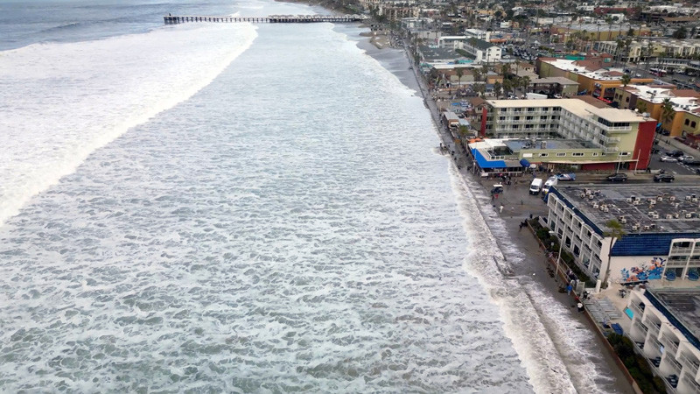
What’s Coming Next
Over the next two lessons, you will investigate sea level rise, what causes it, and how it affects coastal communities.
You will explore how global warming is connected to sea level rise and analyze simulations that predict future changes.
Mission Beach, San Diego, CA, during a King Tide event in December 2023.
Photo Credit: UC San Diego, Scripps Institution of Oceanography
Module 3.3 CO₂ & Sea Level Rise/ Coastal Erosion Slide 5
Notes:
Advance to Slide 5 where students will be told that over the next two lessons, they will investigate sea level rise, its causes, and how it can impact coastal accessibility for communities. They will do so by investigating how global warming is connected to sea level rise and look at simulations for predictions for the future.

Slide 6
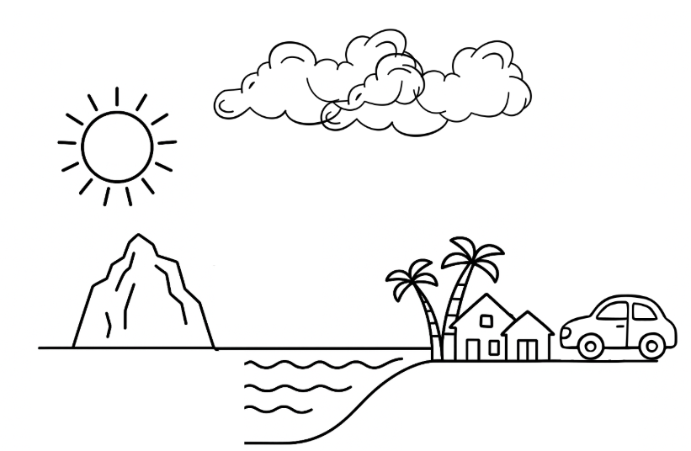

Create a Model
With your team, take a moment and draw what you think is causing sea level rise.
Instructions:
Using a poster paper, draw the process of how you think sea level rise happens.
Label the components of your model and explain processes that are happening. Example: “Component A interacts with Component B, causing [what happens]
Module 3.3 CO₂ & Sea Level Rise/ Coastal Erosion Slide 6
Notes:
Have students advance to Slide 6 and share that first, in their teams, you would like them to create a drawn model on what they think is causing sea level rise. Here students will see instructions to help guide them through the model.
Using a poster paper, draw what is contributing to sea level rise.
Remember to label the components of your model and explain processes that are happening, for example, “Component A interacts with Component B, causing [what happens]”
Give student teams 10 minutes to model their explanation of what is causing sea level rise. As they work, walk around and support the students in reflecting back to what they have learned in previous lessons that might help their explanation.
What in your model is directly impacting sea levels?
Do you think there are any human impacts that might indirectly affect sea levels?

Slide 7
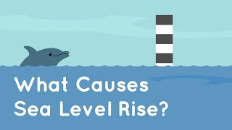
What Causes Sea Level Rise
With your team, watch the video on the left to help you build a deeper understanding of what causes sea level rise. As you watch, think about the following:
What are you observing in the video that you would like to add to your team’s model?
How are humans contributing to the sea level rise process?
How will sea levels impact communities that value Southern California’s ocean?
Module 3.3 CO₂ & Sea Level Rise/ Coastal Erosion Slide 7
Notes:
Once students start wrapping up their initial model, have them advance to Slide 7, where they will be asked to watch a short video, What Causes Sea Level Rise? [2:43], which will help them expand their models.
As students watch the video, they will be asked to think of the following:
What are you observing in the video that you would like to add to your team’s model?
How are humans contributing to the sea level rise process?
How will sea levels impact communities that value Southern California’s Ocean?

Slide 8
Revise Your Model
Based on your newfound knowledge, revise your model. As you revise think about the following:
What processes or components did you learn about in the video that you would like to add to your model?
How does seal level rise impact communities that value Southern California’s ocean? How can that be shown in our team’s model?
Module 3.3 CO₂ & Sea Level Rise/ Coastal Erosion Slide 8
Notes:
Once students have watched the video, advance to Slide 8 and have them revisit their team’s model to revise it with their newfound knowledge.
What processes or components did you learn about in the video that you would like to add to your model?
How does sea level rise impact communities that value Southern California’s Ocean? How can that be shown in our team’s model?
As you reach the end of the class period, bring the students back together for a class conversation (See Module 3.3 & 3.4 Introduction Slides, Slide 6). As not all students did the exact same activity, get at least one student from each exploration to share responses to the following questions with the class.
What did you do today?
What were some of the most surprising findings you gained from today?
As students share their experiences, ask the following questions
What specific data do you think is still missing to further your understanding?
What might help strengthen your understanding of carbon dioxide’s impact on sea level rise?
What might help strengthen your understanding of carbon dioxide’s impact on ocean acidification?
Where might you collect this data

Slide 9
Reflect
In your science journal (p. 35), take a couple of minutes to reflect on your experiences during Module 3.3, Day 1.
How has your thinking about what causes sea level rise changed? Think about new ideas or surprises you noticed while creating or revising your model.
How could sea level rise impact communities and things they value about the Southern California ocean?
Which parts of your model do you still have questions about?
Module 3.3 CO₂ & Sea Level Rise/ Coastal Erosion Slide 9
Notes:
Advance to Slide 9 and have student teams work together to answer the following questions together on Module 3.3: CO2 and Sea Level Rise/Coastal Erosion (Day 1: Investigating Sea Level Rise Student Reflection). P. 35 of their Science Journals.
How has your thinking about what causes sea level rise changed? Think about new ideas or surprises you noticed while creating or revising your model.
How could sea level rise impact communities and things they value about the Southern California ocean?
Which parts of your model do you still have questions about?
Thank students for their participation today and inform them that in the next session, they will continue to learn more about sea level rise, but through scientific simulations!

Slide 10
CO₂ & Sea Level Rise/ Coastal Erosion
Module 3.3 | Day 2
Del Mar, CA
Photo Credit: Los Angeles Times
Module 3.3 CO₂ & Sea Level Rise/ Coastal Erosion Slide 10
Notes:
Lesson 3.3/3.4 Introduction Slideshow- Students select either lesson 3.3 or 3.4
Link to Module 3.3 Lesson Plan
BEFORE YOU START TEACHING
Review the Teacher Facilitation Guide for an overview of content and the curriculum as well as helpful facilitation suggestions.
For Lesson 3.3, review Student Our Coast Our Future Instructions (also in Science Journal, p. 36-43) to model or support students. Explore Our Coast Our Future Website.
Include a numbered list of general steps to set up the investigation before students arrive.
This can also include other things that educators should do or think about before starting the lesson, such as checking for safety concerns.
__________
Welcome students back for day two of their sea level rise investigation. Have students open the slideshow to Slide 10, where day two starts.

Slide 11
Reflect on Your Observation
Now that you have begun to explore sea level rise, let’s revisit the image on the left.
What do you think is happening in this image? Why is it happening?
Is what you are observing a natural occurrence? How often does this happen?
Why might communities want to understand this scenario?
Alamitos Bay, Long Beach, CA
Module 3.3 CO₂ & Sea Level Rise/ Coastal Erosion Slide 11
Notes:
When student teams are ready, advance to Slide 11 where they will see the same image from Long Beach on day one to see how their thinking has changed. As a group and answer the following questions.
Now that you have gained more information about sea level rise, let's revisit this image.
What do you think is happening in this image? Why is it happening?
Is what you are observing a natural occurrence? How often does this happen?
Why might communities want to understand this scenario?

Slide 12
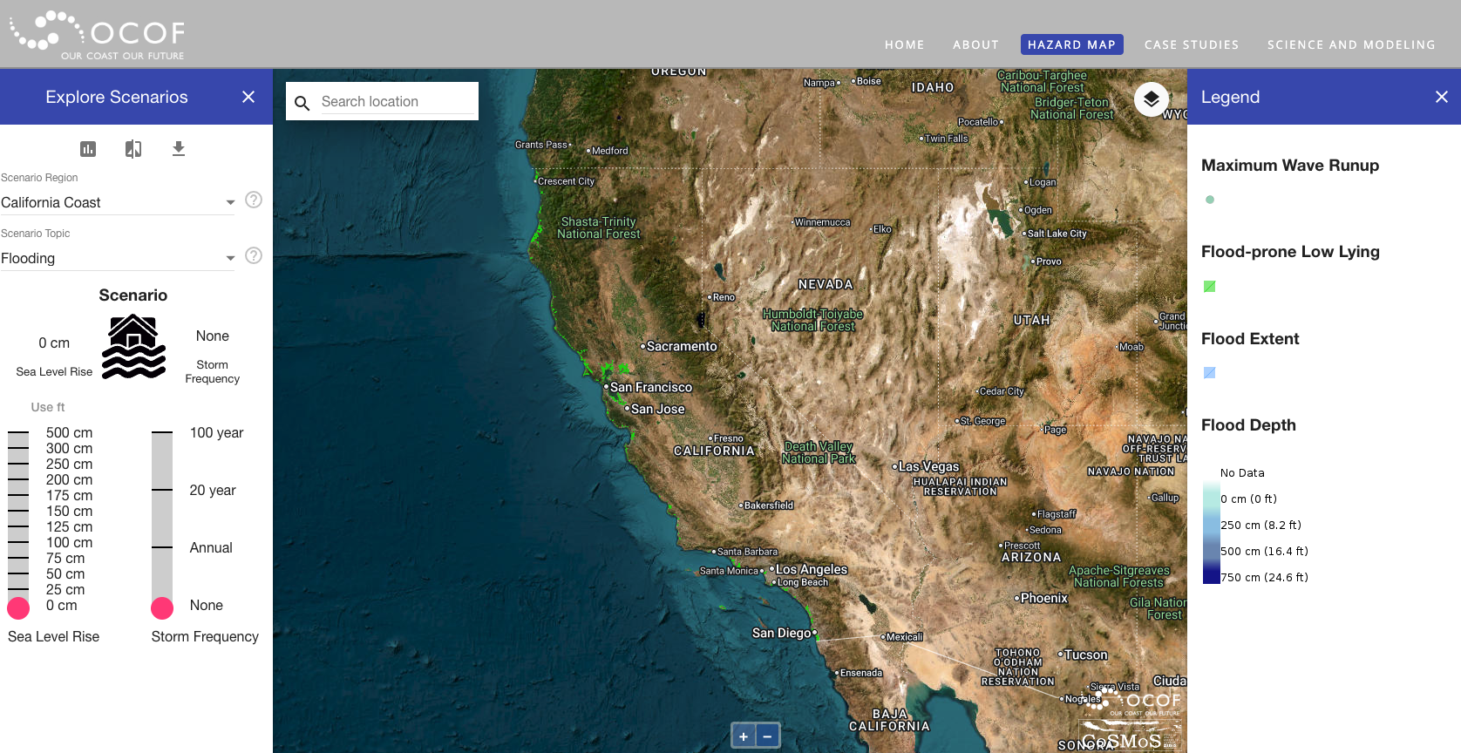
Day 2: Lesson Overview
Today, you will further investigate how sea level rise is affecting communities through exploring scientific sea level rise simulations and use the information you gather to plan how you want to update your SageModeler model to describe how ocean acidification impacts the values your community places on Southern California’s ocean.
Our Coast Our Future
Module 3.3 CO₂ & Sea Level Rise/ Coastal Erosion Slide 12
Notes:
Have students share with their group and then when they are ready they can advance to Slide 12. Where they will see their goal for today.
Today, you will further investigate how sea level rise is affecting communities through exploring scientific sea level rise simulations and use the information you gather to plan how you want to update your SageModeler model to describe how ocean acidification impacts the values your community places on Southern California’s ocean.

Slide 13
Our Coast Our Future Simulation
As a team, you will investigate Our Coast Our Future simulation tool to explore:
Sea level rise impact on flooding in Alamitos Bay.
Sea level rise impact on shoreline position on Alamitos Bay.
Instructions:
Refer to Instruction Guide in Science Journal (p. 36).
Module 3.3 CO₂ & Sea Level Rise/ Coastal Erosion Slide 13
Notes:
As students advance to Slide 13 they will see the simulation tool they will use to further investigate sea level rise, Our Coast Our Future, along with some tasks for the day.
As a team, you will investigate the Our Coast Our Future simulation tool to explore sea level rise impact predictions.
On Module 3.3 Impacts of Sea Level Rise on Coastal Communities Our Coast Our Future (p.36) of your Science Journal, you will have scenarios to investigate and questions to answer. Work as a team to answer these questions.
Once students are ready, have them open their Science Journals to Module 3.3 Impact of Sea Level Rise on Flooding in Alamitos Bay Our Coast Our Future where they will track their findings during their investigation.
When students are ready, have them open up the Our Coast Our Future platform and locate Alamitos Bay in Long Beach. They will focus on exploring two different scenarios
Sea level rise’s impact on flooding in Alamitos Bay
Sea level rise’s impact on shoreline position on Alamitos Beach
As students navigate through the Our Coast Our Future platform, walk around the group and provide support and ask questions to guide their investigation. Examples include:
What impact is the sea level rise projection for 2050 having on the Alamitos Bay community? How can you tell?
How does the shoreline position differ on Alamitos Beach with the projections for sea level rise for 2050 and 2100?
If time allows as students investigate the platform, invite them to search another coast that they might be familiar with to see if the sea level impact is similar or different between these locations.
How does sea level rise impact these locations differently? How does it impact them similarly?

Slide 14
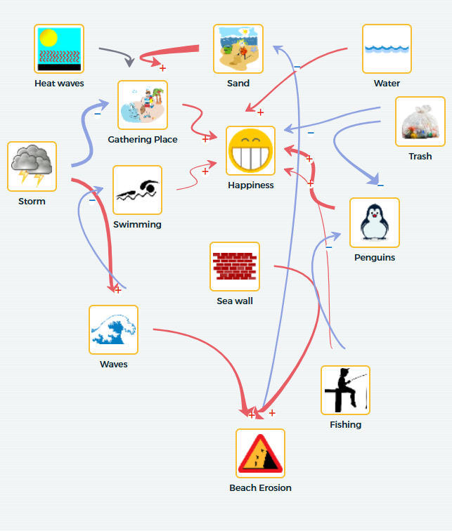
Plan: Update Your SageModeler
In your Science Journal, under Module 3.3 (p.36), reflect on the following questions:
What investigation did you take part in?
How did your thinking change as a result of this investigation? What new information did you learn?
What do you want to add, remove, or update in your SageModeler model?
Module 3.3 CO₂ & Sea Level Rise/ Coastal Erosion Slide 13
Notes:
As students wrap up their investigation, advance to Slide 14 and tell students that their next step is to create a plan to update their SageModeler model from Module 2 with their newfound knowledge during their investigation.
Have students open their Science Journal to Module 3.3: Impacts of Sea Level Rise on Coastal Communities (Planning to Update Our SageModler Model) (p.44), where they will have a table to help them think through their updates. As students work together, walk around the groups and support them in answering the questions.
What investigation did you take part in?
How did your thinking change as a result of this investigation? What new information did you learn?
What do you want to add, remove, or update in your SageModeler model?
Students may need support in thinking about how to expand their original model, invite students to take a look back at their materials from module 3 so far and look at what components they investigated.
Some options may include:
For all investigations: carbon dioxide emissions and atmospheric carbon dioxide.
For sea level rise and coastal erosion investigations: melting land ice, shoreline width, or flooding
For ocean acidification investigations: ocean pH levels, organisms with calcium carbonate shells, or connections back to the food chain that impacts their value, for example, availability of fish.
Once students have created their plan, bring the class back together (See Module 3.3 & 3.4 Introduction Slides, Slide 7) and have them share out with the class if time permits. Since different students will have different investigations and their models share different values, focus on the following question.
What value does your SageModeler model center on?
What investigation did you take part in? (sea level rise or ocean acidification)’
How do you want to update your SageModeler model as a result of your investigation? How does this impact connect with the value your model centers?

Slide 15
Reflect
In your Science Journal (p.45), take a couple of minutes to reflect on your experiences during Module 3.3, Day 2.
What new information or evidence changed your thinking about what causes sea level rise or how it affects communities?
What questions do you still have about sea level rise?
What updates do you plan to make to your SageModeler in the next lesson to strengthen your model?
Module 3.3 CO₂ & Sea Level Rise/ Coastal Erosion Slide 14
Notes:
As students wrap up for the day, their final task for the day is to reflect on what they did.
Advance to Slide 15 and have student teams work together to answer the following questions together on Module 3.3: CO2 and Sea Level Rise/Coastal Erosion (Day 2: Investigating Sea Level Rise Student Reflection), (p. 37) of their Science Journals.
What new information or evidence changed your thinking about what causes sea level rise or how it affects communities?
What questions do you still have about sea level rise?
What updates do you plan to make to your SageModeler in the next lesson to strengthen your model?
Thank students for their participation today and inform them that in the next session, they will come back to their SageModeler model and update it with their newfound knowledge from their investigations.

Slide 16




Thank you!
If you have any questions, please feel free to reach out.
Erick Valdez
Inside the Outdoors
evaldez@ocde.us
Ha Nguyen, Ph.D.
Assistant Professor
ha.nguyen@unc.edu

