Slide 1
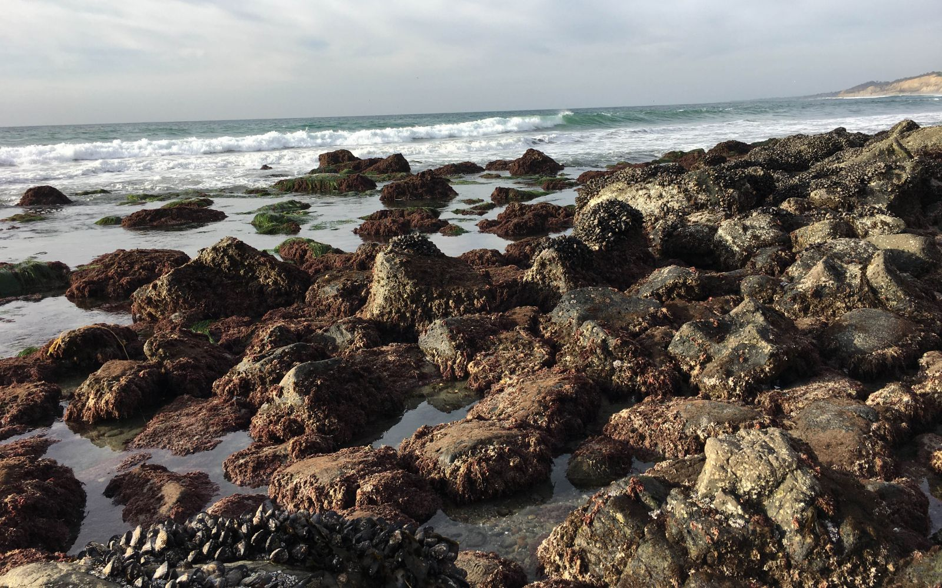
Ocean Acidification
Module 3.4 | Day 1
San Diego, CA
Photo Credit: UC San Diego, Jacobs School of Engineering
AISciComm | Module 3.4 Ocean Acidification
Notes:
Link to Module 3.4 Lesson Plan
BEFORE YOU START TEACHING
Review the Teacher Facilitation Guide for an overview of content and the curriculum as well as helpful facilitation suggestions.
For Lesson 3.4, review Student SageModeler Instructions (also in Science Journal, p. 51) to model or support students. Review SageModeler Ocean Foodweb Preset Model.
Include a numbered list of general steps to set up the investigation before students arrive.
This can also include other things that educators should do or think about before starting the lesson, such as checking for safety concerns.
__________
Open the Ocean Acidification slideshow to Slide 1 where students will see a notice that this lesson is a student-led lesson, meaning that they will move through it with their team within the next two sessions.

Slide 2
Lesson Overview
During this lesson, you will work with your team to build additional background knowledge on how CO₂ impacts ocean chemistry, such as ocean acidification and ultimately food web interactions.
During the lesson, you will:
Explore how acidifying ocean conditions mpact shelled organisms and how this has an impact on the greater ecosystem.
Use this information to create a plan to update your SageModeler model from Module 2.
Module 3.3 CO₂ & Sea Level Rise/ Coastal Erosion Slide 2
Notes:
Move on to Slide 2 where students will see the two day overview for module 3.4.

Slide 3
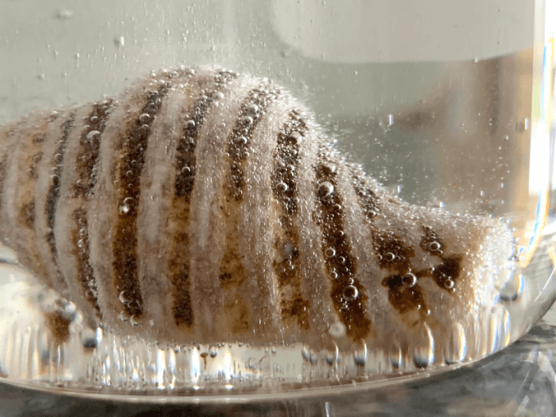
Make an Observation
With your team, take a moment to observe the image on the left.
What do you think is happening in this image?
Is what you are observing a natural occurrence?
Why might communities want to understand this scenario?
Photo Credit: Little Bins, Little Hands
Module 3.4 Ocean Acidification Slide 3
Notes:
When student teams are ready, advance to Slide 3 where they will see an image of a shell that is placed in an acidic solution (vinegar). Students are then asked to take 5 minutes to discuss with their group and answer the following questions.
What do you think is happening in this image?
Is what you are observing a natural occurrence?
Why might communities want to understand this scenario?
Gather the students as a class and ask students to share their responses with the class. At this point it is not important for them to be accurate with responses, you just want to gauge what they are noticing.

Slide 4
Reflect
Using your understanding from lesson 3.2, answer the following:
What role do you think carbon dioxide might play in this process?
What happens when carbon dioxide interacts with ocean water?
Photo Credit: Little Bins, Little Hands
Module 3.4 Ocean Acidification Slide 4
Notes:
Advance to Slide 4 and have students think back to their previous lessons in this module and ask:
What role do you think carbon dioxide might play in this process?
What happens when carbon dioxide interacts with ocean water?

Slide 5
Shell in Acidic Solution
The image shows a shell that has been placed in an acidic solution. Our ocean leans towards a more basic pH but through reactions with atmospheric carbon dioxide, the ocean becomes slightly acidic. This is natural, but humans have impacted this reaction through the emissions of carbon dioxide.
Photo Credit: Little Bins, Little Hands
Module 3.4 Ocean Acidification Slide 5
Notes:
After students have discussed, have them advance to Slide 5 where more information is shared with students about carbon dioxide interacting with ocean water.
The image shows a shell that has been placed in an acidic solution. Our ocean leans towards a more basic pH but through reactions with atmospheric carbon dioxide, the ocean becomes slightly acidic. This is natural, but humans have impacted this reaction through the emissions of carbon dioxide.
Stay on Slide 5 where students will be told that over the next two lessons, they will investigate how this might happen through a process called ocean acidification. This includes how humans have accelerated its process and how it can impact coastal accessibility for communities.

Slide 6
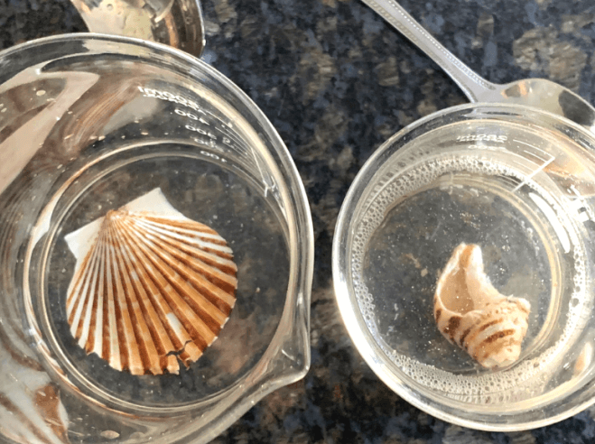
What’s Coming Next
We are going to take a closer look at ocean acidification and how it impacts ocean life.
You will be setting up an experiment to investigate what happen when ocean pH levels changes and how different pH levels affect marine organisms.
Photo Credit: Little Bins, Little Hands
Module 3.4 Ocean Acidification Slide 6
Notes:
Advance to Slide 6 and let students know that to further explore the impacts that ocean acidification has on our oceans, they are going to set up an experiment.
On Slide 6, students will be introduced to a set up for an experiment, where they will see how varying ocean pH levels affect organisms living in the ocean, just like the image they saw earlier.

Slide 7
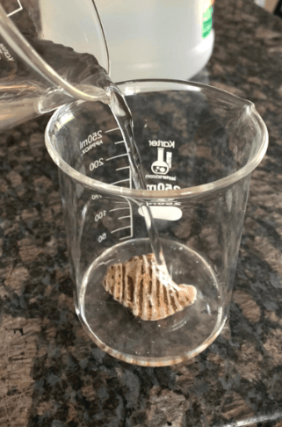
Ocean Acidification Experiment
Our goal is to explore what happens to a shell when placed in two different solutions, one representing the ocean and one representing an extreme case of ocean acidification.
Set Up Instructions:
Grab two identical containers and label one “Basic Ocean Conditions” and one “Acidic Ocean Conditions”.
Place a shell in each of the containers.
Pour enough of the the “Basic Ocean Conditions” solution to cover the shell into its respective container.
Repeat the process with the “Acidic Conditions”.
Photo Credit: Little Bins, Little Hands
Module 3.4 Ocean Acidification Slide 7
Notes:
Advance to Slide 7 and have students set up the experiment following the experiment set up instructions.

Slide 8
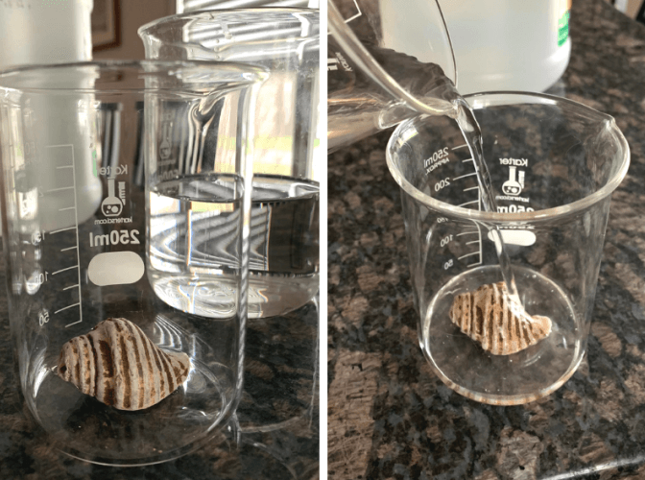
Day 1: Ocean Acidification Experiment
In your Science Journal, Module 3.4 (p.46-49), draw your predictions for the basic solution and the acidic solution.
Ask yourself the following:
What do you think is happening in the solutions?
What processes or reactions are happening?
Are there any similarities between the two? Differences?
Photo Credit: Little Bins, Little Hands
Module 3.3 CO₂ & Sea Level Rise/ Coastal Erosion Slide 8
Notes:
Once the experiment is set up, advance to Slide 8 and ask students to turn to Module 3.4 Ocean Acidification (Student Task, p. 46-49) in their Science Journals. Here they will see an observation sheet for their experiment set up.
On this observation sheet, students will see two modeling areas, one for the basic solution and one for the acidic solution. Have students take a moment to draw a model of what they think is happening in each of the solutions under the “Start of Experiment" section.
As students are drawing a model, walk around and ask probing and pressing questions to support their thinking.
What do you think is happening in the solutions?
What processes or reactions are happening?
Are there any similarities between the two? Differences?

Slide 9
What do you predict will happen to the shells in each solution? Why?
Photo Credit: Little Bins, Little Hands
Module 3.3 CO₂ & Sea Level Rise/ Coastal Erosion Slide 9
Notes:
As students finish their initial model, advance to Slide 9 and have them make a prediction on what they think will happen to the shell in each solution.
What do you predict will happen to the shells in each solution? Why?
As students are making their predictions, walk around to answer questions they may have. If students need support making a prediction, provide a sentence frame to get them started.
We predict that the shell in the [ basic / acidic ] solution will [what will happen] because [why you think it will happen]

Slide 10
Ocean Acidification Experiment
Once you have made your initial observations on both the basic and acidic solutions, take a moment to store your containers in a safe place. You will observe them again in the following lesson.
Storing Instructions:
Using a post it note or tape, take a moment to add your group’s name to your experiment. If you have not labeled the containers with their solution type, now is the time to do so.
Find a place within the classroom where you can leave your experiment for the day, you will revisit the experiment in the next lesson.
Photo Credit: Little Bins, Little Hands
Module 3.4 Ocean Acidification Slide 10
Notes:
After students have made their predictions, advance to Slide 10, where students will have instructions to store their experiment for day two.
As you reach the end of the class period, bring the students back together for a class conversation (See Module 3.3 & 3.4 Introduction Slides, Slide 5). As not all students did the exact same activity, get at least one student from each exploration to share responses to the following questions with the class.
What did you do today?
What were some of the most surprising findings you gained from today?
As students share their experiences, ask the following questions
What specific data do you think is still missing to further your understanding?
What might help strengthen your understanding of carbon dioxide’s impact on sea level rise?
What might help strengthen your understanding of carbon dioxide’s impact on ocean acidification?
Where might you collect this data?

Slide 11
Reflect
In your Science Journal (p. 50), take a couple of minutes to reflect on your experiences during Module 3.4, Day 1.
What new information or evidence changed your thinking about how CO₂ affects ocean ecosystems?
What questions do you still have about ocean acidification?
Module 3.4 Ocean Acidification Slide 11
Notes:
As students wrap up for the day, send groups back to their slideshow to reflect on the process of learning about ocean acidification and creating their experiment models (Lesson 3.4, slide 10).
Advance to Slide 11 and have student teams work together to answer the following questions together on Day 1: Module 3.4 Ocean Acidification (Student Reflection), p. 50 in their Science Journals.
What new information or evidence changed your thinking about how CO₂ affects ocean ecosystems?
What questions do you still have about ocean acidification?
Thank students for their participation today and inform them that in the next session, they will continue to learn more about ocean acidification!

Slide 12
Ocean Acidification
Module 3.4 | Day 2
San Diego, CA
Photo Credit: UC San Diego, Jacobs School of Engineering
AISciComm | Module 3.4 Ocean Acidification
Slide 12
Notes:
Link to Module 3.4 Lesson Plan
BEFORE YOU START TEACHING
Review the Teacher Facilitation Guide for an overview of content and the curriculum as well as helpful facilitation suggestions.
For Lesson 3.4, review Student SageModeler Instructions (also in Science Journal, p. 51) to model or support students. Review SageModeler Ocean Foodweb Preset Model.
Include a numbered list of general steps to set up the investigation before students arrive.
This can also include other things that educators should do or think about before starting the lesson, such as checking for safety concerns.
__________
Welcome the students back for day two of their Ocean Acidification investigation. Have students open the slideshow to Slide 12 where day two starts.

Slide 13
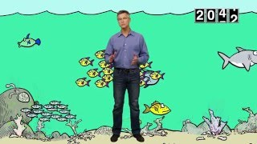
What is Ocean Acidification?
During this lesson, you will take a moment to learn more about ocean acidification and how it might impact the way your community values the ocean. To begin, watch the video below.
Module 3.4 Ocean Acidification Slide 13
Notes:
When students are ready, tell them that the first task they have is to watch a quick video to further learn about Ocean Acidification. Advance to Slide 13 where students will play the video, What is Ocean Acidification? [2:05].

Slide 14
Make an Observation
Now that you have more information, revisit the following image and answer the questions.
What do you think is happening in this image?
Is what you are observing a natural occurrence?
Why might communities want to understand this scenario?
Photo Credit: Little Bins, Little Hands
Module 3.4 Ocean Acidification Slide 3
Notes:
After the students have watched the video, advance to Slide 14, where they will see the same image of the shell in an acidic solution from day one to see how their thinking has changed. As a group, have students answer the following questions.
What do you think is happening in this image? Why is it happening?
Is what you are observing a natural occurrence?
Why might communities want to understand this scenario?

Slide 15
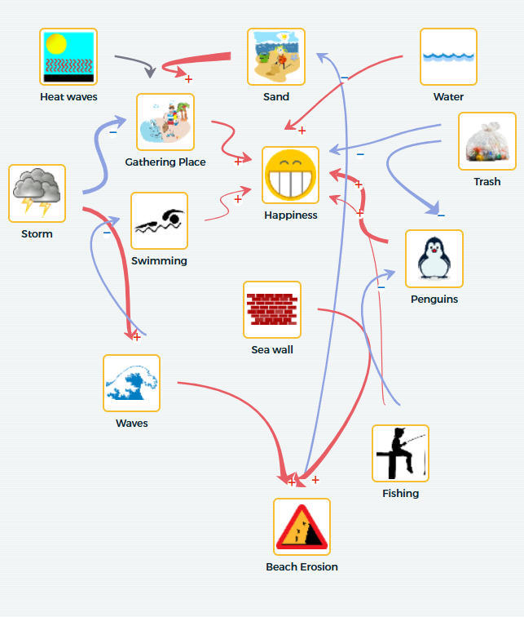
Day 2: Lesson Overview
Today, you will further explore your experiment and use the information you gather to plan how you want to update your SageModeler model to describe how ocean acidification impacts the values your community places on Southern California’s ocean.
Module 3.4 Ocean Acidification Slide 15
Notes:
Have students share with their group and when they are ready, they can advance to Slide 15. Where they will see their goal for today.
Today, you will further explore your experiment and use the information you gather to plan how you want to update your SageModeler model to describe how ocean acidification impacts the values your community places on Southern California’s ocean.

Slide 16
Day 2: Ocean Acidification Experiment
Take a moment to retrieve your experiments from day one and make observations on how they’ve changed. In your Science Journal, p.46-49, draw what you see is happening. To help ask yourself:
What do you notice? How is this different from the beginning of the experiment?
What processes or reactions happened? What do you think caused this to happen?
How are the two experiments different? Similar?
Photo Credit: Little Bins, Little Hands
Module 3.4 Ocean Acidification Slide 16
Notes:
When students are ready, advance to Slide 16 and have students open their Science Journal to Module 3.4 Ocean Acidification (Student Task) p. 46-49, where they made observations in the previous lesson.
Have students bring out their experiments from day one and make observations on how they have changed, drawing and labeling their observations in the section that reads “Day Two of Experiment”.
As students are drawing their observations, go around and ask probing and pressing questions.
What do you notice? How is this different from the beginning of the experiment?
What processes or reactions happened? What do you think caused this to happen?
How are the two experiments different? Similar?
Once students have finished filling out their observation sheets, have them clean up the experiments and ask them to move to Module 3.4: Impact of Carbon Dioxide Emissions on the Ocean’s pH and foodweb (Day 2: Sage Modeler Instructions), p. 51 in their Science Journals. Here they will be asked to think about how to apply all the information they have gathered together through exploring a pre-set SageModeler model.

Slide 17
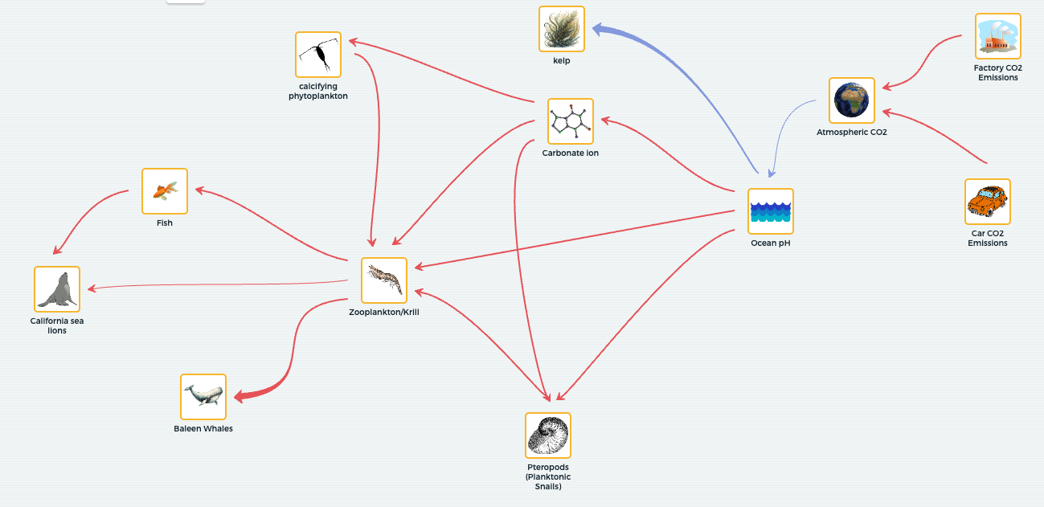
Day 2: Ocean Acidification Experiment
Visit the SageModeler Model and then answer the following questions in your Science Journal, p.51.
How does carbon dioxide get introduced into the Earth’s system in the model?
What happens to the sea water as it comes in contact with carbon dioxide?
How can you manipulate this model to reflect the basic solution and acidic solution scenarios you observed during your experiment?
How does increasing the amount of carbon dioxide impact the living organisms in this model?
Module 3.4 Ocean Acidification Slide 17
Notes:
Advance to Slide 17 where students will see a link to visit a preset SageModeler model. Here they will be asked to think about how to apply all the information they have gathered.
Open the SageModeler model and ask the students to follow along with their Science Journal on Module 3.4: Impact of Carbon Dioxide Emissions on the Ocean’s pH and foodweb (Day 2: Sage Modeler Instructions), p. 51. As students are investigating the model, walk around and provide support by asking probing questions.
How does carbon dioxide get introduced into the Earth’s system in the model?
What happens to the sea water as it comes in contact with carbon dioxide?
How can you manipulate this model to reflect the basic solution and acidic solution scenarios you observed during your experiment?
How does increasing the amount of carbon dioxide impact the living organisms in this model?

Slide 18
Reflect
As a group, take a moment to reflect on your findings and connect it back to how your community values the ocean.
How does a change to the ocean’s pH level affect the value your community places on Southern California’s ocean?
San Diego, CA
Photo Credit: UC San Diego, Jacobs School of Engineering
Module 3.4 Ocean Acidification Slide 18
Notes:
As students are finishing up, advance to Slide 18 and ask them.
How does a change to the ocean’s pH level affect the value your community places on Southern California’s ocean?

Slide 19
Plan: Update Your SageModeler
In your Science Journal, under Module 3.4, Day 2, p.54, reflect on the following questions:
What investigation did you take part in?
How did your thinking change as a result of this investigation? What new information did you learn?
What do you want to add, remove, or update in your SageModeler model?
Module 3.4 Ocean Acidification Slide 19
Notes:
As students wrap up their investigation, advance to Slide 19 and tell students that their next step is to create a plan to update their SageModeler model from Module 2 with their newfound knowledge during their investigation.
Have students open their Science Journal in Module 3.4: Ocean Acidifications (Planning to Update Our SageModler Model) (p.54) where they will have a table to help them think through their updates. As students work together, walk around the groups and support them in answering the questions.
What investigation did you take part in?
How did your thinking change as a result of this investigation? What new information did you learn?
What do you want to add, remove, or update in your SageModeler model?
Students may need support in thinking about how to expand their original model, invite students to take a look back at their materials from module 3 so far and look at what components they investigated.
Some options may include
For all investigations: carbon dioxide emissions and atmospheric carbon dioxide.
For sea level rise and coastal erosion investigations: melting land ice, shoreline width, or flooding
For ocean acidification investigations: ocean pH levels, organisms with calcium carbonate shells, or connections back to the food chain that impacts their value, for example, availability of fish.
Once students have created their plan, bring the class back together (Reference AISciComm Module 3.3 & 3.4 Introduction Slides, slide 7) and have them share out with the class if time permits. Since different students will have different investigations and their models share different values, focus on the following question.
What value does your SageModeler model center on?
What investigation did you take part in? (sea level rise or ocean acidification)’
How do you want to update your SageModeler model as a result of your investigation? How does this impact connect with the value your model centers?
Then, return to AISciComm Module 3.4 Slides, slide 20

Slide 20
Reflect
In your Science Journal (p.55), take a couple of minutes to reflect on your experiences during Module 3.4, Day 2.
How does ocean acidification affect the ocean food web and the people who depend on it?
What questions do you still have about ocean acidification?
What updates do you plan to make to your SageModeler in the next lesson to strengthen your model?
Module 3.4 Ocean Acidification Slide 20
Notes:
As students wrap up for the day, their final task for the day is to reflect on what they did.
Advance to Slide 20 and have student teams work together to answer the following questions together in Module 3.4 Ocean Acidification (Day 2: Student Reflection), p.55 of their Science Journals.
How does ocean acidification affect the ocean food web and the people who depend on it?
What questions do you still have about ocean acidification?
What updates do you plan to make to your SageModeler in the next lesson to strengthen your model?
Thank students for their participation today and inform them that in the next session, they will come back to their SageModeler model and update it with their newfound knowledge from their investigations.

Slide 21




Thank you!
If you have any questions, please feel free to reach out.
Erick Valdez
Inside the Outdoors
evaldez@ocde.us
Ha Nguyen, Ph.D.
Assistant Professor
ha.nguyen@unc.edu

