Slide 1
Build a Chatbot to Test Our Message
Module 4.3
AISciComm | Module 4.3 Build a Chatbot to Test our Message Slide 1
Source: Edweek. https://www.edweek.org/technology/what-is-age-appropriate-use-of-ai-4-developmental-stages-to-know-about/2024/02
Notes:
Link to Module 4.3 Lesson Plan
BEFORE YOU START TEACHING
Review the Teacher Facilitation Guide for an overview of content and the curriculum as well as helpful facilitation suggestions.
Review AISciComm chatbot website to model and/ or support students.
Review the Science Communication Product Student Checklist (also in Science Journal p. 60) and Teacher Rubric to know the expectations of students.
Throughout the program, students will be working in teams of three (preferably).
Make sure that you have a way to project a video with sound.
The science journal is intended to be a digital notebook. However, if you decide to print copies for students they may need a writing instrument (pen, pencil, etc.).
___________
Open the slideshow to slide 1 and introduce the lesson. Explain to students that now that we have planned our messages and identified our target audience, they’ll build a GenAI chatbot to represent their chosen audience and help them test their message.

Slide 2
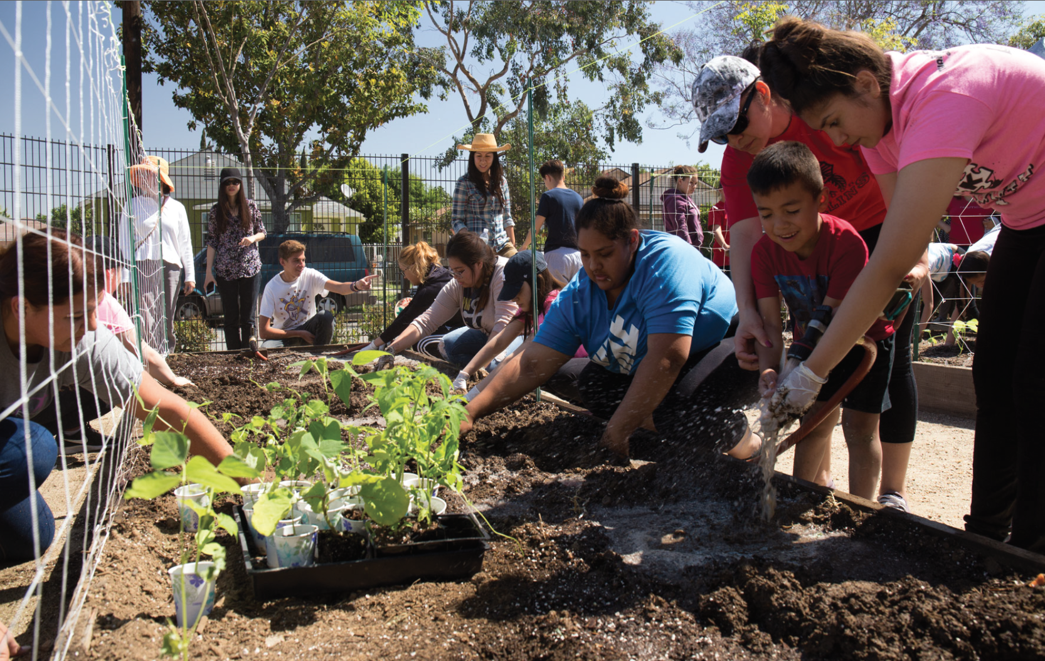
Brainstorm
What aspects of our target audience do we want to simulate, so that we can test our messages?
For example, is it their background (age, gender, occupation), interests, motivation, or values they associate with the ocean, etc?
Illustrative image. Community garden cleanup, Lynwood, CA. Source: https://www.lynwoodca.gov/CivicAlerts.aspx?AID=78&ARC=113
Module 4.3 Build a Chatbot to Test our Message Slide 2
Notes:
Advance to slide 2 and ask students to brainstorm: What aspects of our target audience do we want to simulate, so that we can test our messages?
Students can come up with responses like demographics (e.g., age, gender, occupation), interests, values they associate with the ocean, etc.

Slide 3
Prompt Example
Review the prompt example to get ideas for testing messages.
You are a construction worker who spends most of the day outdoors and cares about keeping your crew safe and comfortable in changing weather.
Role
Task
You are talking with a high school student who is explaining how climate change affects local air quality and heat levels.
You live in LA and notice hotter summers over the years. You are a high school graduate and have a lot of knowledge working in the field.
Background
Constraints for the Conversation
Keep your responses short (2-3 sentences). Use informal language.
Module 4.3 Build a Chatbot to Test our Message Slide 3
Notes:
Advance to slide 3 and walk students through a prompt example that contains different characteristics of a simulated profile:
Role (e.g., civil engineer)
Task (e.g., conversation about climate change)
Background information (e.g., living experiences in OC)
Constraints (e.g., when to cite sources),
Example responses (e.g., question-answer pairs so the chatbots can sound like our intended character)

Slide 4
Your Turn
Revisit the audience profile you worked on from Module 4.2. In your team, build the profile for your audience chatbot.
Role
What role will your chatbot play? It could be another occupation (not already included in Module 3) or a local community figure.
Task
What is the task that your chatbot should perform? Examples: “critique my science communication plan”; “act as a conversational partner and ask me follow-up questions about my message”.
Who is your chatbot? You can build this part based on your answers in lesson 4.2. Specify age, race/ethnicity, living experiences (urban, rural, coastal, etc).
Background
Are there any constraints for your chatbot? E.g., simplify the answer, answer in fewer than 100 words, etc.
Constraints
Module 4.3 Build a Chatbot to Test our Message Slide 4
Notes:
Advance to slide 4. Explain to students that in their project teams, students will work on their science communication plan and develop the prompt for the chatbots to test their plans. Invite students to pull up the target audience profiles they created in Module 4.2.
Students brainstorm their “target audience” chatbot profile based on the following guiding questions:
Role: What role will your chatbot play? It could be another occupation (not already included in Module 3) or a local community figure. It would be best to include roles that you have encountered in your research in prior modules (e.g., interviewing community members, families, teachers, and friends).
Task: What is the task that your chatbot should perform? It could be: “critique my science communication plan” or “act as a conversational partner and ask me follow-up questions about my message”.
Background information: Who is your chatbot? You can build this part based on your answers in lesson 4.2 (Target audience).
Age: [Specify age range]
Race/Ethnicity: [Describe the racial/ethnic background]
Living Experiences: [Urban, rural, coastal, etc.]
Constraints: Are there any constraints you want your chatbot to do, so that its responses will be what you want? For example: only answer questions related to science communication; only answer in 2-3 sentences; answer in fewer than 100 words, etc.
Example interactions (OPTIONAL): These chatbots work better if we provide them example interactions (e.g., questions-answers) of what the real person will sound like. You could add 2-3 example question-answer pairs here to provide examples for the chatbot.

Slide 5
Test your Message
In your project team, go to Module 4.3 science journal page 69. Test your message by filling in the bolded sections. You can use this template:
You are role-playing as {character}. Here are details about you: you will act as this role: {role}. In this task, I want you to {provide task description}. You will role-play as an individual with this background information: {describe background, like age, race/ethnicity, living experiences, occupation}.
Your response should have the following constraints: {constraints}. I will share details about a science communication product with you, and you will critique my plan from the perspective of this character.
Here is my product type: {product type, like a social media post, board game, or infographic}. Here is my science communication plan: {plan}. What do you think about this plan? Ask me questions about what is unclear or can be improved about my plan.
Module 4.3 Build a Chatbot to Test our Message Slide 5
Notes:
In project teams, students will input the prompt they have just created to create their target audience to the AISciComm chatbot site > default chatbot.
Advance to slide 5 to show a possible prompt (Science Journals, p. 69). The prompt format could be: see slide

Slide 6
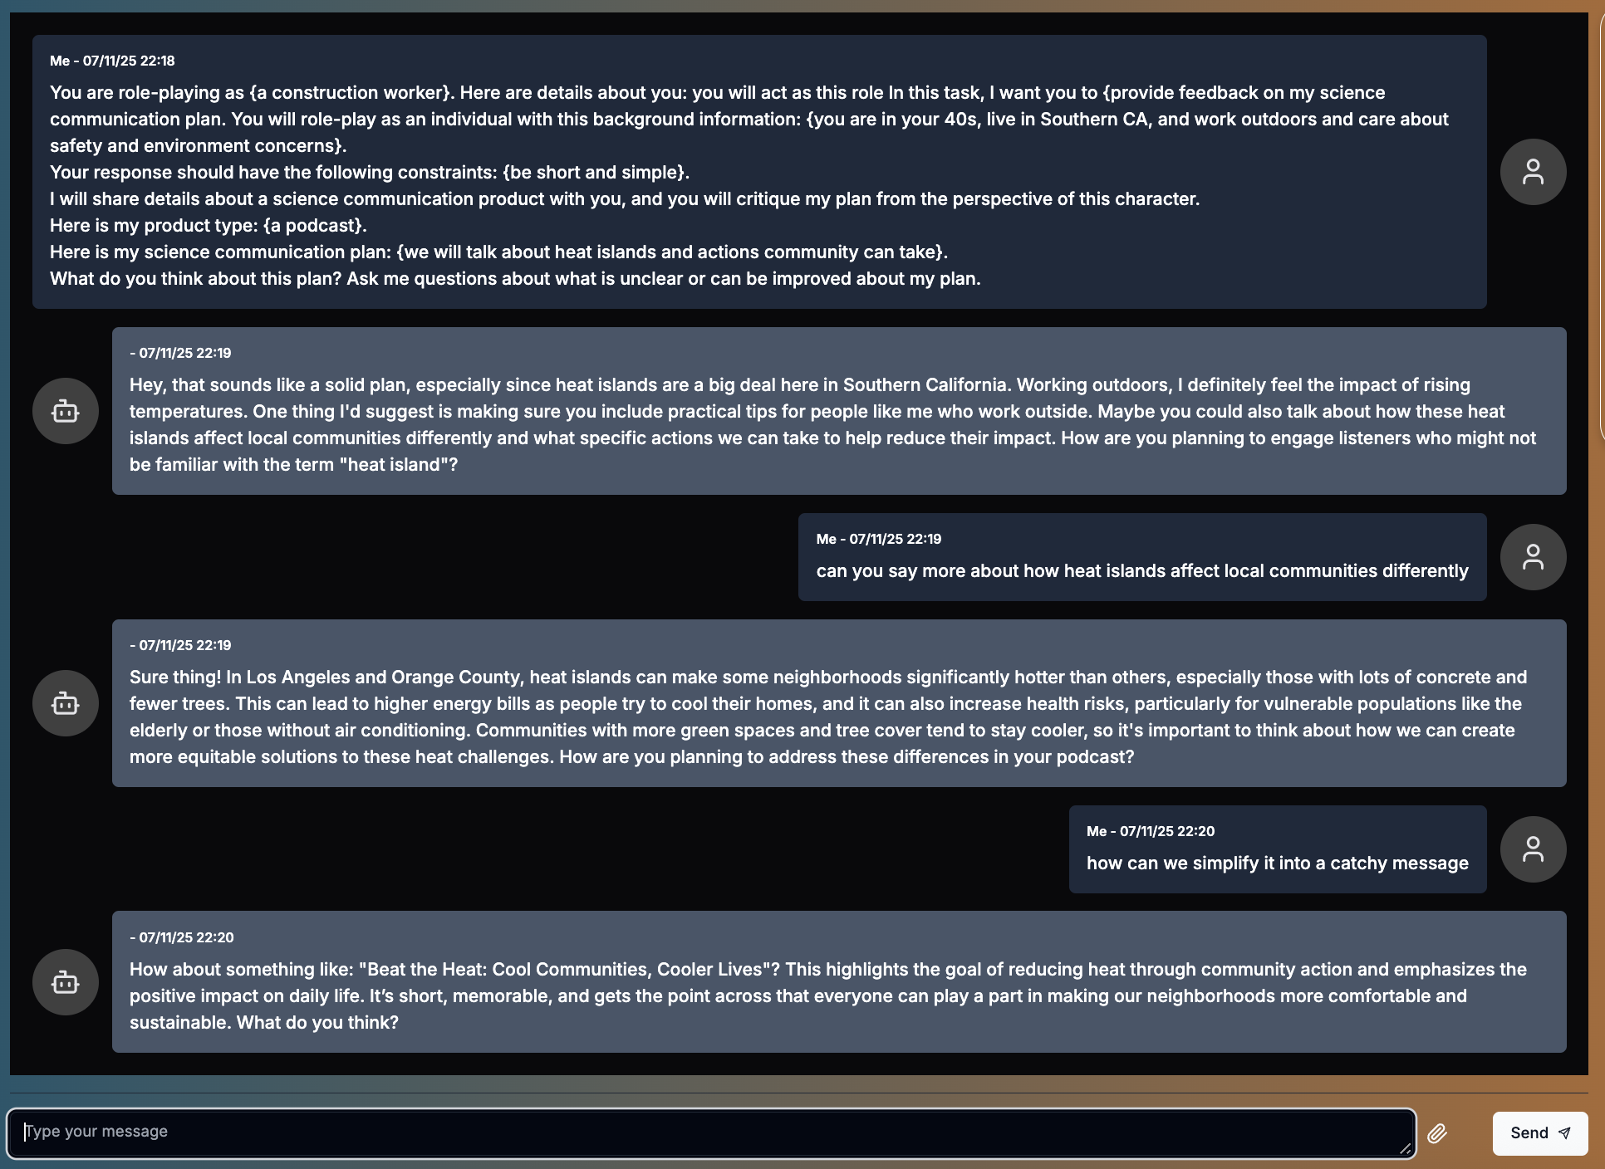
Evaluate your Chatbot; Iterate on Prompts
Is the chatbot’s response good? Reprompt so it can be more specific.
After your initial message, you can ask follow-up questions to continue developing your science communication plan.
For example ask, “can you say more” or “how should we revise/simplify/improve our plan”?
Prepare to take screenshots of your conversation.
Module 4.3 Build a Chatbot to Test our Message Slide 6
An example conversation with a chatbot roleplaying as a construction worker who spends a lot of time outdoors.
Notes:
Advance to slide 6 and show students an example conversation using this template. Ask student teams to test their communication plan and take screenshots of the conversation with the chatbots roleplaying as the target audience and add it to Google Drive. Instructions are on Slide 7.
Remind students to critically evaluate the chatbots’ responses and ask follow-up questions and prompts to revise the persona as needed.
Instructions to take a screenshot for students slide 7:
Devices will differ in ways to take a snapshot.
If on a Windows computer
Press Window + Shift + S at the same time
If on a Mac computer
Press Command (⌘) + Shift + 4 at the same time
If on a Chromebook
Press Ctrl + Shift + Show Windows at the same time

Slide 7
Take and Save a Snapshot of Your Model
Take a moment to screenshot your chatbot conversation. Save this screenshot to your Google Drive. You may need to reference to conversation while revising your product.
Devices will differ in ways to take a snapshot.
If on a Windows computer
Press Window + Shift + S at the same time
If on a Mac computer
Press Command (⌘) + Shift + 4 at the same time
If on a Chromebook
Press Ctrl + Shift + Show Windows at the same time
Module 4.3 Build a Chatbot to Test our Message Slide 7
Notes:
Instructions to take a screenshot for students slide 7:
Devices will differ in ways to take a snapshot.
If on a Windows computer
Press Window + Shift + S at the same time
If on a Mac computer
Press Command (⌘) + Shift + 4 at the same time
If on a Chromebook
Press Ctrl + Shift + Show Windows at the same time

Slide 8
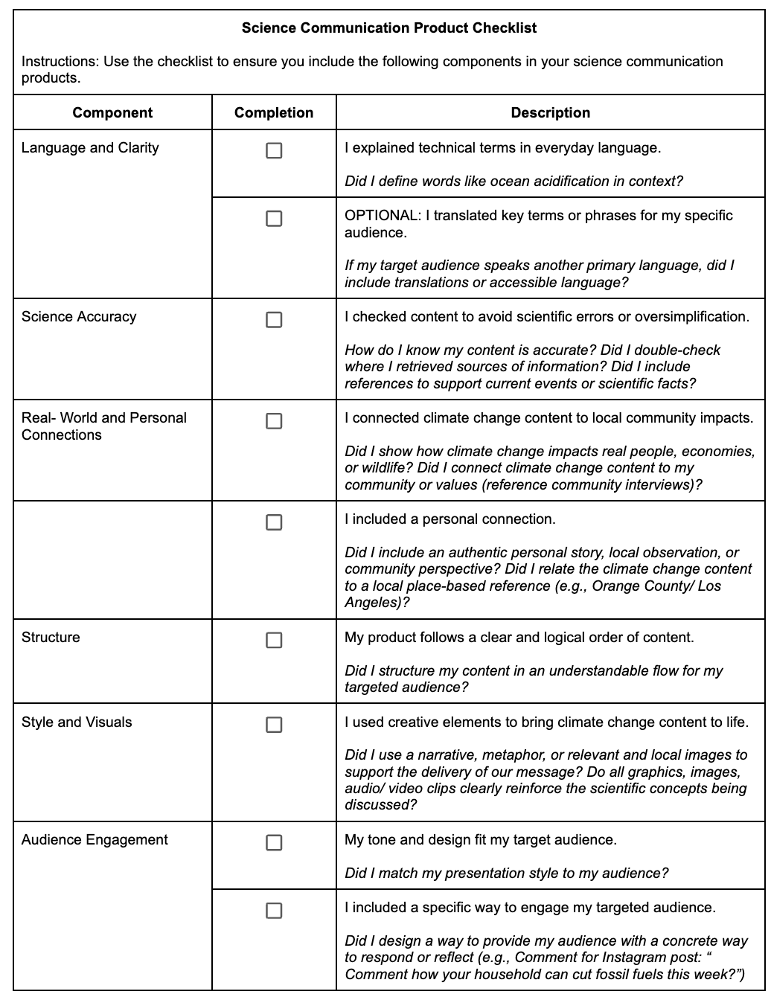
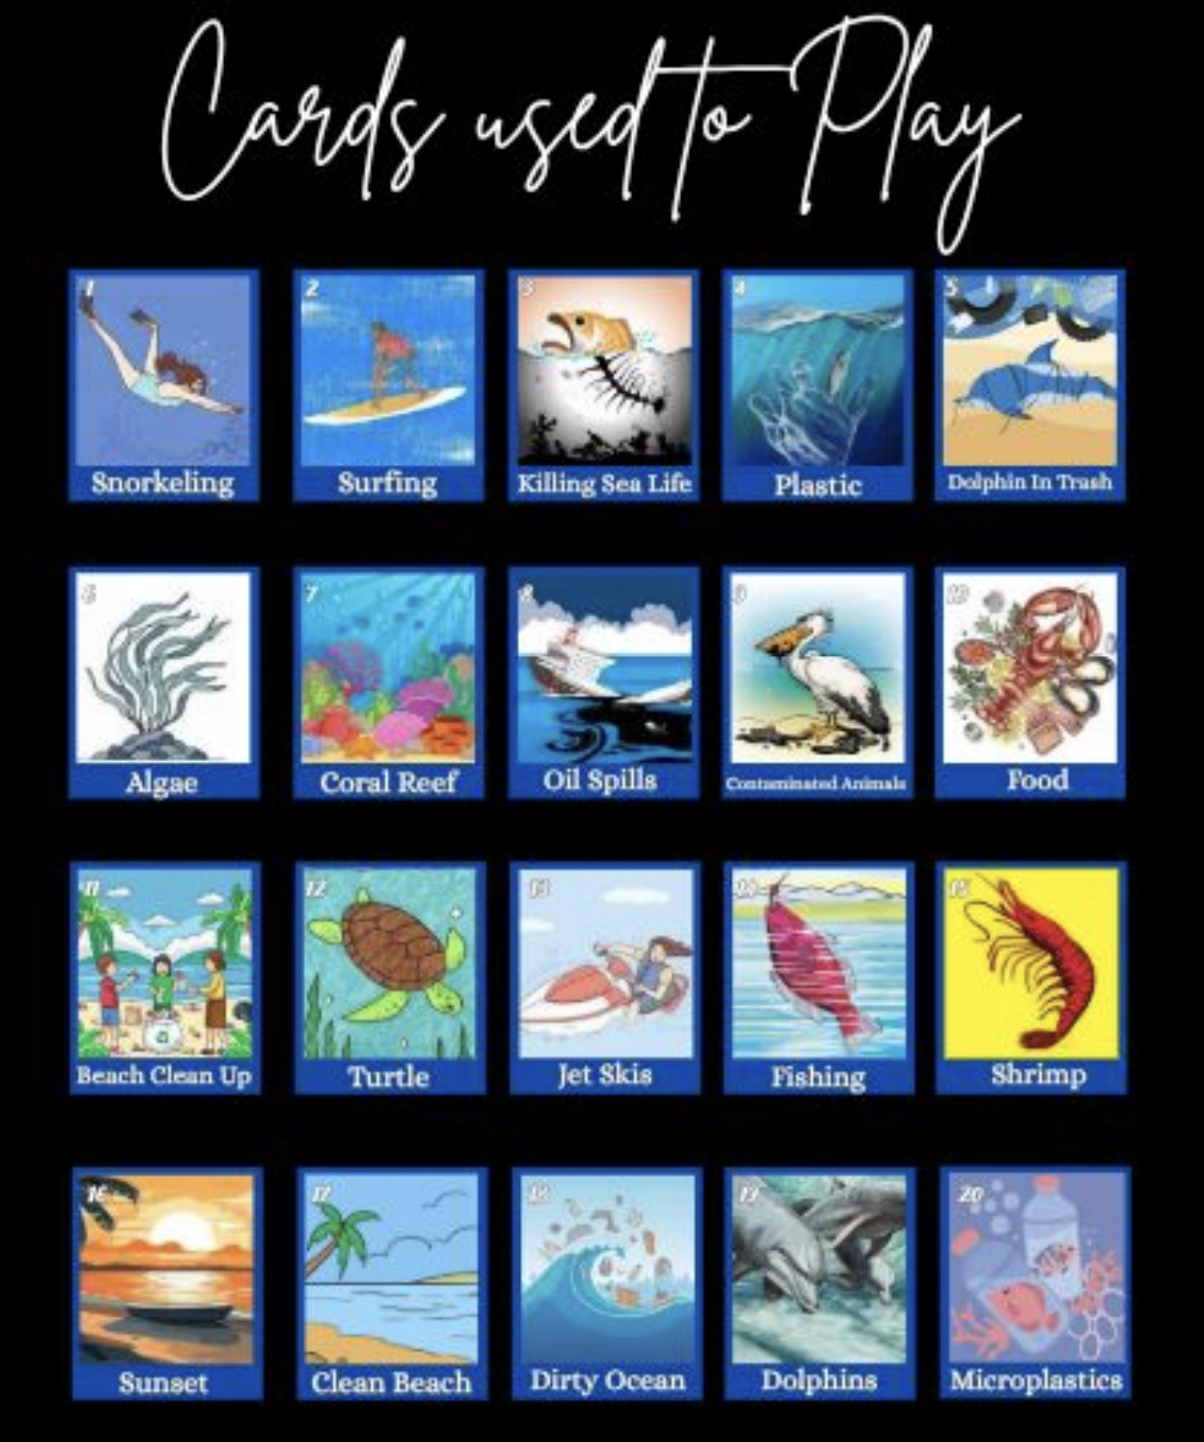
Ask Additional Questions
Using your student checklist, you may ask the chatbot additional questions related to specific parts of your product.
Example: Recall the Lotería Game
Target Audience: Middle School Students
Questions to ask:
Structure: Does it have a logical structure to play the game?
Style and Visuals: Are there imagery, metaphors, or storytelling elements that can enhance the scientific content?
Module 4.3 Build a Chatbot to Test our Message Slide 8
Notes:
Advance to Slide 8. Remind students that they may use the student science communication product checklist as another helpful resource to ask the chatbot additional questions related to specific parts of their product: language and clarity, science accuracy, real-world and personal connections, structure, style and visuals, and audience engagement.
Provide students an example using the Lotería Game designed for middle school students would be to ask specific questions to improve its:
Structure: Does it have a logical structure to play the game?
Style and visuals: Are there imagery, metaphors, or storytelling elements that could enhance the scientific content?
NOTE: Some past student products do not always have all science communication components, such as Loteria game does not explicitly make it clear that their is an audience engagement part. So, in your design, ask the chatbot how you can specifically address them.

Slide 9
Test your Message
In your project team, test your message with the chatbot (https://aiscicomm.vercel.app/). You can use the template from your science journal. Take screenshots of the conversation.
You are role-playing as {character}. Here are details about you: you will act as this role: {role}. In this task, I want you to {provide task description}. You will role-play as an individual with this background information: {describe background, like age, race/ethnicity, living experiences, occupation}.
Your response should have the following constraints: {constraints}. I will share details about a science communication product with you, and you will critique my plan from the perspective of this character.
Here is my product type: {product type, like a social media post, board game, or infographic}. Here is my science communication plan: {plan}. What do you think about this plan? Ask me questions about what is unclear or can be improved about my plan.
Module 4.3 Build a Chatbot to Test our Message Slide 9
Notes:
Advance to Slide 9 (similar to slide 5) so students can see the prompt template.

Slide 10

Reflect
Reflect on what you learned for module 4.3. Complete your science journal for page 71.
How did the chatbot respond to your message? Was there anything surprising or interesting about the feedback you received?
What did you learn about your audience from this conversation?
Did this feedback make you think differently about how to communicate your science topic? How?
How might this chatbot experience be similar to or different from talking to a real person? How might you validate what the chatbot shared?
Image created with ChatGPT Prompt: Create an image about SoCal beaches.
Module 4.3 Build a Chatbot to Test our Message Slide 10
Notes:
Advance to Slide 10. Invite student teams to discuss the chatbot’s responses to improve their science communication plan. Science Journal p. 71 for reference.
Students complete their individual science journal and respond to the questions: What feedback about your science communication plan did you learn? Was there anything interesting or surprising?

Slide 11




Thank you!
If you have any questions, please feel free to reach out.
Erick Valdez
Inside the Outdoors
evaldez@ocde.us
Ha Nguyen, Ph.D.
Assistant Professor, UNC
ha.nguyen@unc.edu

