Slide 1
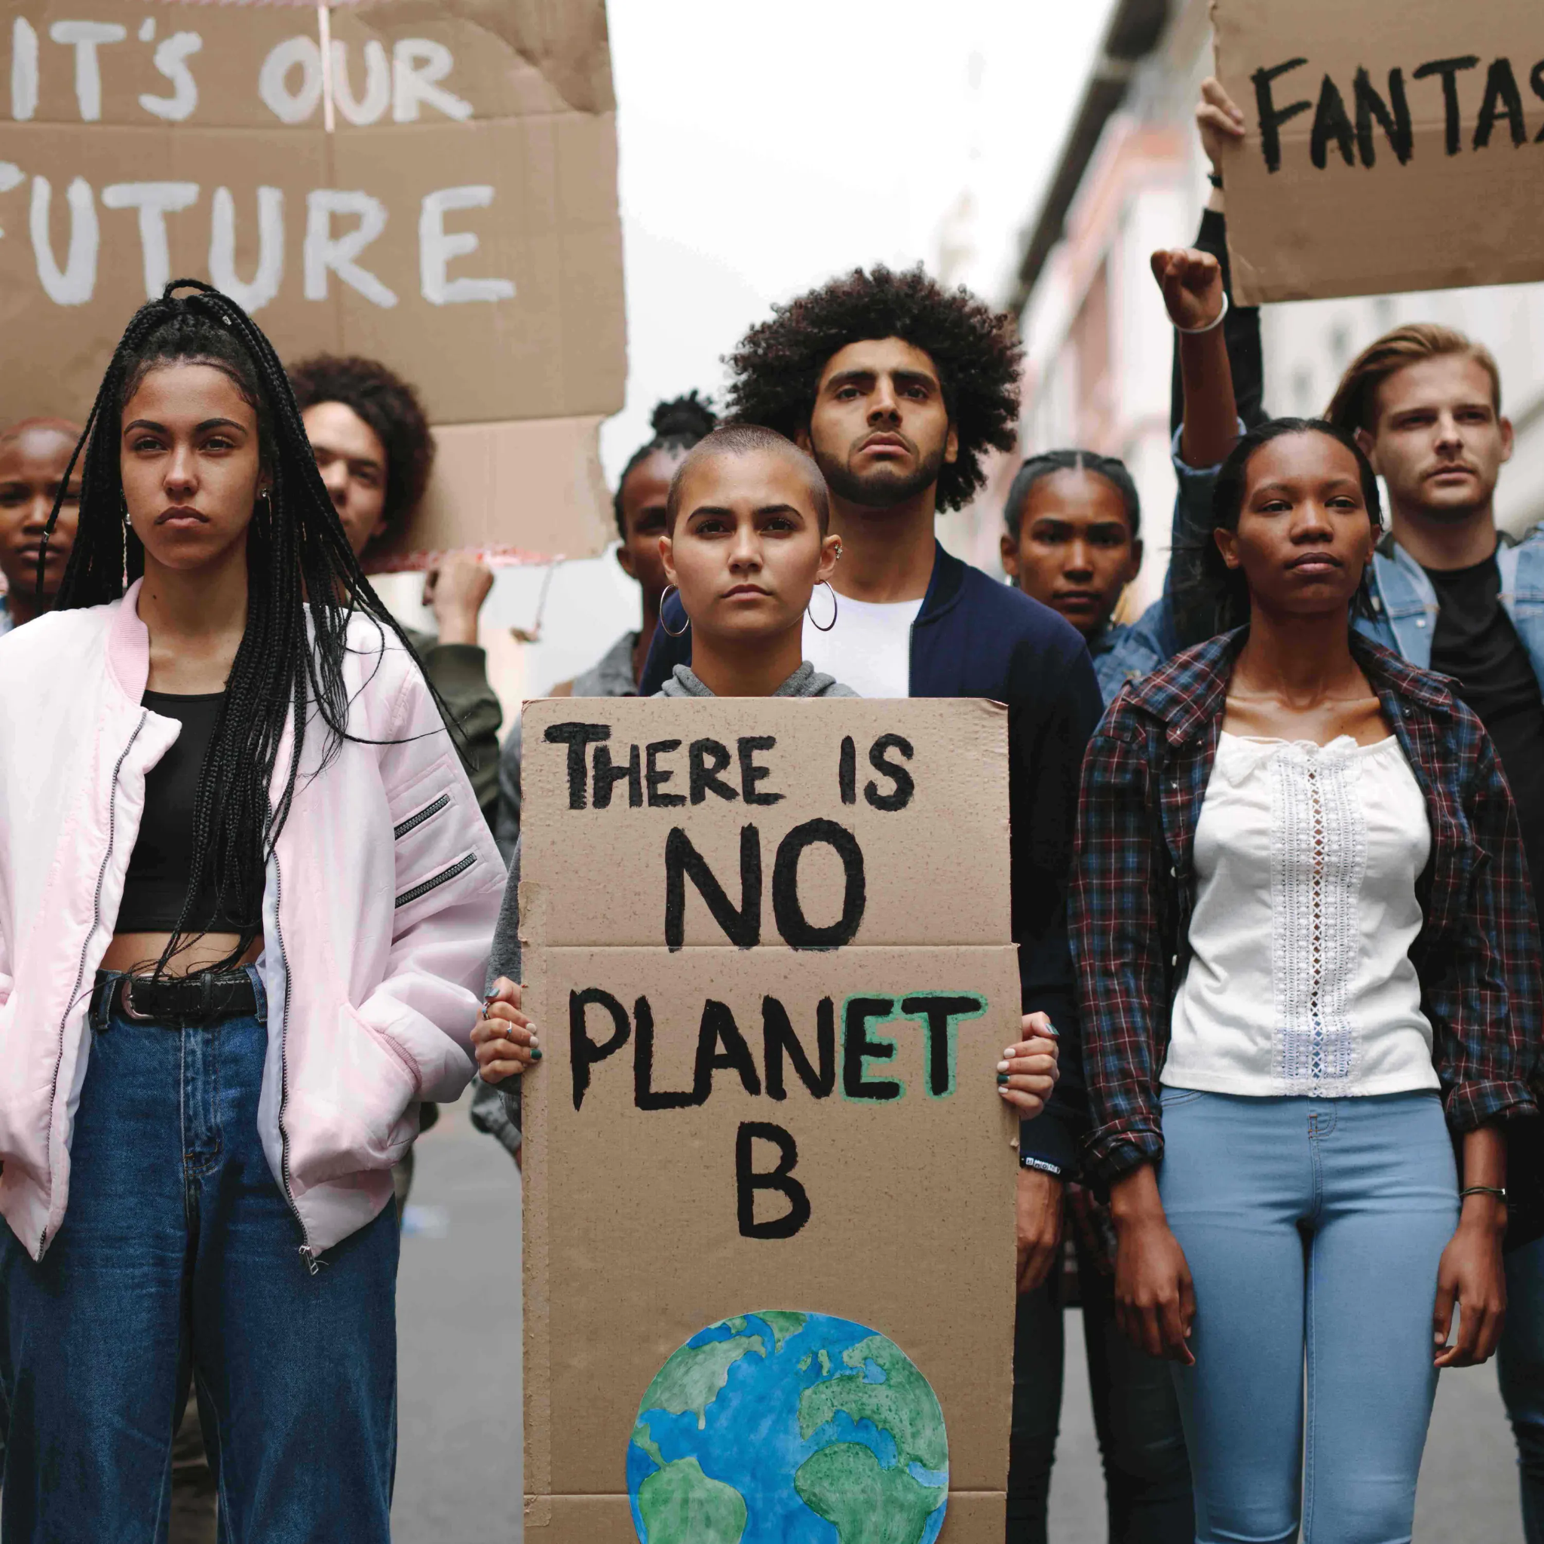
Put Our Plan Into Action
Module 4.4
Source: https://togetherband.org/blogs/news/young-climate-activists
AISciComm | Module 4.4 Put Our Plan Into Action Slide 1
Notes:
Link Module 4.4 Lesson Plan
BEFORE YOU START TEACHING
Review the Teacher Facilitation Guide for an overview of content and the curriculum as well as helpful facilitation suggestions.
Review AISciComm chatbot website to model and/ or support students.
Review the Science Communication Product Student Checklist (also in Science Journal p. 60) and Teacher Rubric to know the expectations of students.
Review possible student template options to provide students scaffolds and guidance:
Canva: https://www.canva.com/
Infographic templates: https://www.canva.com/infographics/templates/
Instagram templates: https://www.canva.com/instagram-posts/templates/
Board game idea templates: https://www.canva.com/templates/?query=board-game-interact
If students are creating a board game, they could use generative AI (e.g., ChatGPT, our AISciComm Default chatbot) to help them refine the rules of the game.
Throughout the program, students will be working in teams of three (preferably).
Make sure that you have a way to project a video with sound.
The science journal is intended to be a digital notebook. However, if you decide to print copies for students they may need a writing instrument (pen, pencil, etc.).
_____
Open the slideshow to slide 1 and introduce the lesson. Explain to students that now that we have tested their message with a chatbot, they will reflect on the interactions and refine their science communication plan.

Slide 2

Refine Your Message
Based on the chatbot conversation from Module 4.3, discuss in your project team:
What will you change about your science communication plan? Why?
What seems to work well with this audience? What evidence do you have from the conversations that supports this claim?
Image created with ChatGPT Prompt: Create an image about target audience bullseye.
Module 4.4 Put Our Plan Into Action Slide 2
Notes:
In their project team, students refine their science communication plans, based on the conversations they had with the target audience chatbots in Module 4.3. Advance to slide 2 to show students the guiding questions for Refine your Message:
Based on the conversations with the target chatbot, what will you change about your science communication plan? Why?
What seems to work well with this audience? What evidence do you have from the conversations that supports this claim?
Invite student teams to share their responses. Possible student ideas to listen for:
We realized our audience didn’t understand some scientific terms, so we need to simplify our language.
The chatbot responded well to visuals, so we will include more graphs and images.
Our message felt too negative; we want to add hopeful solutions to keep the audience engaged.
Our slogan worked really well. The chatbot repeated it back, which shows it was memorable.

Slide 3
Testing Your Message with a Broader Audience
As a class, discuss this scenario: you were building the chatbot based on one target audience group. Now consider:
How can we create opportunities for other audience groups to provide feedback on the science communication plan?
For example, can we recruit more people? Who, and how?
Module 4.4 Put Our Plan Into Action Slide 3
Notes:
Then, advance to slide 3 and invite students to discuss as a class: Testing your Message with a Broader Audience:
You were building the chatbot based on one target audience group. How can we create opportunities for other audience groups to provide feedback on the science communication plan?
Possible student ideas to listen for:
We could test our message with classmates who aren’t in our group to see if it makes sense to them.
We could show our infographic to family members or younger students for feedback.
We could run a quick survey (online or paper) with peers.
We could recruit other teachers.

Slide 4
Define Success
As a class, discuss the following questions to evaluate your plan.
How will you know if you are successful with your science communication plan?
How will you be able to tell if your audience has learned or begun to feel the way that you want them to?
Module 4.4 Put Our Plan Into Action Slide 4
Notes:
Advance to slide 4 and invite students to share ideas as a class:
Define Success:
How will you know if you are successful with your science communication plan?
How will you be able to tell if your audience has learned or begun to feel the way that you want them to?
Possible student ideas to listen for:
If the audience can repeat back our key message in their own words, we know it landed.
If they show interest or ask follow-up questions, that’s a good sign.
If they can identify at least one action they can take, that shows impact.

Slide 5
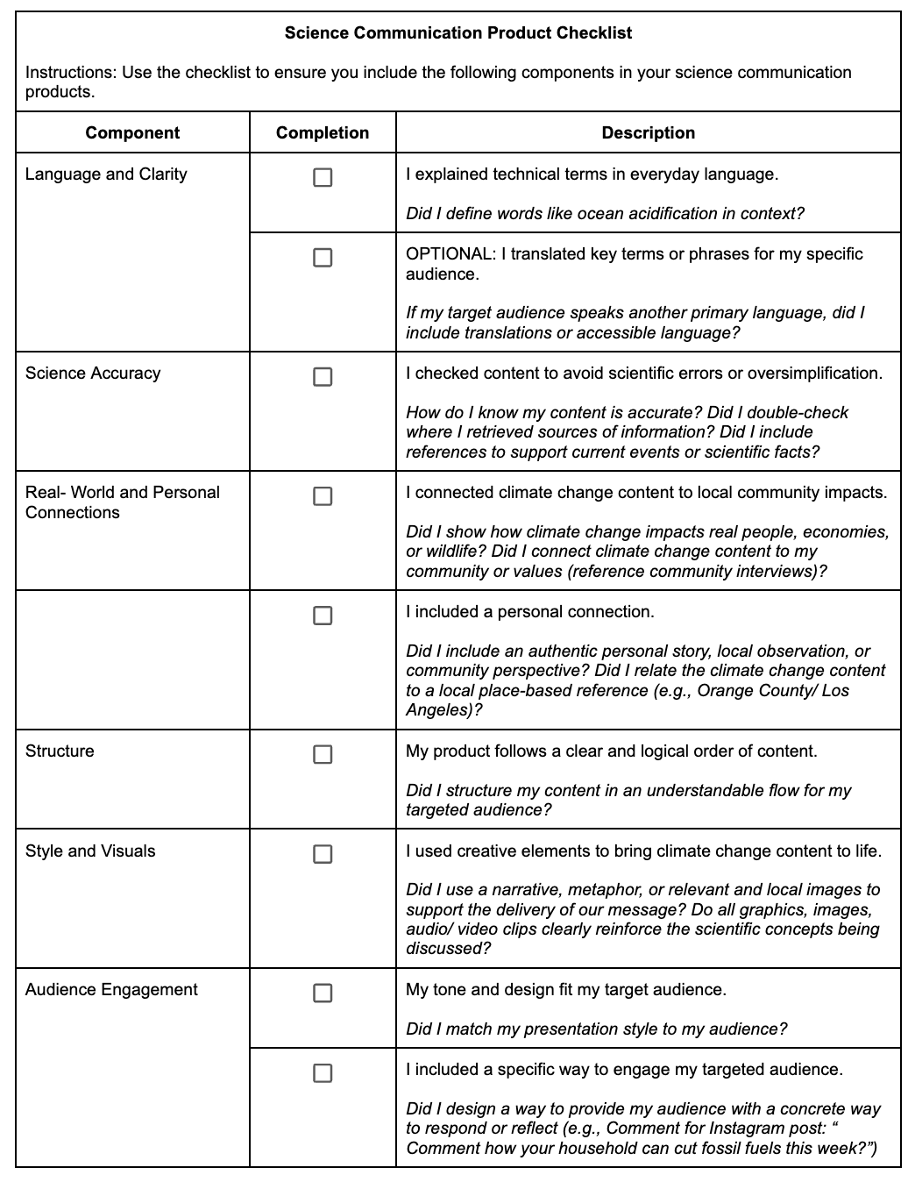
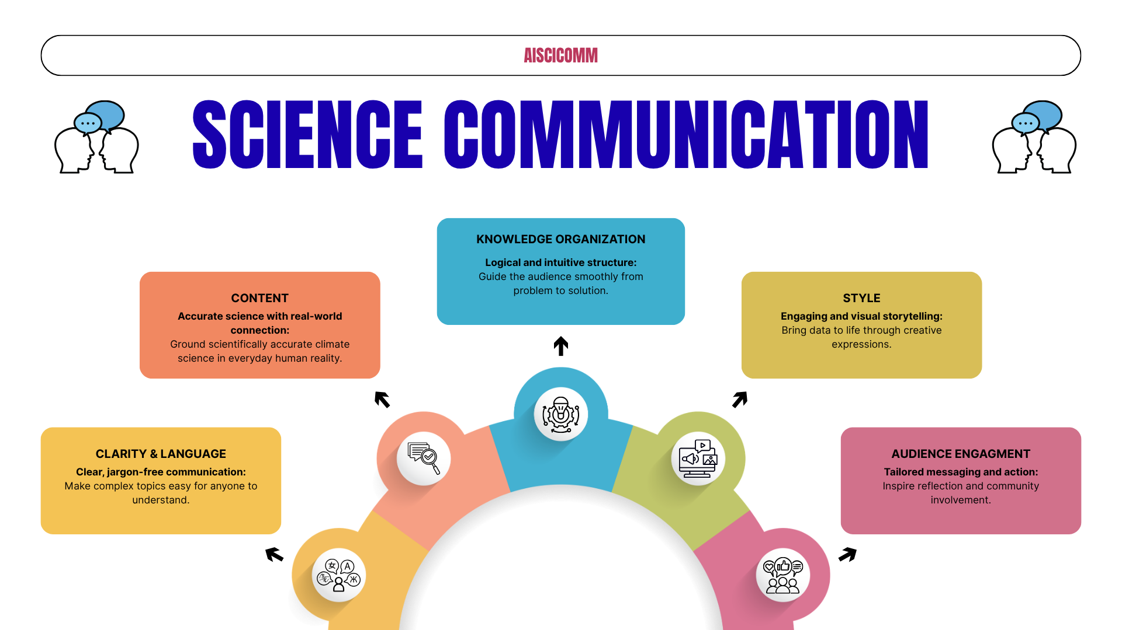
Science Communication Product Student Checklist
Module 4.4 Put Our Plan Into Action Slide 5
Notes:
Advance to slide 5 and reference student checklist

Slide 6
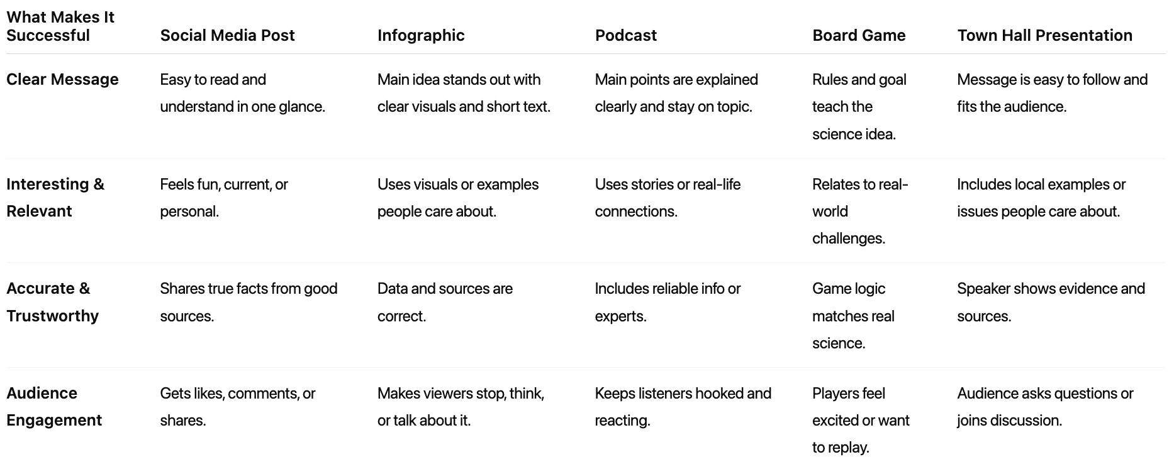
What does this look like for various products?
Module 4.4 Put Our Plan Into Action Slide 6
Notes:
Highlight for students that different science communication products may have different success criteria. Engagement for an online Instagram post that is measured by comments will be easier to gauge than a paper infographic.

Slide 7
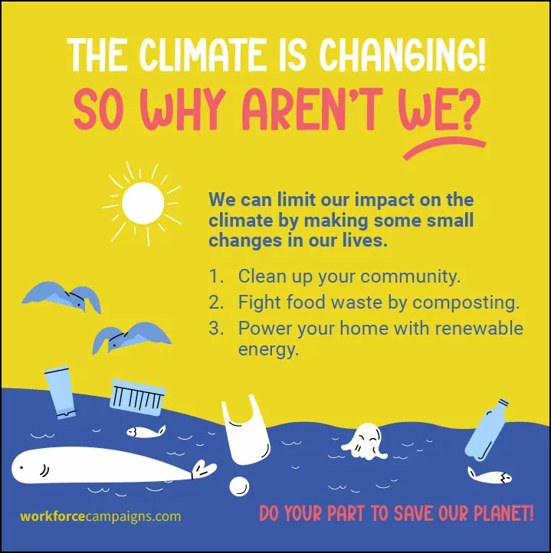
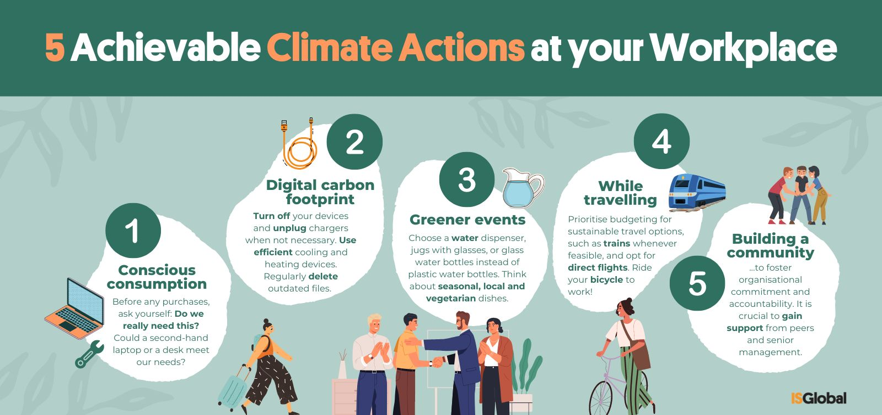
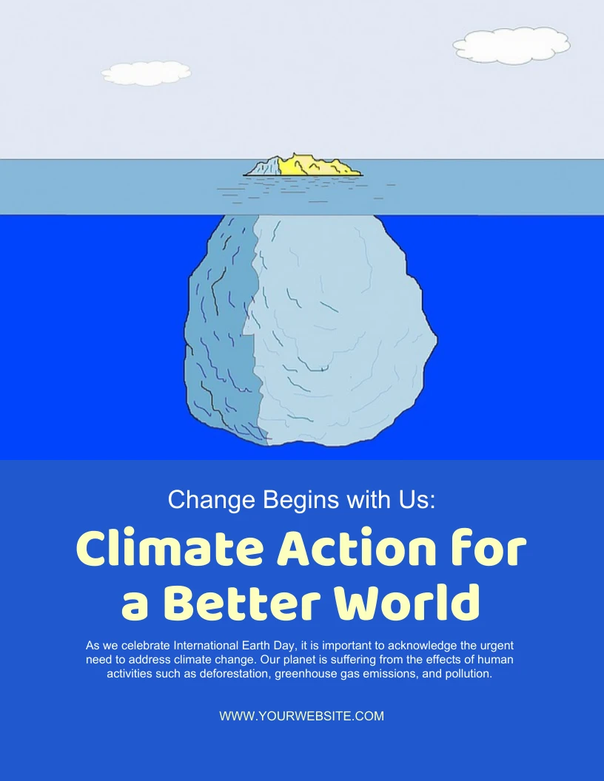
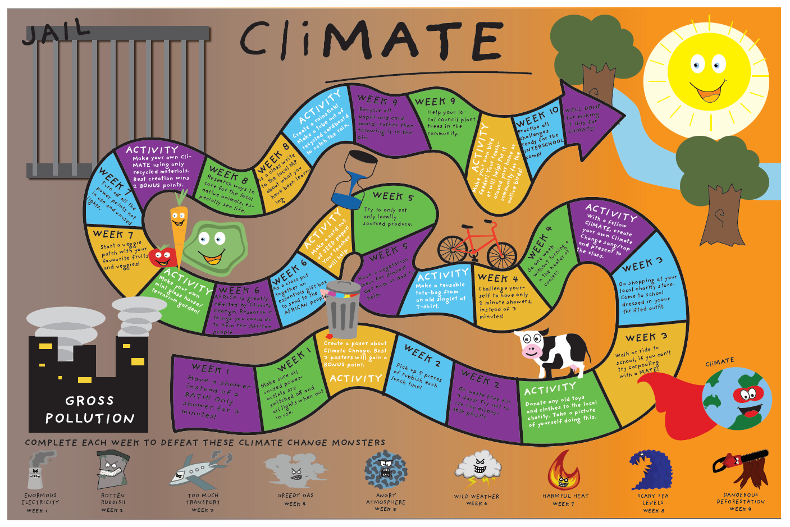
Work Time
In your project team, draft your science communication product. Canva can be a good tool. Visit science journal page 72 to view other resources.
Module 4.4 Put Our Plan Into Action Slide 6
Notes:
Advance to slide 7. In small groups (from previous lessons), students create their science communication products, based on the plans that they have created. Students can draft the products in Canva. Science Journal p. 72 shares directions and additional information.

Slide 8
Virtual Gallery Walk
We will be conducting a virtual gallery walk to see what other groups have worked on.
Download and upload a copy of your science communication product to the shared Google folder.
View other groups’ projects and take notes to share with your peers:
Which project team did you review?
What is the key message that the product seems to convey?
What part of this product helped you understand how climate change is impacting the Southern California ocean?
What did this group do well?
What suggestions do you have to make this product more complete, engaging, or clear?
Module 4.4 Put Our Plan Into Action Slide 7
Notes:
As students finish up their products, let them know that their next step will be to conduct a virtual gallery walk to see what others have worked on.
Advance to slide 8. Give students instruction to download a copy of their science communication product and upload it to a shared Google Folder.
Assign each project team to review the science communication product of another team. Have students write down on post-it notes or PearDeck their reviews:
Which project team did you review?
What is the key message that the product seems to convey?
What part of this product helped you understand how climate change is impacting the Southern California ocean?
What did this group do well?
What suggestions do you have to make this product more complete, engaging, or clear?

Slide 9

Reflect
Reflect on what you learned for module 4.4 by discussing in project teams and then adding to your science journal page 73.
In your team, discuss: What patterns did you notice as you conducted your gallery walk?
Were there any ideas or aspects you saw in other products that you would like to incorporate into yours?
What surprised you about the different ways teams communicated the same climate issue?
Image created with ChatGPT Prompt: Create an image about SoCal beaches.
Module 4.4 Put Our Plan Into Action Slide 8
Notes:
Advance to slide 9. As students finish up their gallery walk, invite them to take a look back at their product. Ask student teams to answer the following questions as a group, and then fill out their science journal (p.73).
What patterns did you notice as you conducted your gallery walk?
Were there any ideas or aspects you saw in other products that you would like to incorporate into yours?
What surprised you about the different ways teams communicated the same climate issue?

Slide 10




Thank you!
If you have any questions, please feel free to reach out.
Erick Valdez
Inside the Outdoors
evaldez@ocde.us
Ha Nguyen, Ph.D.
Assistant Professor, UNC
ha.nguyen@unc.edu

