Slide 1
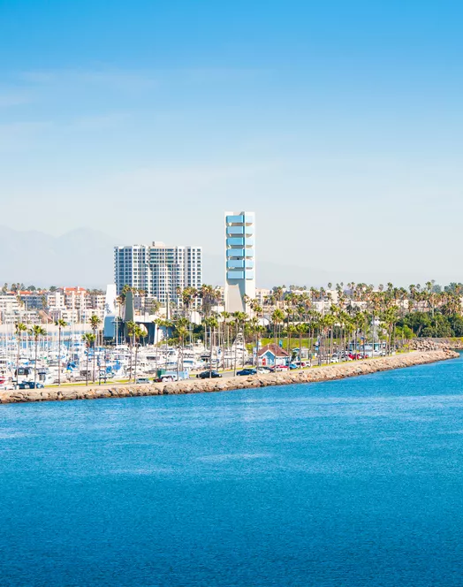
Planning Community Interviews
Module 1.2
AISciComm | Module 1.2 Planning Community Interviews
Notes:
Link to Module 1.2 Lesson Plan
BEFORE YOU START TEACHING
Review the Teacher Facilitation Guide for an overview of content and the curriculum as well as helpful facilitation suggestions.
Make a copy of the slideshow and make any appropriate changes for your class.
Make sure that you have a way to project a video with sound if you watch the interview etiquette videos.
The science journal is intended to be a digital notebook. However, if you decide to print copies for students, they may need a writing instrument (pen, pencil, etc.).
Optionally, you may want to provide a blank sheet of paper for students so they can easily reference their interview questions when they meet their interviewees.
Open the slideshow to Slide 1 and welcome the class for the day. Tell them that today, their goal is to continue their investigations to learn how Southern California’s ocean is being impacted by climate change.

Slide 2
Module 1.1 Recap
During module 1.1 you took the time to investigate how climate change is impacting Southern California’s ocean. With your team discuss the following questions.
What did you learn about how climate change might be affecting Southern California’s ocean?
How does climate change affect your experiences at the ocean?
What differences did you notice between using a search engine and generative AI ?
What are the pros and cons of each method?
Module 1.2 Planning Community Interviews Slide 2
Notes:
Advance to Slide 2 and invite students to discuss what they did in lesson 1.1. Use the following questions to help guide the conversation.
What did you learn about how climate change might be affecting Southern California’s ocean?
How does climate change affect your experiences at the ocean?
What differences did you notice between using a search engine and generative AI ?
What are the pros and cons of each method?

Slide 3
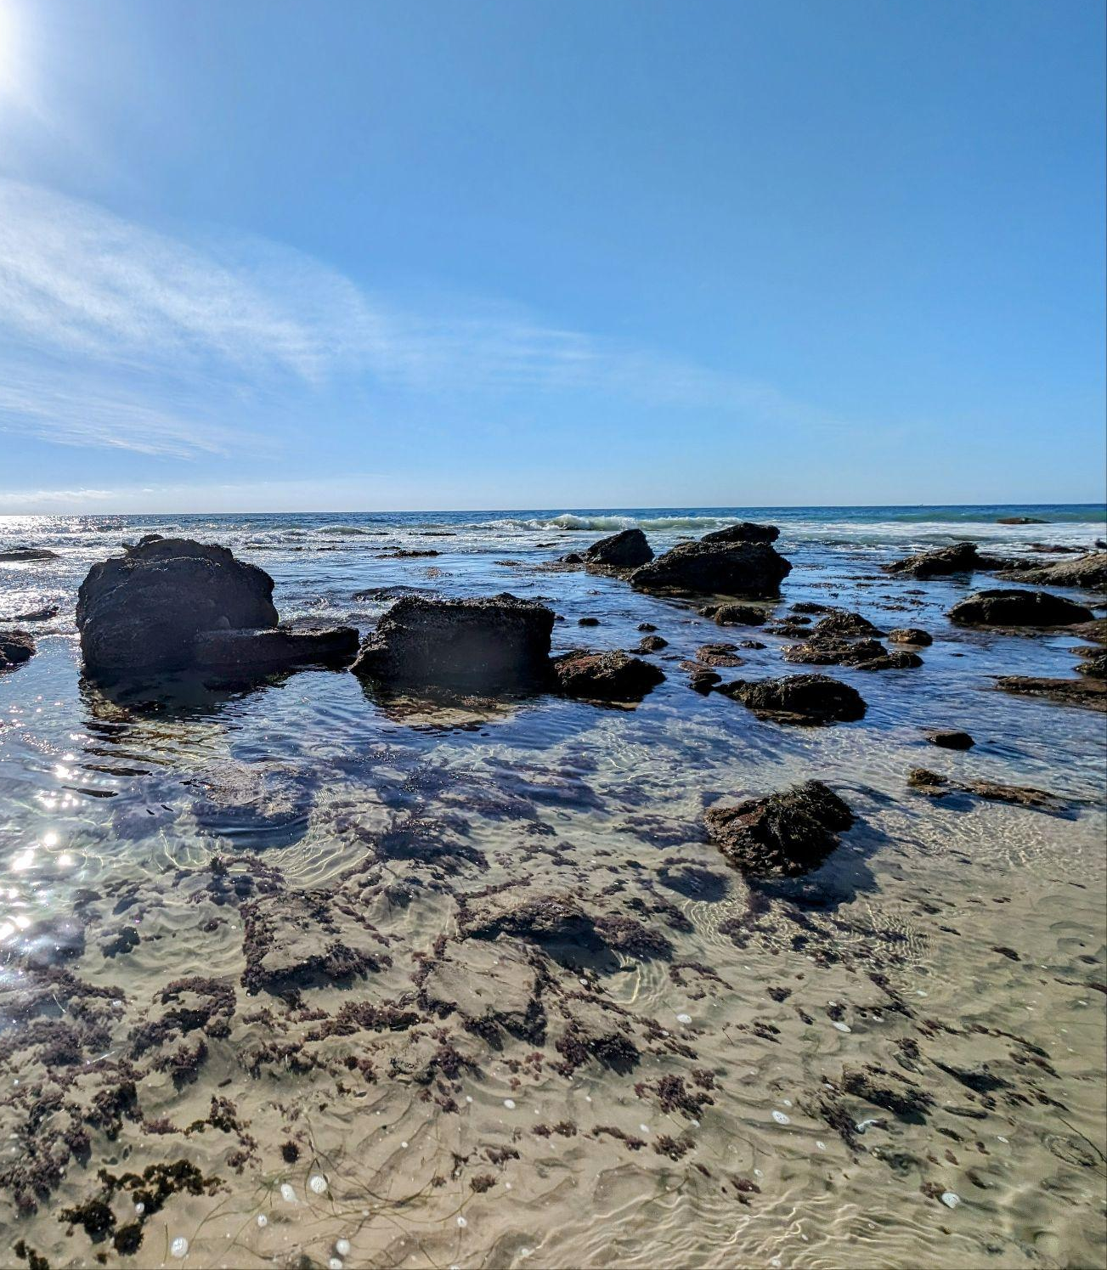
Module Overview
During module 1.2, you will:
Explore community members’ ideas on how climate change is impacting Southern California’s ocean.
Prepare to conduct an interview with the community member
Module 1.2 Planning Community Interviews Slide 3
Crystal Cove State Park
Newport Beach, California
Notes:
Advance to Slide 3 and give students the overview for the module.

Slide 4
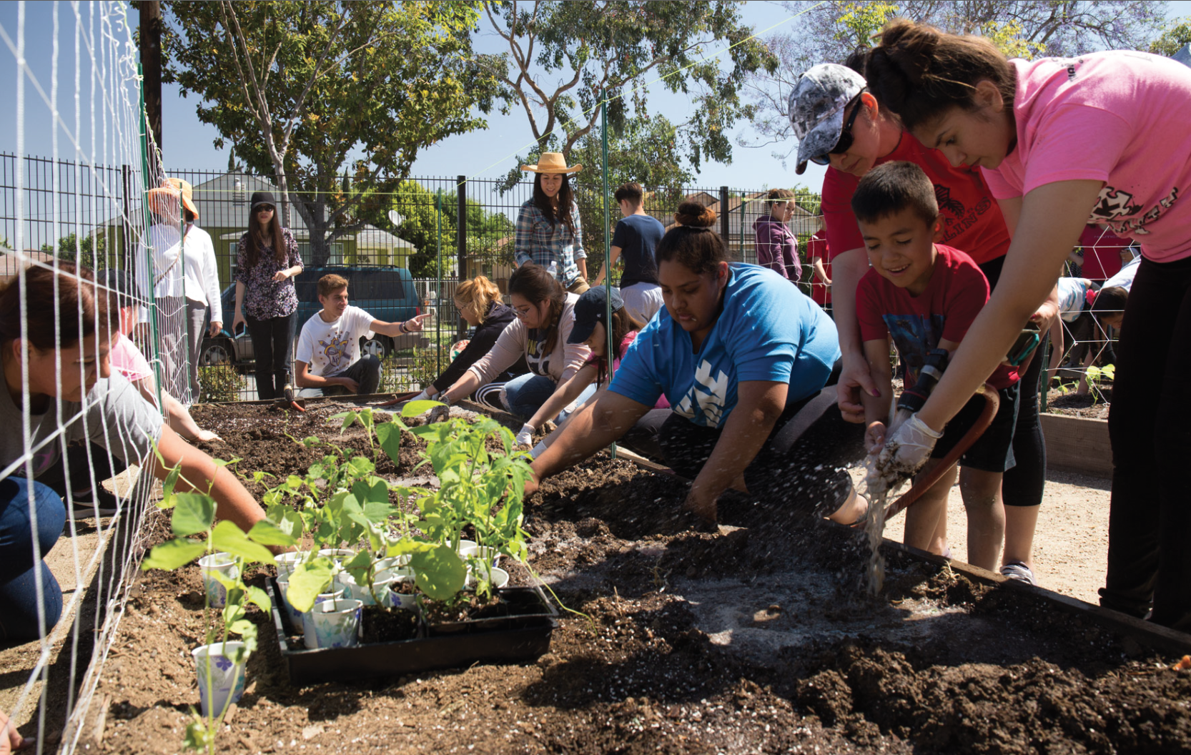
Conducting Interviews
One way to collect information is through conducting interviews. Discuss in a team:
What is an interview? What experience do you have with them?
Why do we use interviews? What can they help us learn?
Who might interview someone as part of their job?
When and where do interviews take place?
Community garden in Lynwood. Source: https://www.lynwoodca.gov/CivicAlerts.aspx?AID=78&ARC=113
Module 1.2 Planning Community Interviews Slide 4
Notes:
Advance to Slide 4 and tell students that another way in gathering information is conducting interviews. Inform them that they will use interviews to find out more about why our community cares about the ocean, and what they know about climate change.
To begin thinking about interviews, have students discuss the following questions with their team.
What is an interview? What experience do you have with them?
Why do we use interviews? What can they help us learn?
Who might interview someone as part of their job?
When and where do interviews take place?
If time allows, join the class together for a group discussion and tell students during lesson 1.2 they will step into the shoes of a social scientist and interview people to learn more about how the community feels about climate change on Southern California’s ocean.

Slide 5
How can interviews help us understand our community’s perspectives around how Southern California's ocean is changing?
Module 1.2 Planning Community Interviews Slide 5
Notes:
Wrap up activity and transition to the question of the day on Slide 5:
How can interviews help us understand our community’s perspectives around how Southern California's ocean is changing?
Give students 1-2 minutes to discuss in small groups, and then ask for volunteers to share.
Tell students that their next goal is to interview someone to help them understand the community’s perspective around how Southern California’s ocean is changing.

Slide 6
Planning your Interview
With your team, identify who may be someone you want to interview:
Examples of individuals you may interview may include:
A family member who fishes on the weekend
A person who enjoys eating seafood
A teacher who teaches marine biology
A lifeguard
A local artist that paints the ocean
A person who runs on the beach
Someone who lives on or near the coast
Module 1.2 Planning Community Interviews Slide 6
Notes:
Advance to Slide 6 and inform students that their first task in planning for their interview is to determine who they may want to interview. Tell students that the slide shares examples of individuals they may interview and give them a moment to identify someone to interview.

Slide 7

Planning your Interview
With your team, you will create an interview protocol. The protocol will answer the following:
Who you are interviewing?
What questions will you ask your interviewee?
What roles will each team member play?
Image created with ChatGPT Prompt: Generate an image, in a minimalistic style, that shows two individuals participating in a community interview.
Module 1.2 Planning Community Interviews Slide 7
Notes:
Advance the slideshow to Slide 7 and inform them that just like social scientists plan their interviews, they will have to as well. When they plan their interviews they will have to think about creating an interview protocol, which answers the following questions:
Who will you be interviewing?
What questions will you ask your interviewee?
What roles will each team member play?

Slide 8
Question Bank
With your team, prepare 3-4 questions for your interview (Science Journal, p.3). Below are a couple of questions you may consider asking. If you’d like, feel free to make your own questions!
What experiences do you have with the ocean?
Do you care about the ocean? Why or why not?
What’s a memorable day or experience you had interacting with the ocean or at the beach?
How have you noticed changes in the ocean affecting your daily life (family, job, or culture)?
How has your work as a [occupation] changed due to shifts in fish populations/rising water temperatures/etc.?
What do you wish more people understood about climate change and the ocean?
Can you share a personal experience that made you realize climate change was affecting the ocean?
What role do humans play in both causing and solving these issues?
What do you think will happen to [object or location] in the future?
How does [your experience] compare to how it was 10 years ago?
Module 1.2 Planning Community Interviews Slide 8
Notes:
To help students think about what types of questions they might want to ask, advance to Slide 8 to display a question bank of potential questions. Tell students to prepare 3-4 questions to get them started and add them to on Module 1.2: Planning Community Interviews (Student Task: Interview Planning), page 3 of their Science Journals. If they would like, they could create their own questions.
While students work, walk around the room to check in on each group or provide support when needed. During this time, make note of a few interview plans to showcase in the Expand activity where they will work on the Lesson 1.2 Interview Etiquette Worksheet, which starts on Module 1.2 Part 1: Planning Community Interviews (Student Task: Interview Etiquette), page 4-5 in the Science Journal.
Once teams have created their interview plan, bring the whole class back together. Tell them that their next step is to work with another team to refine their interview plan.

Slide 9
Refining interview plans
Share your interview plans with another team. Provide feedback using the following guiding questions:
Are the interview questions clear and specific?
Do they make sense? Would the interviewee understand what’s being asked?
Do the interview questions encourage a detailed answer rather than a simple “yes” or “no”?
Are the interview questions relevant and connect to climate change and the ocean?
Are the interview questions unbiased and neutral?
Do they allow for honest responses without leading the interviewee?
Are the interview questions engaging and invite personal stories, experiences, or expert knowledge?
Module 1.2 Planning Community Interviews Slide 9
Notes:
Once student teams are paired together, advance to Slide 9. Have student teams share their plan with each other and then refine their plans using the feedback they receive. Below are questions that can help guide the conversation:
Are the interview questions clear and specific?
Do they make sense? Would the interviewee understand what’s being asked?
Do the questions encourage a detailed answer rather than a simple “yes” or “no”?
Are the interview questions relevant and connect to climate change and the ocean?
Are the interview questions unbiased and neutral?
Do they allow for honest responses without leading the interviewee?
Are the interview questions engaging and invite personal stories, experiences, or expert knowledge?
As students are talking with each other, walk around and provide support where students have questions. If time allows, get the group back together and have a group share their interview plan.

Slide 10
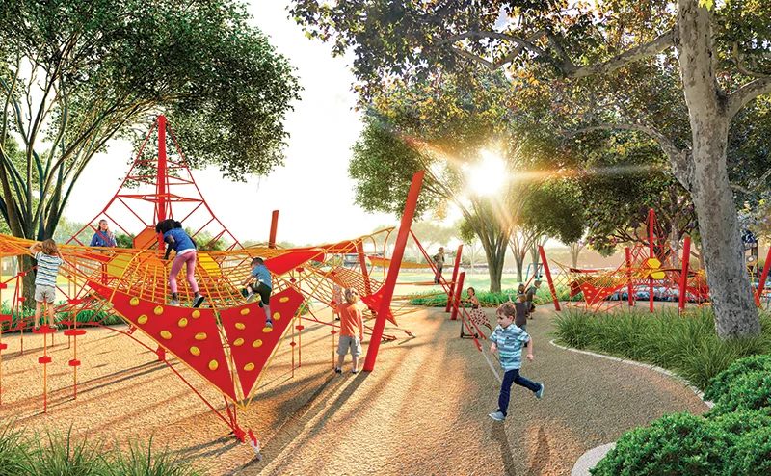
Interview Etiquette
With your group go through the Module 1.2 Interview Etiquette Worksheet. Examine if each excerpt demonstrates proper interview etiquette
What are examples of effective vs ineffective interview etiquette?
If it is not effective, what can be improved?
Space Exploration Park in Lynwood. Source:https://landscape architect.com/landscape-articles/space-exploration-park
Module 1.2 Planning Community Interviews Slide 10
Notes:
Pick from 1 of the 2 options: Worksheets or Videos
Tell students that another area that social scientists focus on before and during their interview is their interview etiquette, or a guide on how to behave in a social setting like an interview.
To identify the best practices in interview etiquette tell students that they will observe what makes an interview effective or ineffective and why. The educator can pick from one of the following options:
Activity Option 1: Lesson 1.2 Interview Etiquette Worksheet
Advance to Slide 10 and ask students to find the interview etiquette page in their science journals (p. 4-5).
With their teams, have students go through the three excerpts and state why the situation demonstrates proper interview etiquette.
What are examples of effective vs ineffective interview etiquette?
If it is not effective, what can be improved?
Once students are done, bring the class together to discuss and come up with a list of ideal mannerisms for their interviews.
Activity Option 2: Interview Videos
Advance to Slide 11 where there are two videos. One video portrays effective interview etiquette, the other videos portrays ineffective interview etiquette.
As students watch the interviews, have them note down their observations.
Once both videos have been watched, bring the class back together to discuss.
What are some similarities and differences between both videos?
What are examples of effective vs ineffective interview etiquette?
Bring the class together after the activity and share that they will create a list containing qualities of a good interview.

Slide 11
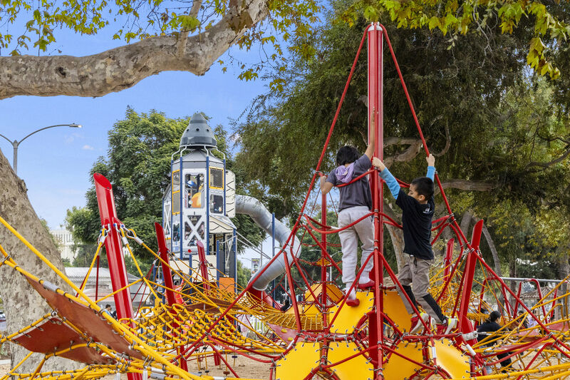
Interview Etiquette
With your group watch the following videos and determine how interview etiquette is portrayed in them.
Video 1 | Video 2
What are some similarities and differences between both videos?
What are examples of effective vs ineffective interview etiquette?
Space Exploration Park in Lynwood. Source:https://landscapearchitect.com/landscape-articles/space-exploration-park
Module 1.2 Planning Community Interviews Slide 11
Notes:
Pick from 1 of the 2 options: Worksheets or Videos
Video 1: https://www.youtube.com/watch?v=OVAMb6Kui6A&ab_channel=KatherineJohnson
Video 2: https://www.youtube.com/watch?v=UJJrBX8YpWA
Tell students that another area that social scientists focus on before and during their interview is their interview etiquette, or a guide on how to behave in a social setting like an interview.
To identify the best practices in interview etiquette tell students that they will observe what makes an interview effective or ineffective and why. The educator can pick from one of the following options:
Activity Option 1: Lesson 1.2 Interview Etiquette Worksheet
Advance to Slide 10 and ask students to find the interview etiquette page in their science journals (p. 4-5).
With their teams, have students go through the three excerpts and state why the situation demonstrates proper interview etiquette.
What are examples of effective vs ineffective interview etiquette?
If it is not effective, what can be improved?
Once students are done, bring the class together to discuss and come up with a list of ideal mannerisms for their interviews.
Activity Option 2: Interview Videos
Advance to Slide 11 where there are two videos. One video portrays effective interview etiquette, the other videos portrays ineffective interview etiquette.
As students watch the interviews, have them note down their observations.
Once both videos have been watched, bring the class back together to discuss.
What are some similarities and differences between both videos?
What are examples of effective vs ineffective interview etiquette?
Bring the class together after the activity and share that they will create a list containing qualities of a good interview.

Slide 12
Interview Etiquette
As a class, work together to build a list containing the qualities of good interview etiquette. You can refer to this list as you prepare to conduct your interview
The qualities that make for good interview etiquette are:
Module 1.2 Planning Community Interviews Slide 12
Notes:
Bring the class together after the activity and share that they will create a list containing qualities of a good interview.
Advance to Slide 12, which asks the class to build a list containing the qualities of good interview etiquette. As students answer, fill in the list on the slideshow.

Slide 13
Get Ready to Conduct Your Interview!
It is time to conduct your interview! With your team, prepare to conduct the interview.
Below are a couple of things to keep in mind for conducting your interview.
Think of where the interview will take place. Is it in-person or online?
Prepare who will ask the questions. You can share this responsibility with your whole group
Review your questions ahead of time.
Make sure to take good notes.
Be respectful and professional.
Module 1.2 Planning Community Interviews Slide 13
Notes:
Advance to Slide 13. If time allows, give students a couple of extra minutes to make further revision to their interview plan after learning more about interview etiquette.
Make sure to remind students to ask interviewees if it is ok to take notes and audio record the interview. Students may use Module 1.2 Part 2: Conducting Community Interviews (Student Task: Optional Interview Notes) in the Science Journal (p. 7) as space to type their questions and responses from interviews (Notes will be used for the next analysis in Lesson 1.3.)

Slide 14

Reflect
Reflect on what you learned in your Science Journal (p.6) for Module 1.2:
What did you learn about planning and preparing for your community interview? How has your thinking about asking questions or gathering information changed?
What do you hope to learn from your community interviews?
What questions do you still have before conducting your interview? How could you find answers or prepare?
Image created with ChatGPT Prompt: Create an image about SoCal beaches.
Module 1.2 Planning Community Interviews Slide 14
Notes:
Advance to Slide 14 and as students wrap up, give them time to reflect back on their experiences during lesson 1.2 on Module 1.2 Part 1: Planning your Community Interviews (Student Reflection) (p. 6) of their Science Journal.
What did you learn about planning and preparing for your community interview? How has your thinking about asking questions or gathering information changed?
What do you hope to learn from your community interview?
What questions do you still have before conducting your interview? How could you find answers or prepare?

Slide 15




Thank you!
If you have any questions, please feel free to reach out.
Erick Valdez
Inside the Outdoors
evaldez@ocde.us
Ha Nguyen, Ph.D.
Assistant Professor, UNC
ha.nguyen@unc.edu
Module 1.2 Planning Community Interviews Slide 15
Notes:
Advance to Slide 15 and thank the students for their time. Allow students to ask any questions they may have before they conduct their interviews. In the next lesson, students will analyze the results of their interview.

