Slide 1

Carbon Dioxide
& Weather
Module 3.2
Day 1
Santa Monica, CA
Credit: Richard Sharrocks
AISciComm | Module 3.2 Carbon Dioxide & Weather
Notes:
Link to Module 3.2 Lesson Plan
BEFORE YOU START TEACHING
Review the Teacher Facilitation Guide for an overview of content and the curriculum as well as helpful facilitation suggestions.
For Day 2, Review Student PhET Instructions (also in Science Journal, p. 30-33) to model or support students. Explore Greenhouse Effect: Waves Simulation.
Include a numbered list of general steps to set up the investigation before students arrive.
This can also include other things that educators should do or think about before starting the lesson, such as checking for safety concerns.
_____________
As class begins, welcome students to the classroom and remind them that today, they will continue learning about carbon dioxide and its impact on the environment, and ultimately, how changes to carbon dioxide levels will impact the values they place on the ocean.

Slide 2
Lesson Objectives
By the end of this lesson, you will be able to…
Explain how an increase in atmospheric carbon traps heat energy on Earth.
Draw a model showing how increased levels of carbon dioxide in the Earth’s atmosphere is acting as a blanket and trapping more heat.
Explain how rising atmospheric carbon levels trap heat and influence Earth’s climate.
Predict how increasing temperatures might affect processes in Southern California’s ocean, both now and in the future.
Module 3.2 Carbon Dioxide & Weather Slide 2
Notes:
Open the slideshow to Slide 2 to introduce students to the overview of Lesson 3.2.

Slide 3
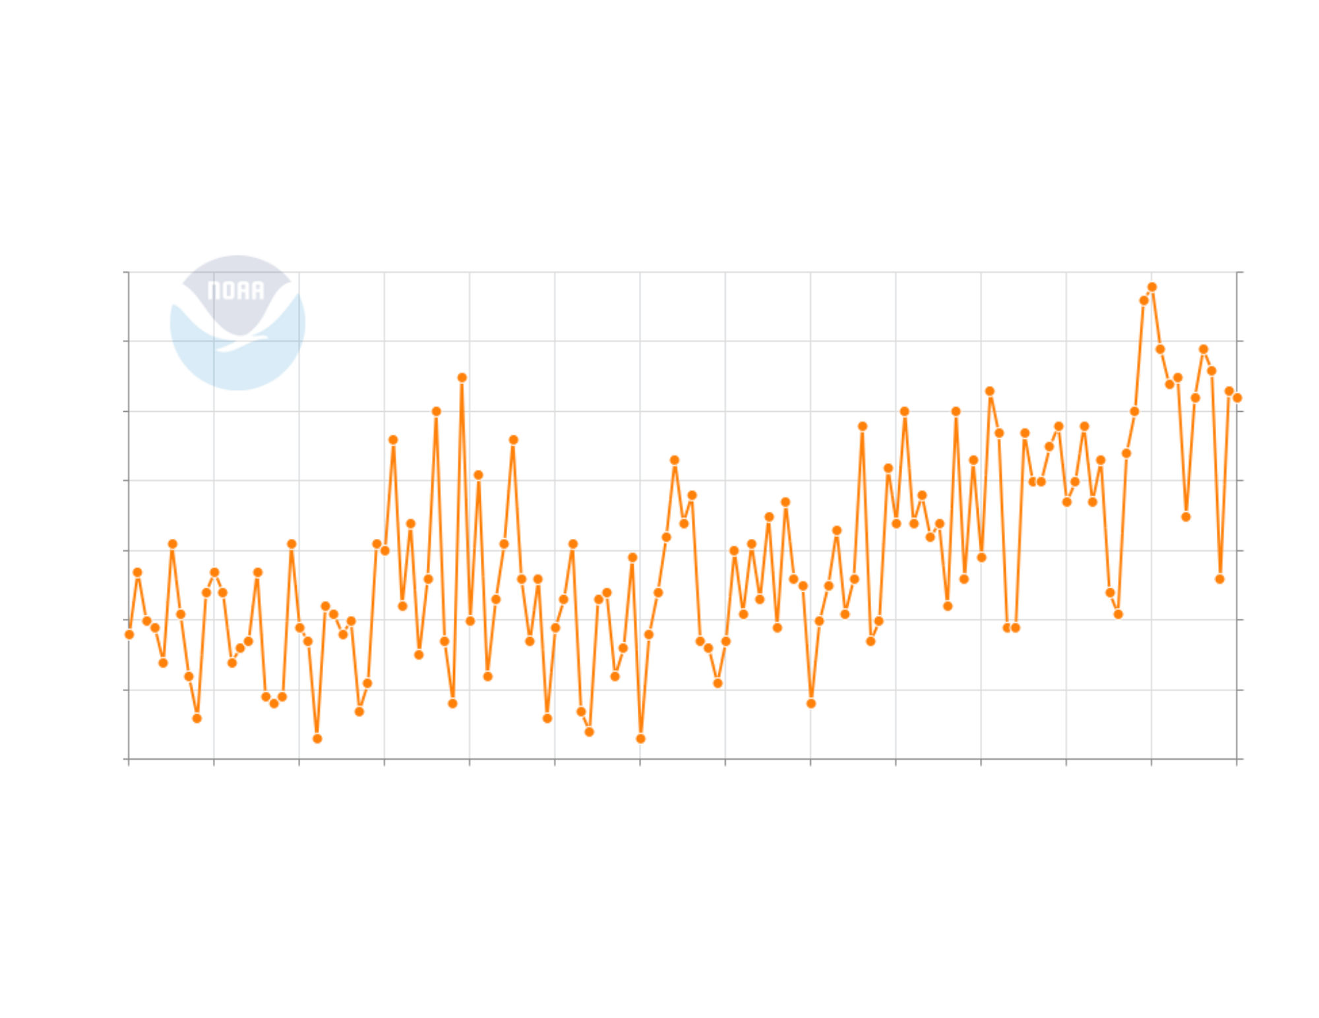
Making an Observation
What do you notice?
What do you wonder?
How would you describe the trends that you see?
Module 3.2 Carbon Dioxide & Weather Slide 3
Notes:
Tell students that for the first task of the lesson, you would like them to work with a partner to make some observation of a graph in the next few slides.
Over the next few slides, students will make observations on a slow reveal graph from NOAA, that shows the average temperature from 1895-2025 in the state of California.
Advance to Slide 3, where students will see the first part of a line graph with no axis or title. Ask students:
What do you notice? What do you wonder?
How would you describe the trends that you see?

Slide 4
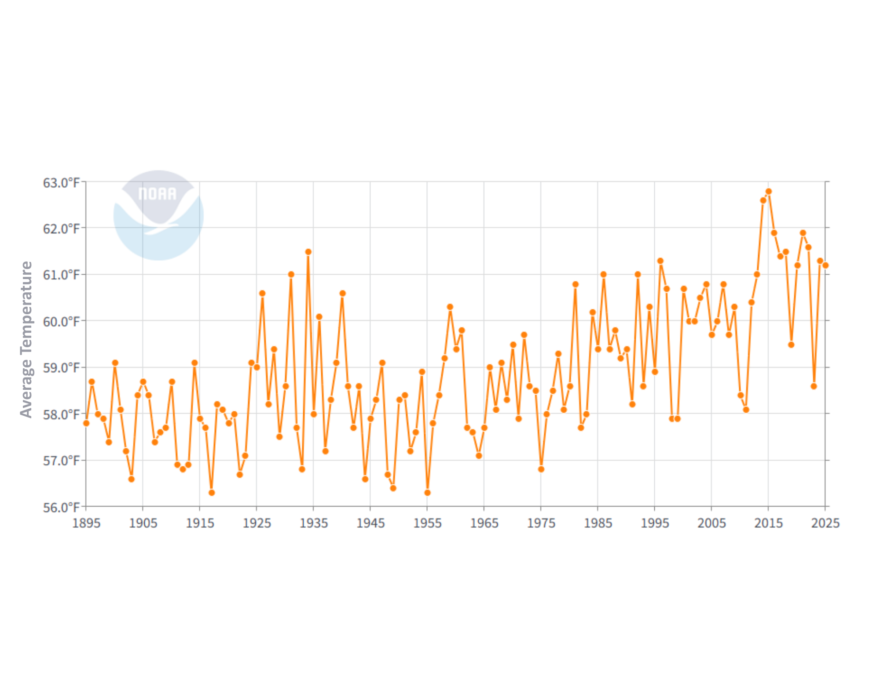
Making an Observation
What do you notice?
What do you wonder?
How would you describe the trends that you see?
Module 3.2 Carbon Dioxide & Weather Slide 4
Notes:
After students have had a chance to share, advance to Slide 4, and reveal the x-axis which shows the years 1895-2025 and the y-axis that shows the average temperature. Ask students:
What new information do you have? What else do you wonder?
How would you describe the trends that you see?

Slide 5
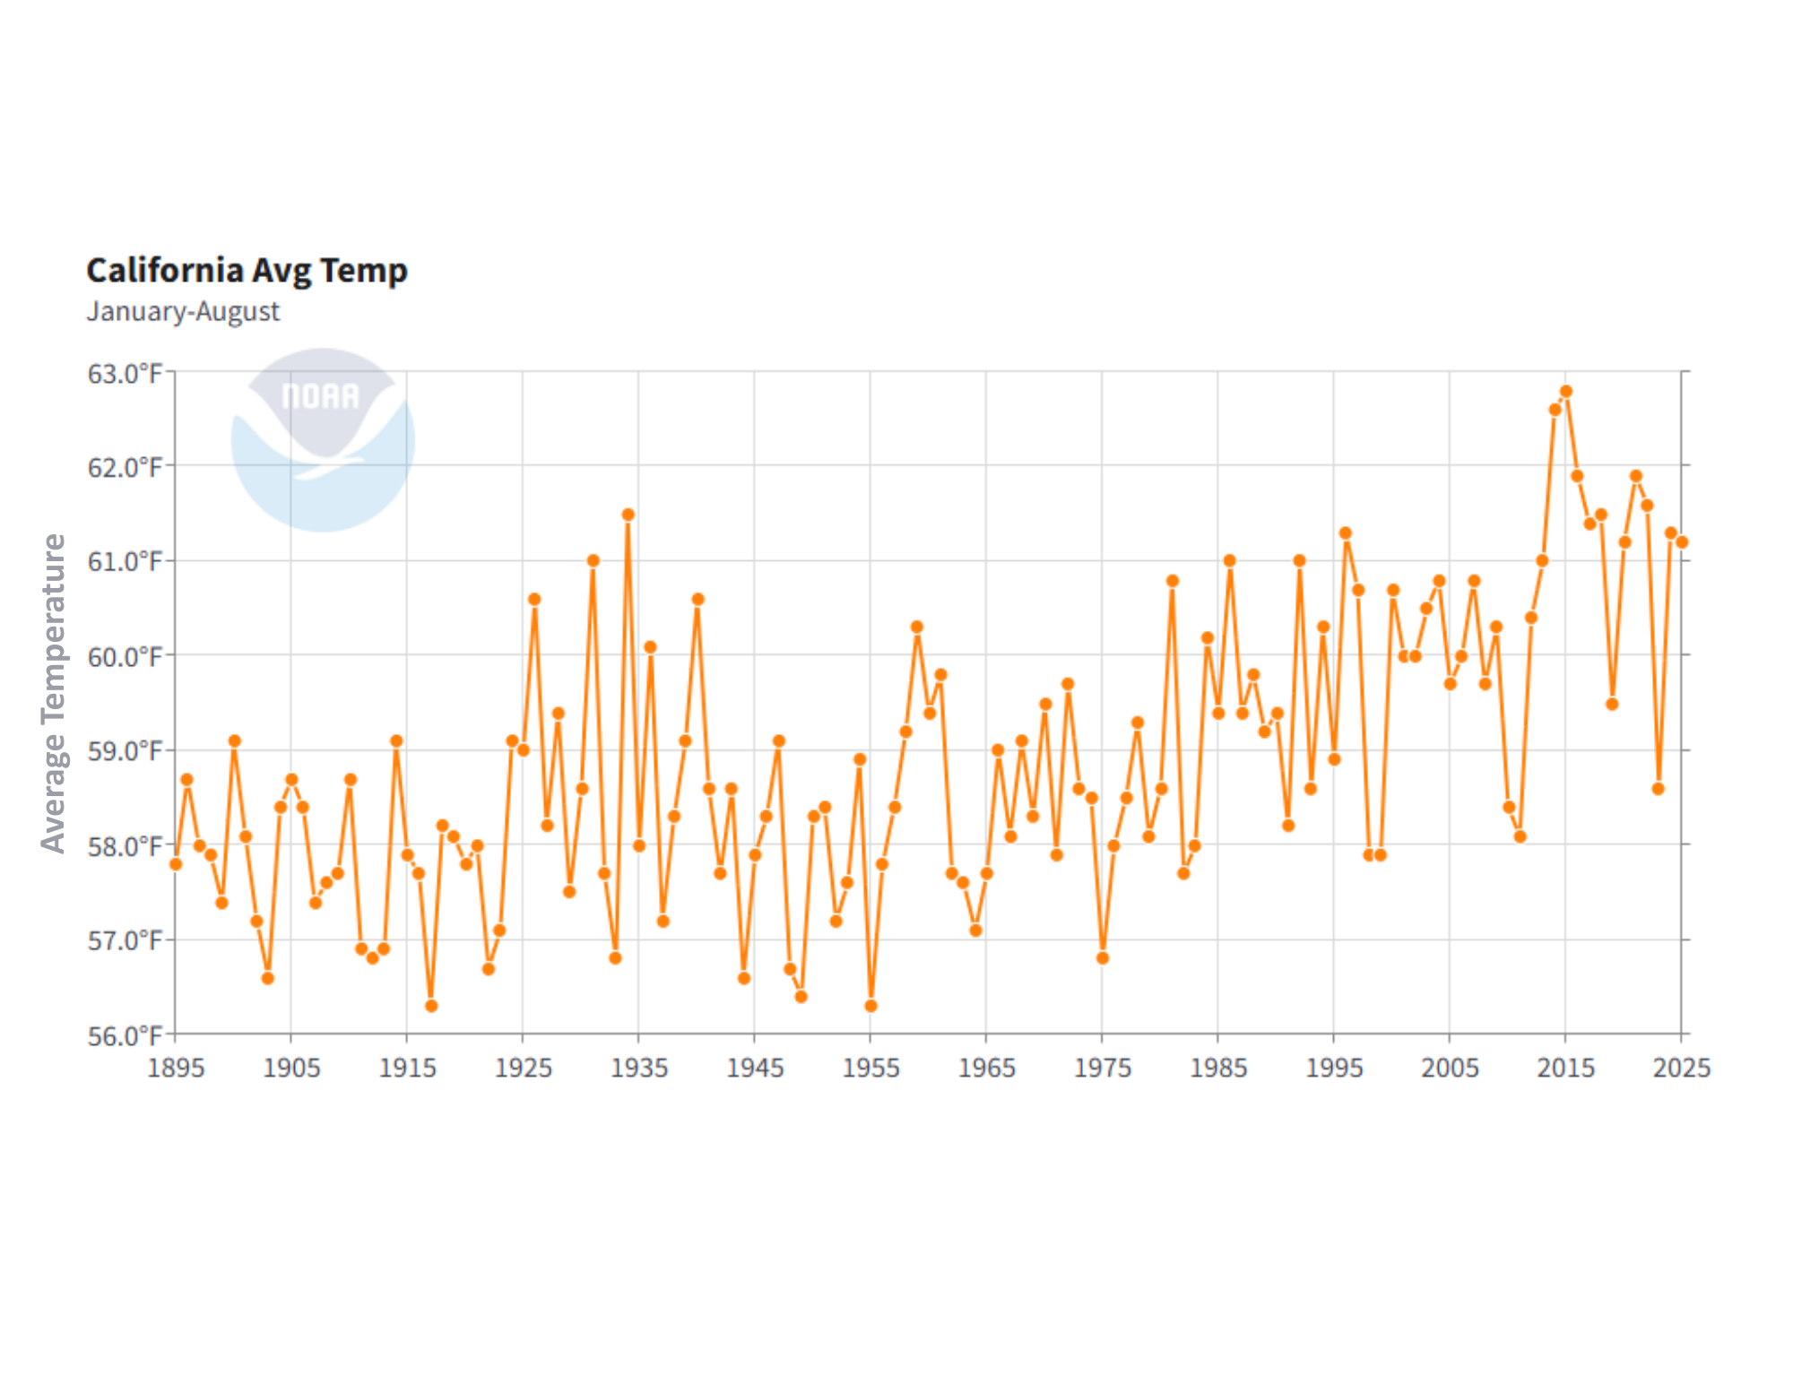
Making an Observation
How would you describe the trends that you see now that you have this new information?
Module 3.2 Carbon Dioxide & Weather Slide 5
Notes:
Next advance to Slide 5, which shows the title of the graph. Give students another moment to think and ask them:
How would you describe the trends that you see now that you have this new information?

Slide 6
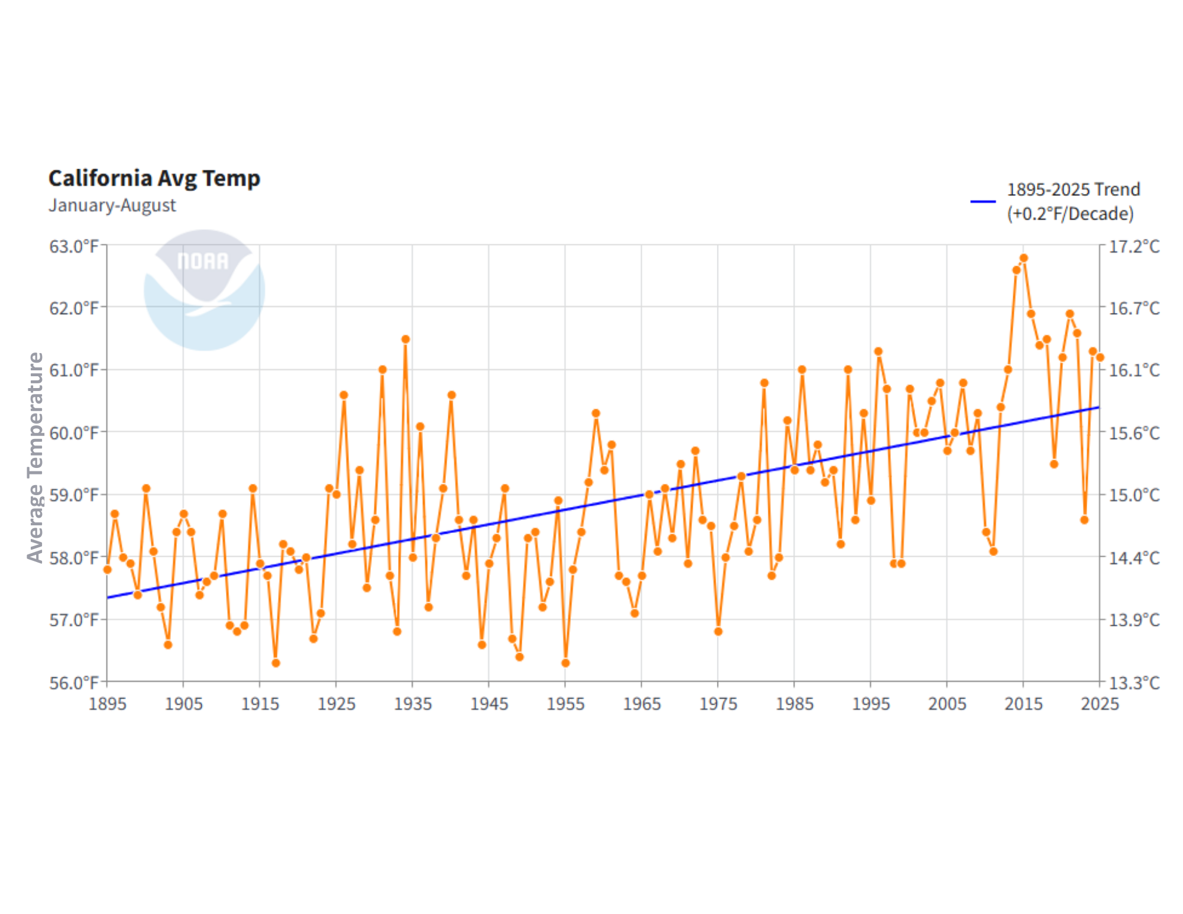
Making an Observation
What do you notice about this new information?
What is it telling us?
Why do you think we are noticing this trend?
Module 3.2 Carbon Dioxide & Weather Slide 6
Notes:
Lastly, advance to Slide 6 to add the 1895-2025 trendline to the graph. Ask students:
What do you notice about this new information? What is it telling us?
Why do you think we are noticing this trend?
Tell students that today, they are going to begin exploring what is causing the trend they are seeing with temperature in California.

Slide 7

Making an Observation
Where is heat coming from in this picture?
Where does the heat go once it leaves its source?
Heat energy
Heat energy
Heat energy
Module 3.2 Carbon Dioxide & Weather Slide 7
Notes:
To begin exploring how the average temperature has changed in California over time, tell students that you will first explore a scenario they can relate to, keeping warm at night.
Advance the slideshow to Slide 7, where you see an image of a person laying in bed without a blanket. Ask the class the following questions.
Where is heat coming from in this picture?
Where does the heat go once it leaves its source?
As students share their responses, transition the slideshow to display arrows that show heat moving from the heat source (person) into the open air.
Then ask students:
What would you do if you needed to keep warm?

Slide 8

Making an Observation
Where is heat coming from in this picture?
Where does the heat go once it leaves its source?
Module 3.2 Carbon Dioxide & Weather Slide 7
Notes:
Once students share, reinforce ideas that relate to putting on extra layers, like a blanket. Advance to Slide 8 where you see the same image, but this time, with a blanket covering the person. Ask the class the following questions.
Where is heat coming from in this picture?
Where does the heat go once it leaves its source?
As students share responses, listen for responses that you could build upon later, such as the blanket trapping heat.

Slide 9
How does this process apply to the Earth?
To see how this process applies to the Earth, you and your team will create a drawn model.
Module 3.2 Carbon Dioxide & Weather Slide 9
Notes:
Advance to Slide 9 and tell students that you would like for them to now apply what they have just discussed to a similar process with Earth. To do so, they will draw a model.

Slide 10
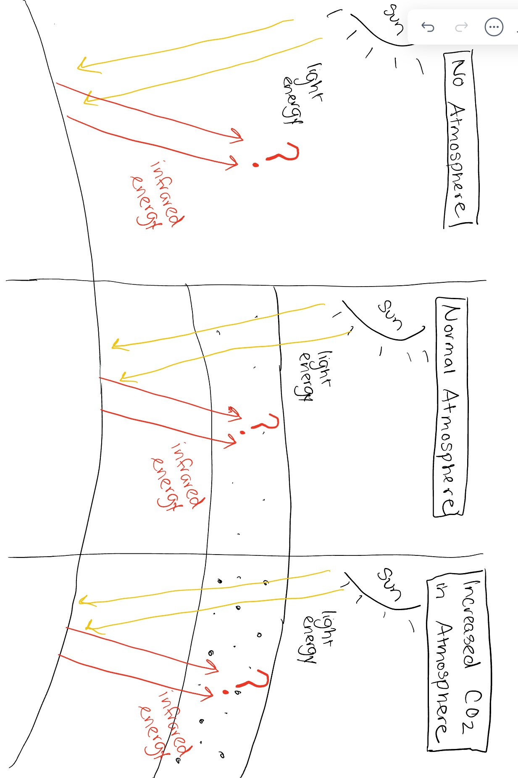
Modeling Earth’s Processes
Take a piece of paper and split it into two equal halves or use Science Journal p. 28. Use the image on the right as a framework to help you think about how light energy interacts with Earth.
How do you think the sun’s light energy interacts with Earth? How does it interact with the atmosphere?
Think back to the blanket model, what purpose did the blanket serve? Is there something similar happening with Earth?
Earth
Notes:
Hand each student group a blank sheet of paper and advance to Slide 10, which shows them how to set up their paper. Optional use: Science Journal, Module 3.2 Student Task: Model and Compare Natural vs. CO2 Atmosphere model, p. 28
Transition the slide to show the phrase “Normal Atmosphere” appears in the first box. Give student the following task:
Draw and label what you think happens to the sun’s light energy as it interacts with the normal atmosphere of Earth that hasn’t been impacted by other processes.
As student groups draw their model, walk around and support their thinking by asking probing and pressing questions.
How do you think the sun’s light energy interacts with the Earth? How does it interact with the atmosphere?
Think back to the blanket model, what purpose did the blanket serve? Is there something similar or different happening with Earth?
As students are finishing up their model, gather the group back together to share their findings from their initial model.

Slide 11
Share Your Model
Now that you’ve had a chance to create a model as a team, share as a class.
How did the sun’s energy interact with Earth?
Where did the sun’s energy go once it got to Earth?
Earth
Notes:
After students have shared their ideas, advance to Slide 11 and ask students to share the pieces they included in their model.
How did the sun’s energy interact with the Earth?
Where did the sun’s energy go once it got to Earth?
As students share, listen for and reinforce two ideas 1) light energy enters the atmosphere and leaves as heat energy, or 2) heat energy gets trapped within Earth and heats the planet. You will build upon the second one in the following session as they learned about elevated CO₂ levels due to human emissions.
An example model: https://www.climatecentral.org/graphic/heat-trapping-pollution-2024?graphicSet=Greenhouse+Effect&location=national&lang=en
As students share their responses, ask the following questions
How do you think humans have impacted this natural process?
What have we already learned that can help us expand our model?
Where might we learn more about this?
As students share, listen for connections back to Module 3.1, and human’s impact on carbon dioxide levels in the atmosphere, this is what the following day for the lesson will focus on.

Slide 12
Reflect
In your science journal (p. 29), take a couple of minutes to reflect on your experiences during Module 3.2, Day 1.
How might trapped heat and changes in weather patterns impact things your community cares about, like beaches, fishing, or wildlife?
Consider both direct effects (e.g., warmer ocean water, stronger storms) and indirect effects (e.g., changes in recreation, local economy, or ecosystems).
Module 3.2 Carbon Dioxide & Weather Slide 12
Notes:
As students wrap up for the day, their final task for the day is to reflect on the process of learning about the Earth’s atmosphere.
Advance to Slide 12 and have student teams work together to answer the following questions together on Module 3.2 Day 1 Carbon Dioxide & Weather (Student Reflection), p. 29 in their Science Journals.
How might trapped heat and changes in weather patterns impact things your community cares about, like beaches, fishing, or wildlife? Consider both direct effects (e.g., warmer ocean water, stronger storms) and indirect effects (e.g., changes in recreation, local economy, or ecosystems).

Slide 13
Carbon Dioxide
& Weather
Module 3.2
Day 2
Santa Monica, CA
Credit: Richard Sharrocks
AISciComm | Module 3.2 Carbon Dioxide & Weather
Notes:
Link to Module 3.2 Lesson Plan
BEFORE YOU START TEACHING
Review the Teacher Facilitation Guide for an overview of content and the curriculum as well as helpful facilitation suggestions.
For Day 2, Review Student PhET Instructions (also in Science Journal, p. 30-33) to model or support students. Explore Greenhouse Effect: Waves Simulation.
Include a numbered list of general steps to set up the investigation before students arrive.
This can also include other things that educators should do or think about before starting the lesson, such as checking for safety concerns.
_________
Welcome students back to day two of the CO₂ investigation. Open the slideshow to Slide 13, where day two starts.

Slide 14
Reflect on Our Models
How do you think humans have impacted this natural process?
What have we already learned that can help us expand our model?
Earth
Module 3.2 Carbon Dioxide & Weather Slide 14
Notes:
Ask students to get back into their student teams from the last lesson, and when they are ready, advance to Slide 14, where they will see an image of the model they began in the previous session.
As a class, ask the students the following questions from the last session to get them started.
How do you think humans have impacted this natural process?
What have we already learned that can help us expand our model?
As students share their responses, highlight any ideas that connect to humans causing an increase of carbon dioxide emissions, that impact the amount of carbon dioxide in the atmosphere.

Slide 15
Building on Our Models
During this lesson, we will be building upon our model to explore how humans have impacted the Earth through increased carbon emissions.
Earth
Module 3.2 Carbon Dioxide & Weather Slide 14
Notes:
Move onto Slide 15, where the phrase “Increased CO₂ in Atmosphere” appears in the empty box of their model.
Remind students that in a previous session they learned about how humans cause an impact on the amount of carbon dioxide in the atmosphere by increasing the amount of carbon dioxide that is emitted.
Share with students that the goal of the day is to explore further on how these human caused increased levels of carbon dioxide affect how the sun’s energy interacts with the Earth’s atmosphere.

Slide 16
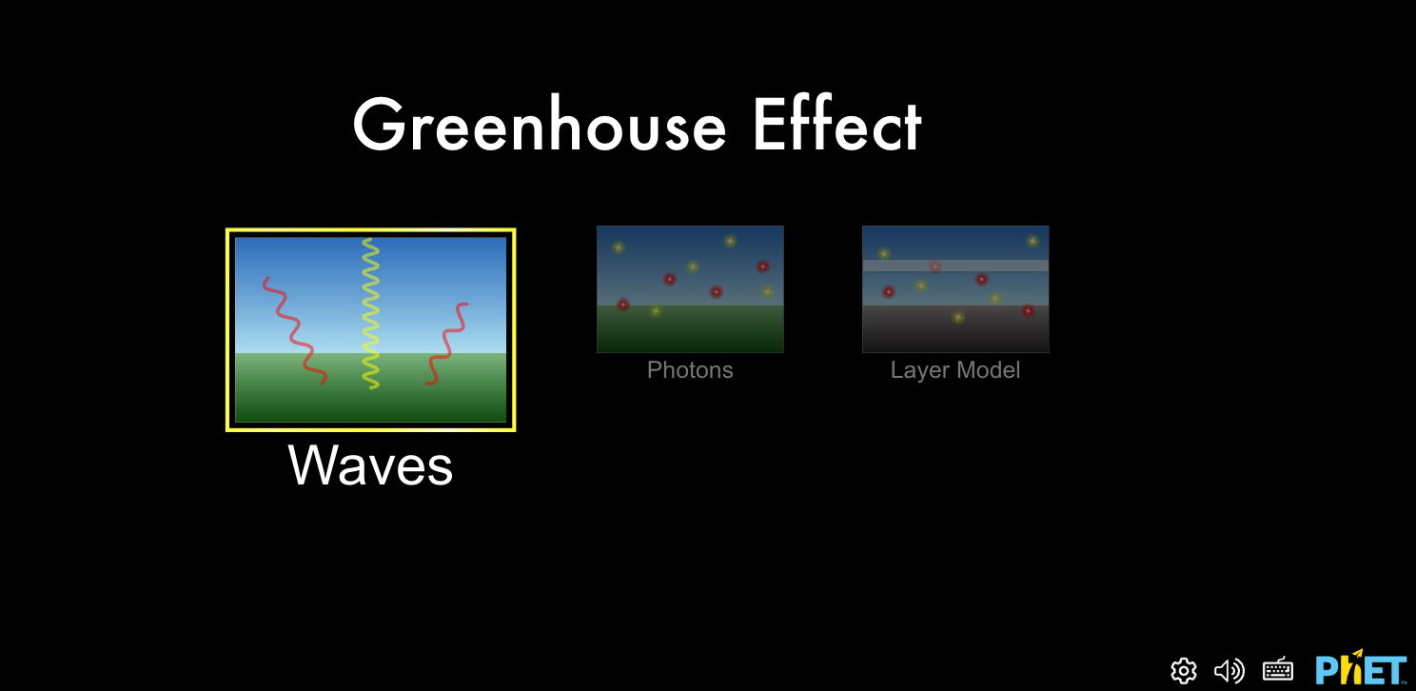
PhET Lab Exploration
As a team, you will investigate PhET’s Greenhouse Effect: Waves simulation to explore how light waves are impacted by CO₂ in the atmosphere. Answer questions in Science Journal under Module 3.2, Day 2 (p.30-33).
Module 3.2 Carbon Dioxide & Weather Slide 16
Notes:
Advance to Slide 16 and share PhET Lab, the simulation tool students will use to explore their models further, along with their tasks for the day.
As a team, you will investigate PhET’s Greenhouse Effect: Waves simulation (https://phet.colorado.edu/sims/html/greenhouse-effect/latest/greenhouse-effect_all.html) to explore how light waves are impacted by CO₂ in the atmosphere.
On Module 3.2 Day 2: The Greenhouse Effect with PhET Simulations Exploring Wave Interactions (Student Instructions), p.30-33 of your Science Journal, you will have scenarios to investigate and questions to answer. Work as a team to answer these questions.
Once students have opened up their Science Journals and are ready to begin, give them time to explore the Greenhouse Effect: Waves simulation. They will focus on two main scenarios:
No carbon dioxide present in the atmosphere
Lots of carbon dioxide present in the atmosphere
As students navigate through the PhET Lab simulation, walk around the group and provide support and ask questions to guide their investigation. Examples include:
What do the different color waves represent?
When there is no carbon dioxide, what happens to the sunlight when it hits the Earth? What about when you increase the carbon dioxide levels?
What happens to the surface temperature as carbon dioxide levels increase? Why do you think this happens?
What do the width of the waves represent?
If time allows, have students explore the temperature at different time periods (calendar icon). As students explore, ask:
What changes did you observe with the land between the ice age, 1750, 1950, and 2020?
How did the greenhouse gas levels (carbon dioxide) change during these periods? What impact did it have on the Earth’s temperature?

Slide 17
Building on Our Models
Now that you have explored greenhouse gasses on PhET Lab’s simulation, as a group, take a moment to build upon your model and describe how increased CO₂ impacts the Earth’s system.
As you build on your model, think about the following:
How do increased levels of CO₂ impact Earth?
How is this different than the “Normal Atmosphere”?
Earth
Module 3.2 Carbon Dioxide & Weather Slide 14
Notes:
Once students have explored the simulation, advance to Slide 17 and bring them back to their paper models and ask them to draw their observations on the model sheet under the section that reads “Increased CO₂ in Atmosphere”.
As students draw their models, walk around and support them by asking probing and pressing questions:
Where is heat coming from in this picture?
Where does the heat go once it leaves its source?
How does increased levels of carbon dioxide impact this process?
As students finish their models, bring the class back together to share their findings.

Slide 18
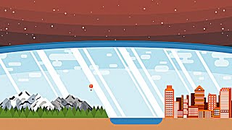
How Do Greenhouse Gases Actually Work?
Module 3.2 Carbon Dioxide & Weather Slide 18: OPTIONAL EXTENSION
Notes:
Once students have their models, tell them that you want to share a little more information that can help them refine it even further.
Advance to Slide 18 and play the video How Do Greenhouse Gases Actually Work? (https://www.youtube.com/watch?v=sTvqIijqvTg) [3:08] During this video investigation, students get to explore in depth how carbon dioxide interacts with sunlight to trap heat on Earth.
Once students have watched the video, give them a moment to go back to their models and refine them with their newfound knowledge.

Slide 19
Share Your Model
As a class, take a moment to share your models and share how an increased level of CO₂ impacts Earth.
How does the sun’s light energy interact with the Earth in your models?
What do increased levels of carbon dioxide have on these interactions?
Earth
Earth
Module 3.2 Carbon Dioxide & Weather Slide 19
Notes:
Once students have their models created, advance to Slide 19 and invite the students to share their models as a class.
How does the sun’s light energy interact with the Earth in your models?
What do increased levels of carbon dioxide have on these interactions?
As students share out loud, reinforce ideas that talk about how increased global temperatures means that ice caps can melt, raising sea levels in the process, or that excess carbon dioxide can also interact with the ocean water, impacting the ocean’s chemistry.

Slide 20
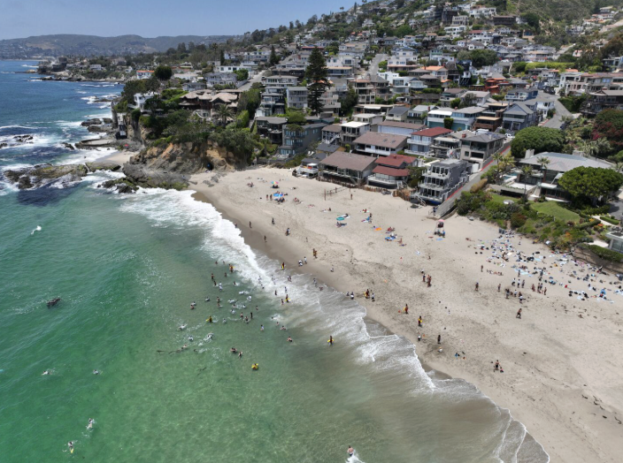
Reflect
How do you think increased CO₂ impacts the value your community places on Southern California’s ocean?
How might you investigate this?
Photo Credit: Los Angeles Times
Module 3.2 Carbon Dioxide & Weather Slide 20
Notes:
Once students have shared, advance to Slide 20 and ask them to further think about what else they need to explore.
How do you think increased CO₂ impacts the value your community places on Southern California’s ocean?
How might you investigate this?

Slide 21
Reflect
In your science journal (p.34), take a couple of minutes to reflect on your experiences during Module 3.2, Day 2.
What did you learn today? How has your thinking changed?
How might trapped heat and changes in weather patterns impact things your community cares about, like beaches, fishing, or wildlife?
Module 3.2 Carbon Dioxide & Weather Slide 21
Notes:
As students wrap up for the day, tell them that their final task is to reflect on what they did.
Advance to Slide 21 and have student teams work together to answer the following questions in Module 3.2 Day 2: Carbon Dioxide & Weather (Student Reflection), p. 34 in their science journal.
What did you learn today? How has your thinking changed?
How might trapped heat and changes in weather patterns impact things your community cares about, like beaches, fishing, or wildlife?

Slide 22




Thank you!
If you have any questions, please feel free to reach out.
Erick Valdez
Inside the Outdoors
evaldez@ocde.us
Ha Nguyen, Ph.D.
Assistant Professor
ha.nguyen@unc.edu

