Slide 1
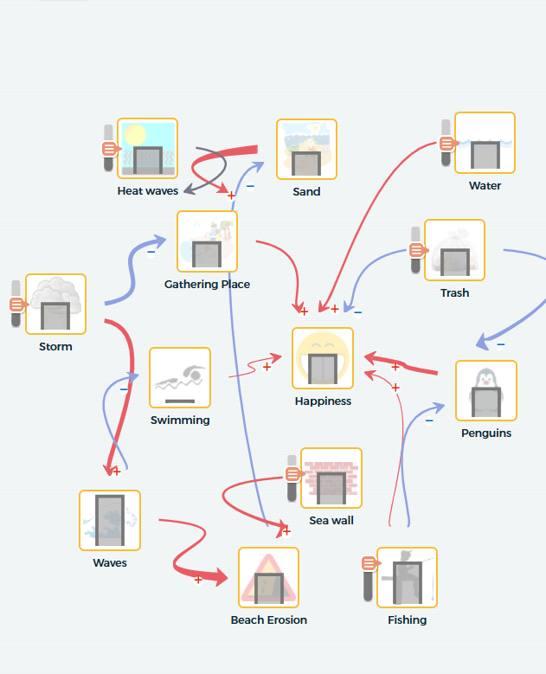
Updating
Our Models
Module 3.5
AISciComm | Module 3.5 Updating Our Models
Notes:
Link to Module 3.5 Lesson Plan
BEFORE YOU START TEACHING
Review the Teacher Facilitation Guide for an overview of content and the curriculum as well as helpful facilitation suggestions.
Include a numbered list of general steps to set up the investigation before students arrive.
This can also include other things that educators should do or think about before starting the lesson, such as checking for safety concerns.
_____
Open the slideshow to Slide 1 and invite the class to get together for the final lesson of Module 3.

Slide 2
Lesson Overview
During this lesson, you will work with your team to revise your SageModeler model using your newfound knowledge from Module 3.
During the lesson, you will:
Revise your SageModeler model from Module 2 to include your learning from Module 3.
Begin to work with your team to decide what parts of your model you would like to share our to your community.
Module 3.5 Updating Our Models Slide 2
Notes:
Advance to Slide 2 to show the Overview of lesson 3.5. Explain to students that in this lesson, they will bring all the new findings from Module 3 to update our models about how climate change impacts the values their community places on the ocean.
When you are ready, begin by inviting students to get into their model groups from Module 2 and have students bring up the models on SageModeler from Module 2.

Slide 3
Plan: Update Your Model
In your Science Journal to page 56-57. With your team, take a moment to reflect on the knowledge you build during Module 3.
Which processes that we have studied, including sea level rise, coastal erosion, global warming, and ocean acidification, affect the values your community cares about? How do they affect the components you have in your models?
Which processes do you want to add to your model?
Which components were not in your original model that you want to add now?
Which relationships were not in your original model that you want to add now?
What human activities contribute to the changes in these natural processes?
Module 3.5 Updating Our Models Slide 3
Notes:
Advance to Slide 3, and have students open their Science Journals to Module 3.5: Updating our Models (Student Task: Plan SageModeler Update), p. 56-57. Here groups will plan how they will use their new knowledge to update their models.
Which processes that we have studied, including sea level rise, coastal erosion, global warming, and ocean acidification, affect the values your community cares about? How do they affect the components you have in your models?
Which processes do you want to add to your model?
Which components were not in your original model that you want to add now?
Which relationships were not in your original model that you want to add now?
What human activities contribute to the changes in these natural processes?
As students are working in their groups, walk around and help support them by asking probing and pressing questions.
Is there a component that may be missing here? Think back to the beginning of Module 3.
How do you think this component connects to what you learned in Module 3?
How might we make this relationship explicit in our model?
As students finish working in their Science Journals, take a moment to gather the class back together and let them know that their next step is going to be including these changes into their SageModeler models.

Slide 4
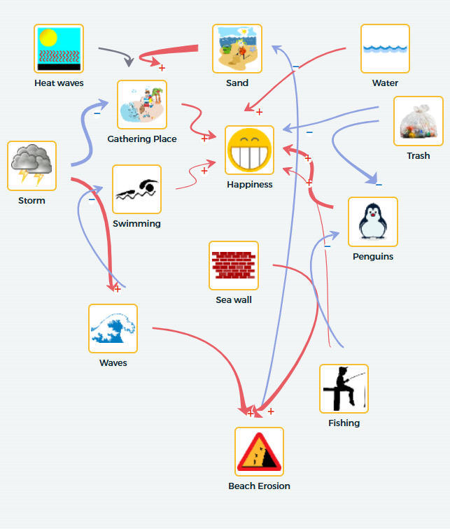
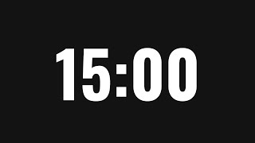
Revise Your Model
Now that you have created a plan, with your team, take a moment to revise your model using your plan as a guide. Keep the following in mind:
How does carbon dioxide play a role in your model?
How does carbon dioxide impact other parts in your model?
How can you demonstrate carbon dioxide’s relationship to other portions of your model?
Module 3.5 Updating Our Models Slide 4
(link)
Notes:
Have groups rejoin their team and advance to Slide 4. Explain to students that they will now begin revising their SageModeler models using the plans they created in their Science Journals.
As you revise your models, keep the following in mind:
How does carbon dioxide play a role in your model?
How does carbon dioxide impact other processes in your model?
How can you demonstrate carbon dioxide’s relationship to other portions of your model?
Give students 15 minutes to work on updating their models. Timer: https://www.youtube.com/watch?v=tuVa27WISyo&t=1s
As students are working make sure to walk around providing support to help them refine their models and emphasize how to demonstrate direct relationships and indirect relationships. Make sure that students include carbon dioxide as a component in their model.
Does this component play a larger role in impacting your community value than previously thought? How can you change the intensity of the relationship to reflect this?(increase the relationship magnitude within SageModeler.)
Can you explain how this human caused impact indirectly impacts the value your community places on Southern California’s ocean?

Slide 5
Share Your Model
Take a moment to share out with the class.
What changes did you make to your model? Why did you make those changes?
Module 3.5 Updating Our Models Slide 5
Notes:
At the 15 minute mark, call student groups back to the class and advance to Slide 5. As students:
What changes did you make to your model?
Tell students that now that they have made revisions, together, they will track how one component that they explored in the last module, carbon dioxide emissions, impacts the value their model is centered around. If they haven’t added carbon dioxide emissions in yet, give them a moment to include it.

Slide 6
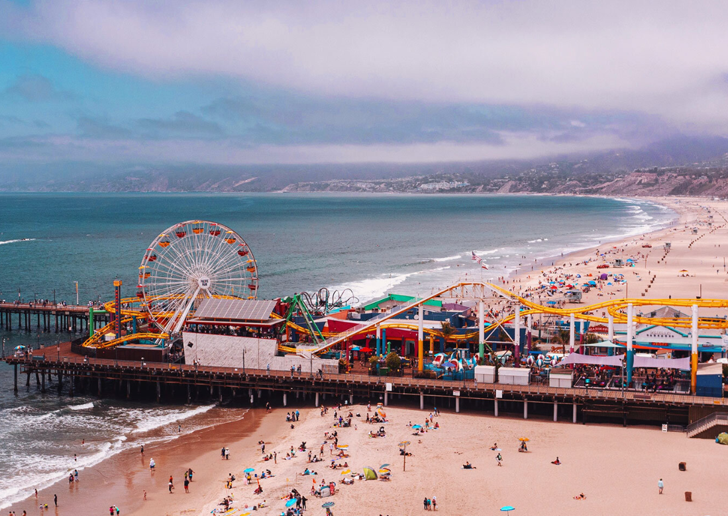
Predictions
In your Science Journal, Module 3.5: Updating Our Models (Student Task: Make a Prediction), p. 58, make a prediction on how your chosen value will change as carbon dioxide emissions increase:
Prediction Sentence Frame:
We predict that as carbon dioxide emissions increase, [our value] will [describe the change]. This is because [explain the process using the model as evidence].
Santa Monica, CA
Module 3.5 Updating Our Models Slide 6
Notes:
Advance to Slide 6 and have students open their Science Journals to Module 3.5: Updating Our Models (Student Task: Make a Prediction), p.58. Here, students will be asked to make a prediction on how their chosen value will change as carbon dioxide emissions increase.
Prediction Sentence Frame
We predict that as carbon dioxide emissions increase, [our value] will [describe the change]. This is because [explain the process using the model as evidence].
Examples:
We predict that as carbon dioxide emissions increase, our seafood availability will decrease. This is because higher carbon dioxide levels decrease the ocean’s pH, which reduces the survival of calcifying organisms that fish depend on for food.
We predict that as we increase carbon dioxide emissions, our access to the coast will decrease. This is because high carbon dioxide levels increase the global temperature, melting ice caps and raising sea levels, leading to more coastal flooding and erosion.

Slide 7
Test Your Prediction
Test your prediction by running a simulation within your SageModeler model. As you do, think about the following questions:
What is happening to my chosen value as carbon dioxide emissions increase?
What is happening to other components or processes within my model as carbon dioxide levels increase?
Module 3.5 Updating Our Models Slide 7
Notes:
Advance to Slide 7 and tell students that now it is time to test their prediction. Tell students that to test their prediction they will run a simulation in SageModeler. At the top right of your SageModeler screen, click on “Simulate” and bars will appear on components within your model.
Have students move their carbon dioxide emissions bar to the bottom (lowest levels of carbon dioxide emissions) and then test their prediction by slowly moving the bar up towards higher levels of carbon dioxide emissions. As students do that, have them think about the following questions:
What is happening to my chosen value as carbon dioxide emissions increase?
What is happening to other components or processes within my model as carbon dioxide levels increase?
Note: If students have added components that contribute to carbon dioxide emissions, they may have to manipulate those instead of carbon dioxide emissions directly.
If there is time, ask students to test other components within their model following the same process.

Slide 8
Share Your Model
Now that you have had a chance to test your prediction, share your updated model with the class. When sharing, think about the following:
What value did your team center their model around? How did an increase of carbon dioxide emissions impact your chosen value?
What processes or components do you think had the biggest impact on your value?
What discoveries about your model and its relationships was the most surprising to your team? Why?
Module 3.5 Updating Our Models Slide 8
Notes:
Once student groups have had a chance to test their models out, bring the class back together to share what they found. Advance to Slide 8 and ask the class the following questions:
What value did your team center their model around? How did an increase of carbon dioxide emissions impact your chosen value?
What processes or components do you think had the biggest impact on your value?
What discoveries about your model and its relationships was the most surprising to your team? Why?
Listen for and reinforce ideas that connect carbon dioxide emissions to impacts of other portions within their models, leading to a change in the value their community places on Southern California’s ocean.

Slide 9
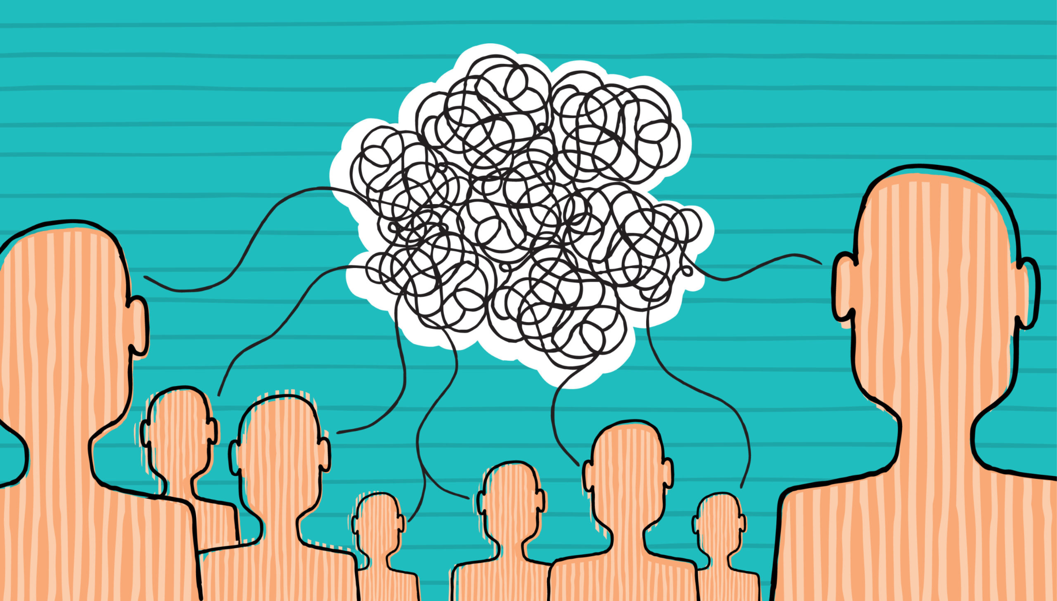
What Do You Want to Share?
Now that you have shared your findings, take a moment with your group to think about how you may share our to your community. To help, think about the following:
What is something about your model that you think everyone should know?
If you had to explain your updated model to someone in the community, what would you highlight first?
Module 3.5 Updating Our Models Slide 8
Notes:
Once students have shared their findings, advance to Slide 9 where they will see another question to discuss with the class
What is something about your model that you think everyone should know?
If you had to explain your updated model to someone in the community, what would you highlight first?

Slide 10
Reflect
In your science journal (p.59), take a couple of minutes to reflect on your experiences during Module 3.5.
If you were explaining your updated model to someone in your community, what key idea or relationship would you highlight? Why should this idea or relationship matter to them?
Based on what your model now shows, what action or solution could your community take to reduce or respond to these impacts?
Module 3.5 Updating Our Models Slide 6
Notes:
As students wrap up for the day, their final task for the day is to reflect on what they did.
Advance to Slide 10 and have student teams work together to answer the following questions together on Module 3.5 Updating our Models (Student Reflection) page 59 of their Science Journals.
If you were explaining your updated model to someone in your community, what key idea or relationship would you highlight? Why should this idea or relationship matter to them?
Based on what your model now shows, what action or solution could your community take to reduce or respond to these impacts?
Thank students for their participation today and inform them that in the next session, they will start to think about what information they want to communicate back out to their community and how they might do so.

Slide 11




Thank you!
If you have any questions, please feel free to reach out.
Erick Valdez
Inside the Outdoors
evaldez@ocde.us
Ha Nguyen, Ph.D.
Assistant Professor
ha.nguyen@unc.edu

