Slide 1

Variables Affecting Team Success
New York Football Giants – Grayson, Anish, Cameron, Michael

Slide 2

Research Questions
How Do Certain Variables affect Team Success?
How does ball security (turnovers) affect team success?
How does discipline (penalties) affect team success?
Does the effectiveness of a team's passing or running game correlate with their success?
Will an efficiency or big play emphasis lead to better outcomes?

Slide 3
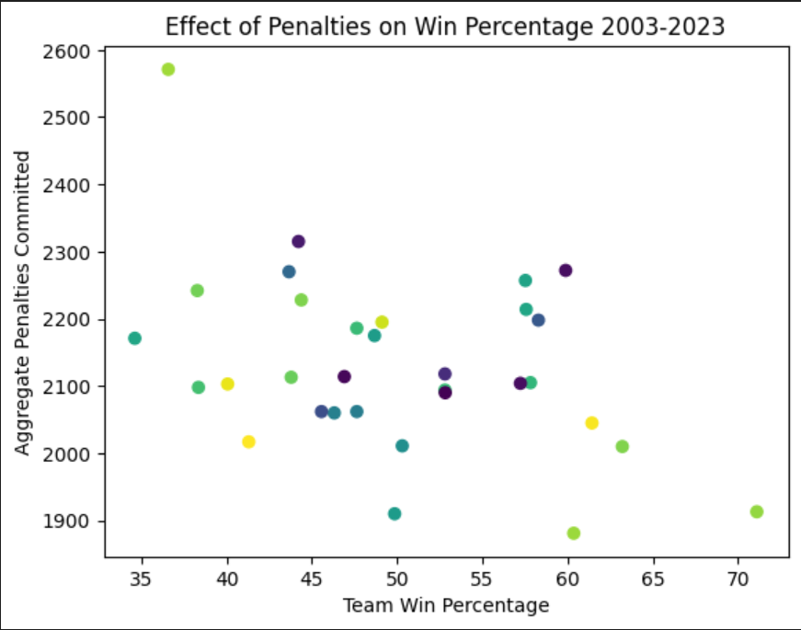
Correlation Analysis: R = - 0.41; moderate negative

Slide 4
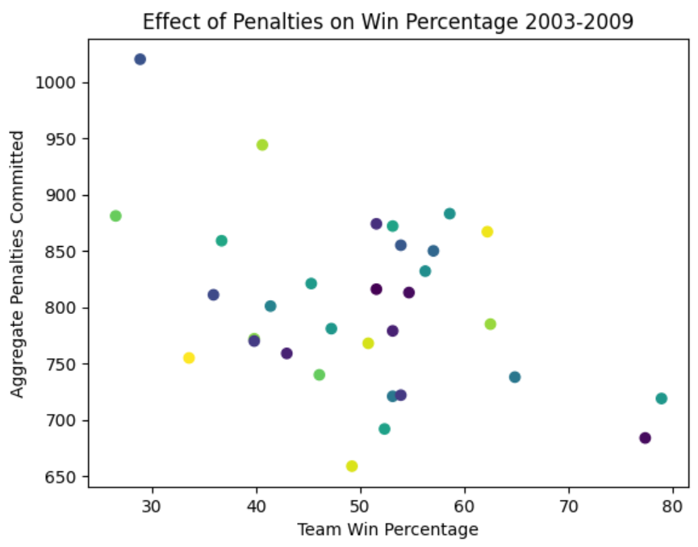
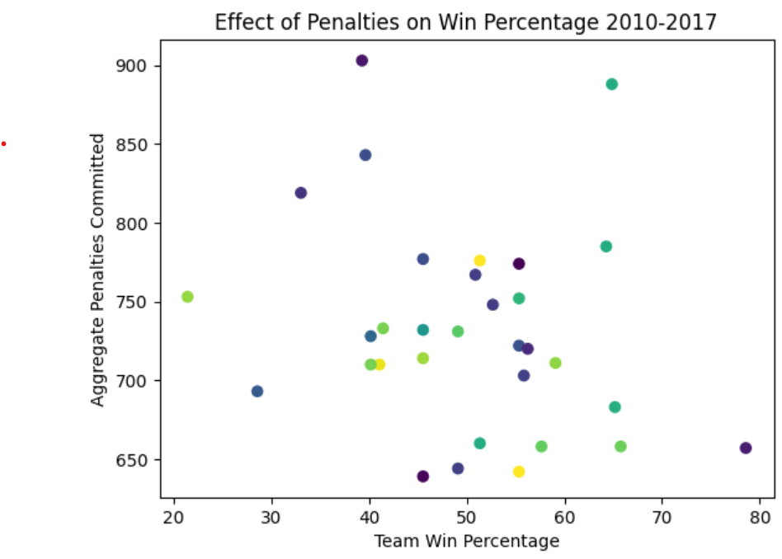
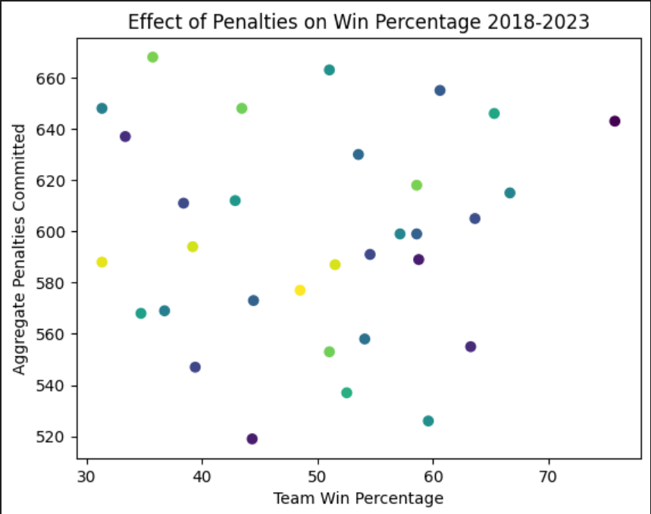
Effect of Penalties Across Eras
2003-2009: R = - 0.4; moderate negative
2010-2017: R = - 0.23; weak negative
2018-2023: R = 0.038; weak/none

Slide 5
What is the relationship between ball security (turnovers) & team success in our data?
Notes:
Isolated columns of interest and aggregated across entire time period

Slide 6
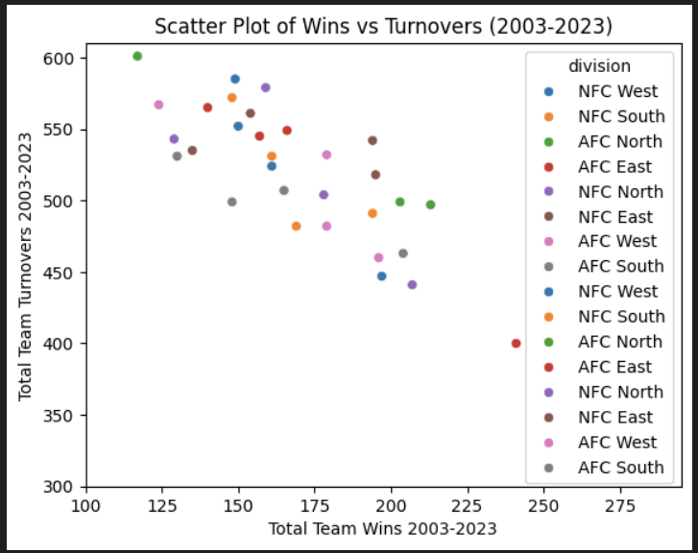
*data aggregated across all years (2003-2023)
R = -0.79 (strong)
Eq: y = -1.25x + 729.4
P-value < 0.05
Max wins: 241 (Patriots)
Max turnovers: 601 (Browns)
NFC East teams seem to have a slightly weaker correlation than the other divisions and the larger dataset
Notes:
(ignore colors) Strong negative correlation across all teams
suggests that limiting the number of turnovers your team has is strongly correlated with their success
R, equation
However I was interested to see if there were any divisions or teams that went against this trend
Isolate a color and they should follow similar shape, but looking at the brown dots they appear to be a little bit more flat

Slide 7
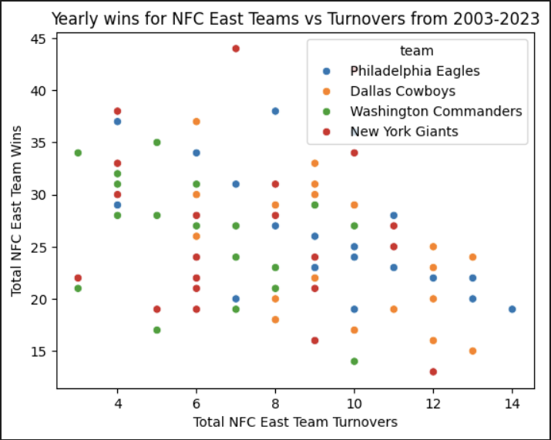
*only NFC East team data
*NOT aggregated across entire time-period
R = -0.38 (weak/moderate)
P-value < 0.05
Eq: y = -0.91 + 33.02
Each dot represents a season total of wins and turnovers (not aggregated across 2003-2023)
Notes:
the correlation for just the NFC East teams is much weaker than it was for all of the teams in the league
(dots are much more spread out)
Looks like between the four teams in the division the new york giants have the largest spread

Slide 8
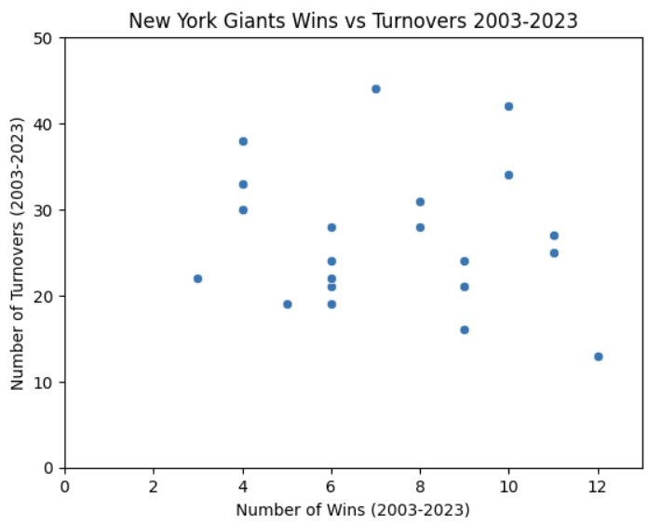
R = -0.11 (weak) eq: y = -0.04x + 8.29 p-value > 0.05 presence of high win and high turnover seasons
Notes:
the New York Giants correlation is fairly nonexistent
However the giants represent a deviation from the norm and the larger data showed had a pretty strong correlation
When analyzing at the aggregate level there is a strong correlation, but that is not necessarily the case at the division or team level
Suggests that there are other interacting factors here

Slide 9
Does the effectiveness of a team's passing or running game correlate with their success?

Slide 10
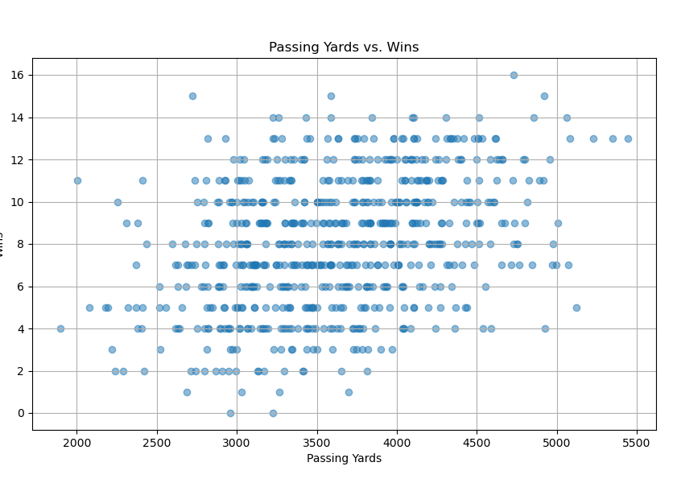
Correlation Between Passing Yards & Wins
Pearson Correlation Coefficient
Passing Yards vs Wins = 0.364705

Slide 11
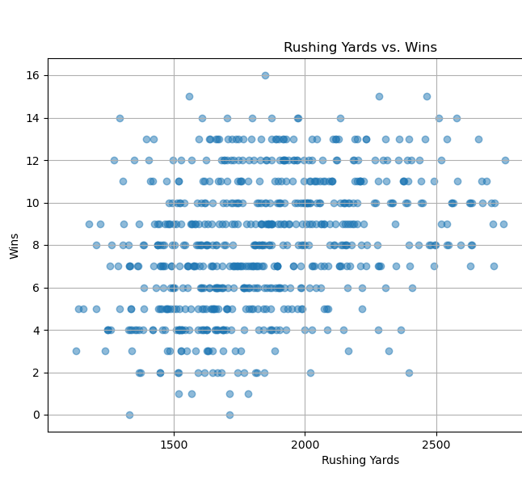
Correlation Between Rushing Yards & Wins
Pearson Correlation Coefficient
Rushing Yards vs Wins = 0.346847

Slide 12
Similar Correlation between Passing Yards and Running Yards
Pearson Correlation Coefficient
Passing Yards vs Wins = 0.364705
Pearson Correlation Coefficient
Rushing Yards vs Wins = 0.346847
The similar correlation suggests that both passing and rushing yards matter.
Balance is key. Teams may benefit from having a balanced offensive approach that incorporates both.

Slide 13
Do total yards or yards per play affect the wins/losses of a team more?

Slide 14
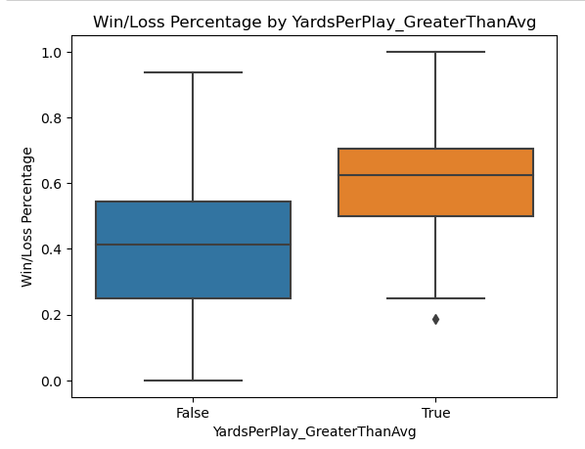
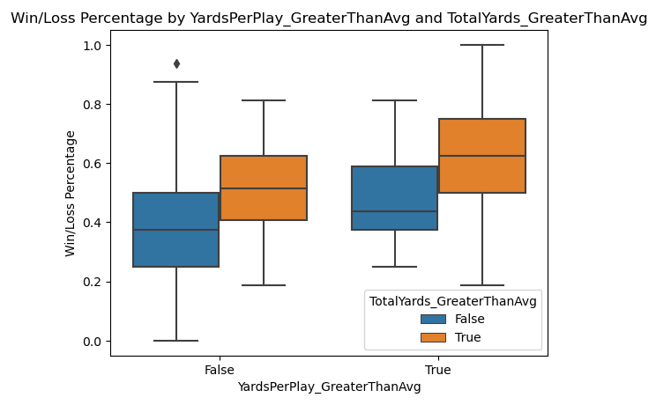
Box Plot of Win Loss Percentages

Slide 15
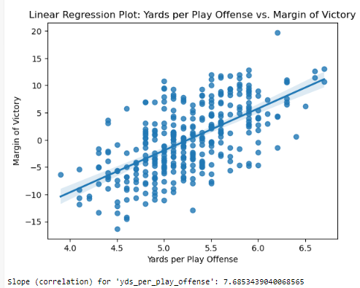
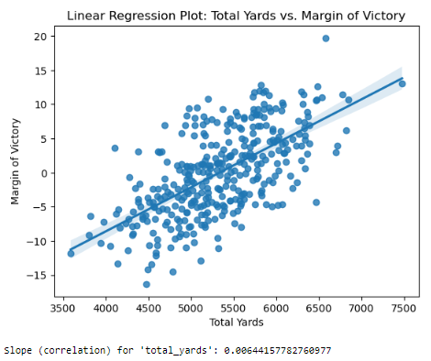
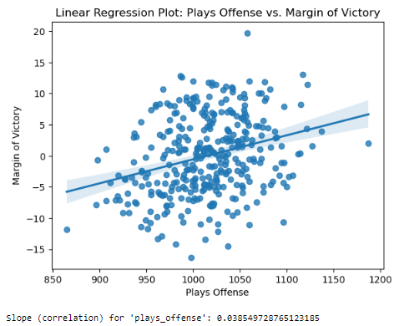
Linear Regression of Yards, Plays and Total Offense vs. Margin of Victory

Slide 16
Correlation Analysis for Yards Per Play and Total Plays
Correlation coefficient between mov and plays_offense: 0.28777313385307685
Correlation coefficient between mov and total_yards: 0.6368231080171423
Total yards has a stronger correlation with mov.
When controlling for total yards, plays_offense has a negative correlation with margin of victory. -0.589793793242636
Correlation coefficient between win_loss_perc and plays_offense: 0.23889031514078327
Correlation coefficient between win_loss_perc and total_yards: 0.5394834674375731
Total yards has a stronger correlation with win_loss_perc
When controlling for total yards, plays_offense has a negative correlation with win_loss_perc. -0.5889508467874391

