Slide 1
Predicting seasonal flu vaccine uptake
Camilla Callierotti

Slide 2
Overview
Dataset:
p = 35
n = 26’707
Research question:
Predict whether a person will or will not take the seasonal flu and H1N1 vaccines
Algorithms:
Clustering – to visualise data
Regularised regression – to determine which factors are most associated with flu shot uptake
Decision tree

Slide 3
Data processing overview
Missingness:
>50% observations are null: drop feature
<50% observations are null: impute
Mode (categorical features)
Mean (numerical features)
Resulting dataset:
p = (where 31 are individual features)
n = 26,707 (unchanged)
Categorical features
Hierarchical structure of feature: label encoding
Collinearity
Feature engineering to merge collinear features into one normally distributed feature
Standardisation
Columns containing gibberish (3): remove features
Non-hierarchical structure of feature: one-hot encoding

Slide 4
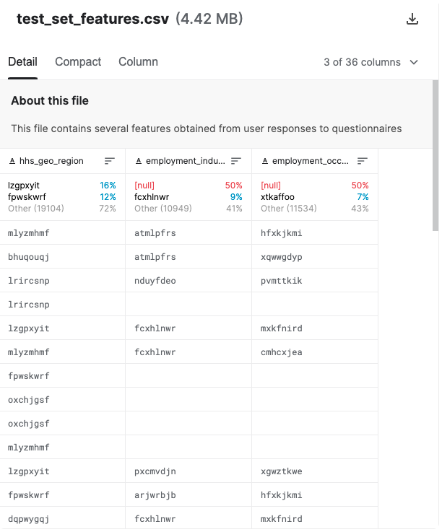
Data processing
1. Removing one column containing gibberish

Slide 5
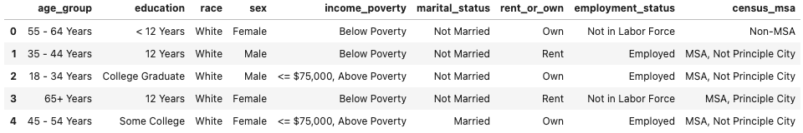
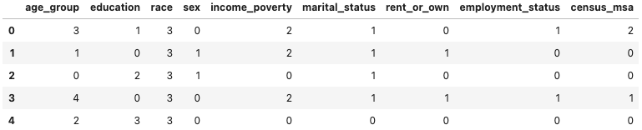
Data processing
2. Label encoding of categorical features
Notes:
Many machine learning algorithms cannot support categorical values, and they require manipulation to be turned from text attributes to numerical values without affecting their meaning. For example, converting categories to numbers would imply that some categories are "closer" to others (as 1 is closer to 2 than to 3). Label encoding in this dataset is appropriate because there is a hierarchy in the levels of the categories.

Slide 6
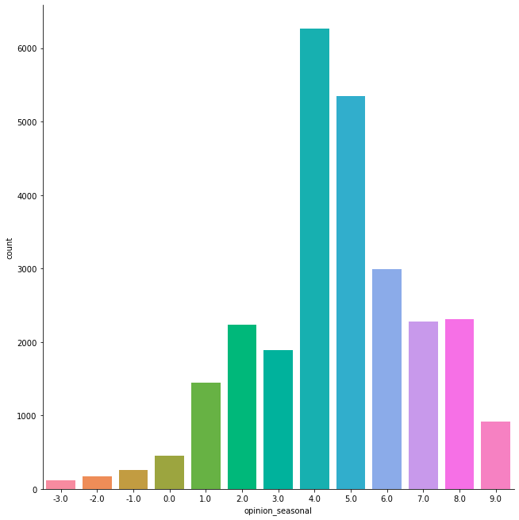
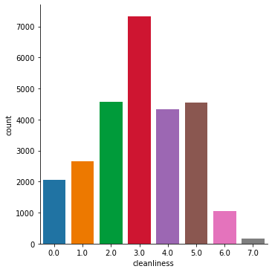
Data processing
3. Feature engineering
Cleanliness: Antiviral meds, avoidance, face mask, hand washing, large gatherings, outside home, face touching |  | Opinion on seasonal flu vaccine: - Vaccine effectiveness - Seasonal flu risk - Getting seasonal flu from vaccine
Notes:
Create new features:
Cleanliness (includes behavioural features)
Opinions (includes opinion features)
Because we want to perform feature selection (Lasso), which doesn't handle collinear data well (randomly selects one of collinear variables). It's important that the variables are normally distributed and we can see that they are.

Slide 7
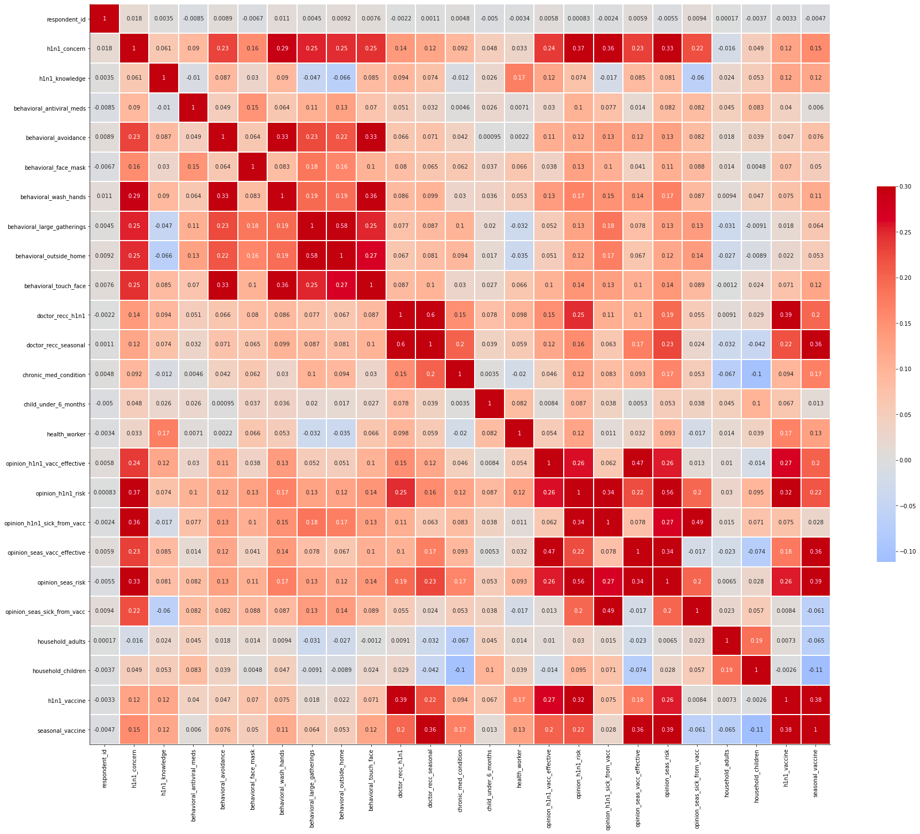
Correlation heatmap
High correlation between behavioural features:
Face touching
Washing hands
Avoidance
Outside home
Large gatherings
Notes:
Correlation heatmap justifying feature engineering done in the previous slide

Slide 8
Data processing
4. Standardisation
Standardisation to standard normal random variables with mean 0 and standard deviation 1:
z= (x - µ) / sigma
Motivation: the features are in different scales, so standardisation brings them to comparable scales

Slide 9
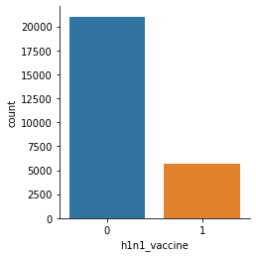
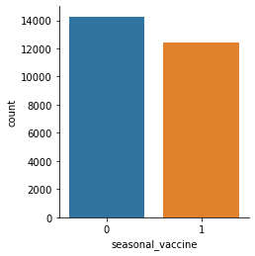
Exploratory analysis: variable distributions
Outcome variables:
Notes:
More controls than cases in h1n1 vaccine: can't use a performance metric.

Slide 10
Exploratory analysis: variable distributions
Predictor variables:

Slide 11
Train and test splitting
80-20 train-test split
Motivation: 26'707 observations so a test set of 20% (small) will still give robust error metrics

Slide 12
Regularised regression with Lasso
Motivation: understand features most associated to vaccine uptake
K-fold cross-validation:
N splits= 10
N repeats= 3
Result: the best alpha (lambda) value is 0.1
Mean squared error (MSE) | Root mean squared error (RMSE) | Mean absolute error (MAE) | R²

Slide 13
Decision trees and Random forest
Decision tree motivation
Used because interpretability is important (we want to know what are the decisive factors in getting the seasonal flu vaccine so we can leverage those)
Sacrificing some accuracy for more interpretability
Random forest motivation:
RF performs very well for classification problems compared to other improvements of decision tree algorithms
Obtain a variable importance plot
Random forest
Mean squared error (MSE) | Root mean squared error (RMSE) | Mean absolute error (MAE) | R²
0.146 | 0.382 |  | 0.287

Slide 14
Random forest feature importance plot
representing how useful the model found each feature in trying to predict the target
what features contributed to the accuracy of the model and what features were just noise

Slide 15
Hierarchical clustering
Motivation:
Mixed data types (22 numerical, 9 categorical)
Mean squared error (MSE) | Root mean squared error (RMSE) | Mean absolute error (MAE) | R²

Slide 16
Study relevance
Importance of predicting flu vaccine uptake:
How many doses to purchase from manufacturers
How to allocate health resources (e.g. vaccines or ventilators)
What factors to spend more resources on to increase compliancy (lasso)

Slide 17
Issues encountered
Perfect metrics (MSE= 0.00994, R^2= 1)
Solution: response variables (vaccine uptake) were not removed from X datasets

Slide 18
Bibliography
Dataset and starter code: https://www.kaggle.com/darkknight98/flu-shot-prediction-complete-eda-and-hpo

