Slide 1
Shape Descriptors
Alex Belyaev
EM229
a.belyaev@hw.ac.uk

Slide 2
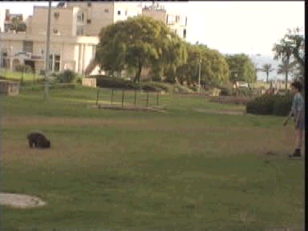



From extraction to recognition
Shape Extraction
Shape description
Shape recognition
?
dog
cat

Slide 3
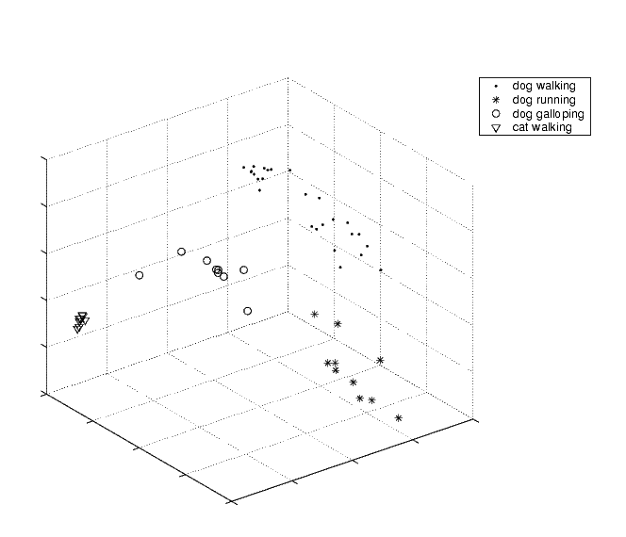
From extraction to recognition

Slide 4







From extraction to recognition
Shape Extraction
Shape description
Shape recognition

Slide 5
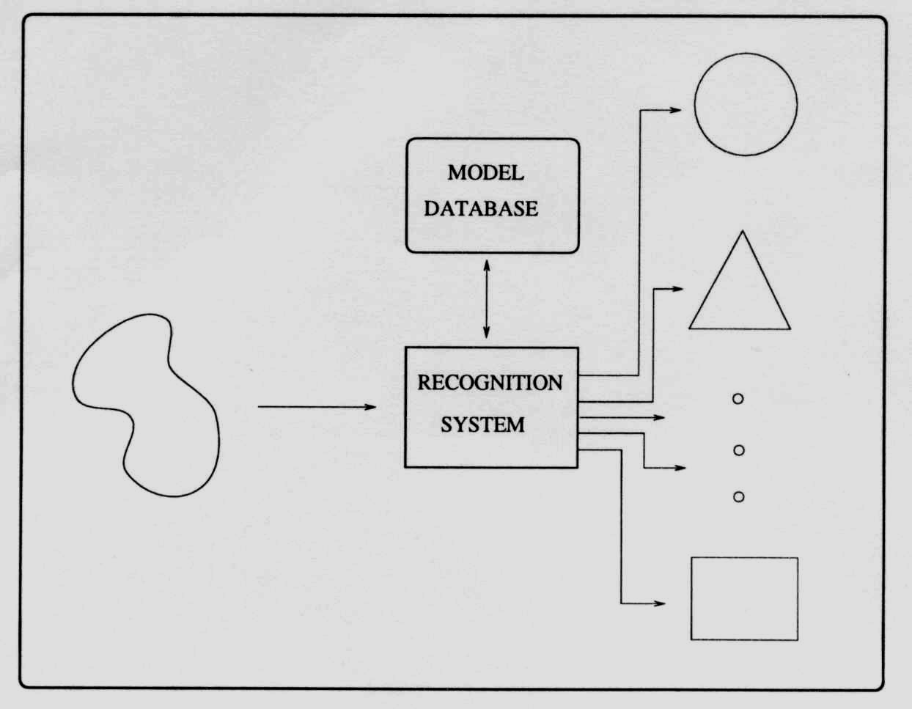
Shape recognition

Slide 6
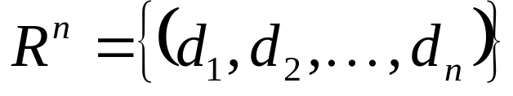
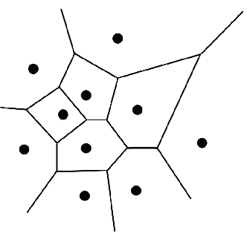

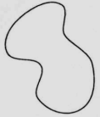
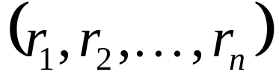
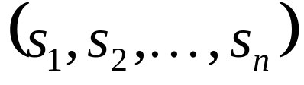


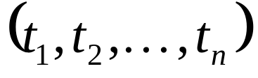
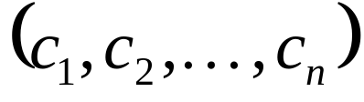
Descriptors: nearest neighbours classification

Slide 7
Voronoi diagram

Slide 8

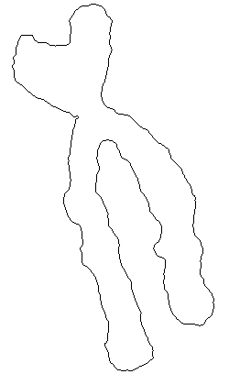
Region and boundary descriptors

Slide 9
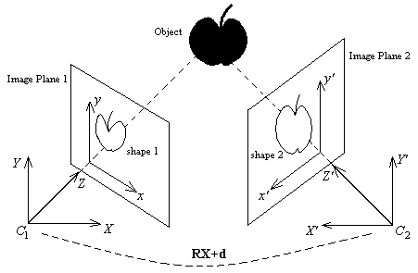
Criteria for shape representation/descriptors
  Rotation, scale, and translation invariant
  Compact & easy to derive
  Robust to shape variations
  possibly application independent
Sometimes affine (or even projective) invariance is required

Slide 10

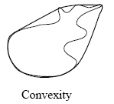
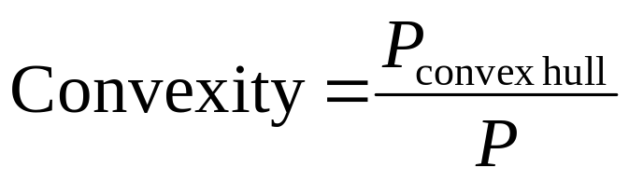
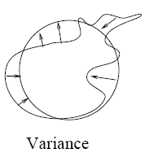
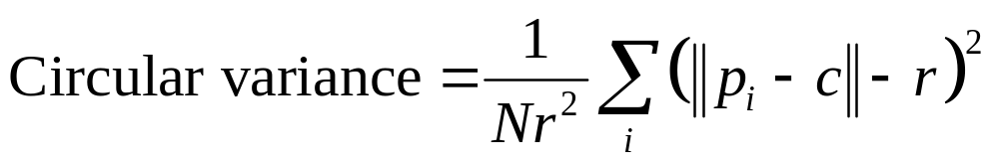
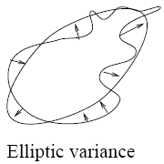
Simple geometric descriptors
Elliptic variance (fitting an ellipse instead of a circle)

Slide 11
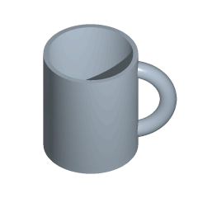
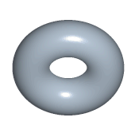
Topological descriptors
Topology is the study of properties of a figure that are unaffected by rubber-sheet distortions
=

Slide 12
Topological descriptors: connectivity
X’
X
Y’
Y
X and Y are connected
X’ and Y’ are NOT connected
Discrete connectivity depends on how we define the path for discrete images
4-neighbors
8-neighbors

Slide 13
Topological descriptors:connectivity
q
q
p
p
p and q are connected w.r.t. 4-neighbors topology and 8-neighbors topology
p and q are connected w.r.t. 8-neighbors topology only

Slide 14
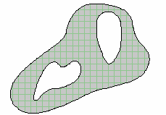

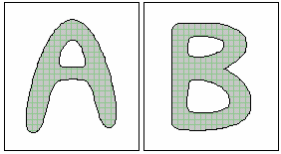
Topological descriptors: Euler number
Euler number = # connected components – # holes
EN = -3
EN = 0
EN = -1

Slide 15
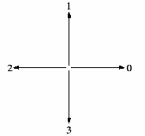
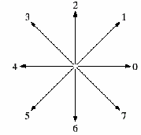
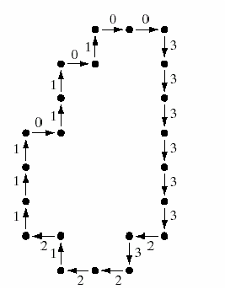
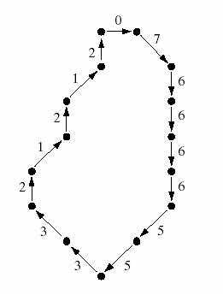
Boundary descriptors: chain codes
4-directional chain code:
0033333323221211101101
8-directional chain code:
076666553321212

Slide 16
Normalized chain codes
33001122
33001122
30011223
00112233
01122330
11223300
12233001
22330011
23300112
00112233
01122330
11223300
12233001
22330011
23300112
33001122
30011223
First row gives the
normalized chain code
Sort
rows
00112233

Slide 17
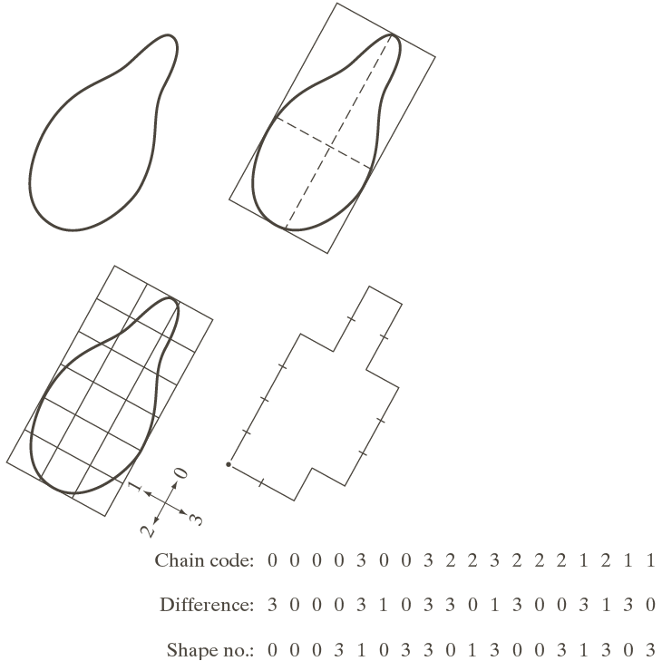
Differential chain codes
Differential code:
d_{k}=c_{k}-c_{k-1} (mod 4)
33001212
33010122
differentiate
differentiate
10101131
10113110
normalize
normalize
01011311
01011311
Shape numbers

Slide 18
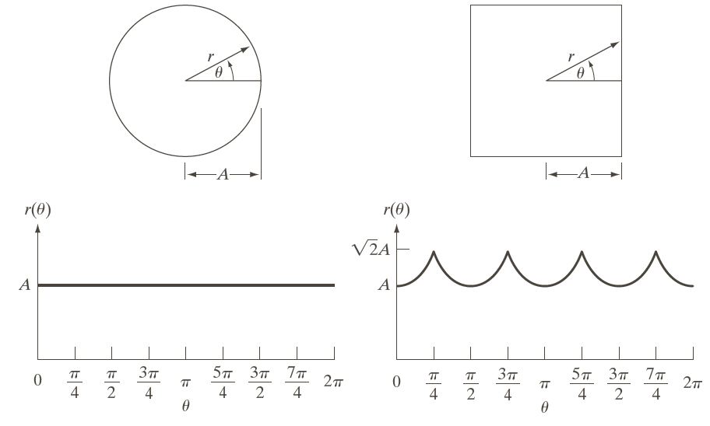
Shape signatures 1
A signature of a planar figure is a 1D functional representation of the boundary of the figure
Example: Distance to the centroid vs angle:
(then, for example, compute Fourier coefficients, etc.)

Slide 19
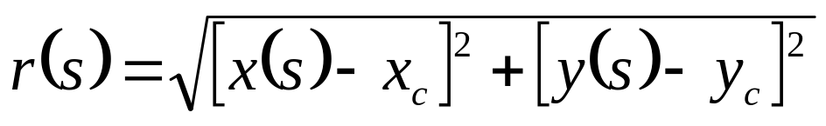

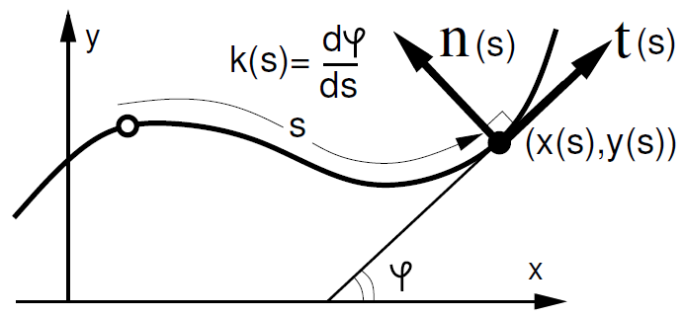
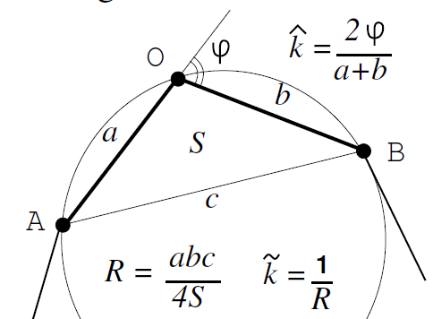
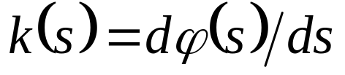
Shape signatures 2
Example 2. Distance to the centroid vs arclength:
Example 3. Curvature vs arclength
discrete curvature

Slide 20
Shape signatures (3)
Example 4. Curvature derivative w.r.t arclength vs curvature

Slide 21
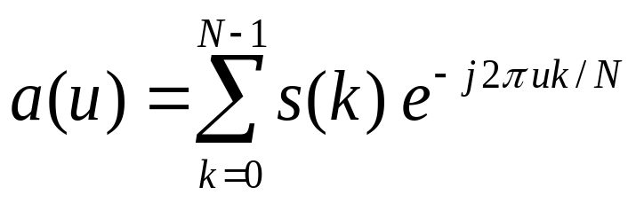
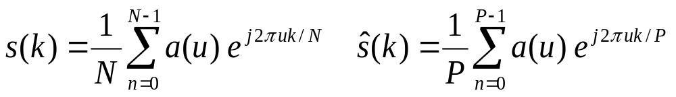
Boundary descriptions: Fourier descriptors
Represent the boundary by a sequence of points { (x₀,y₀), (x₁,y₁), …, (x_{N-1},y_{N-1}) }
Write each point [x(n),y(n)] as a complex number s(n) = x(n) + j y(n)
Take 1D Fourier transform of s(n) to get coefficients a(u)
Higher order coefficients can be truncated for a more concise representation

Slide 22
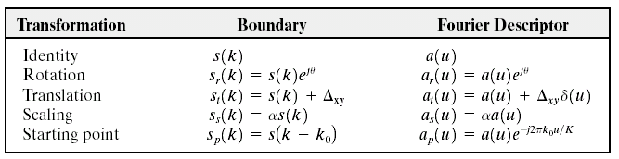
Fourier descriptors under various transformations
Transforming the contour by rotation is equivalent to multiplying the Fourier transform by e^{jθ}
Changing the starting point of the sequence to point k is equivalent to multiplying the Fourier transform by e^{-j2πku/N}
Can normalize a Fourier descriptor vector for rotation, translation, scaling, and starting point
Images © 2002 R. C. Gonzalez & R. E. Woods

Slide 23

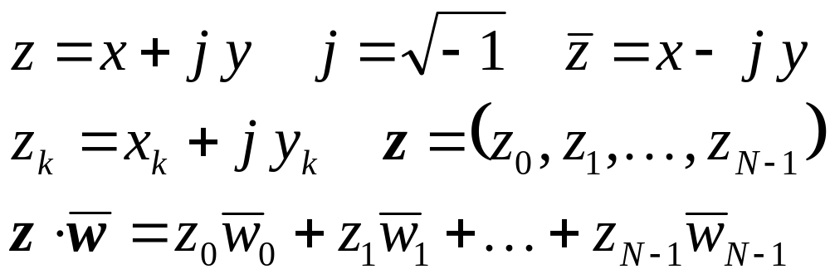
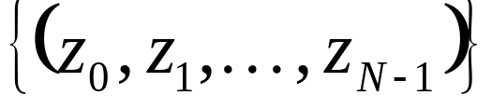
Boundary descriptions: Fourier descriptors
To analyze planar polygons it is convenient to use complex numbers:
Consider the following basis in the space of N-dimensional vectors with complex components

Slide 24
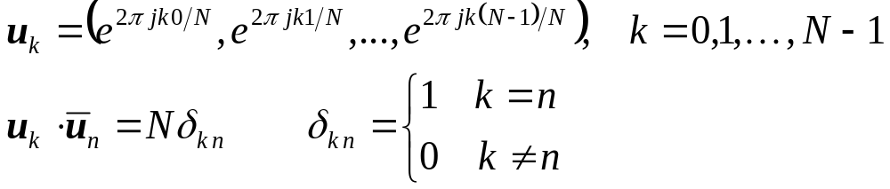
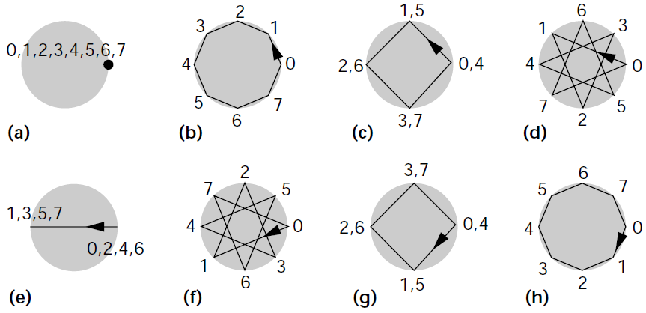
Boundary descriptions: Fourier descriptors

Slide 25
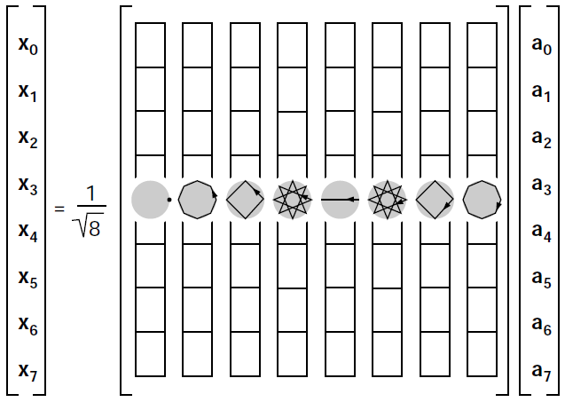
Boundary descriptions: Fourier descriptors

Slide 26
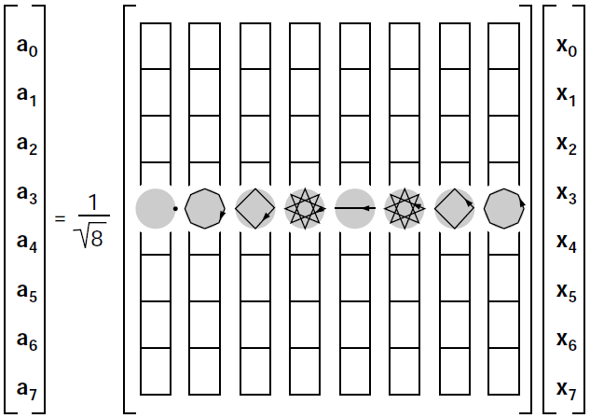
Boundary descriptions: Fourier descriptors

Slide 27
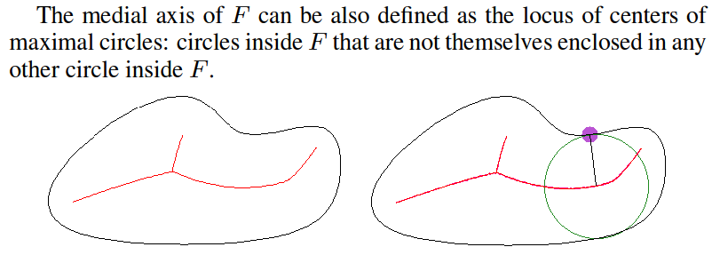
Region descriptions: Skeletons
We can also define the medial axis (skeleton) as the locus of the centres of all inner bitangent circles.

Slide 28
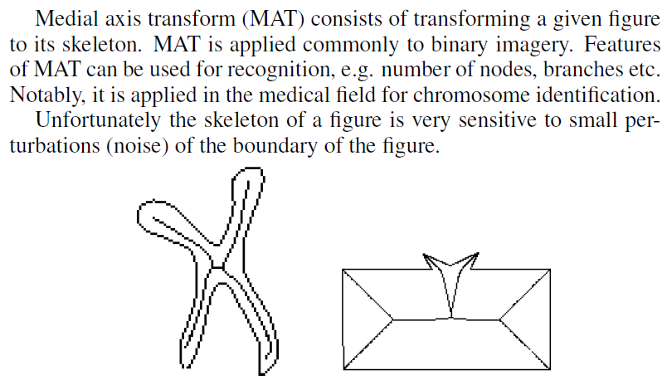
Skeletonization

Slide 29
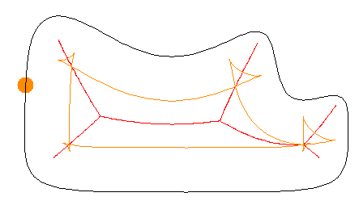
Skeleton: grass-fire analogy
Imagine that the shape is covered by grass and is set on fire all around the boundary simultaneously. It is assumed that the flame propagation speed is constant everywhere. Than the set of quench points form the skeleton (medial axis) of the shape.
The skeleton is formed by the first self-intersections of the inner offset curves.

Slide 30

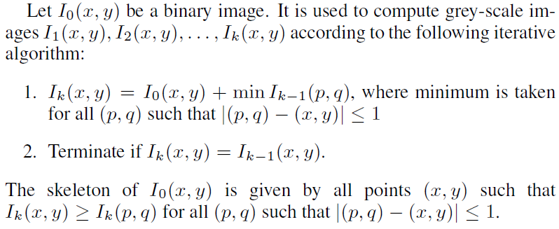
Skeletonization via thinning

Slide 31
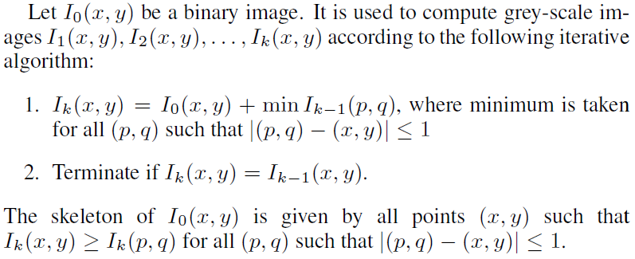
Skeleton extraction: thinning
1 1 1 1 1
1 1 1 1 1
1 1 1 1 1
1 1 1 1 1
1 1 1 1 1
1 1 1 1 1
1 2 2 2 1
1 2 2 2 1
1 2 2 2 1
1 1 1 1 1
1 1 1 1 1
1 2 2 2 1
1 2 3 2 1
1 2 2 2 1
1 1 1 1 1
1 1
2 2
3
2 2
1 1
I₀(x,y)
I₁(x,y)
I₃(x,y)
local max
skeleton

Slide 32
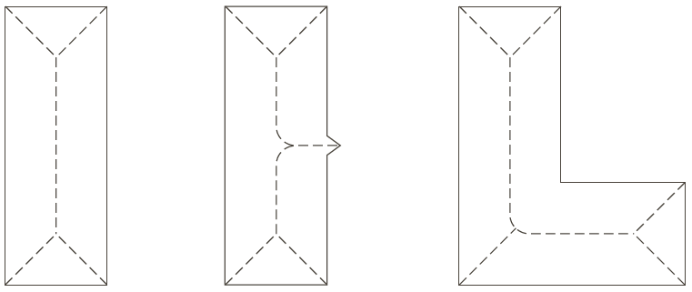
Skeleton extraction: thinning
1 1 1 1 1
1 1 1 1 1
1 1 1 1 1
1 1 1 1 1
1 1 1 1 1 1 1 1 1 1
1 1 1 1 1 1 1 1 1 1
1 1 1 1 1 1 1 1 1 1
1 1 1 1 1 1 1 1 1 1
1 1 1 1 1 1 1 1 1 1
1 1 1 1 1 1 1 1 1 1
1 1 1 1 1 1 1 1 1 1
1 1 1 1 1
1 2 2 2 1
1 2 2 2 1
1 2 2 2 1
1 2 2 2 1 1 1 1 1 1
1 2 2 2 2 2 2 2 2 1
1 2 2 2 2 2 2 2 2 1
1 2 2 2 2 2 2 2 2 1
1 2 2 2 2 2 2 2 2 1
1 2 2 2 2 2 2 2 2 1
1 1 1 1 1 1 1 1 1 1
1 1 1 1 1
1 2 2 2 1
1 2 3 2 1
1 2 3 2 1
1 2 3 2 1 1 1 1 1 1
1 2 3 2 2 2 2 2 2 1
1 2 3 3 3 3 3 3 2 1
1 2 3 3 3 3 3 3 2 1
1 2 3 3 3 3 3 3 2 1
1 2 2 2 2 2 2 2 2 1
1 1 1 1 1 1 1 1 1 1
1 1 1 1 1
1 2 2 2 1
1 2 3 2 1
1 2 3 2 1
1 2 3 2 1 1 1 1 1 1
1 2 3 2 2 2 2 2 2 1
1 2 3 3 3 3 3 3 2 1
1 2 3 4 4 4 4 3 2 1
1 2 3 3 3 3 3 3 2 1
1 2 2 2 2 2 2 2 2 1
1 1 1 1 1 1 1 1 1 1

Slide 33
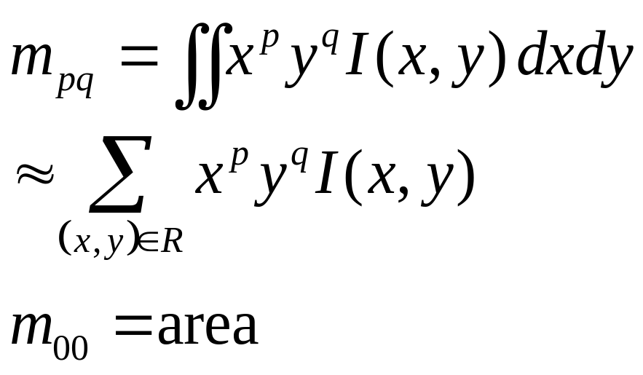
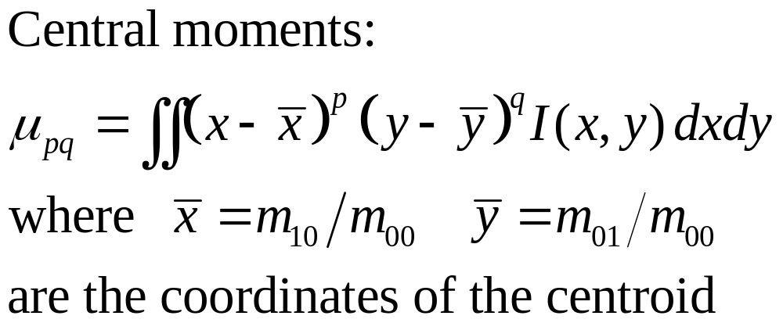
Statistical image moments
R

Slide 34
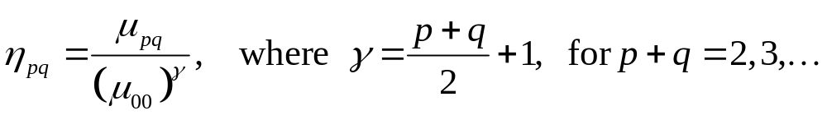
Normalized central moments
Normalized central moments (divide by area raised to a power)

Slide 35
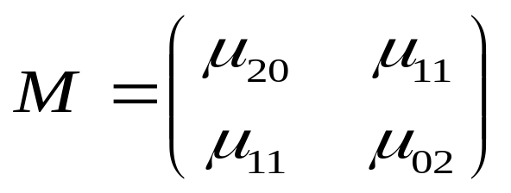



Principal Axes
Major and minor axes are the eigenvectors of
Eigenvalues λ₁,λ₂ are the lengths
Matlab’s regionprops computes these

Slide 36
Problems 1
1. Compute the Euler number for the following binary image. Assume (a) 4-connectivity; (b) 8-connectivity
1 1 1 0 0 0 0 0
1 1 1 0 1 1 0 0
1 1 1 0 1 1 0 0
1 1 1 0 0 0 1 0
1 1 1 0 0 0 1 0
1 1 1 0 0 0 1 0
1 1 1 0 0 1 1 0
1 1 1 0 0 0 0 0
4-neighbors
8-neighbors

Slide 37
Problems 2
2. Generate the shape corresponding to the following 8-connected chain code:
5 6 7 6 0 0 1 2 2 4 3 4
3. Find the normalized and differential chain codes for the following 4-connected polygon:

Slide 38




Problems 3
1 1 1 1 1
1 1 1 1 1
1 1 1 1 1
1 1 1 1 1
1 1 1 1 1 1 1 1 1 1
1 1 1 1 1 1 1 1 1 1
1 1 1 1 1 1 1 1 1 1 1 1 1 1 1 1 1 1 1 1
1 1 1 1 1 1 1 1 1 1 1 1 1 1 1 1 1 1 1 1
1 1 1 1 1 1 1 1 1 1 1 1 1 1 1 1 1 1 1 1
1 1 1 1 1 1 1 1 1 1 1 1 1 1 1 1 1 1 1 1
1 1 1 1 1 1 1 1 1 1 1 1 1 1 1 1 1 1 1 1
4. Use thinning to find the skeleton of
5. Suggest shape descriptors classification the images below into two classes: turtles and firs

Slide 39
Problems 4
6. Is curvature translation-invariant? Is it rotation-invariant? Is it scale invariant?
7. Is the Euler number invariant w.r.t. translation, rotation, and scaling?
8. Give an example of a shape descriptor which is translation, rotation, and scale invariant simultaneously.
9. Find the Fourier descriptors for the rectangle
(0,0) (1,0) (1,2) (0,2)

