Slide 1
Wonderfresh Conceptual Design
Austin Bagnato
Kevin Carr
Sarah Higbee
Angela Hoeltje
Camille Holland
Kayla Walker
Notes:
<number>

Slide 2
Overall Package Diagram
Notes:
<number>

Slide 3
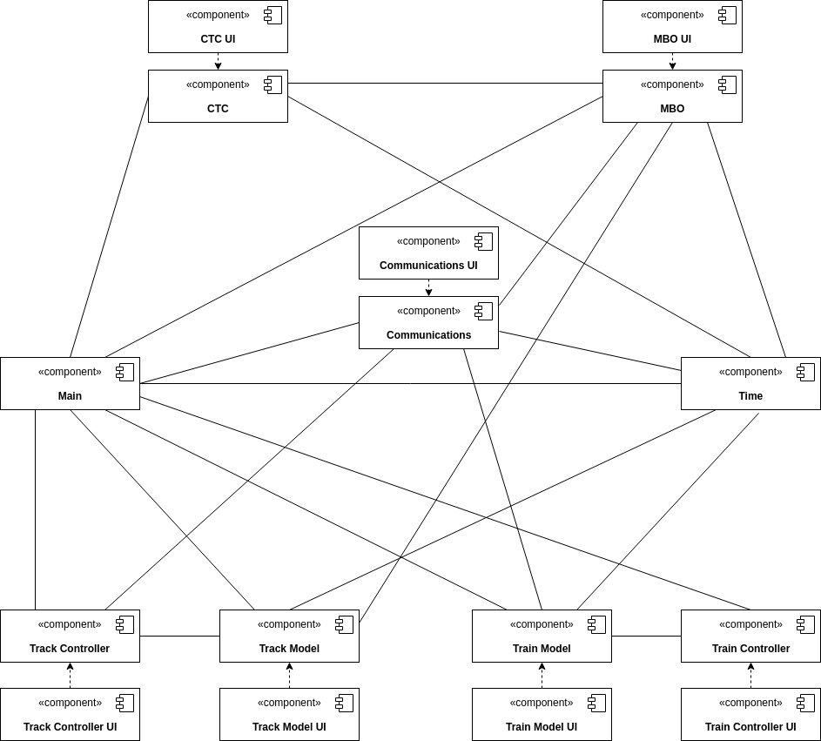
Overall Component Design
Notes:
<number>

Slide 4
User Case Diagrams
Notes:
<number>

Slide 5
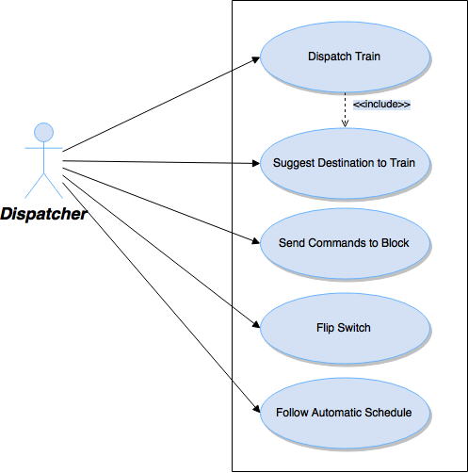
CTC
Notes:
<number>

Slide 6
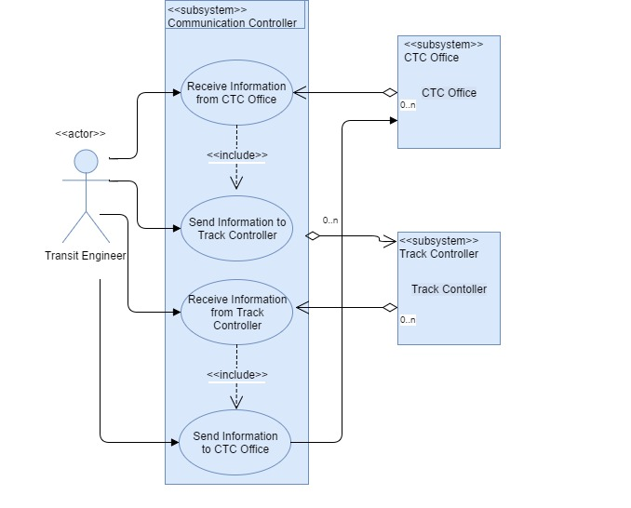

Communication Controller
Notes:
<number>

Slide 7
Track Model
Notes:
<number>

Slide 8
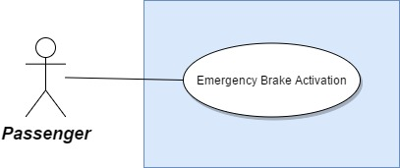
Train Model
Notes:
<number>

Slide 9
Train Controller
Notes:
<number>

Slide 10
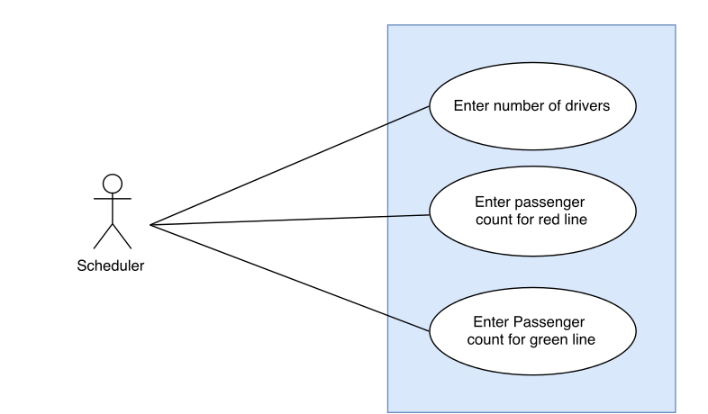
MBO
Notes:
<number>

Slide 11
Class Diagrams
Notes:
<number>

Slide 12
Overall System
Notes:
<number>

Slide 13
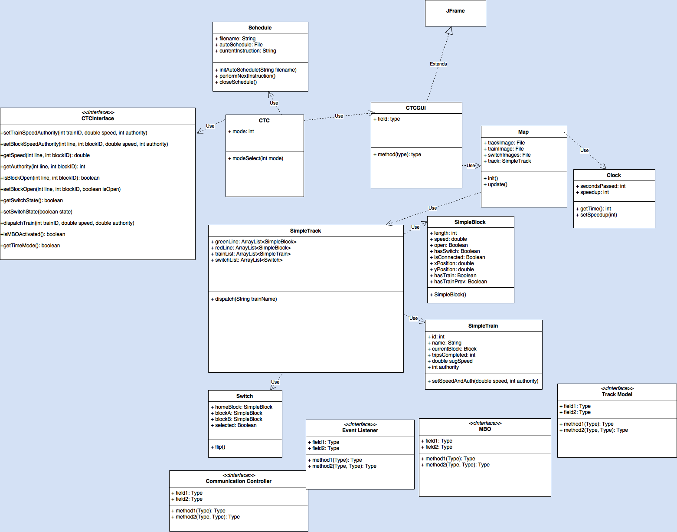
CTC
Notes:
<number>

Slide 14
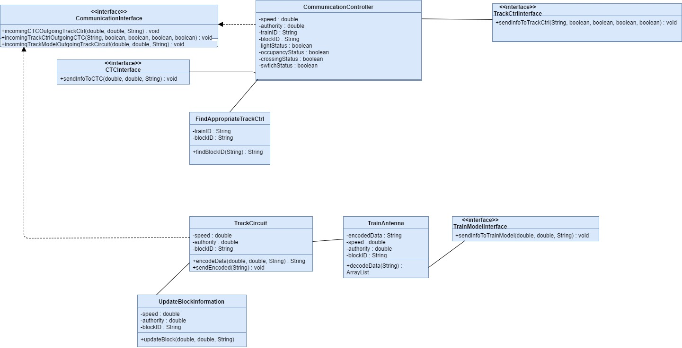
Communication
Notes:
<number>

Slide 15
Track Model
Notes:
<number>

Slide 16
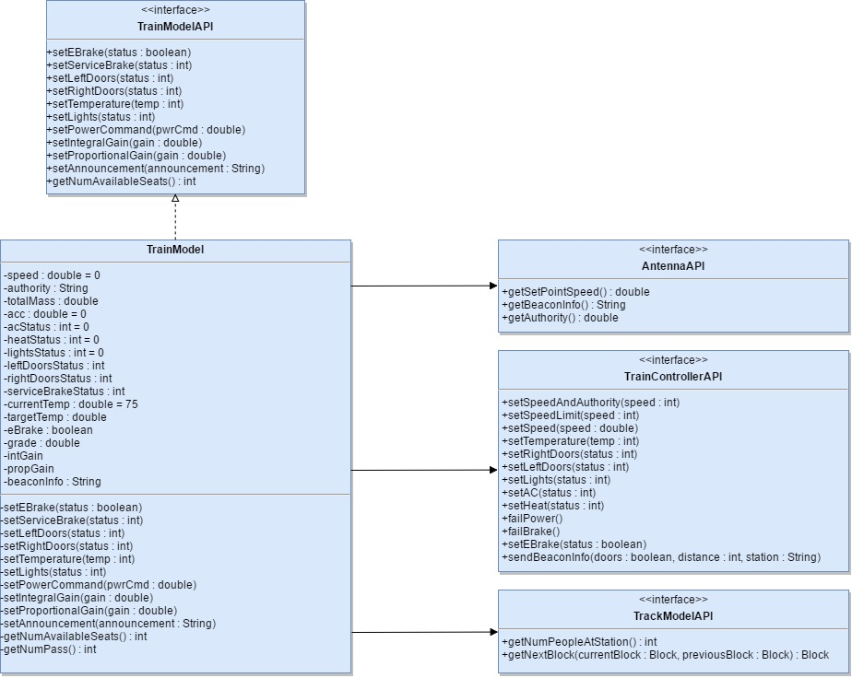
Train Model
Notes:
<number>

Slide 17
Train Controller
Notes:
<number>

Slide 18
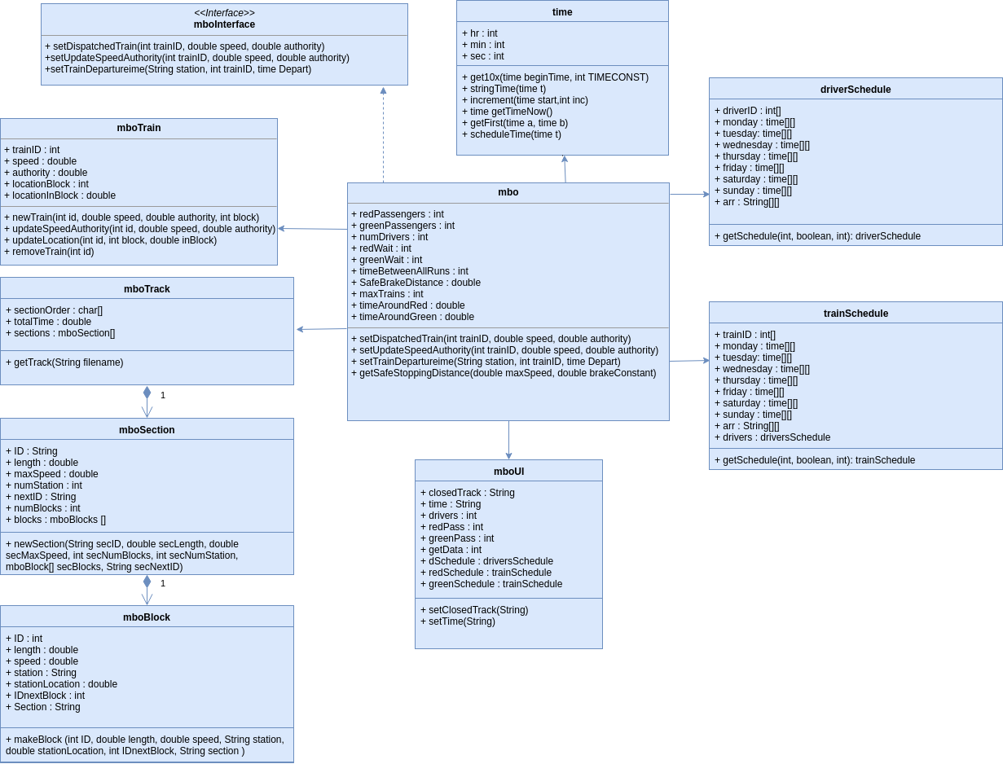
MBO
Notes:
<number>

Slide 19
Sequence Diagrams
Notes:
<number>

Slide 20
CTC
Notes:
<number>

Slide 21
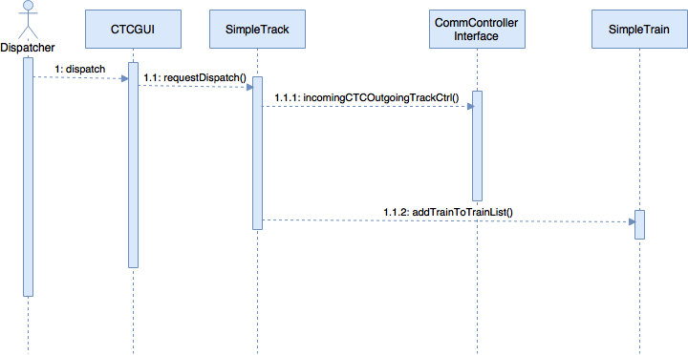
Dispatch Train
Notes:
<number>

Slide 22
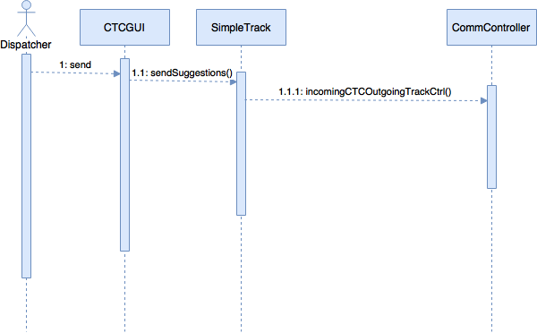
Send Speed/Authority
Notes:
<number>

Slide 23
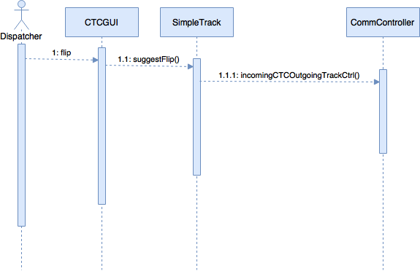
Flip Switch
Notes:
<number>

Slide 24
Communication
Notes:
<number>

Slide 25
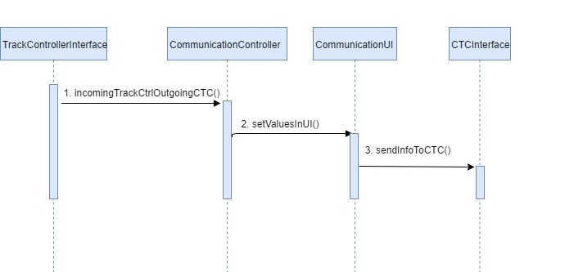
Receive data from Track Controller and send data to CTC
Notes:
<number>

Slide 26
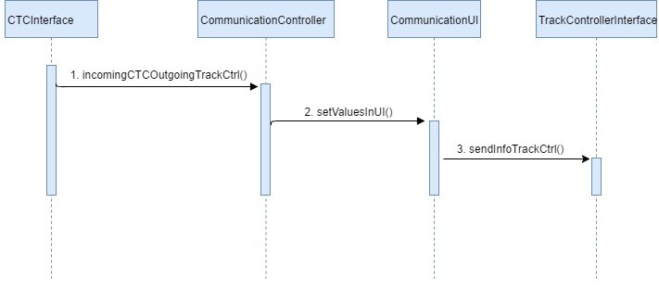
Receive data from CTC and send data to Track Controller
Notes:
<number>

Slide 27
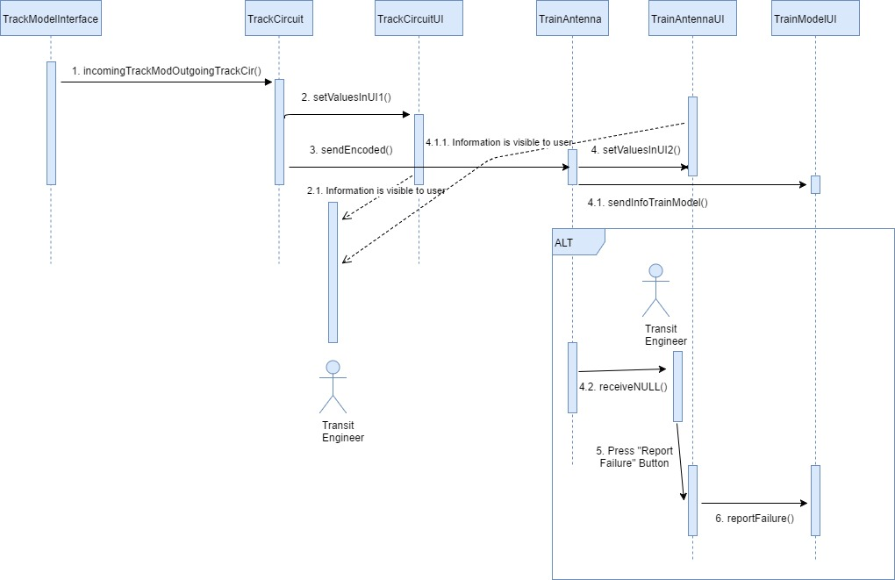
Handle communication between Track Model and Train Model
Notes:
<number>

Slide 28
Track Model
Notes:
<number>

Slide 29
Setting Temperature
Notes:
<number>

Slide 30
Causing Failures
Notes:
<number>

Slide 31
Loading File
Notes:
<number>

Slide 32
Viewing a Block
Notes:
<number>

Slide 33
Train Model
Notes:
<number>

Slide 34
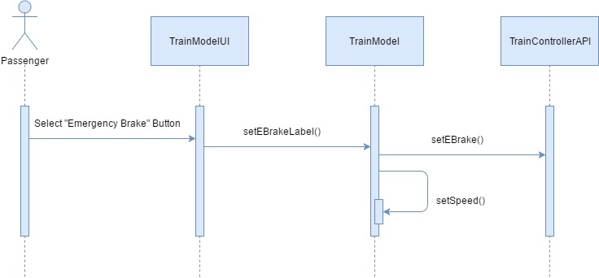
Activating Emergency Brake
Notes:
<number>

Slide 35
Train Controller
Notes:
<number>

Slide 36
Set Speed
Engage Emergency Brake
Notes:
<number>

Slide 37
Open/Close Doors
Send Announcement
Notes:
<number>

Slide 38
Set Gain Values
Notes:
<number>

Slide 39
MBO
Notes:
<number>

Slide 40
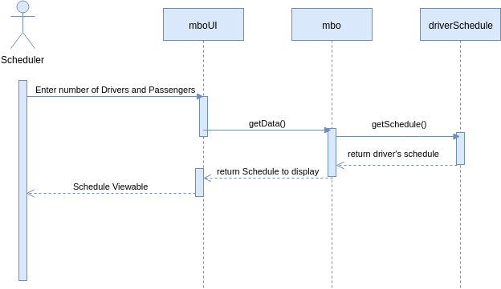
Create Driver Schedule
Notes:
<number>

Slide 41
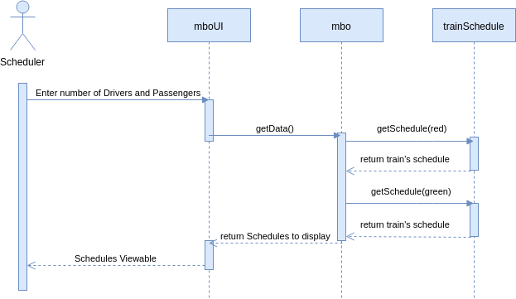
Create Train Schedules
Notes:
<number>

