Slide 1

Email-info@dynamichawaii.com
Call us- +1(800)211-0628
Text us-+1(808)374-2022

Slide 2
KAUAI
Tour Description :
Fly to Pearl Harbor, Oahu for a full day.
Arizona Memorial, Navy Shuttle to the Memorial, Movie
Road to War Museum
Oahu Full Circle Island Tour.
Round trip air ticket included from Kauai

Slide 3
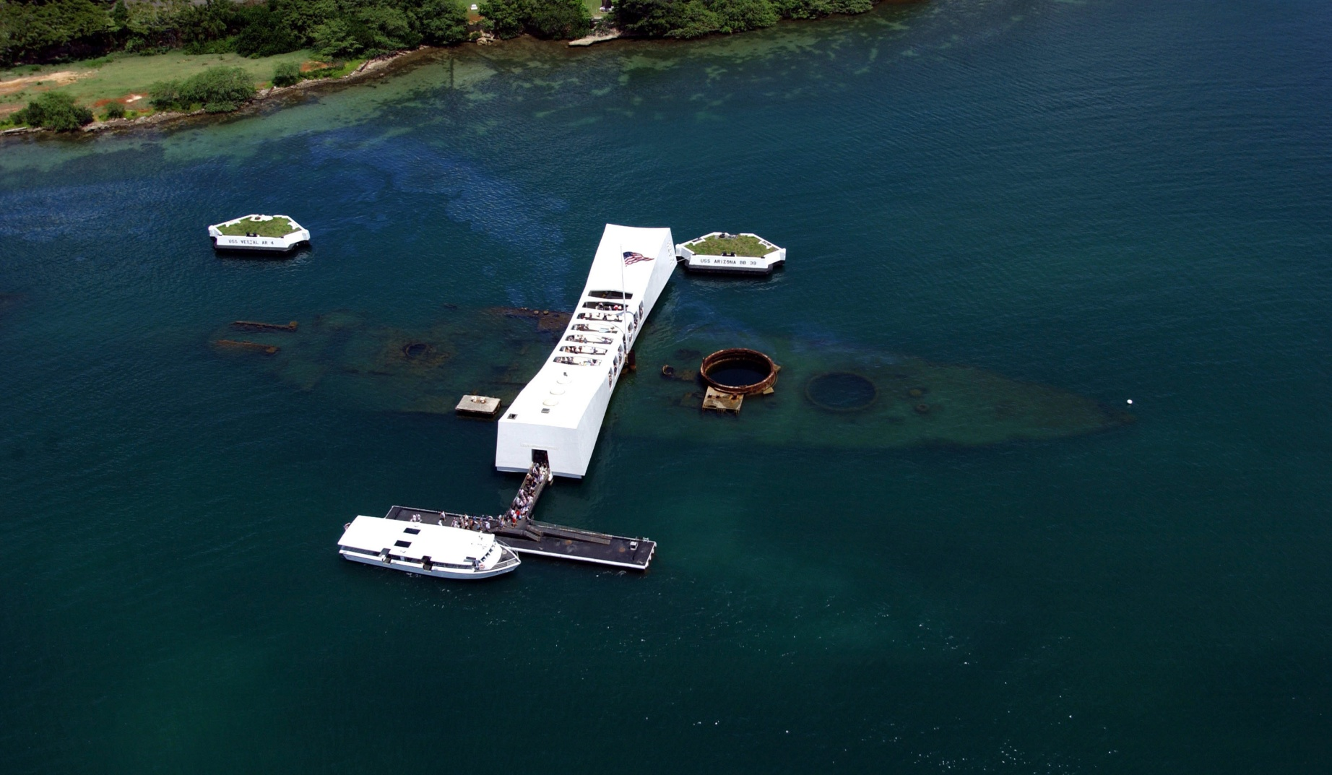
Pearl Harbor & Oahu Circle Island Tour Departing Kauai

Slide 4
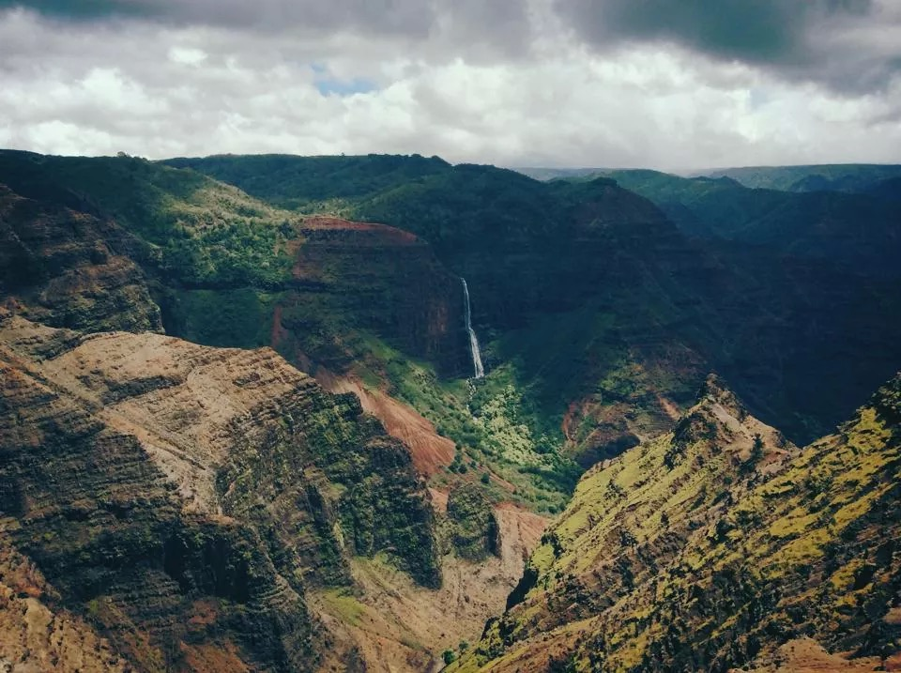
Waimea Canyon, Waterfall Adventure Tour

Slide 5
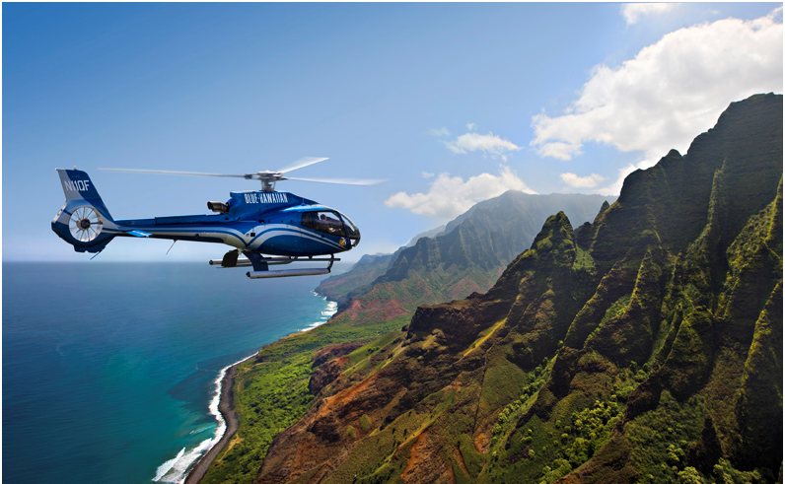
KAUAI HELICOPTER AND GUIDED GROUND TOUR

Slide 6
Maui – Popular Tours

Slide 7
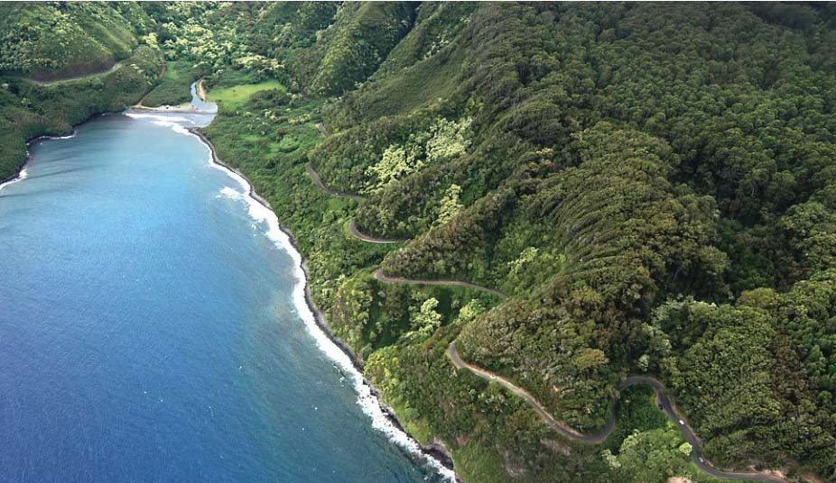
Road to Hana Adventure Tour In Maui

Slide 8
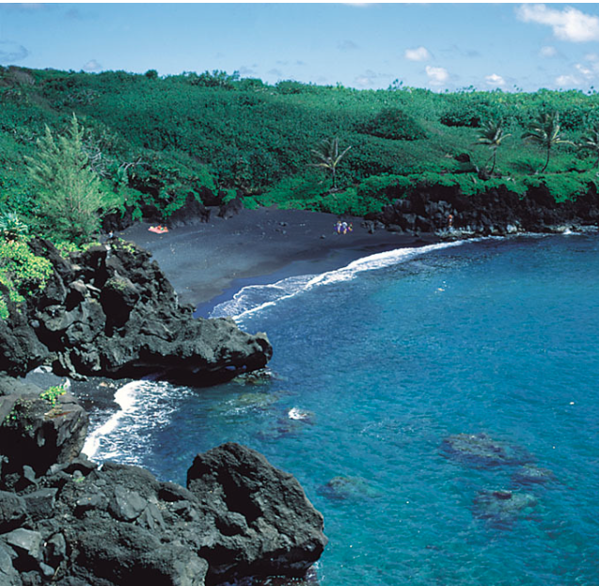
Black Sand Beach

Slide 9
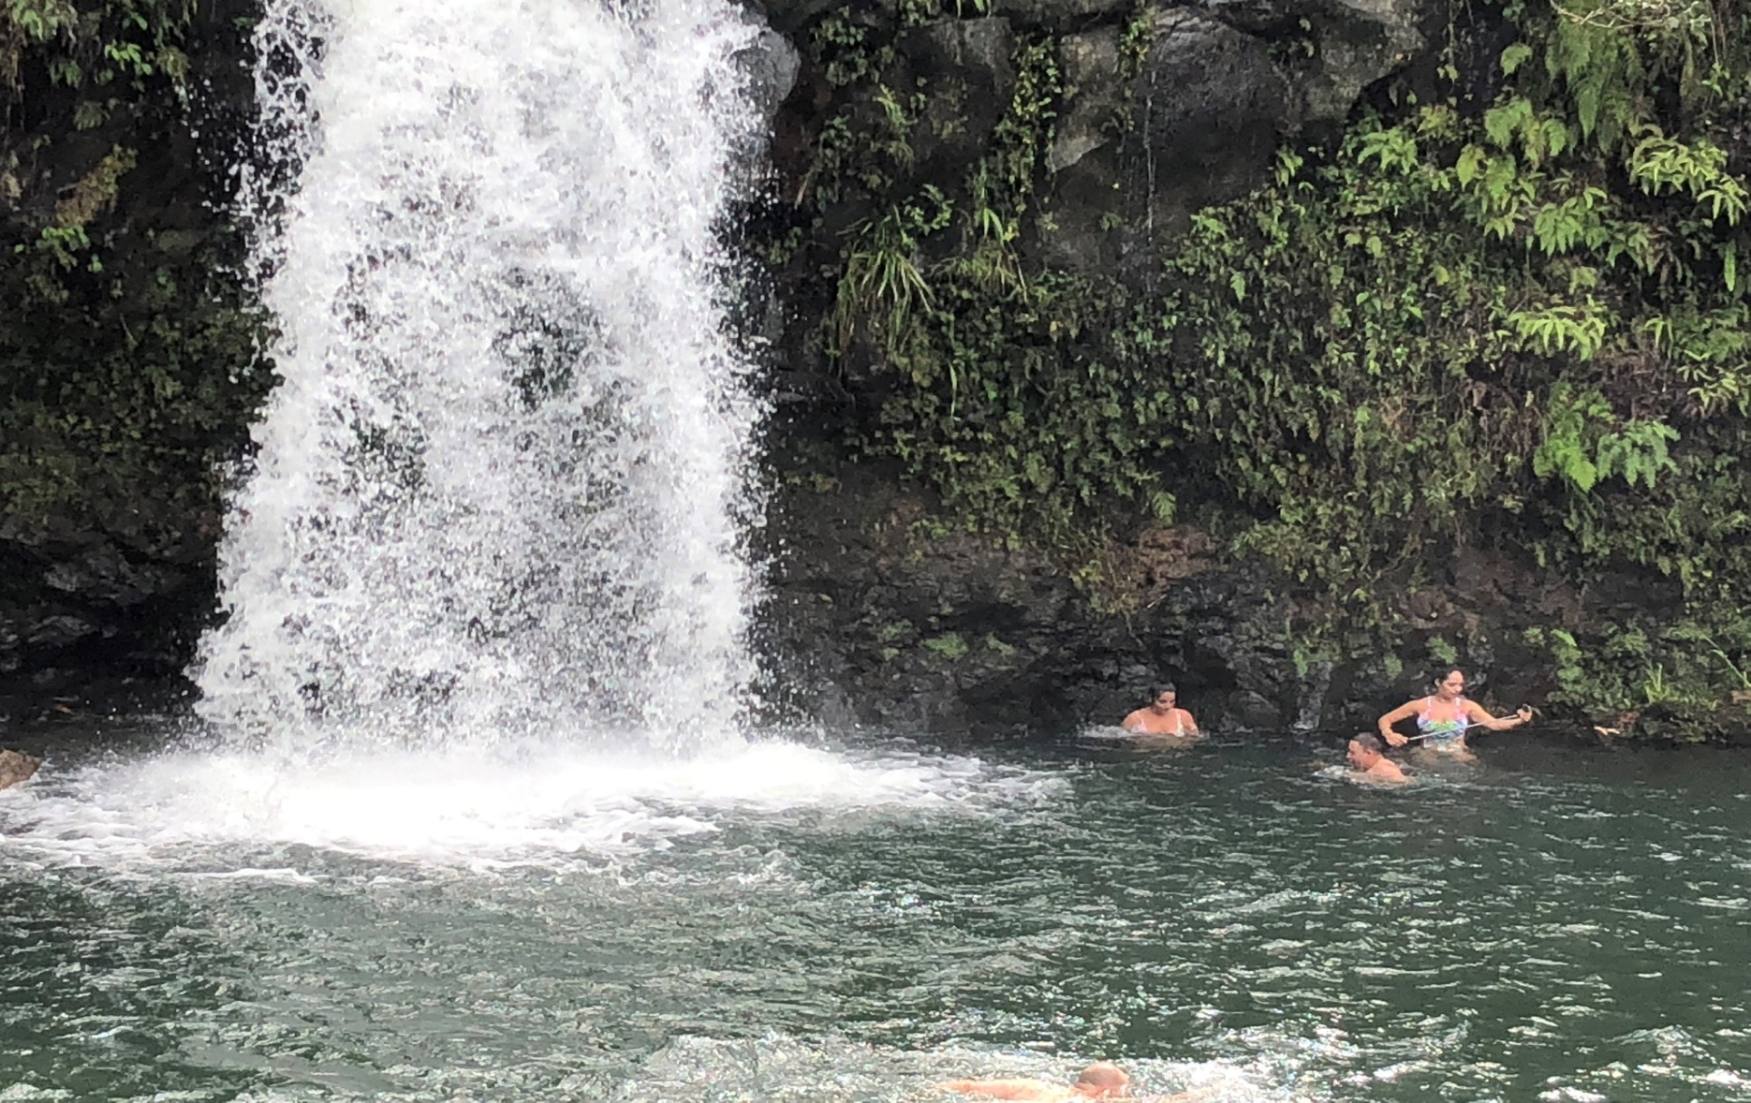
Wailua Waterfalls

Slide 10
Hawaii Big Island Signature Tours

Slide 11
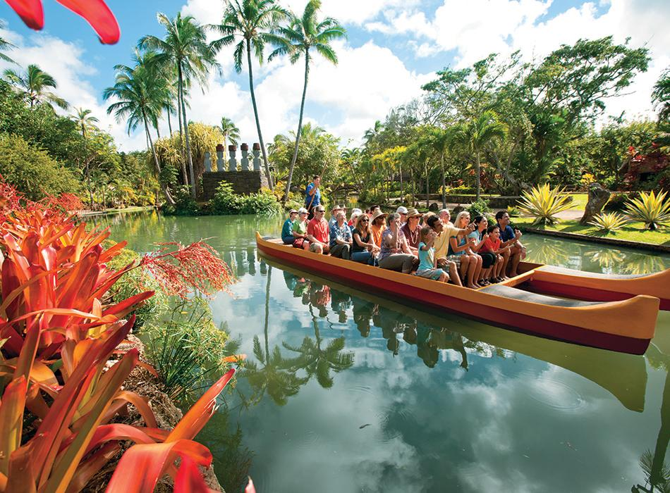
Pearl Harbor & Oahu Circle Island Tour Departing Kona

Slide 12
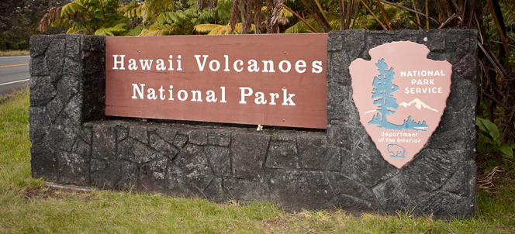
Big Island Volcanoes National Park Adventure Tour

Slide 13
THANKS FOR CHOOSING US
Email-info@dynamichawaii.com
Call us- +1(800)211-0628
Text us-+1(808)374-2022

