Slide 1
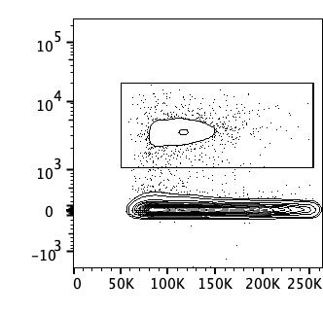
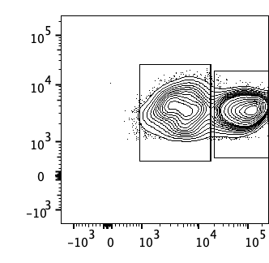
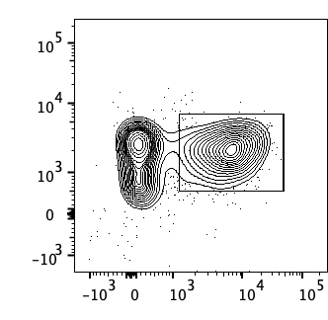
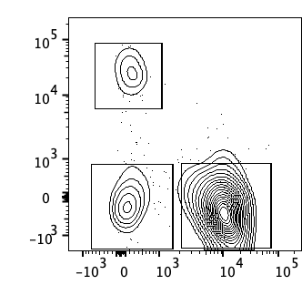
Live cells
CD90.2⁻
CD8 T cells
αβ T cells
CD4 T cells
CD45
CD45
CD90.2⁺
CD3
CD8β
FSC-A
CD90.2
βTCR
CD4

Slide 2
Live cells
CD90.2⁻
CD45
CD45
CD90.2⁺
FSC-A
CD90.2

