Slide 1
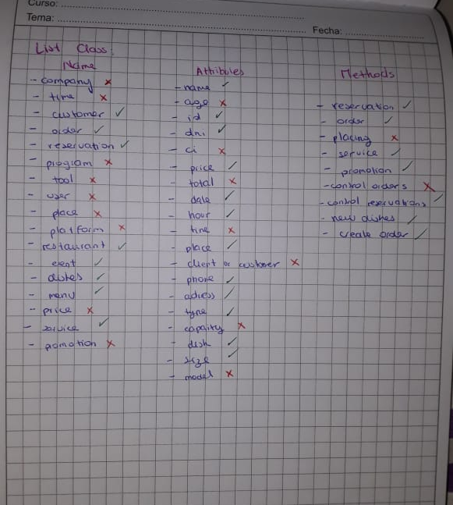
HW_0.5_ClassProject

Slide 2
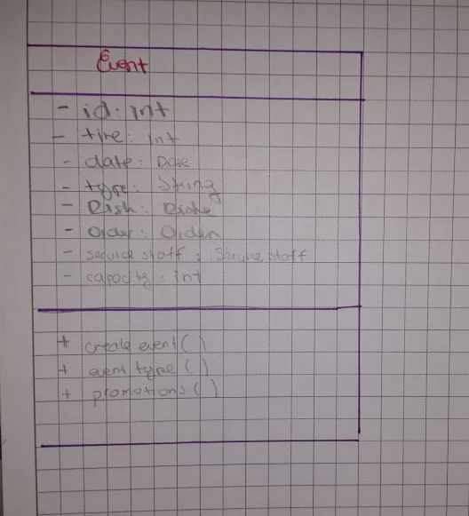
CLASS

Slide 3
