Slide 1
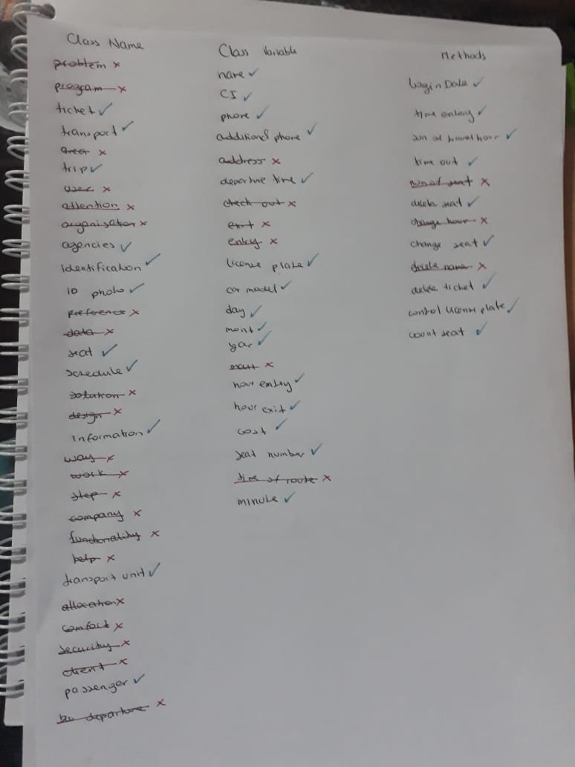
HW_0.5_ClassProject

Slide 2
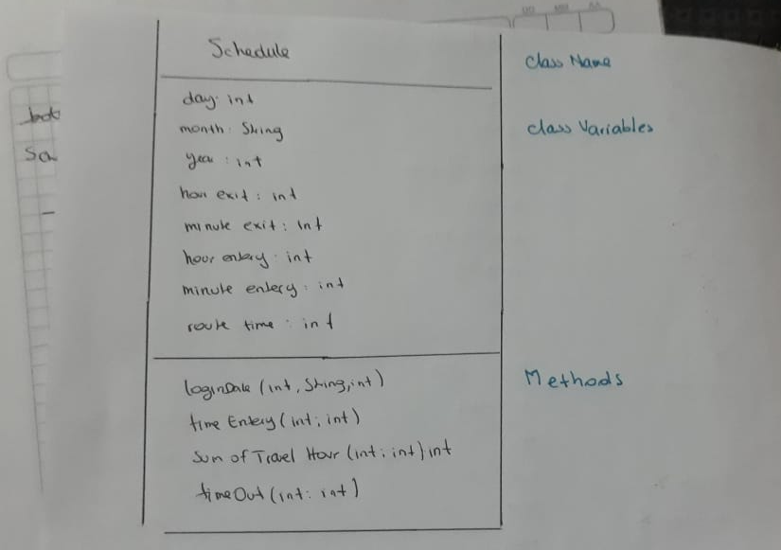

Slide 3
