Slide 1
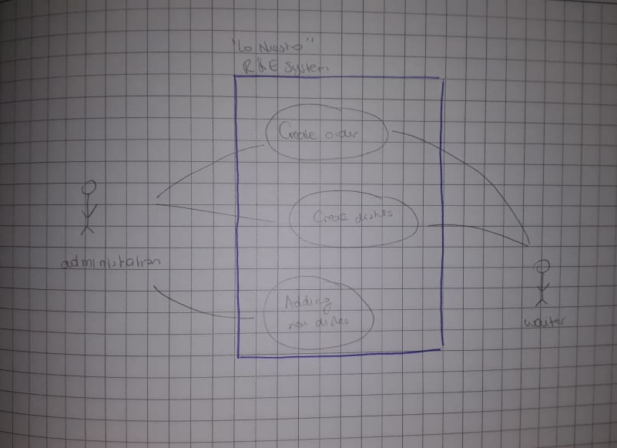
HW_0.6_ USE CASE DIAGRAM

Slide 2
