Slide 1
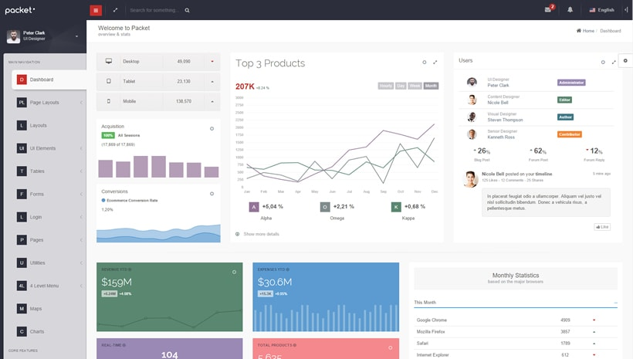
Example

Slide 2
Home
Login
Signup
Student
Search for courses
My Teachers
My Timetable
Payment Info
Teacher
My Students
My Timetable
My Payments
Home
Login
Signup
StudentID
TeacherID
Picture
Name
Class name
My chat
My Timetable
My Package
Upload files
Upload videos

Slide 3
Home
Login
Signup
TeacherID
StudentID
Picture
Name
My chat
My Timetable
My Payments
Upload files
Upload videos
My timetable
Editable Calendar
Google Maps API
Skype API

Slide 4
My Packages
Acquire XXX lessons for €XXX per hour
My Payments
PayPal or Stripe API

Slide 5
Home
I am a:
Teacher
Student
My Virtual School
username
password
The platform where students and teacher learn from one another
First time? Sign in

Slide 6
/studentID
Teachers
Calendar
Search for new courses
Welcome, {name}
My teachers
My timetable
Jan
Karina
My next class is on DATE at TIME with TEACHER NAME at LOCATION / ONLINE
Dutch
Spanish
Go to calendar
My payments
Your next payment is to due on XXX
Your payment is due! Please pay here

Slide 7
/teacherID
Students
Calendar
Welcome, {name}
My students
My timetable
Anna
Paul
My next class is on DATE at TIME with TEACHER NAME at LOCATION / ONLINE
Amsterdam
Rotterdam
My payments
Your next payment is to due on DATE from STUDENT NAME
Go to My Payments

Slide 8
/studentID/teacherID
Teachers
Calendar
Welcome, {name}
Picture
Jan
My timetable
Dutch
DATE TIME online
DATE TIME at Wework
My chat
Edit timetable
Hello. I need your help ☺l
Sure. How can I help you?
My Package
Upload files
Acquire new lessons
Upload videos

