Slide 1
MYFLOVE
One calm way through
everyday life.
Plan for your capacity. Not just your time.
AI-supported digital everyday support
Connect Öst · Online Pitch Review · September 10, 2026
Notes:
Hi, I'm Camilla Baksi, founder of MyFlove. In the next three minutes I want to show you why we believe everyday life needs a completely different kind of support tool - and why we've already built it.

Slide 2
THE PROBLEM
Everyday life requires more
than a to-do list.
People can know exactly what they need to do and still be unable to make the day work.
WHAT NEEDS TO BE DONE
Tasks · Time · Reminders
Traditional tools organise the demands.
WHAT I ACTUALLY HAVE CAPACITY FOR
Energy · Mental load · Invisible work
Rarely accounted for anywhere.
When demands exceed capacity, the person becomes the system.
Notes:
Most tools assume the hard part is knowing what to do. It isn't. People know. What breaks the day is everything the tools ignore - energy, mental load, invisible work, and a capacity that changes from morning to afternoon. When demands exceed capacity, the person has to be the system: remembering, prioritising, rescheduling, and constantly judging what is realistic. That is exhausting, and it is where everyday life falls apart.

Slide 3
THE INSIGHT
Plan for capacity,
not just time.
A CALENDAR SAYS
“You have three things scheduled today.”
MYFLOVE ASKS
“Given how you are today, what is actually reasonable?”
Notes:
So we started from a different question. Not what is scheduled - but what is reasonable, given how this person actually is today. That single shift, from time to capacity, is the insight the whole product is built on.

Slide 4
THE SOLUTION
MyFlove turns capacity into a planning signal.
01 — How are you?
Check energy, mood and what is affecting your capacity right now.
02 — What's happening?
Capture what needs to happen — including the invisible work.
03 — Need to adapt?
FlowPlan adjusts the day to the capacity you actually have.
Capture → Understand → Adapt → Continue
Notes:
In the product it becomes three simple steps. You say how you are. You get everything out of your head. And then the system - not you - does the work of adapting the day. Capture, understand, adapt, continue. That loop runs every single day.

Slide 5
THE PRODUCT
One system. One daily flow.
A working web application in use today.
QuickFlow
Get thoughts and tasks out of your head in seconds.
Battery
Understand today's energy and capacity with one tap.
Calendar / Daily Flow
See what is actually happening, on the right day.
Flow / FlowPlan
Find the next reasonable step and adapt when capacity changes.
Complex technology underneath. Simple experience on the surface.
Notes:
This is not a concept. It is live. Four things carry the experience: QuickFlow to empty your head, the Battery for capacity, the calendar for what is real today, and Flow, our AI companion, that turns all of it into one next reasonable step. Complex underneath, deliberately simple on the surface.

Slide 6
WHY MYFLOVE IS DIFFERENT
From task management to capacity management.
TRADITIONAL TOOLS
MYFLOVE
What needs to be done?
What can I realistically do?
Time-based planning
Capacity-based planning
Tasks and reminders
Tasks + energy + context
User adapts to the system
System adapts to the user
Completion-focused
Sustainable everyday life
Notes:
The difference is easy to say out loud. Other tools ask what needs to be done. MyFlove asks what you can realistically do. In every other tool the user adapts to the system. Here the system adapts to the user.

Slide 7
MARKET OPPORTUNITY
A large problem across markets.
MyFlove serves people with high mental load and complex everyday demands — a scalable platform, not a niche diagnosis app.
B2C — Consumers
People who struggle to align everyday demands with their actual capacity.
B2B — Employers
Organizations investing in sustainable digital support and wellbeing.
B2G — Public sector
Municipalities supporting independence and everyday functioning.
Reference points: ADHD prevalence ~2.58% of adults globally (PubMed, 2021) · ~3% of adults in Sweden (Socialstyrelsen) · ADHD app market estimated at $1.9B in 2025, projected $6.7B by 2033 (Grand View Research).
External estimates — not MyFlove user or revenue figures.
Notes:
The people who need this are not a niche. Our first entry point is consumers, but the same capacity signal is what employers and the public sector are trying to buy today under names like wellbeing and independence. The figures on this slide are external estimates, cited, and we treat them as reference points - not as our claims.

Slide 8
TRACTION & VALIDATION
From product to proof.
BUILT
48 users
Functioning MVP · working web application
QuickFlow · Battery / energy · Calendar · Daily Flow · Flow / AI · energy history · weekly overview
NOW: STRUCTURED VALIDATION + PILOT TESTING
We are measuring
Recurring usage · perceived mental load · sense of control · prioritisation · ability to get started · usefulness of QuickFlow and Flow/FlowPlan · willingness to continue · willingness to pay
No paying customers and no clinical outcomes claimed — those are exactly what we are now measuring.
Notes:
Today we have 48 users on a working MVP. I want to be precise: we do not have paying customers and we do not claim clinical outcomes. What we have is a product that runs, and a validation programme starting now - measuring recurring use, perceived mental load, sense of control, and willingness to pay. That evidence is the next milestone.

Slide 9
BUSINESS MODEL & GO-TO-MARKET
Prove value first. Scale second.
B2C — now
Free → Premium. Pricing validated before it is set.
B2B — next
Employers and organizations.
B2G — then
Public sector and municipalities.
Pilot
Validate
Launch
B2C
B2B / B2G
Scale
We are deliberately validating the product and the business model before scaling.
Notes:
Commercially we start direct to consumer, free to premium, and we validate price rather than guess it. Employers and the public sector are the scale path, and both already buy in this space. We are deliberately proving value before we spend money scaling.

Slide 10
TEAM
Built from lived experience + professional expertise.
Camilla Baksi
Founder, MyFlove
Humanistic Social Pedagogue
Further education in NPF, pedagogy, problematic school absence, and professional response to trauma and difficult events.
Professional experience
Youth coach · support worker · childcare worker
Founder insight
The intersection of professional knowledge, lived experience and product development.
Notes:
I build this from both sides. Professionally I'm a humanistic social pedagogue with further training in neurodevelopmental conditions, school absence and trauma response, and I've worked as a youth coach and support worker. I've also lived this problem. That combination is why the product feels the way it does.

Slide 11
FUNDING
Raising €250K · 18-month runway
Product & technology
iOS / Android · technical stabilization · backend & scalability · security / GDPR
Validation
Structured pilots · analytics · retention measurement · proof of value
Commercialization
Onboarding · launch preparation · initial B2C / B2B / B2G development
MILESTONES BY END OF RUNWAY
Validated product-market fit signals · measured user outcomes · validated retention and recurring use · completed pilot evidence · mobile product ready for broader launch · clearer commercial model and a first scalable customer channel.
Notes:
We're raising two hundred and fifty thousand euros for an eighteen month runway. It goes to three things: finishing mobile and hardening the platform, running real pilots with real measurement, and preparing commercial launch. At the end of it we intend to have evidence - measured outcomes, validated retention, pilot results, and a first scalable customer channel.

Slide 12
Everyday life shouldn't
require you to be
someone else.
MyFlove adapts the system to the person — not the other way around.
Plan for your capacity. Find your next possible step.
MyFlove · myflove.lovable.app
Notes:
People don't need another tool telling them what to do. They need one that helps them understand what they can actually handle. We've built the MVP. Now we're proving it creates measurable value - and building the foundation to scale. Thank you.

Slide 13
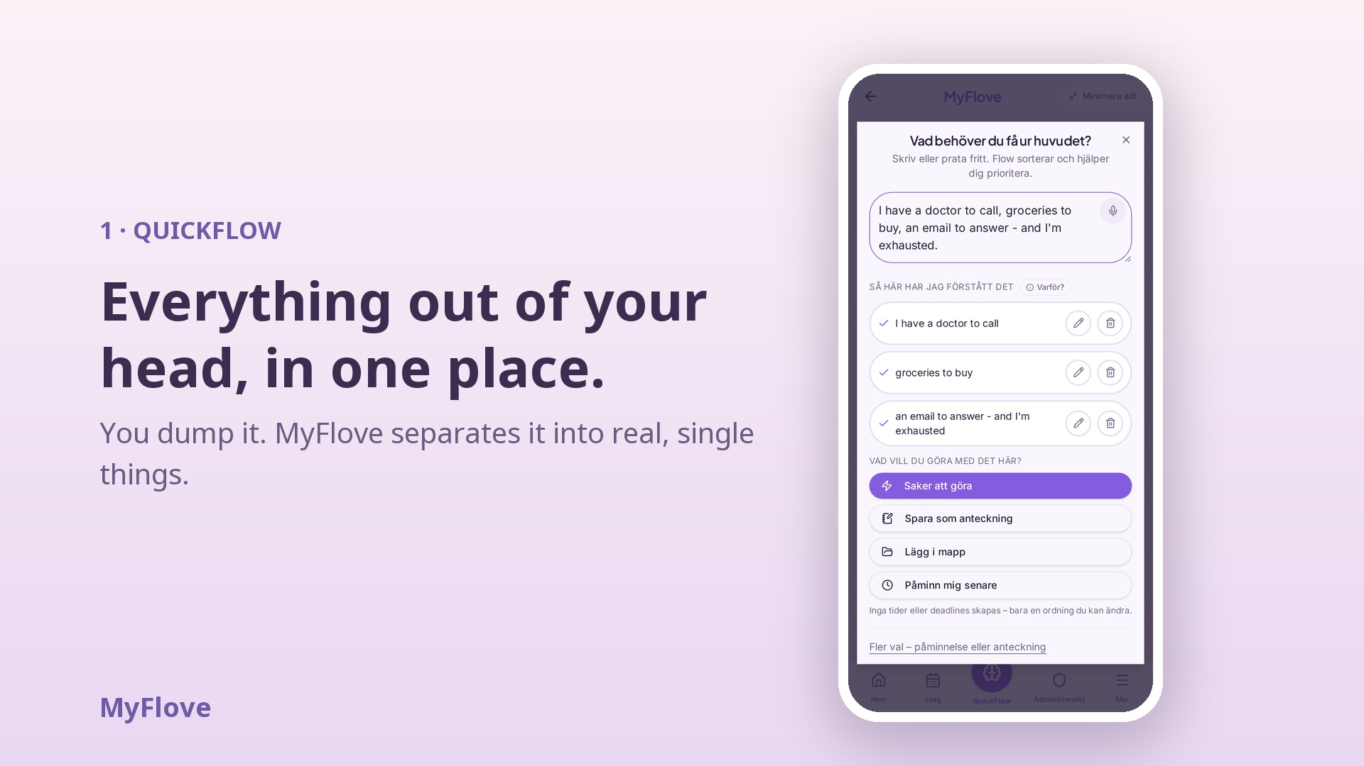
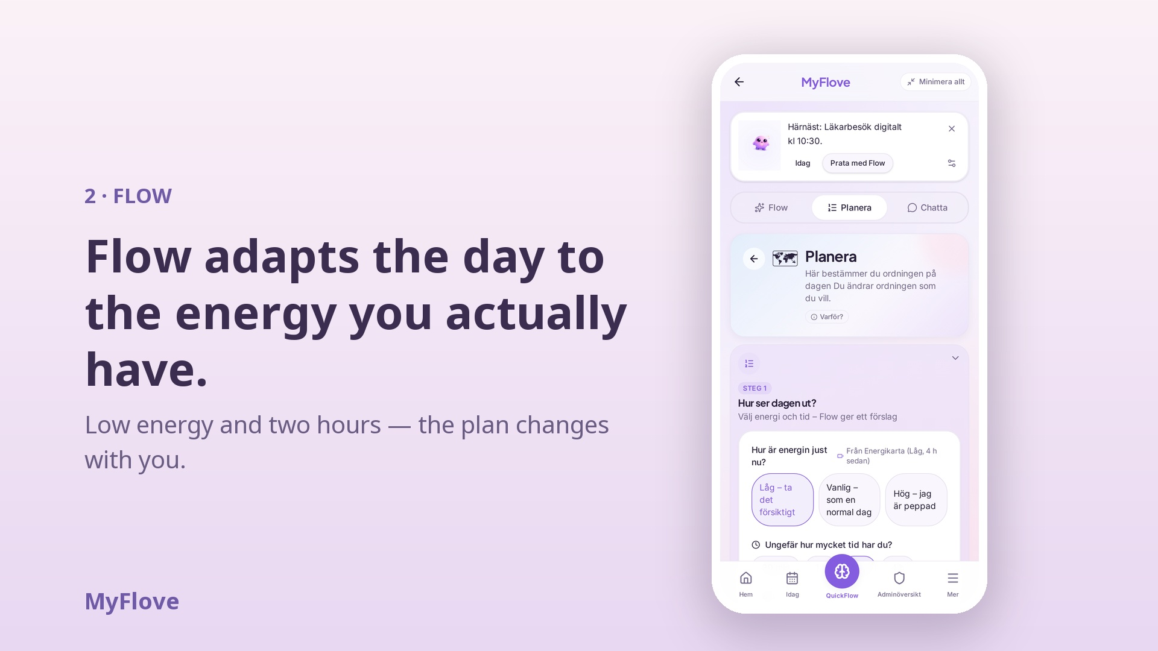
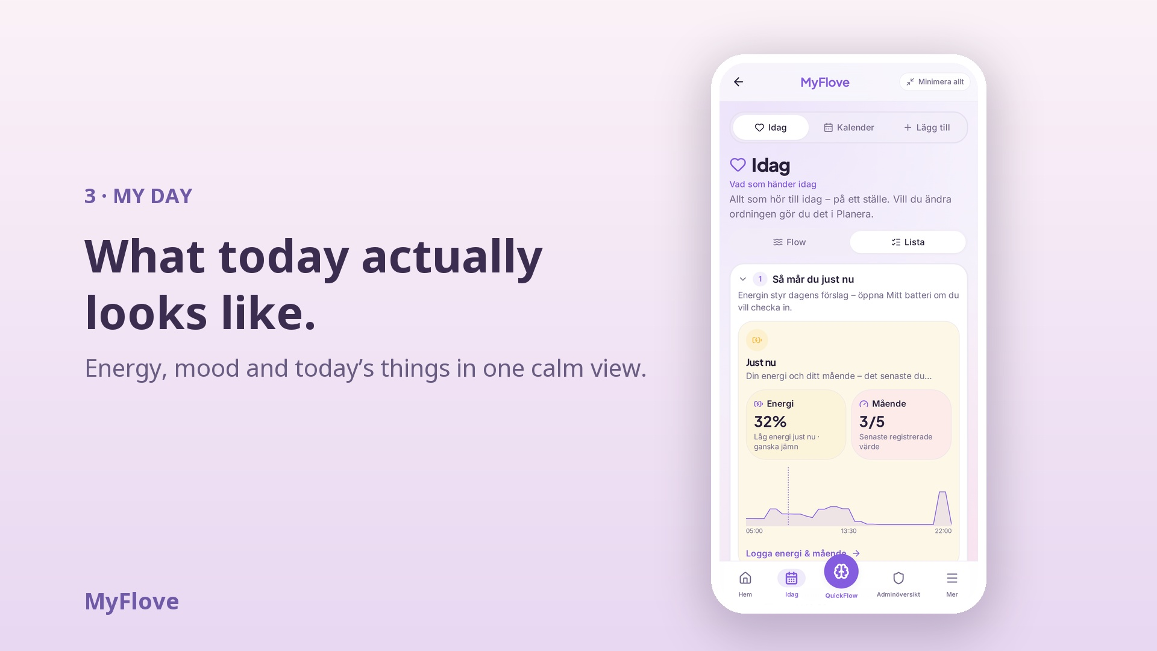
Live product demo — 20 seconds
QuickFlow → Flow → My Day. Real screens from the live app.
“The goal isn’t to get more done. It’s to make the day more doable.”
Video file: myflove-demo-20s.mp4

