Slide 1
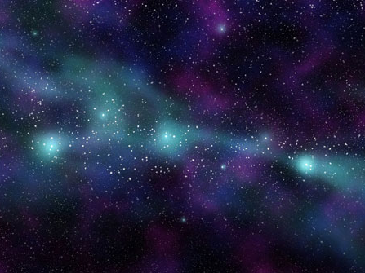

Slide 2
Prisoners’ Dilemma
Welcome Aboard

Slide 3
Mirrors reflect lasers
Blocks absorb lasers
Players alternate placing mirrors (left mouse button)
Press enter at the end of your turn to fire your laser
Player A press A Player B Press L

