Slide 1
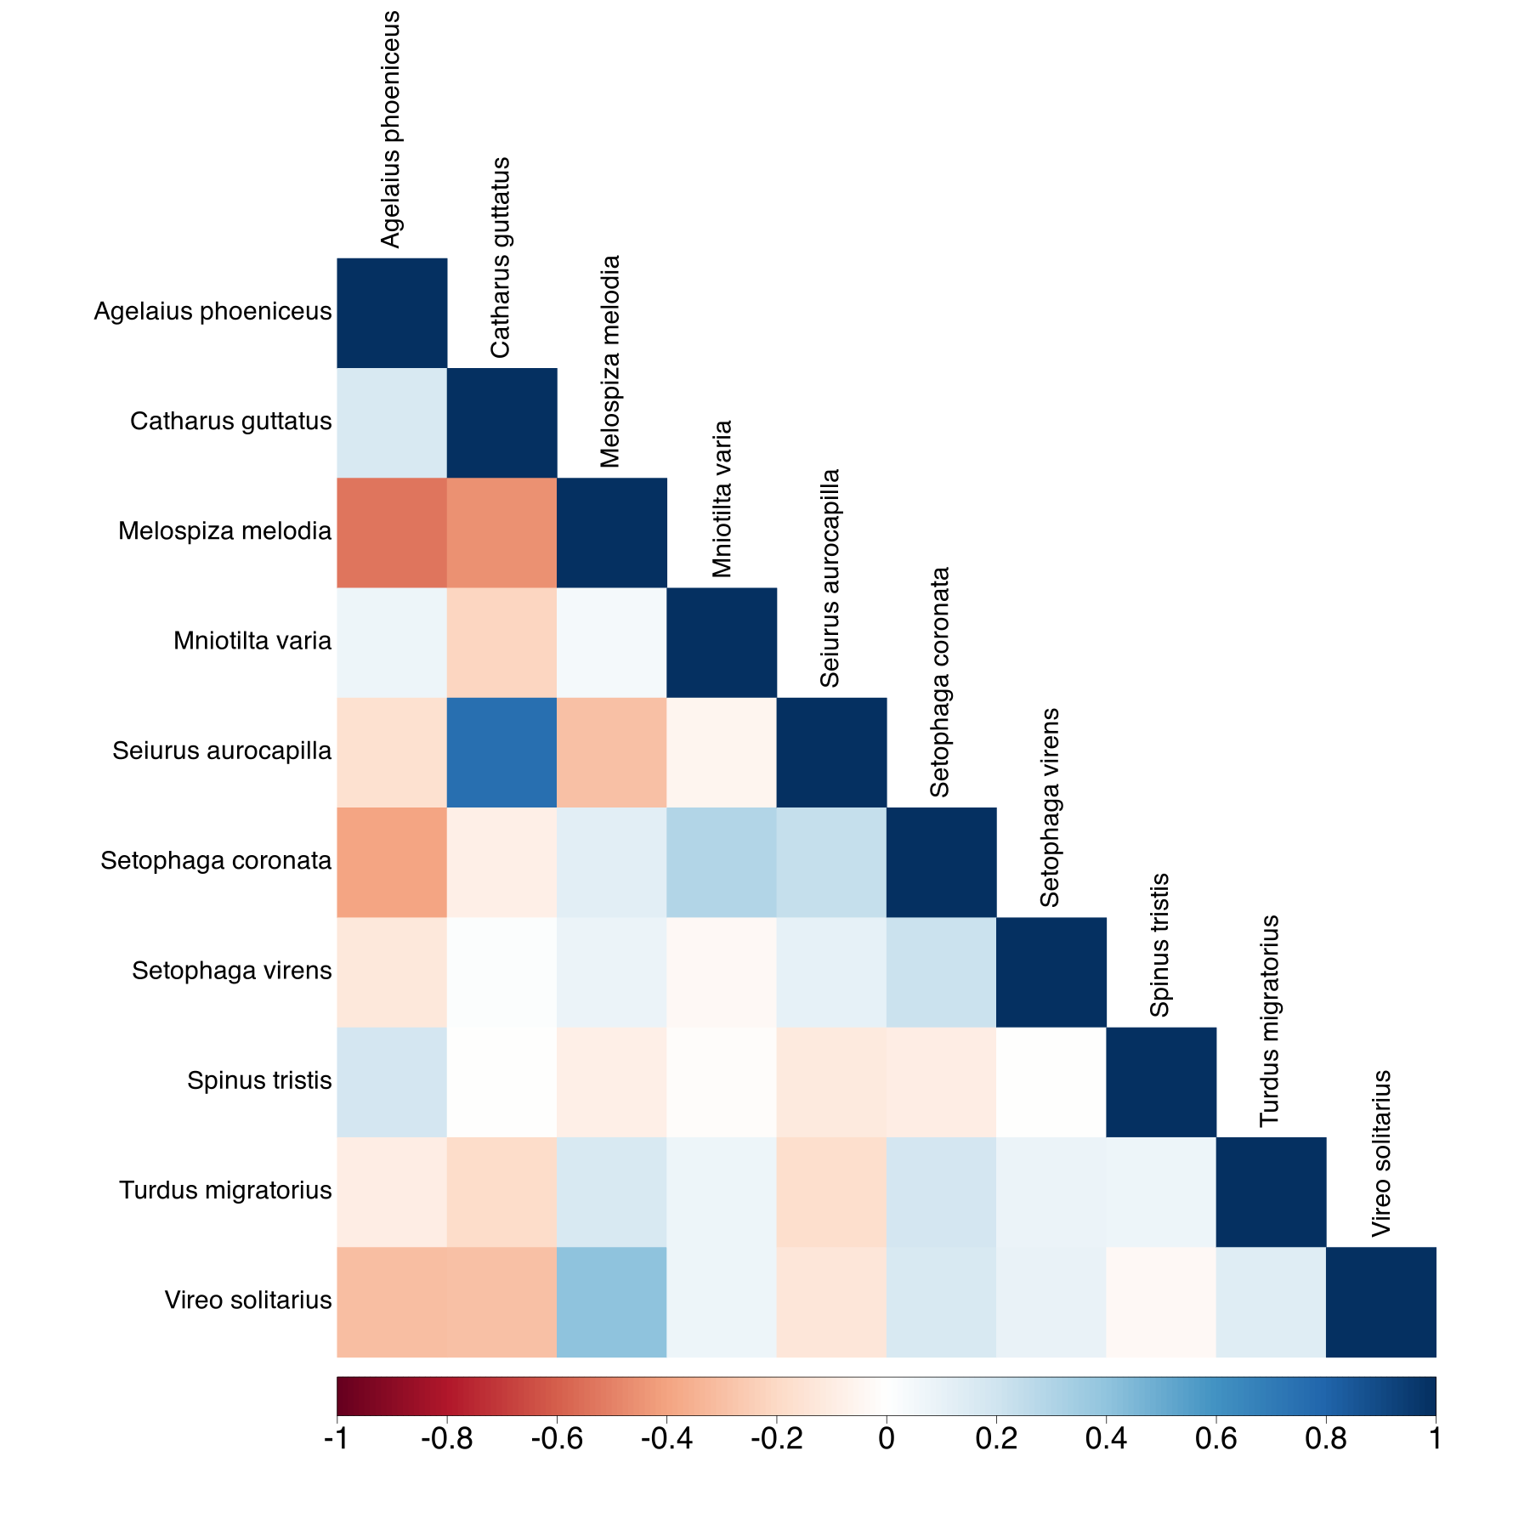
A. phoeniceus
C. guttatus
Red-winged blackbird
Agelaius phoeniceus
M. melodia
Hermit thrush
Catharus guttatus
M. varia
Song sparrow
Melospiza melodia
S. aurocapilla
Black-and-white warbler
Mniotilta varia
S. coronate
Ovenbird
Seiurus aurocapilla
S. virens
Yellow-rumped warbler
Setophaga coronate
S. tristis
Black-throated green warbler
Setophaga virens
T. migratorius
American Goldfinch
Spinus tristis
V. solitarius
American robin
Turdus migratorius
Blue-headed vireo
Vireo solitarius

