Slide 1
Object Oriented Programming Java

Slide 2
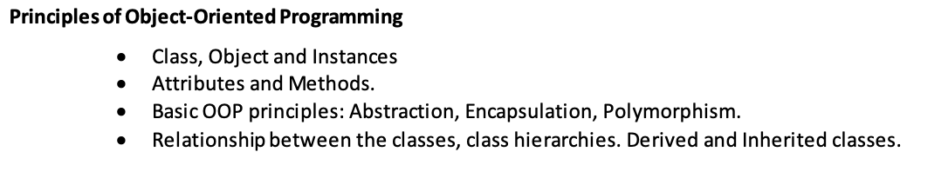
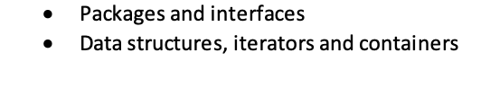
Course Outline

Slide 3
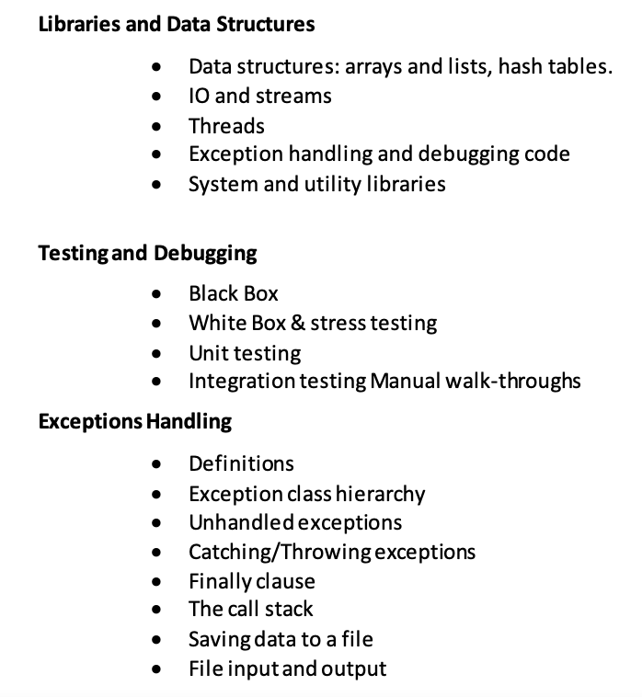
Course Outline

Slide 4
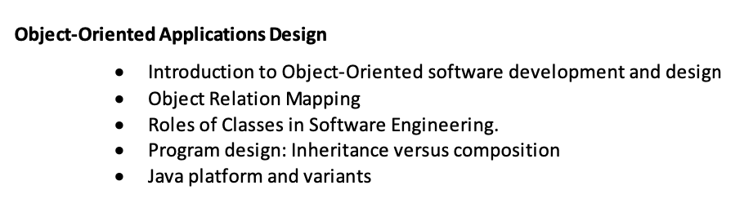
Course Outline

Slide 5
Java Basic Syntax
1
Identifier
5
Basic data types
9
Loop
2
Key word
6
Operator
10
Array
Constants and variables
11
3
7
Expression
Input & Output
4
Scope of a variable
8
Branching structure
12
Debugger

Slide 6
Java Basic Syntax – Data Type
Basic Data Type
numeric
Integer types （byte、short、int、long）
Floating Type（float、double）
character （char）
Data Type
Boolean（boolean）
Reference data type
Class（class）
Interface（interface）
Array（array）

Slide 7
Practice

Slide 8
Task 1: print out the max and min value of byte, short, integer, float, double
Task 2: print out a Boolean value, char. Print out char = a by assign a number to char
Task 3: create a java program with these parts: package, import, class, method, statement
Task 4: create a java class and create static variable, local variable and member variable (indicates by comments)
Task 5: convert data type between: int and double; int and byte; float and long; then print out the data type.
Task 6: calculate 1+2+3…+100, using two method: a++ and ++a
Task 7: find max and min value of (1,2,3) with syntax: x ? y : z
Task 8: compare the size of two values by using syntax: if
Task 9: calculate 1+2+3…+100, using for loop
Task 10: print out 1, 2, 3…20, using while loop
Task 11: print out 1, 2, 3…20, using do while loop, and indicates the different between while by comments
Task 12: print out Good when grade is C and print Great when grade is A, using syntax switch…case, also show how break and continue works
Task 13: create an add method, then call this method
Task 14: Statically initializes an array and print out all values in the array
Task 15: Statically initializes a two-dimension array and print out all values
Task 16: Statically initializes an array and copy part of it to a new array
Task 17: Dynamic initializes an array with 1, 2, 3…100, and print out the array

