Slide 1
X5GON Project
Aniss Bentebib
Camille-Amaury Juge
Vincent Kowalski

Slide 2


Slide 3

Gako

Slide 4
Project technical part
2

Slide 5
AND TABLES TO COMPARE DATA
 | BERT | ROBERTA | XLNET | DISTILLBERT
Inference speed | -- | --- | --- | +++
Accuracy | ++ | ++ | +++ | ---

Slide 6
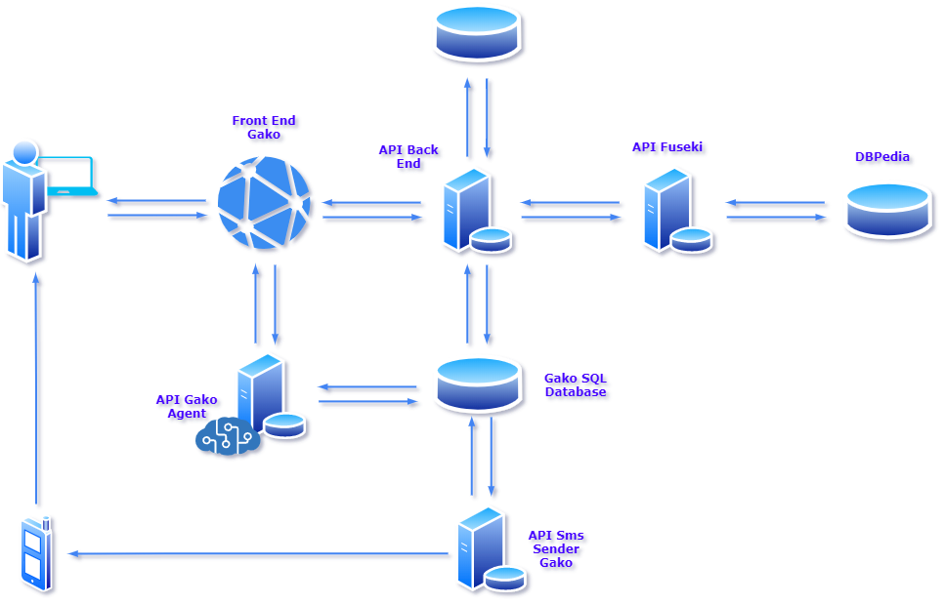

Slide 7
4 APIs
70+ endpoints
185,244 users
4 machine learning models
100+ theoretical languages
2 front-end version
50 million of documents

Slide 8
CREDITS
Thank you for your attention.
We hope you enjoy our presentation.
And thank you for this great opportunity.

