Slide 1
Optimization hyperparameters of VGG trained on Minicifar
10/02/2021
<numéro>
Titre de la présentation - menu « Insertion / En-tête et pied de page »

Slide 2
Summary
VGG ArchiTECTURE
Method used to optimize hyperparameters
Results different: depending on the number of layers
Results not depending On the number of layers
Best Models: application on test set
10/02/2021
1
Titre de la présentation - menu « Insertion / En-tête et pied de page »

Slide 3
I/ VGG Architecture
10/02/2021
2
Titre de la présentation - menu « Insertion / En-tête et pied de page »

Slide 4
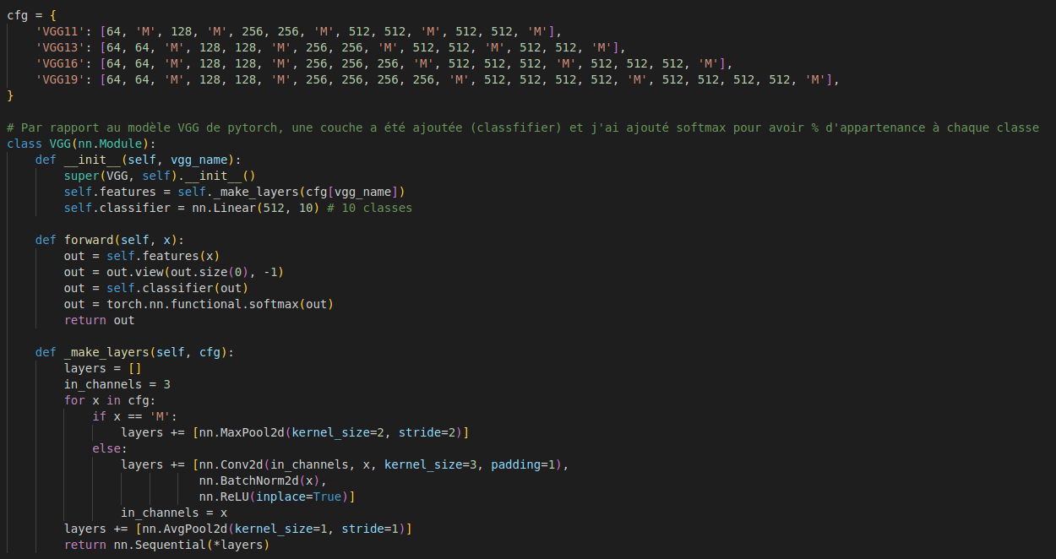

Slide 5
VGG11
VGG13
VGG16
VGG19
Size:
32x32
Input
Size:
32x32
Input
Size:
32x32
Input
Size:
32x32
Input
Size:
32x32
3x3 conv, pad1, 64
Size:
32x32
3x3 conv, pad1, 64
Size:
32x32
3x3 conv, pad1, 64
Size:
32x32
3x3 conv, pad1, 64
Size:
32x32
3x3 conv, pad1, 64
Size:
32x32
3x3 conv, pad1, 64
Size:
32x32
3x3 conv, pad1, 64
MaxPooling
MaxPooling
MaxPooling
Size:
16x16
3x3 conv, pad1, 128
Size:
16x16
3x3 conv, pad1, 128
Size:
16x16
3x3 conv, pad1, 128
MaxPooling
Size:
16x16
Size:
16x16
3x3 conv, pad1, 128
Size:
16x16
3x3 conv, pad1, 128
3x3 conv, pad1, 128
MaxPooling
MaxPooling
Size:
16x16
3x3 conv, pad1, 128
MaxPooling
Size:
8x8
3x3 conv, pad1, 256
Size:
8x8
3x3 conv, pad1, 256
Size:
8x8
3x3 conv, pad1, 256
Size:
8x8
3x3 conv, pad1, 256
MaxPooling
Size:
8x8
3x3 conv, pad1, 256
Size:
8x8
3x3 conv, pad1, 256
Size:
8x8
3x3 conv, pad1, 256
Size:
8x8
3x3 conv, pad1, 256
Size:
8x8
3x3 conv, pad1, 256
Size:
8x8
3x3 conv, pad1, 256
MaxPooling
Size:
8x8
3x3 conv, pad1, 256
MaxPooling
MaxPooling
Size:
4x4
3x3 conv, pad1, 512
Size:
4x4
3x3 conv, pad1, 512
Size:
4x4
3x3 conv, pad1, 512
MaxPooling
Size:
4x4
3x3 conv, pad1, 512
Size:
4x4
3x3 conv, pad1, 512
Size:
4x4
3x3 conv, pad1, 512
Size:
4x4
3x3 conv, pad1, 512
Size:
4x4
3x3 conv, pad1, 512
Size:
4x4
3x3 conv, pad1, 512
Size:
4x4
3x3 conv, pad1, 512
Size:
4x4
3x3 conv, pad1, 512
MaxPooling
MaxPooling
MaxPooling
MaxPooling
Size:
2x2
3x3 conv, pad1, 512
Size:
2x2
3x3 conv, pad1, 512
Size:
2x2
3x3 conv, pad1, 512
Size:
2x2
3x3 conv, pad1, 512
Size:
2x2
Size:
2x2
3x3 conv, pad1, 512
3x3 conv, pad1, 512
Size:
2x2
3x3 conv, pad1, 512
Size:
2x2
3x3 conv, pad1, 512
Size:
2x2
3x3 conv, pad1, 512
Size:
2x2
3x3 conv, pad1, 512
Size:
2x2
3x3 conv, pad1, 512
Classifier
Classifier
Classifier
Classifier
Output: 4 classes
Output: 4 classes
Output: 4 classes
Output: 4 classes

Slide 6
II/ Method used
to optimize
hyperparameters
10/02/2021
2
Titre de la présentation - menu « Insertion / En-tête et pied de page »

Slide 7
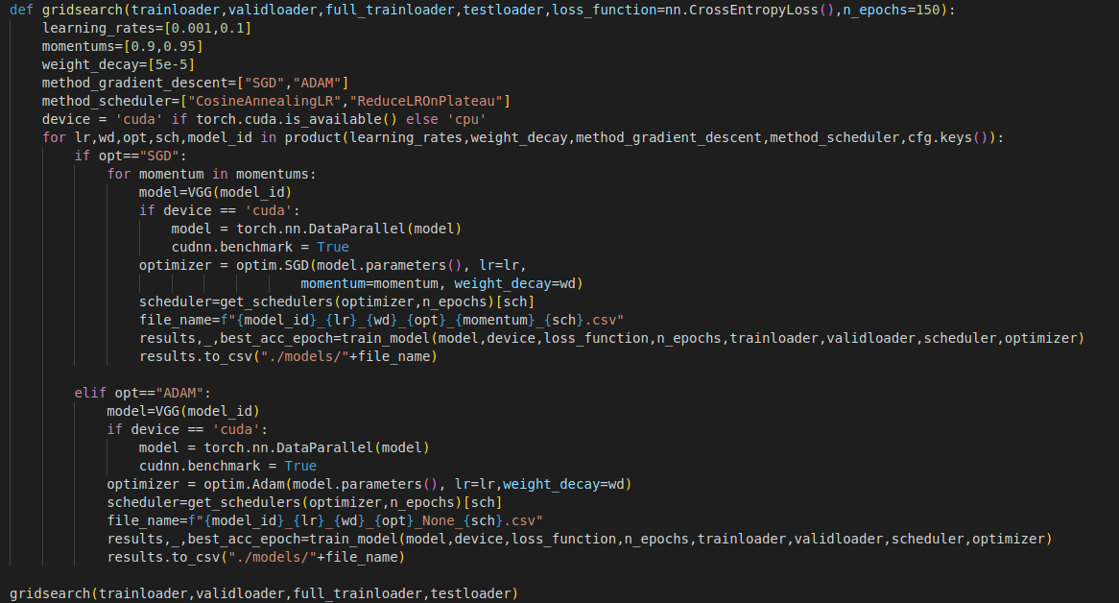

Slide 8
III/ Results different:
depending on
the number of layers
10/02/2021
2
Titre de la présentation - menu « Insertion / En-tête et pied de page »

Slide 9
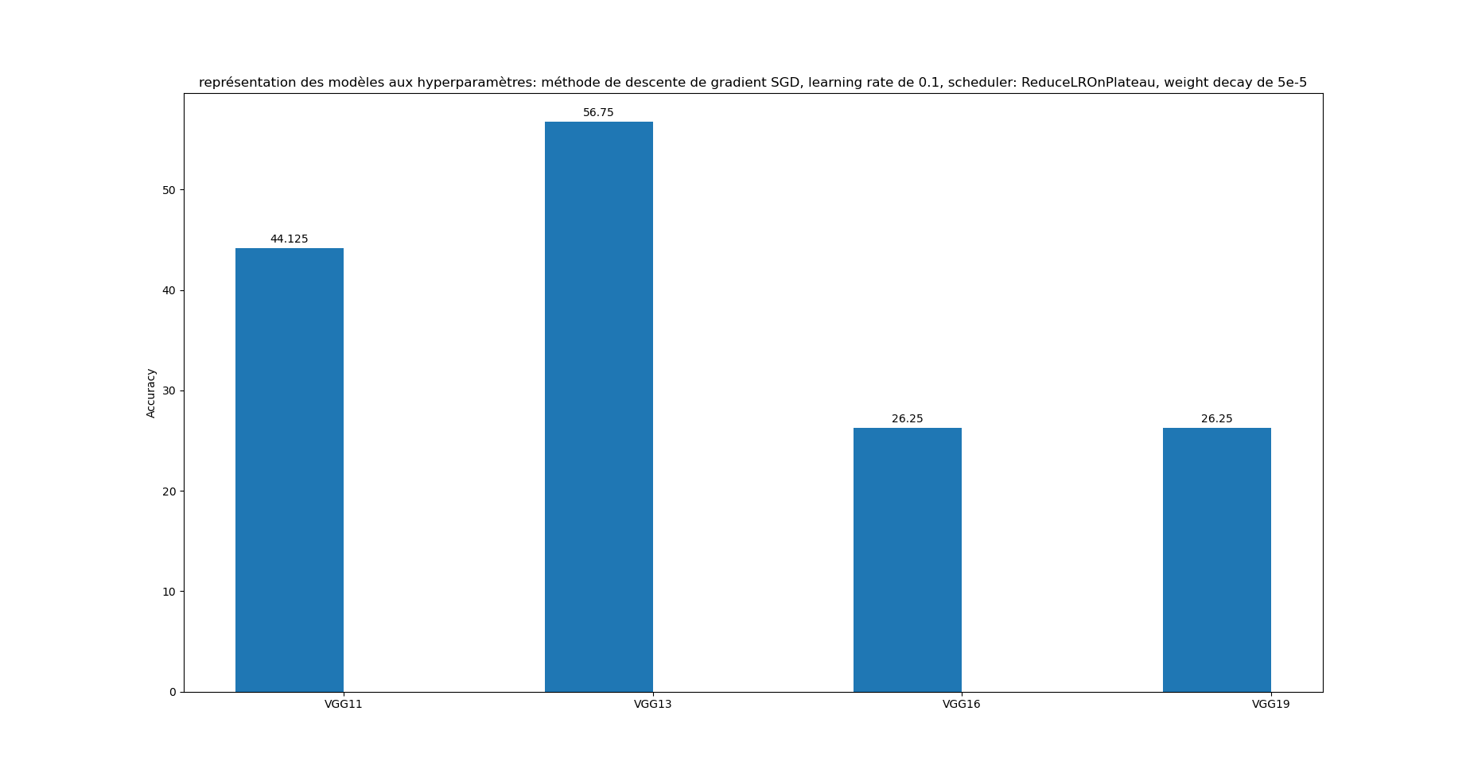
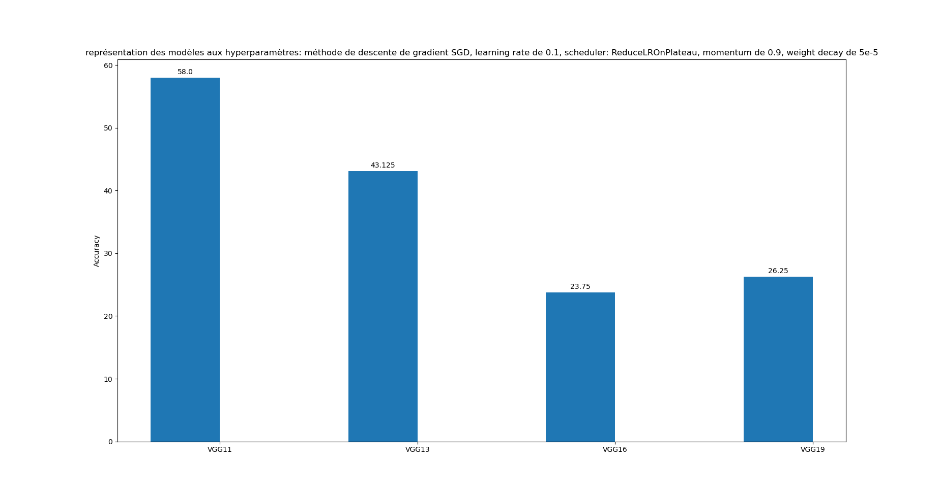
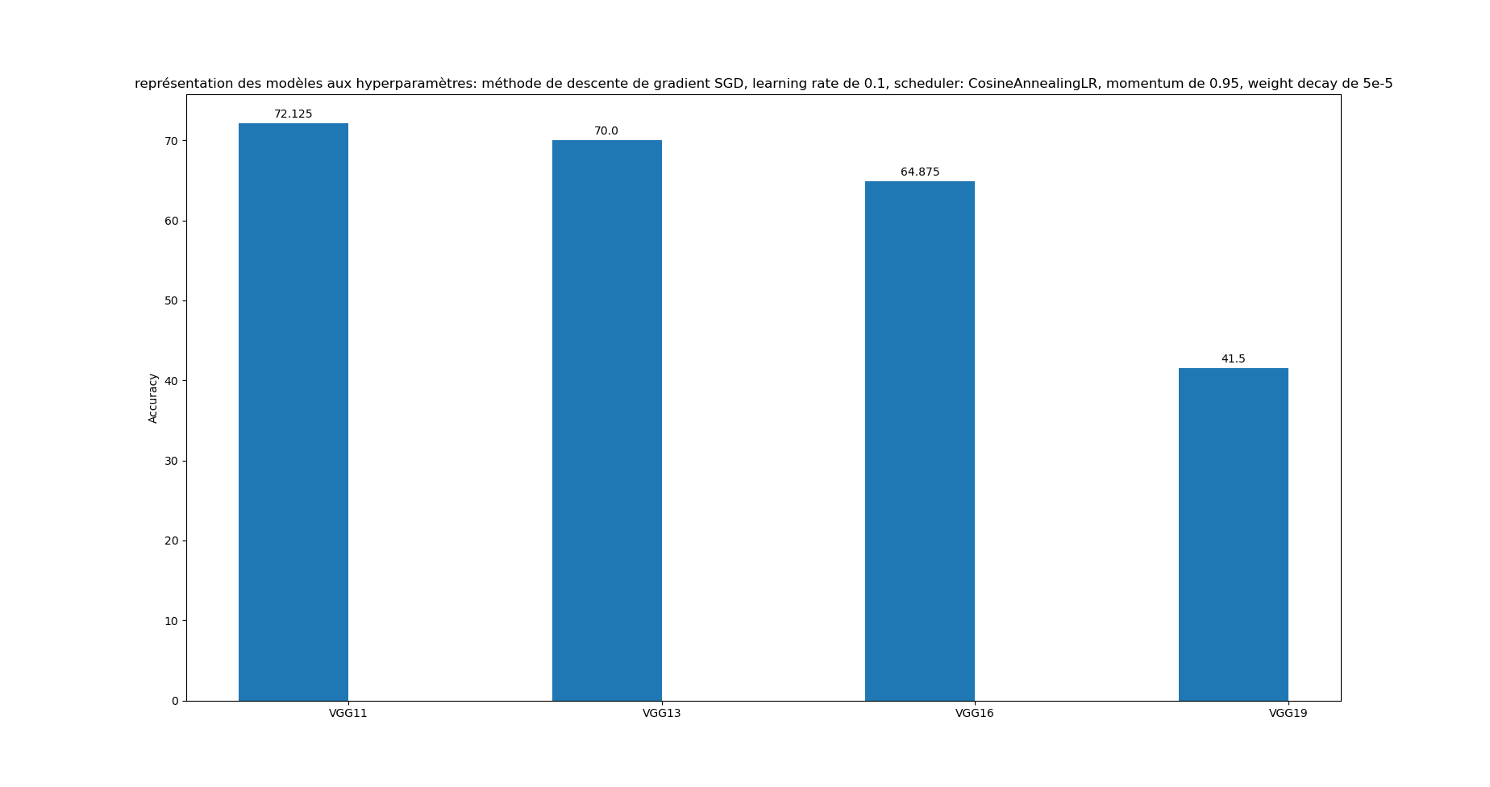
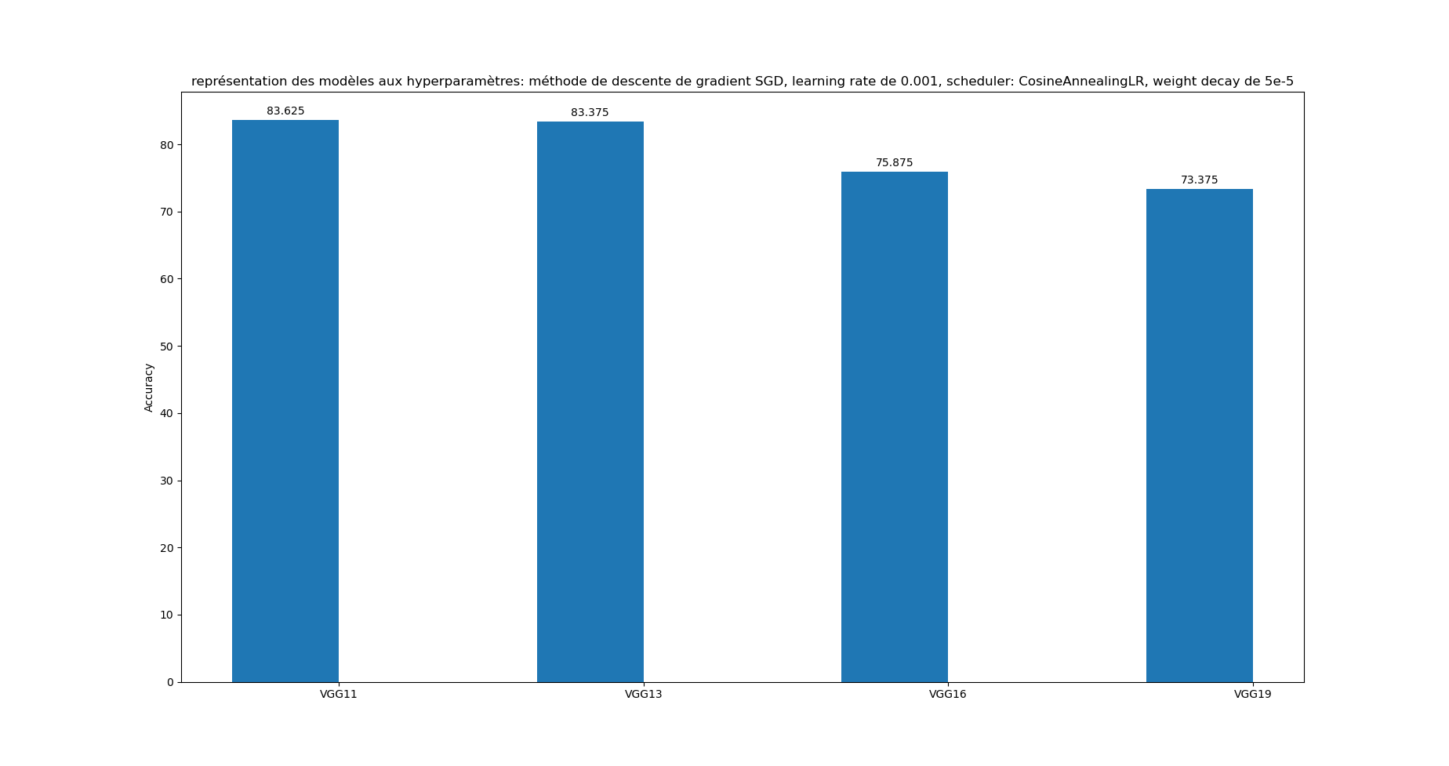
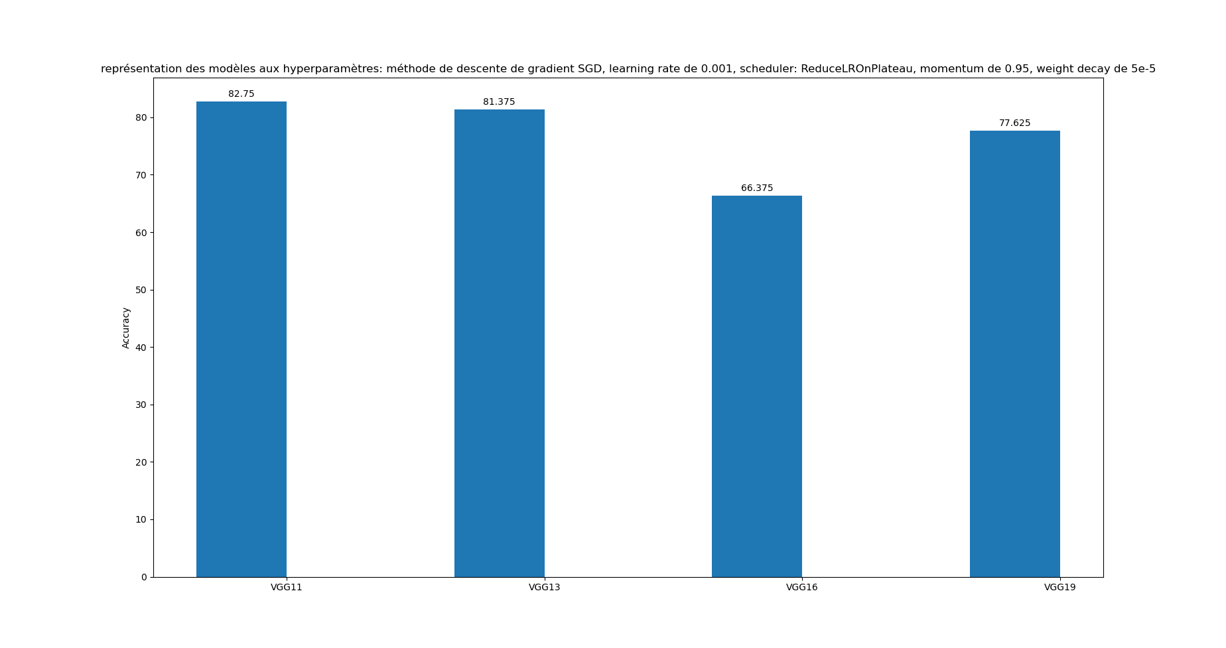

Slide 10
IV/ Results not depending
On the number of layers
10/02/2021
2
Titre de la présentation - menu « Insertion / En-tête et pied de page »

Slide 11
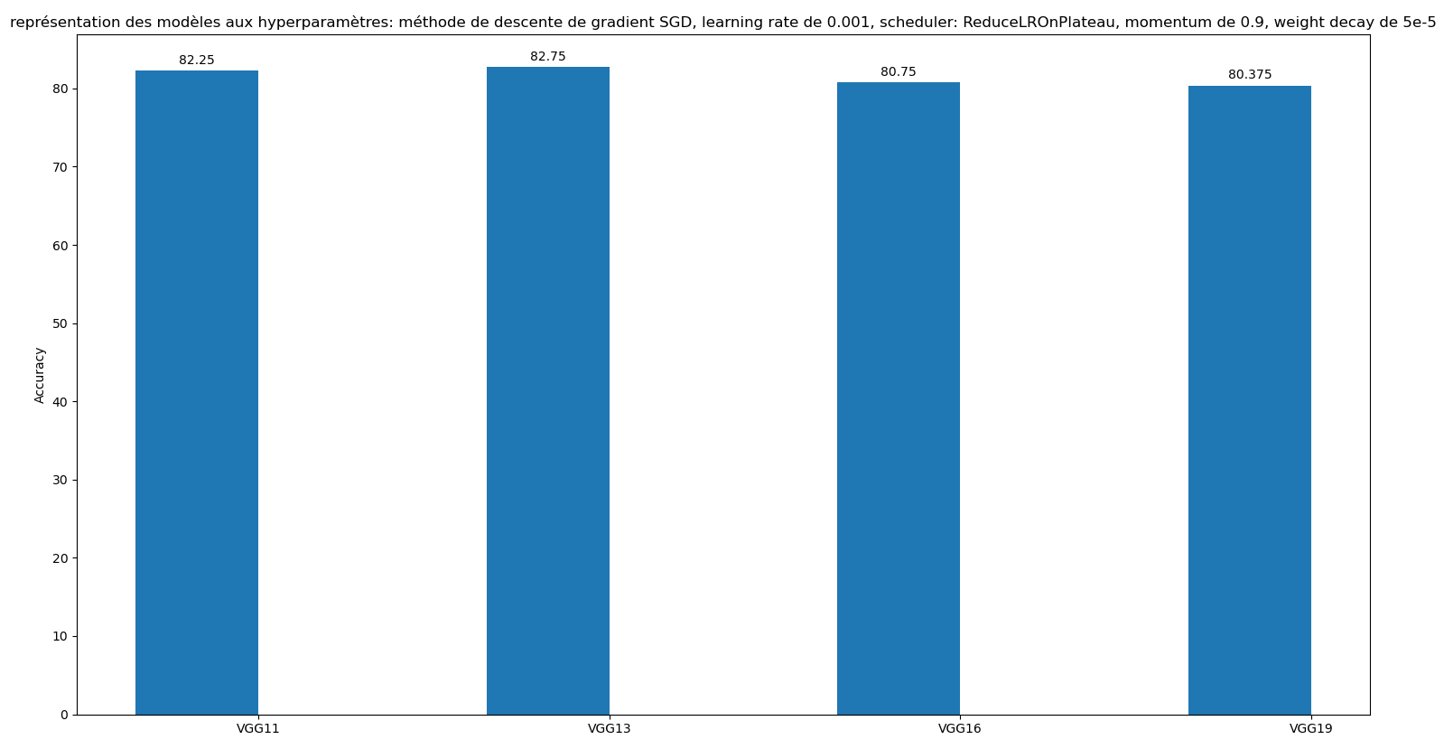
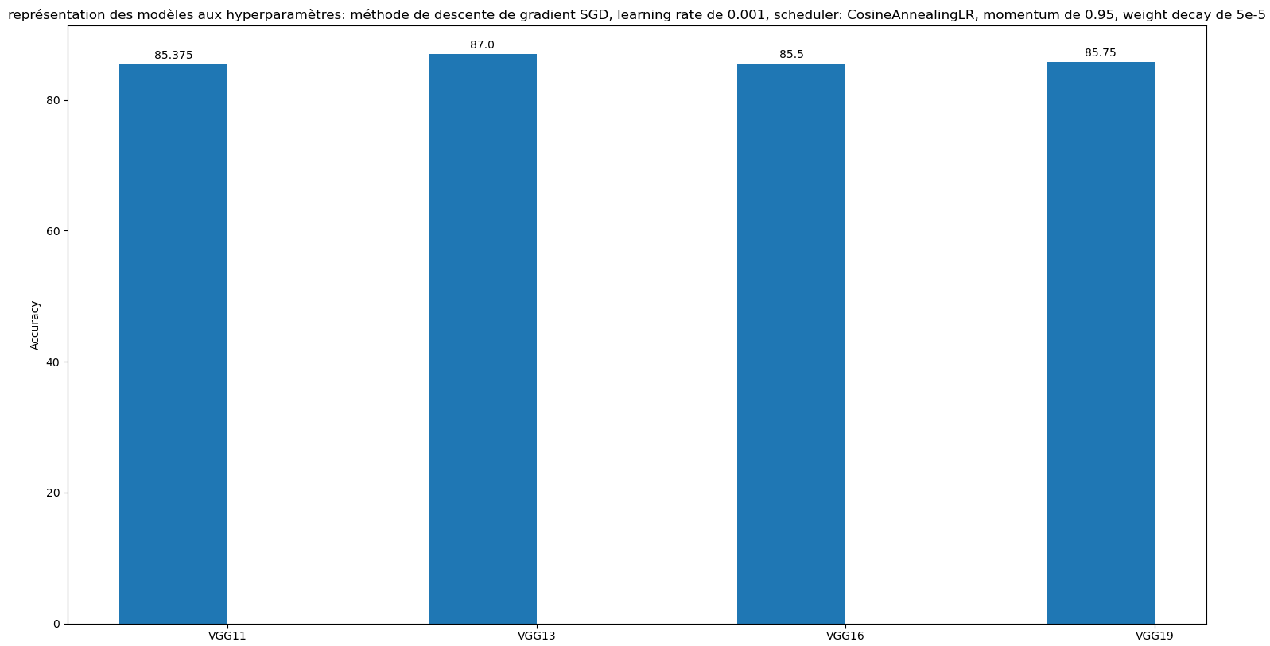


Slide 12
V/ Best Models: application on test set
10/02/2021
2
Titre de la présentation - menu « Insertion / En-tête et pied de page »

Slide 13
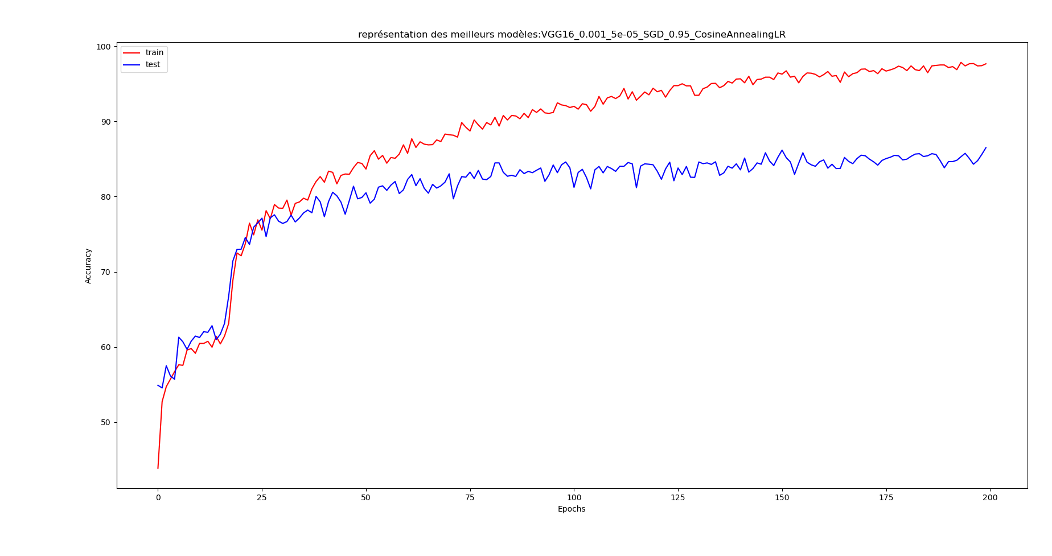
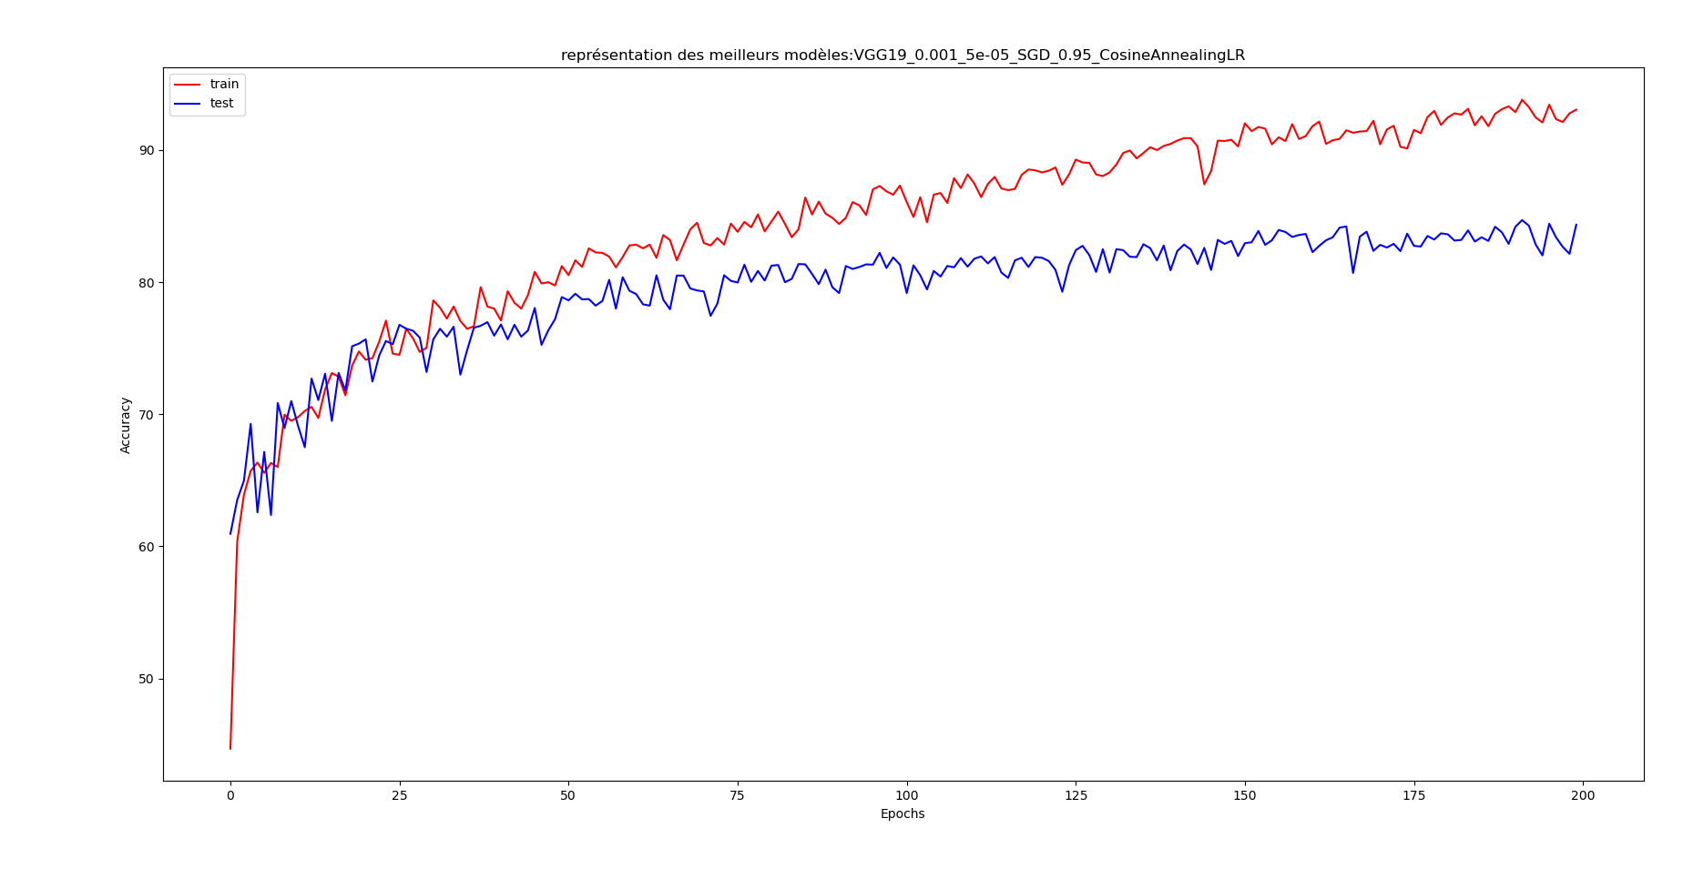
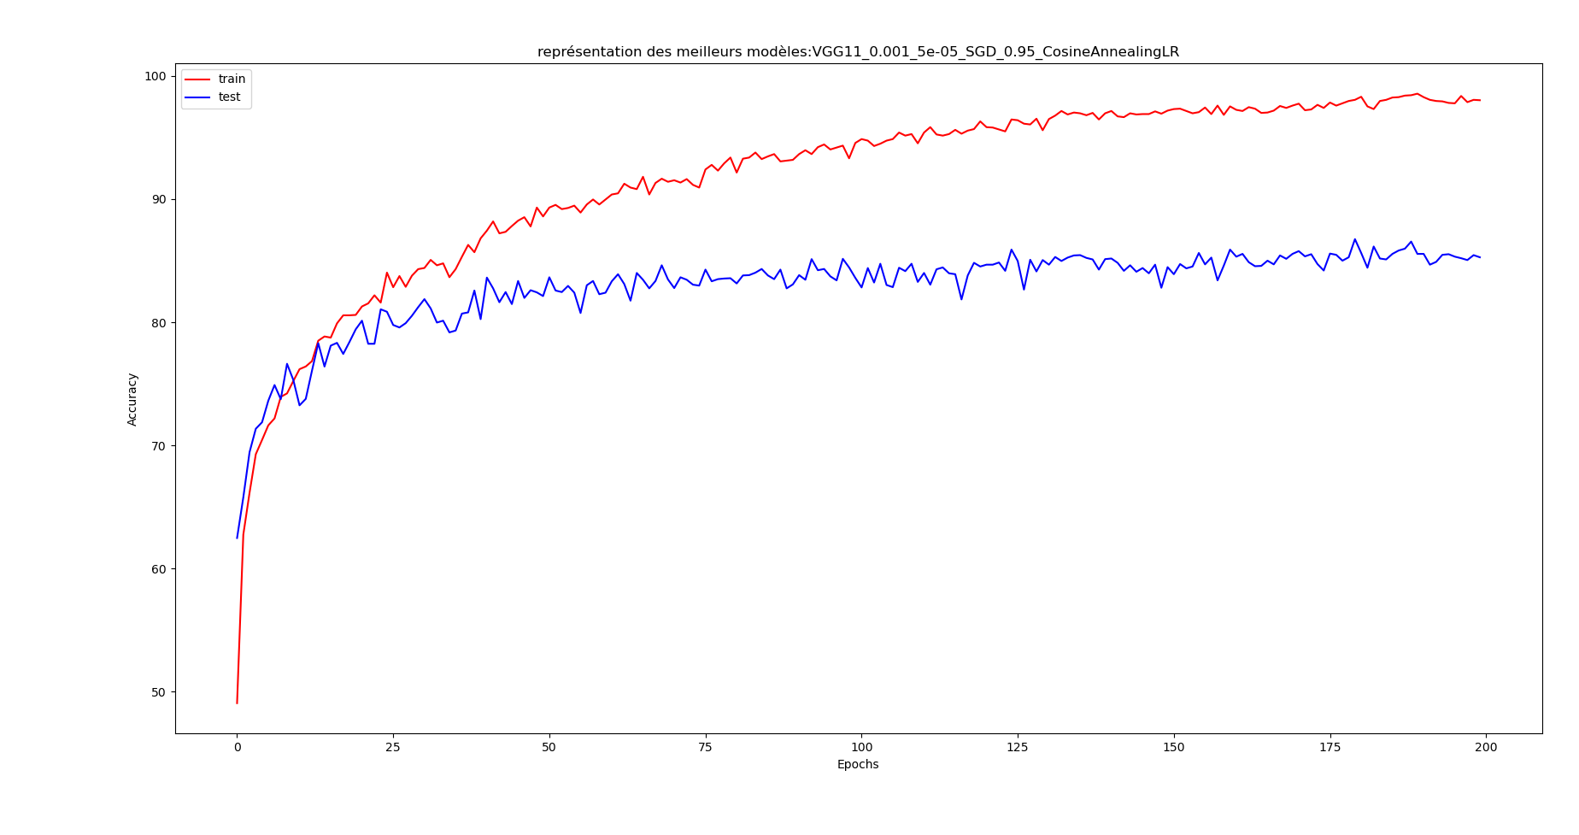
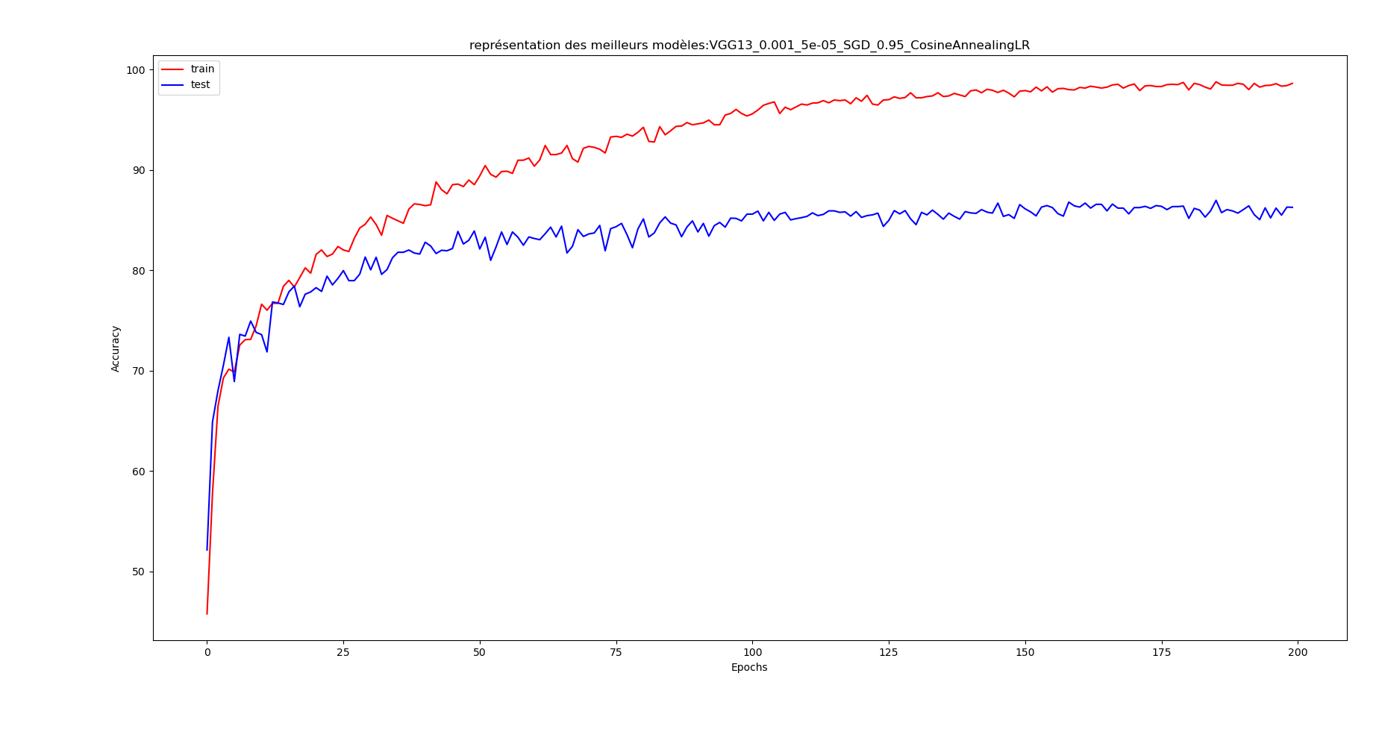

Slide 14
VGG16_0.001_5e-05_SGD_0.95_CosineAnnealingLR | 86.5%
VGG11_0.001_5e-05_SGD_0.95_CosineAnnealingLR | 86.75%
VGG19_0.001_5e-05_SGD_0.95_CosineAnnealingLR | 84.7%
VGG13_0.001_5e-05_SGD_0.95_CosineAnnealingLR | 86.975%
VGG13_0.001_5e-05_SGD_0.9_CosineAnnealingLR | 85.475%
Best Hyperparameters:
Learning Rate = 0.001
Scheduler = CosineAnnaelingLR
Gradient descent method = SGD
Notes:
<numéro>

Slide 15
VI/ CONCLUSION
10/02/2021
2
Titre de la présentation - menu « Insertion / En-tête et pied de page »

Slide 16
Best models are good whatever the infrastructure size of the Network
The more layers does not mean better accuracy on the validation & test sets (overfitting)
The CosineAnnaelingLR scheduler seems to be the most appropriated to this dataset
A 0.001 seems to be the most appropriated to this datasets
The Stochastic Gradient Descent method seems to be the most appropriated to this dataset
0.95 momentum seems to be the best for this dataset

