Slide 1
Identifying customer segment using unsupervised learning
Camille papillon-Hogue

Slide 2
Introduction
Goal : Apply unsupervised Learning techniques to identify segments of the population that form the core customer base for a mail-order sales company in Germany.
Why ? These segments can then be used to direct marketing campaigns towards audiences that will have the highest expected rate of return
This project was delivered during the Udacity Nanodegree class: Introduction to Machine Learning with TensorFlow.
Project Link : https://github.com/camillepapillon/Unsupervised_ML_Identifying_Customer_Segment

Slide 3
Context
3 main datasets:
General population dataset = Demographics data for the general population of Germany; 891211 persons (rows) x 85 features (columns)
Customers population dataset = Demographics data for customers of a mail-order company; 191652 persons (rows) x 85 features (columns)
Data Dictionary : Detailed Information file about the features in the provided datasets

Slide 4
Methodology
Load dataset : General population
Data Preprocessing
Feature Transformation
K-means Clustering
Apply clustering to customer dataset

Slide 5
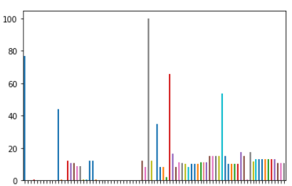
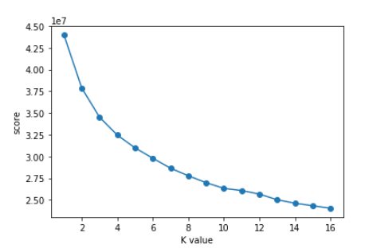

Key Findings & Insights
Percentage of missing data per column in general population dataset
Dropped 6 columns with more than 20% missing data
Re-encoded binary features and dropped the 14 multilevel features
Transformed missing values in rows with Imputer function => average missing values on all rows = 1,37 %
Applied feature scaling with StandardScaler() on general population dataset
Performed dimensionality reduction (PCA) and kept 30 principal components
Applied Kmeans clustering to general population dataset and kept 14 clusters
Model score per count of clusters (K value) in Kmeans clustering

Slide 6
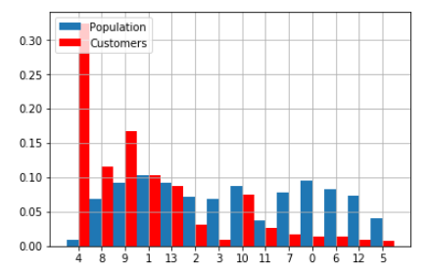
Key Findings & Insights
Customer population is overrepresented by cluster 4 and underrepresented by cluster 0 compared to the general population
Principal Component analysis of cluster 4 and 0 :
Cluster 4 = male between 36-60 years old, lives alone or with someone, from prosperous household, high income, more likely to be homeowner.
Cluster 0 = women less than 30 years old, average income, financially minimalist, less likely to live in 6-10 family home.
Percentage of the population in each of the 14 clusters

