Slide 1
AI DATA SCIENTIST ASSESSMENT
Can financial news improve
next-day stock forecasts?
7
technology stocks
241
A leakage-aware evaluation of historical prices, FinBERT sentiment, and time-series models
trading sessions
4,439
clean news articles
Camilo Chaves
S&P Global · August 2026
Notes:
Open with the research question: does market news improve next-trading-day forecasting beyond historical price and volume information?
Explain that the goal was not simply to fit a complex model. The goal was to construct a credible out-of-sample experiment in a noisy domain.
Preview the conclusion: news showed limited validation signal, but the advantage did not persist on the final test period.
[Sources]
- Candidate assessment notebooks and saved artifacts: https://github.com/camilochaves10/stock-news-forecasting
[/Sources]

Slide 2
EXECUTIVE ANSWER
The short answer: not reliably in this sample
News helped during validation...
Champion
...but the improvement disappeared on the final unseen period.
Ticker-specific
historical mean
The simplest model generalized best.
1.261%
1.275%
test return MAE · ticker historical mean
test return MAE · news-only XGBoost
News remains a challenger—not a production champion.
02
Notes:
Lead with the final answer so the audience knows what the rest of the evidence is resolving.
News-only XGBoost was the best validation candidate, but the ticker-specific historical mean produced the lowest final test errors.
This is a useful negative result: the experiment prevented transient validation signal from being mistaken for a stable forecasting advantage.
[Sources]
- Candidate assessment notebooks and saved artifacts: https://github.com/camilochaves10/stock-news-forecasting
[/Sources]

Slide 3
PROBLEM
Next-day returns are noisy, small, and regime-dependent
01
Low signal
02
Non-stationarity
Most daily movements are small relative to noise.
Relationships change across market regimes.
03
Event timing
04
Strong naive models
After-close and weekend news complicate alignment.
A small positive drift can mimic directional skill.
Design implication
Evaluation quality matters more than model complexity.
03
Notes:
Frame the core difficulty before presenting models.
Return prediction combines weak signal, changing regimes, and difficult timestamp semantics.
Therefore, chronological validation and meaningful baselines are central parts of the solution—not implementation details.
[Sources]
- Candidate assessment notebooks and saved artifacts: https://github.com/camilochaves10/stock-news-forecasting
[/Sources]

Slide 4
DATA
One year of prices and market news across seven stocks
1,687
241
7
4,439
daily OHLCV price rows
shared trading sessions
AAPL · AMZN · GOOGL · META · MSFT · NVDA · TSLA
clean FinBERT-scored articles
2023-11-13
2024-10-28
The common date panel keeps cross-sectional comparisons aligned.
All seven tickers share the same 241 sessions; news coverage is preserved even when no article exists for a ticker-date.
04
Notes:
The data covers 241 sessions from November 2023 through October 2024.
All tickers share the same trading-date panel, which simplifies chronological splitting and market-context features.
The news corpus is much less balanced than the price panel, so missing-news days must be retained rather than dropped.
[Sources]
- Candidate assessment notebooks and saved artifacts: https://github.com/camilochaves10/stock-news-forecasting
[/Sources]

Slide 5
DATA QUALITY
Price data is clean; news requires judgment
Price panel
News corpus
✓
0 missing values
✓
1 exact duplicate removed
✓
0 duplicate ticker-dates
!
35 repeated ticker–timestamps
✓
0 nonpositive prices
!
139 repeated ticker–headline pairs
✓
0 OHLC consistency violations
!
Shared timestamps often contain distinct stories
✓
0 negative-volume rows
!
Recurring coverage may overweight events
Rule: remove exact duplicates; preserve plausible distinct coverage and control redundancy through aggregation.
05
Notes:
The price panel passed all structural checks.
For news, duplicate detection requires judgment: identical rows are safe to remove, but repeated timestamps can represent multiple distinct stories.
I retained plausible coverage rather than applying aggressive deduplication that could discard information.
[Sources]
- Candidate assessment notebooks and saved artifacts: https://github.com/camilochaves10/stock-news-forecasting
[/Sources]

Slide 6
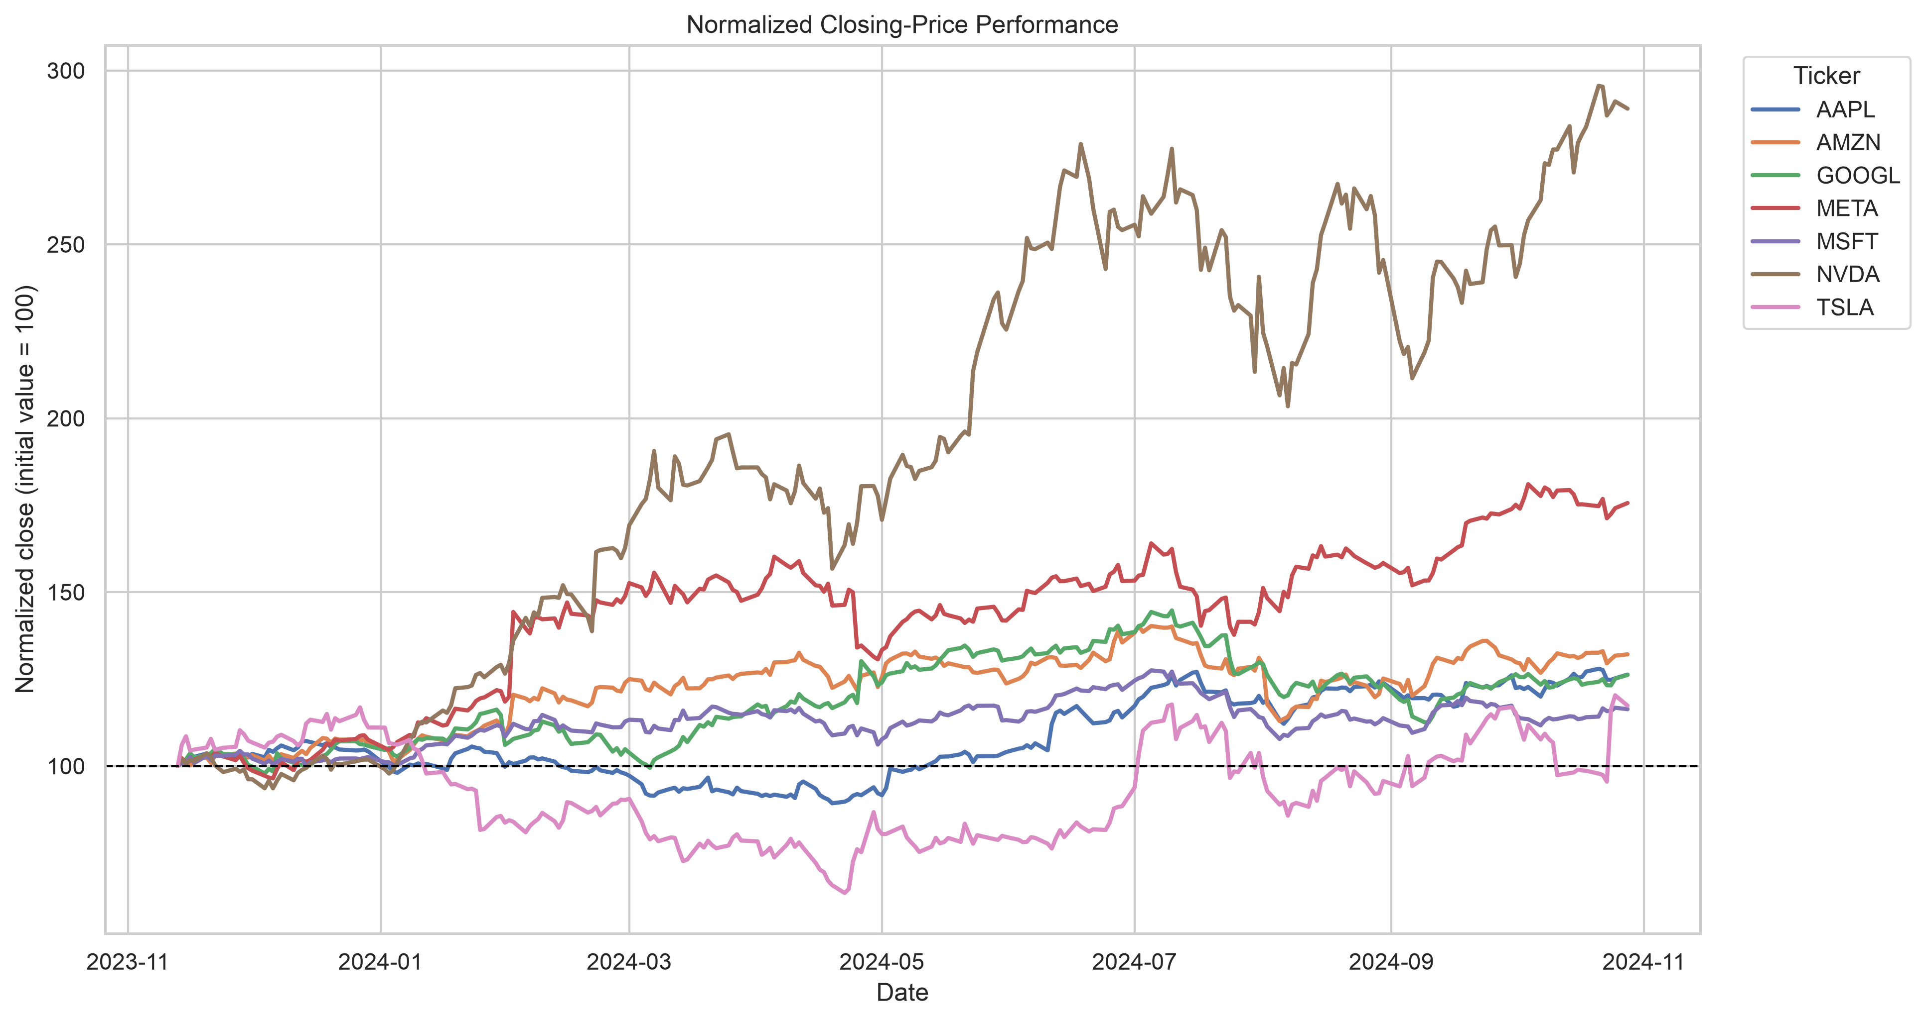
MARKET BEHAVIOR
NVIDIA dominated cumulative performance
The universe does not move uniformly.
NVDA approached 3× its initial level, while TSLA was comparatively weak and unstable. Price levels alone are unsuitable for cross-ticker modeling.
06
Notes:
Normalized prices make nominally different share prices comparable.
NVIDIA produced the strongest cumulative performance, while Tesla followed a different trajectory.
This motivates modeling returns rather than price levels and adding market-relative features.
[Sources]
- Figure: outputs/figures/normalized_price_performance.png in the candidate repository
[/Sources]

Slide 7
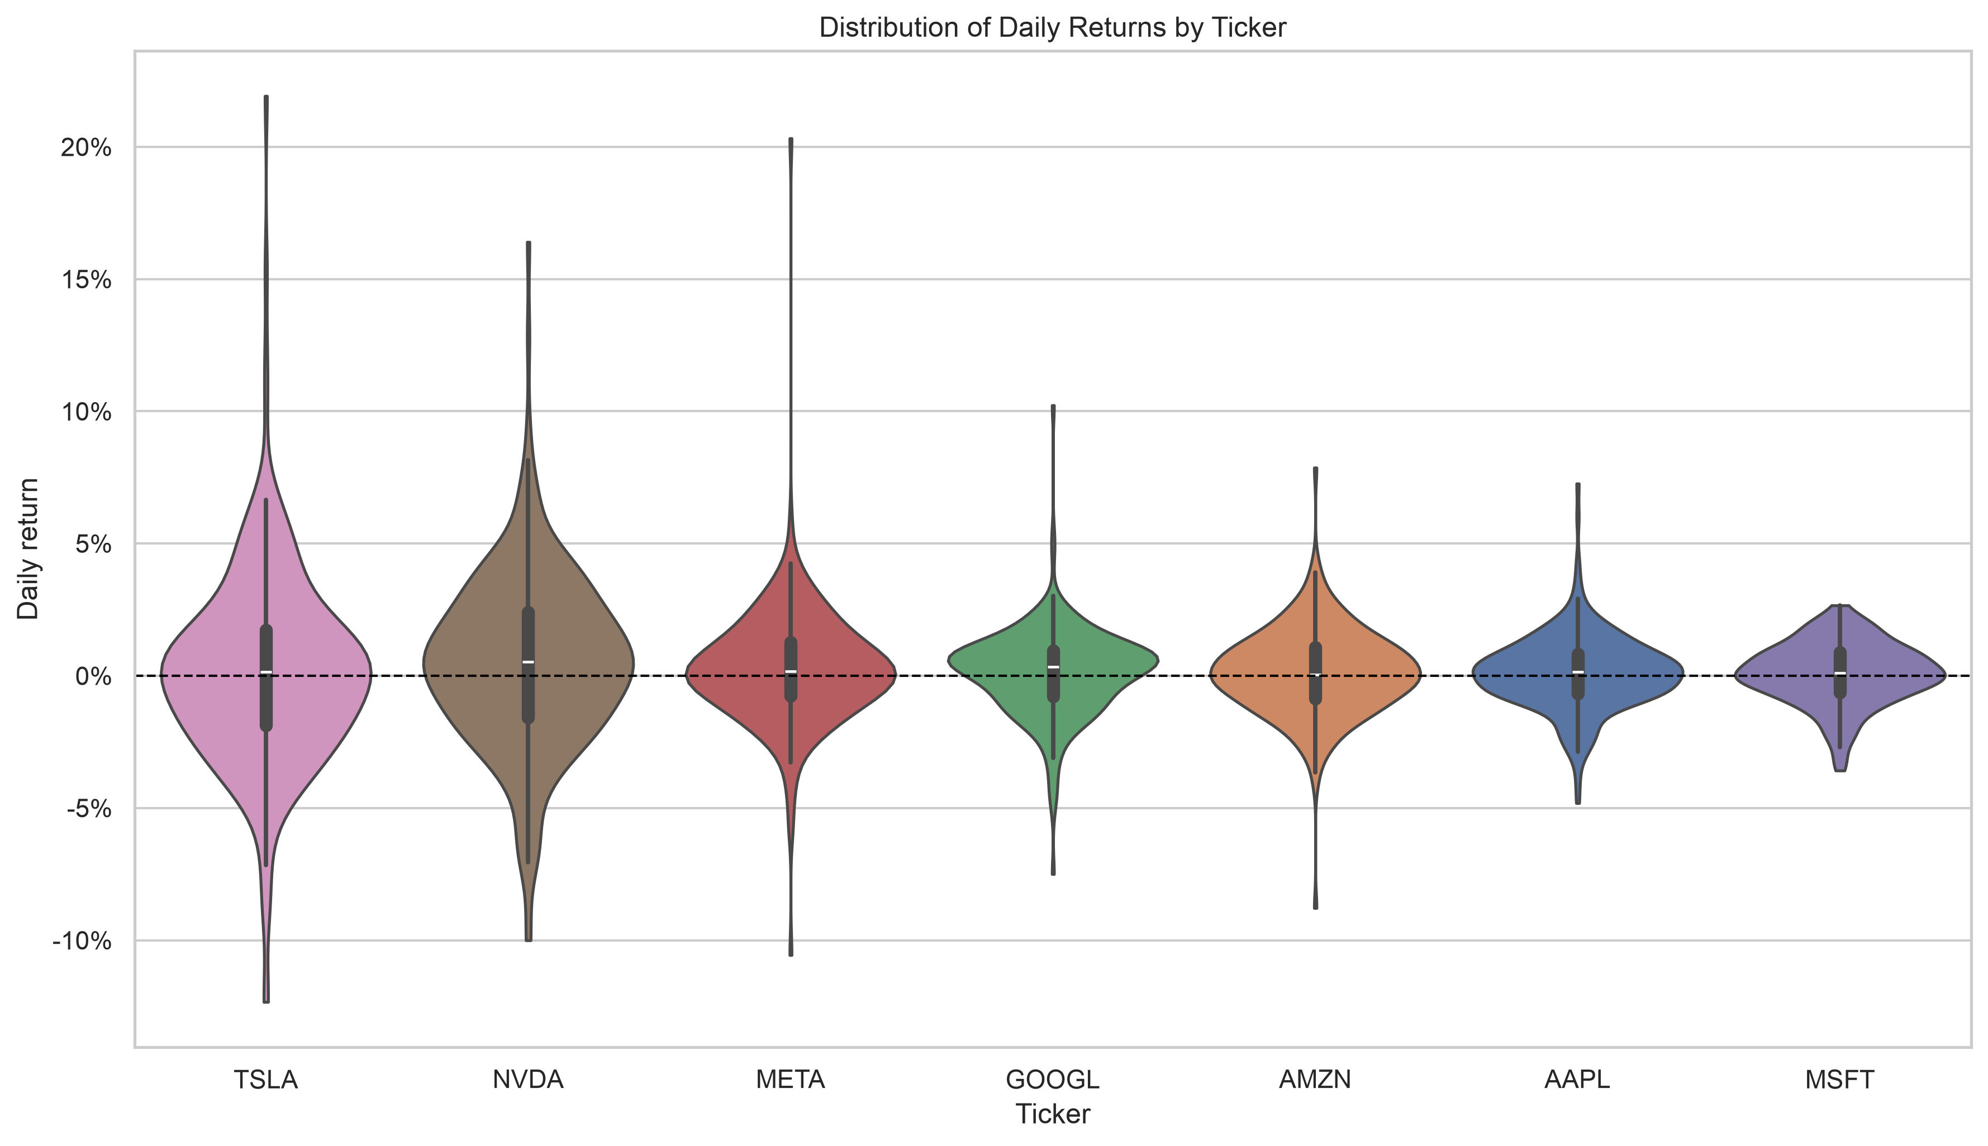
MARKET BEHAVIOR
Volatility differs sharply across tickers
TSLA and NVDA are the hardest names.
Their wider, heavier-tailed return distributions translate into larger forecast errors. MSFT and AAPL are comparatively concentrated.
07
Notes:
The distributions are centered near zero but differ substantially in spread and tail behavior.
Tesla and NVIDIA show the widest distributions; Microsoft shows one of the narrowest.
The model must handle extreme but economically plausible observations rather than deleting them as outliers.
[Sources]
- Figure: outputs/figures/daily_return_violin_plot.png in the candidate repository
[/Sources]

Slide 8
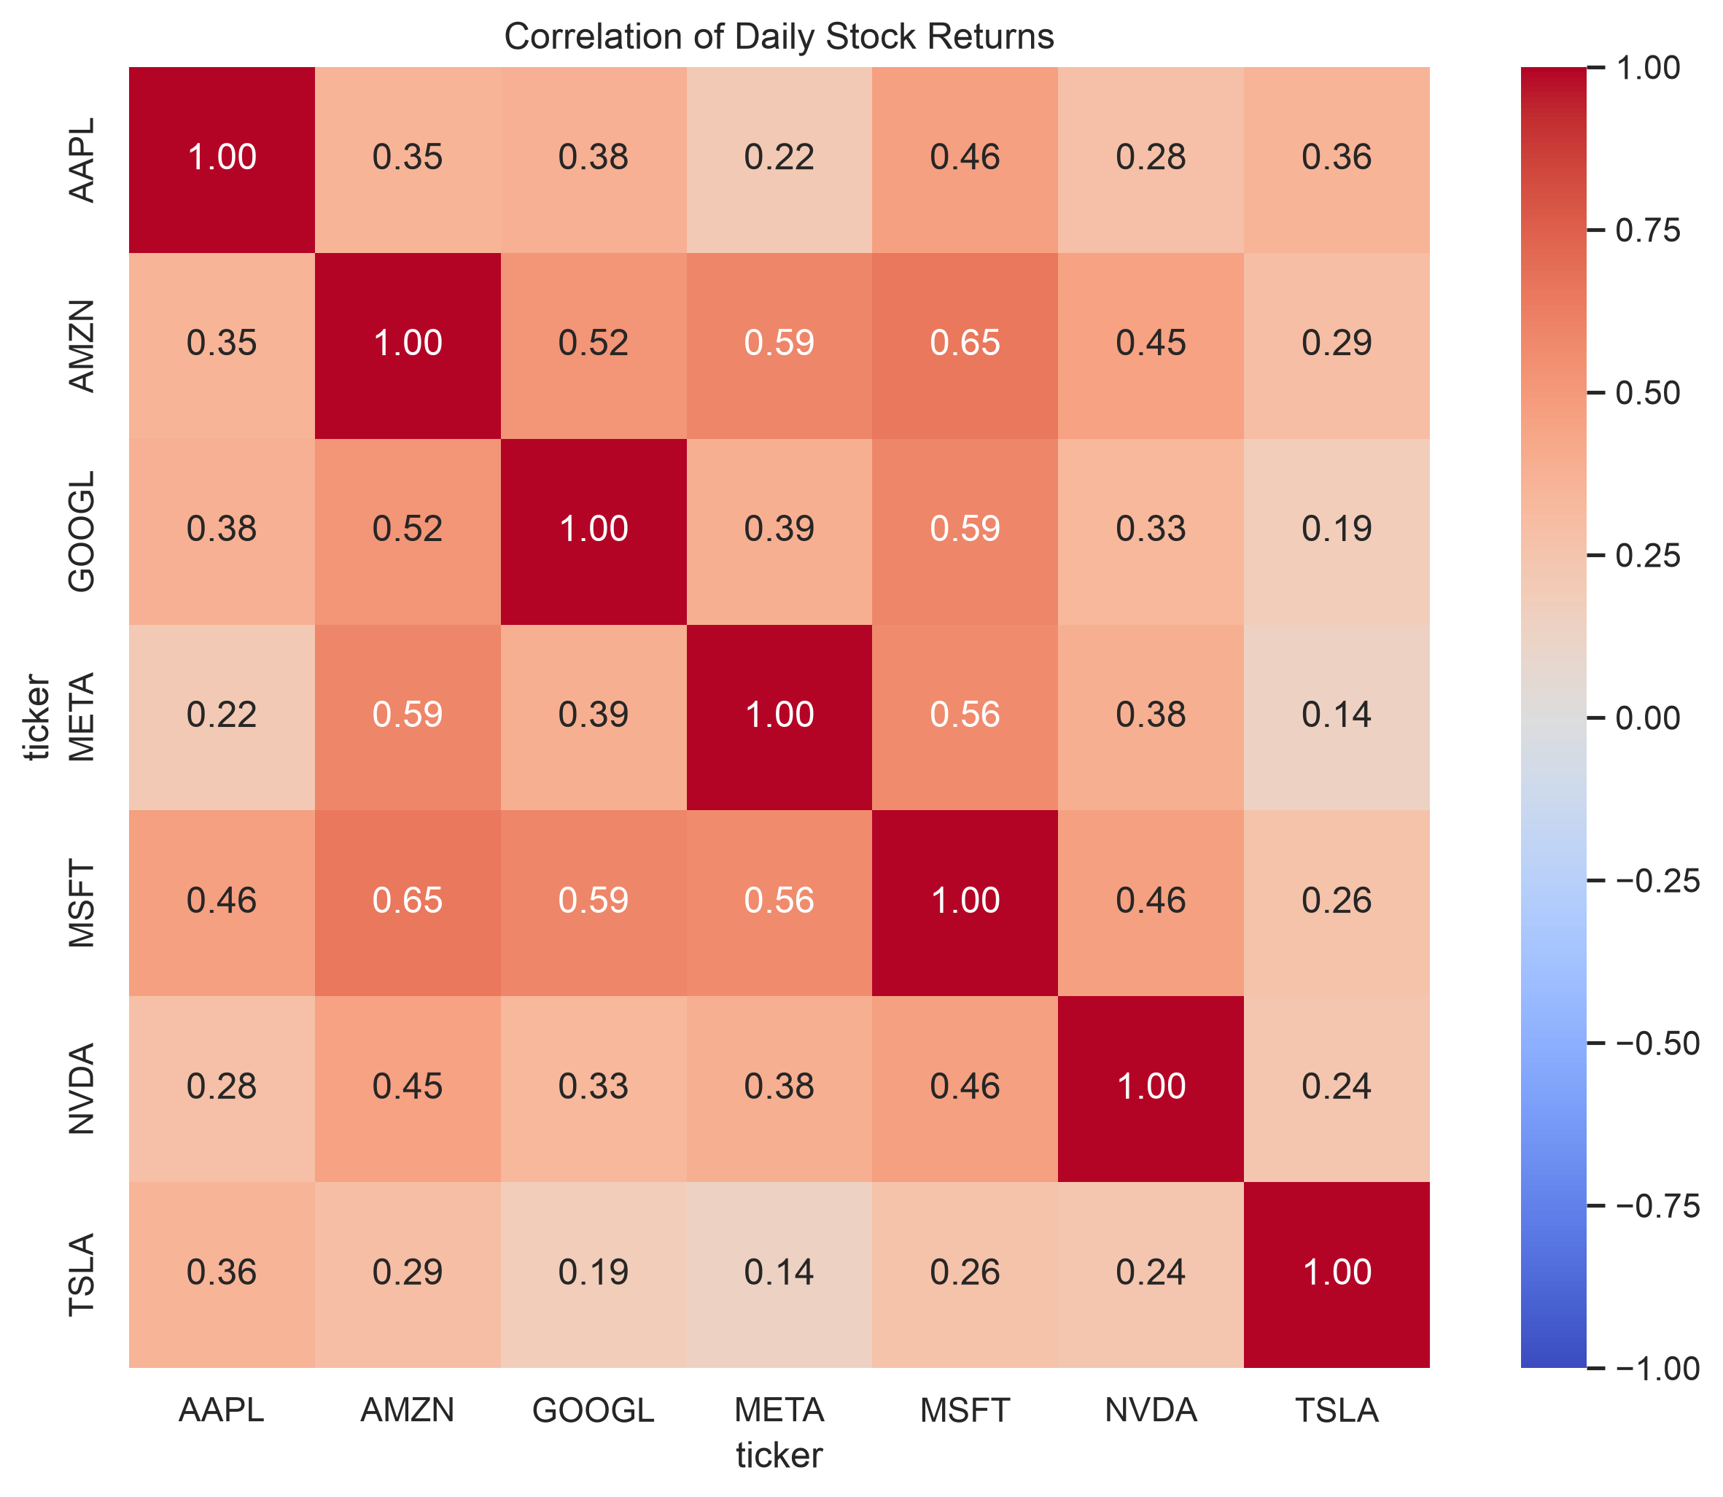
MARKET BEHAVIOR
Returns share market signal, but Tesla is more idiosyncratic
Correlation is positive—but incomplete.
GOOGL–AMZN reaches 0.62. TSLA correlations are weaker, supporting both market-context and ticker-specific features.
08
Notes:
Daily returns are positively correlated across all seven securities.
The strongest relationships occur among large technology peers, while Tesla has weaker links to the rest of the universe.
This supports equal-weight market return and relative-return features, while retaining ticker identity.
[Sources]
- Figure: outputs/figures/daily_return_correlation.png in the candidate repository
[/Sources]

Slide 9
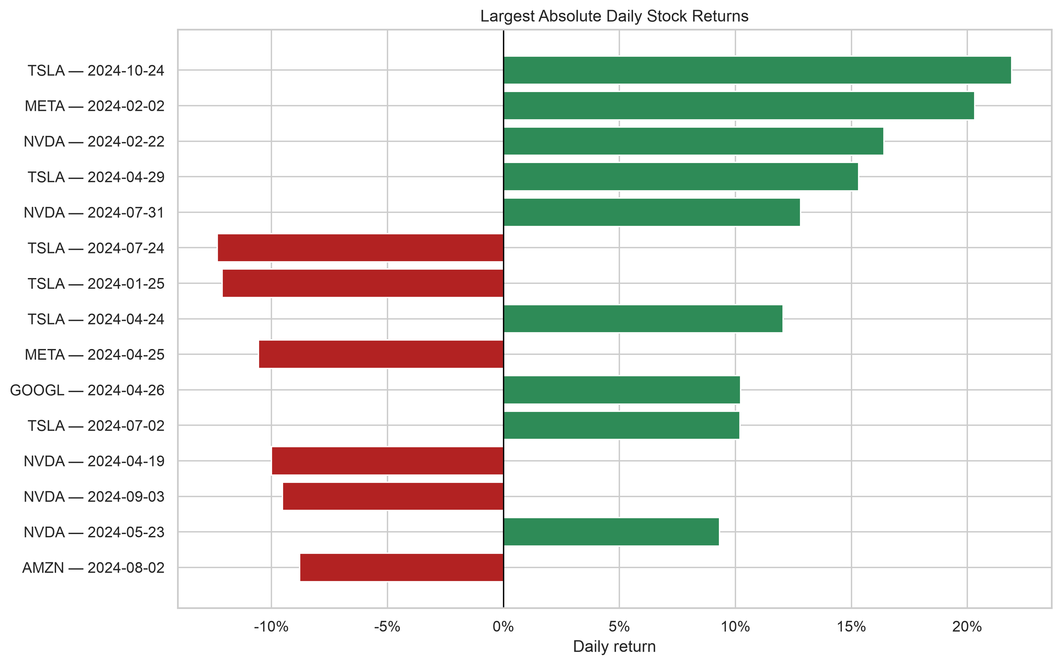
MARKET BEHAVIOR
Extreme days are signal-bearing—not data errors
Large moves cluster in TSLA, NVDA, and META.
Removing them would make the task easier by deleting the behavior the forecast is expected to handle.
09
Notes:
The largest absolute movements concentrate in the most volatile tickers.
These observations are plausible market events, so I retained them.
I interpret poor performance on these days as a forecasting limitation rather than a reason to clean them away.
[Sources]
- Figure: outputs/figures/largest_daily_returns.png in the candidate repository
[/Sources]

Slide 10
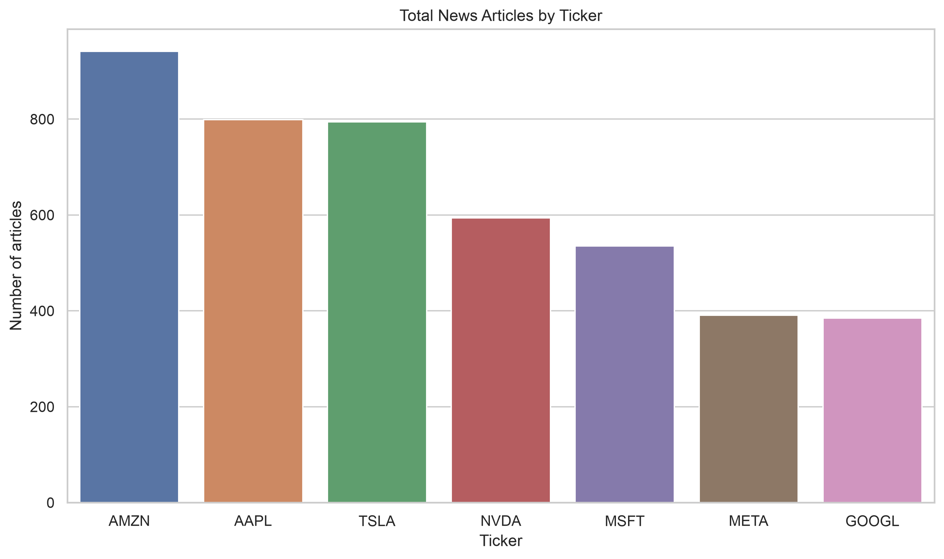
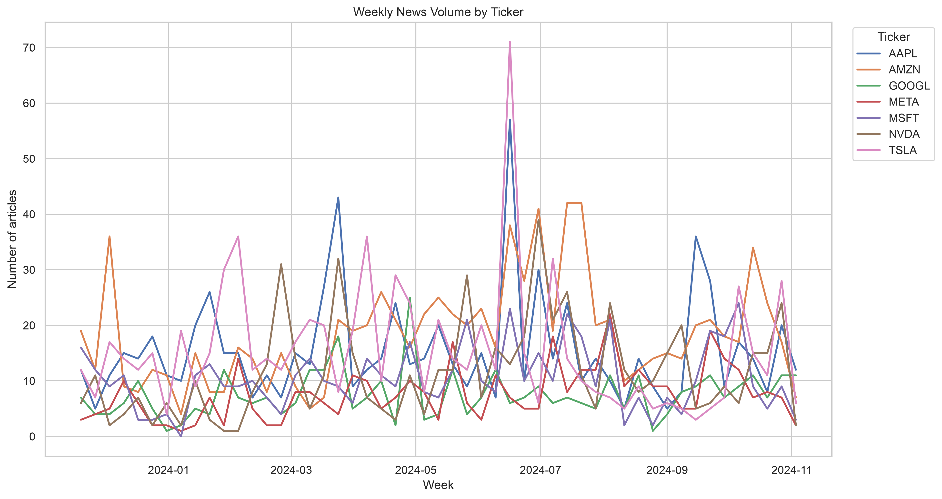
NEWS COVERAGE
Media attention is highly uneven across companies
AMZN receives more than twice the coverage of GOOGL or META.
Volume spikes around active event periods and varies by source attention.
10
Notes:
AMZN has the most articles, while GOOGL and META have far fewer.
Weekly volume is bursty and varies across tickers.
Article count may therefore measure provider attention as much as underlying economic importance.
[Sources]
- Figures: outputs/figures/news_articles_by_ticker.png and weekly_news_volume.png in the candidate repository
[/Sources]

Slide 11
NLP PIPELINE
FinBERT converts articles into daily financial-tone features
1
2
3
4
Article text
FinBERT
Daily aggregation
Forecast table
Headline + summary
Positive · neutral · negative
Tone · dispersion · composition
Join to next trading session
Feature extractor—not forecaster
Conservative alignment
FinBERT supplies sentiment probabilities; XGBoost learns the return relationship.
Undocumented timezone → assign news to the first trading session strictly after publication date.
11
Notes:
FinBERT is used as a pretrained feature extractor, not as the forecasting model.
Article-level probabilities are aggregated into daily tone, dispersion, and composition features.
Because the timestamp timezone is undocumented, I use a conservative next-session alignment to avoid same-day leakage.
[Sources]
- Candidate assessment notebooks and saved artifacts: https://github.com/camilochaves10/stock-news-forecasting
[/Sources]

Slide 12
PREDICTION DESIGN
The prediction contract fixes what is known—and when
At the end of trading day t
Convert the return prediction back to a price forecast
Predict the close-to-close return on trading day t+1
Ĉloseₜ₊₁ = Closeₜ × (1 + r̂ₜ₊₁)
rₜ₊₁ = Closeₜ₊₁ / Closeₜ − 1
Primary metrics
Return MAE · Return RMSE
Secondary metrics
Returns improve cross-ticker comparability and reduce the illusion of accuracy created by persistent price levels.
Price MAE · Price RMSE · Direction accuracy
12
Notes:
The forecast is made after the close of day t using completed information through that session.
The statistical target is the next-day return. Price metrics are reconstructed for interpretability.
Return errors are more comparable across tickers than dollar price errors.
[Sources]
- Candidate assessment notebooks and saved artifacts: https://github.com/camilochaves10/stock-news-forecasting
[/Sources]

Slide 13
VALIDATION
Chronological splits protect the final test
Past
Future
TRAIN
VALIDATION
TEST
Fit parameters
Select features + models
One final assessment
✓
No random shuffle
✓
All tickers from one date stay together
✓
Rolling features use present and past only
✓
Final test is untouched during selection
13
Notes:
All splits are chronological and all securities from the same date remain in the same partition.
Validation is used for feature and model decisions; test is reserved for the final assessment.
This design exposes regime dependence that a random split could conceal.
[Sources]
- Candidate assessment notebooks and saved artifacts: https://github.com/camilochaves10/stock-news-forecasting
[/Sources]

Slide 14
FEATURE ENGINEERING
Features capture momentum, risk, context, and news
Momentum
1-, 2-, 5-, 10-, 20-day returns
Risk
Rolling volatility · intraday range
Trend
Price relative to moving averages
Volume
Change · relative 20-day volume
Market context
Equal-weight return · relative return
News intensity
Counts · unique headlines · availability
News tone
Mean · median · min · max · dispersion
Composition
Positive · neutral · negative shares
14
Notes:
The price feature set spans momentum, volatility, trend, volume, and cross-sectional market context.
News features separate intensity from tone and composition.
All rolling calculations are grouped by ticker and use only information available through day t.
[Sources]
- Candidate assessment notebooks and saved artifacts: https://github.com/camilochaves10/stock-news-forecasting
[/Sources]

Slide 15
MODEL STRATEGY
Every complex model must beat historical drift
Baselines
Linear + trees
Classical
Ensemble
Random walk
Global historical mean
Ticker historical mean
Ridge
XGBoost: price
XGBoost: news
XGBoost: combined
Damped Holt
ARIMA(1,0,0)
Walk-forward evaluation
Validation-weighted
combination of
selected forecasts
A model does not earn deployment because it is sophisticated—it earns deployment by improving unseen-period evidence.
15
Notes:
The model ladder starts with historical-drift baselines, then adds linear, tree-based, classical time-series, and ensemble methods.
Ticker mean is a surprisingly strong benchmark because each stock has a different historical drift.
The central selection criterion is unseen-period performance, not model complexity.
[Sources]
- Candidate assessment notebooks and saved artifacts: https://github.com/camilochaves10/stock-news-forecasting
[/Sources]

Slide 16
VALIDATION RESULT
News-only XGBoost wins validation—by a narrow margin
1.925%
News-only XGBoost validation return MAE
Promising—but not decisive
The margin is small, and a single validation regime cannot establish stability.
16
Notes:
News-only XGBoost has the best validation return MAE at 1.925%.
The improvement over historical mean is real in this period but small.
I treat this model as the validation challenger and require confirmation on the untouched test period.
[Sources]
- Candidate assessment notebooks and saved artifacts: https://github.com/camilochaves10/stock-news-forecasting
[/Sources]

Slide 17
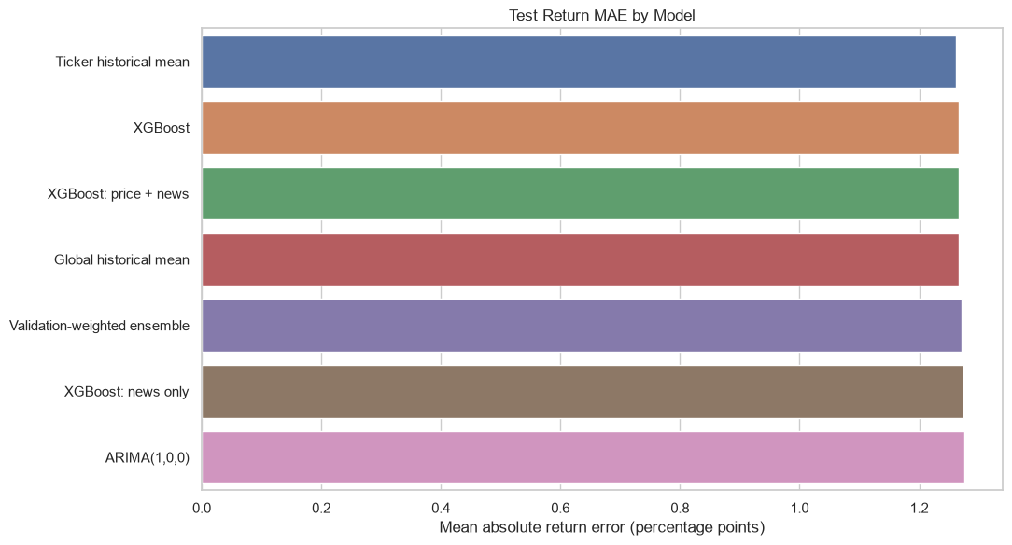
FINAL TEST
The validation advantage disappears on the final test
Ticker historical mean wins.
News-only XGBoost falls behind every historical-mean baseline. The ranking changes across regimes.
17
Notes:
The ticker-specific historical mean delivers the lowest final test return MAE at 1.261%.
News-only XGBoost reaches 1.275%, so its validation advantage does not generalize.
The ranking reversal is direct evidence of regime dependence.
[Sources]
- Figure embedded in notebooks/03_executive_report.ipynb in the candidate repository
[/Sources]

Slide 18
FINAL TEST
Historical drift leads every final test metric
Model
Price MAE
Return MAE
Return RMSE
Direction
Ticker historical mean
$3.184
1.261%
2.214%
58.01%
XGBoost · price
$3.199
1.266%
2.215%
58.01%
XGBoost · price + news
$3.200
1.267%
2.216%
58.01%
Global historical mean
$3.201
1.267%
2.215%
58.01%
News-only XGBoost
$3.229
1.275%
2.227%
58.01%
ARIMA(1,0,0)
$3.208
1.276%
2.224%
55.41%
18
Notes:
Ticker historical mean is best on both price MAE and return MAE.
Price-only and combined XGBoost are nearly identical, which indicates the news features add no stable incremental value.
Direction accuracy requires separate interpretation because several models share the same value.
[Sources]
- Candidate assessment notebooks and saved artifacts: https://github.com/camilochaves10/stock-news-forecasting
[/Sources]

Slide 19
INTERPRETATION
58% direction accuracy is the majority-up baseline
58.01%
positive-return base rate
No discrimination
Matching the majority class does not mean the model identifies which days will rise.
19
Notes:
Five models report 58.01% directional accuracy, but that is also the positive-return base rate.
Their predictions are overwhelmingly positive, so the metric reflects class imbalance rather than genuine classification skill.
This is why baselines change the interpretation of headline metrics.
[Sources]
- Candidate assessment notebooks and saved artifacts: https://github.com/camilochaves10/stock-news-forecasting
[/Sources]

Slide 20
ERROR ANALYSIS
News improves only one of seven tickers
GOOGL
0.773% news XGB vs 0.797% ticker mean
Volatility dominates difficulty
TSLA and NVDA remain the largest-error names under every model.
20
Notes:
News-only XGBoost improves return MAE only for Google.
For the other six stocks, at least one historical-mean baseline is more accurate.
Tesla and NVIDIA remain the hardest names, consistent with their wider return distributions.
[Sources]
- Candidate assessment notebooks and saved artifacts: https://github.com/camilochaves10/stock-news-forecasting
[/Sources]

Slide 21
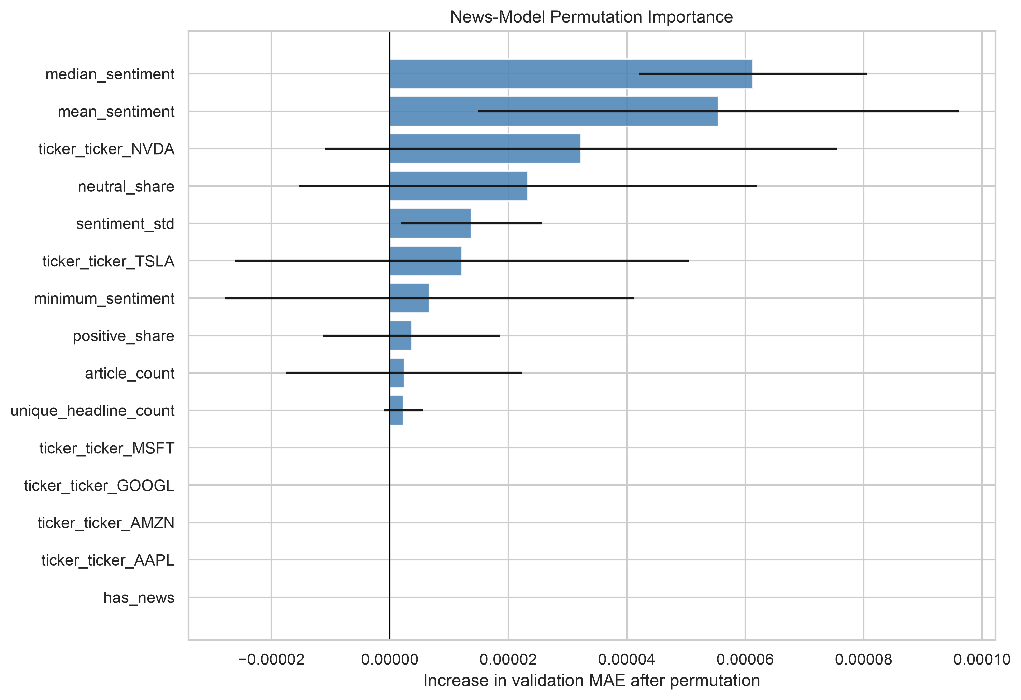
FEATURE IMPORTANCE
News tone matters more than news volume
Median and mean sentiment rank highest.
Article count, unique headlines, and simply having news contribute approximately zero. Uncertainty remains substantial.
21
Notes:
Permutation importance ranks median and mean sentiment as the strongest news variables.
Volume-related features contribute close to zero.
Absolute importance values are small and uncertainty bars are wide, so the result is descriptive rather than causal.
[Sources]
- Figure: outputs/figures/news_permutation_importance.png in the candidate repository
[/Sources]

Slide 22
ERROR ANALYSIS
News days are harder—and the model does not fix them
Days without news
Days with news
0.940%
0.932%
1.334%
1.344%
historical-mean return MAE
news-XGB return MAE
historical-mean return MAE
news-XGB return MAE
Interpretation
Coverage concentrates around material announcements and unusual activity. News availability is associated with difficulty, not necessarily its cause.
On active-news days, news-only XGBoost is slightly worse than historical drift.
22
Notes:
Test days with news are substantially harder: historical-mean return MAE rises from 0.940% to 1.334%.
This is an association. Providers publish more around earnings, controversy, and unusual activity.
News-only XGBoost does not improve active-news days; its MAE is slightly higher at 1.344%.
[Sources]
- Candidate assessment notebooks and saved artifacts: https://github.com/camilochaves10/stock-news-forecasting
[/Sources]

Slide 23
CONCLUSION
The evidence supports a champion–challenger decision
Champion
Challenger
Ticker historical mean
News-only XGBoost
Lowest final test error · transparent · stable relative to challengers
Best validation result · GOOGL benefit · unstable final ranking
Deploy as benchmark
Continue evaluation
• Price MAE: $3.184
• Longer history + multiple regimes
• Return MAE: 1.261%
• Better event timing + relevance
Negative results are valuable when they prevent unstable complexity from reaching production.
23
Notes:
The production recommendation is a champion–challenger setup.
Ticker historical mean remains the champion because it generalizes best and is transparent.
News-only XGBoost remains a challenger because it showed validation signal and helped Google, but it requires broader evidence.
[Sources]
- Candidate assessment notebooks and saved artifacts: https://github.com/camilochaves10/stock-news-forecasting
[/Sources]

Slide 24
NEXT STEPS
Improve the evidence before increasing complexity
01
Broader regimes
Extend history and use expanding-window validation.
02
Market context
Add QQQ, S&P 500, VIX, rates, sectors, and earnings calendars.
03
Better news representation
Model relevance, novelty, surprise, timestamp, and multi-day carryover.
04
Decision value
Evaluate calibration, prediction intervals, turnover, and transaction costs.
Questions & discussion
Camilo Chaves
Notes:
The highest-value next steps are broader data and stronger temporal validation, not immediately larger models.
I would add market and event context, improve news alignment and relevance, and evaluate longer forecast horizons.
For production, I would add calibration, prediction intervals, monitoring, and an economic backtest after costs.
Close by returning to the research question: within this sample, news did not add stable incremental value.
[Sources]
- Candidate assessment notebooks and saved artifacts: https://github.com/camilochaves10/stock-news-forecasting
[/Sources]

Slide 25
APPENDIX
Limitations define the boundary of the conclusion
01
241 sessions per ticker
02
Seven correlated technology stocks
03
Undocumented news timestamp timezone
04
Uneven provider coverage
05
Recurring and syndicated content
06
FinBERT not calibrated to these sources
07
No VIX, rates, market or earnings calendar
08
One final test regime
09
No transaction-cost backtest
APPENDIX
Notes:
Use this slide only if asked about limitations.
The conclusion is deliberately bounded to this dataset, horizon, universe, and feature representation.
The strongest limitation is the short history across a single dominant market regime.
[Sources]
- Candidate assessment notebooks and saved artifacts: https://github.com/camilochaves10/stock-news-forecasting
[/Sources]

Slide 26
APPENDIX
Reproducibility: audit, modeling, and reporting
01_data_quality_eda.ipynb
Data validation · duplicates · EDA · saved figures
02_modeling_validation.ipynb
Targets · features · FinBERT · models · temporal validation
03_executive_report.ipynb
Saved-artifact synthesis · final recommendation
src/
Reusable data, feature, modeling, and validation helpers
outputs/
Figures, predictions, and model-comparison artifacts
APPENDIX
Notes:
Use this slide if asked about reproducibility or project organization.
The first notebook owns the audit and EDA, the second owns modeling, and the third synthesizes saved artifacts without retraining.
Reusable functions are separated into src modules, and outputs are persisted for reporting.
[Sources]
- Candidate assessment notebooks and saved artifacts: https://github.com/camilochaves10/stock-news-forecasting
[/Sources]

