Slide 1
Antidote
Profitability review · Fluke case study
Small, certain, fast.
35 sales · $12,169 in · $4,120 profit · self-funded
Camilo Forcucci · Antidote LLC

Slide 2
Summary
Situation
Free finds made 60% of summer profit
Returns hold near 40%
Price is known before I buy
They make 20% now.
From a $110 meter to a $1,000 one.
Meters sell in two days.
Strategy
01
02
03
Put the money into Fluke
Raise the ticket
Test a higher workload
74% of profit already.
Same hours, bigger sale.
Risk scales with price.
Conclusion
A $1,000 meter earns the same 40% as a $200 meter and sells just as fast. Hours limit this business, money does not.
KPIs
80%
41.8%
1.9 days
74%
of profit from deliberate buys
return on Fluke capital
average hold, buy to sale
of all profit is Fluke
Profitability review
Fluke case study
2

Slide 3

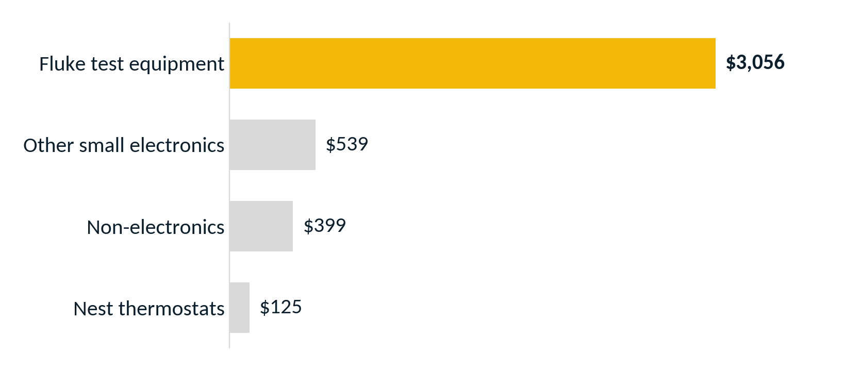
One product line makes three quarters of the profit
Free finds carried the summer. Now they are 20%.
Fluke is $3,056 of the $4,120 made, across nineteen sales.
That is the business.
Profit by how I got the item
Profit by product line
About that margin
Blended margin fell 48% to 34%. Free items book at 100% and flattered the average. Margin on bought inventory held near 30%.
Profitability review
Fluke case study
3

Slide 4
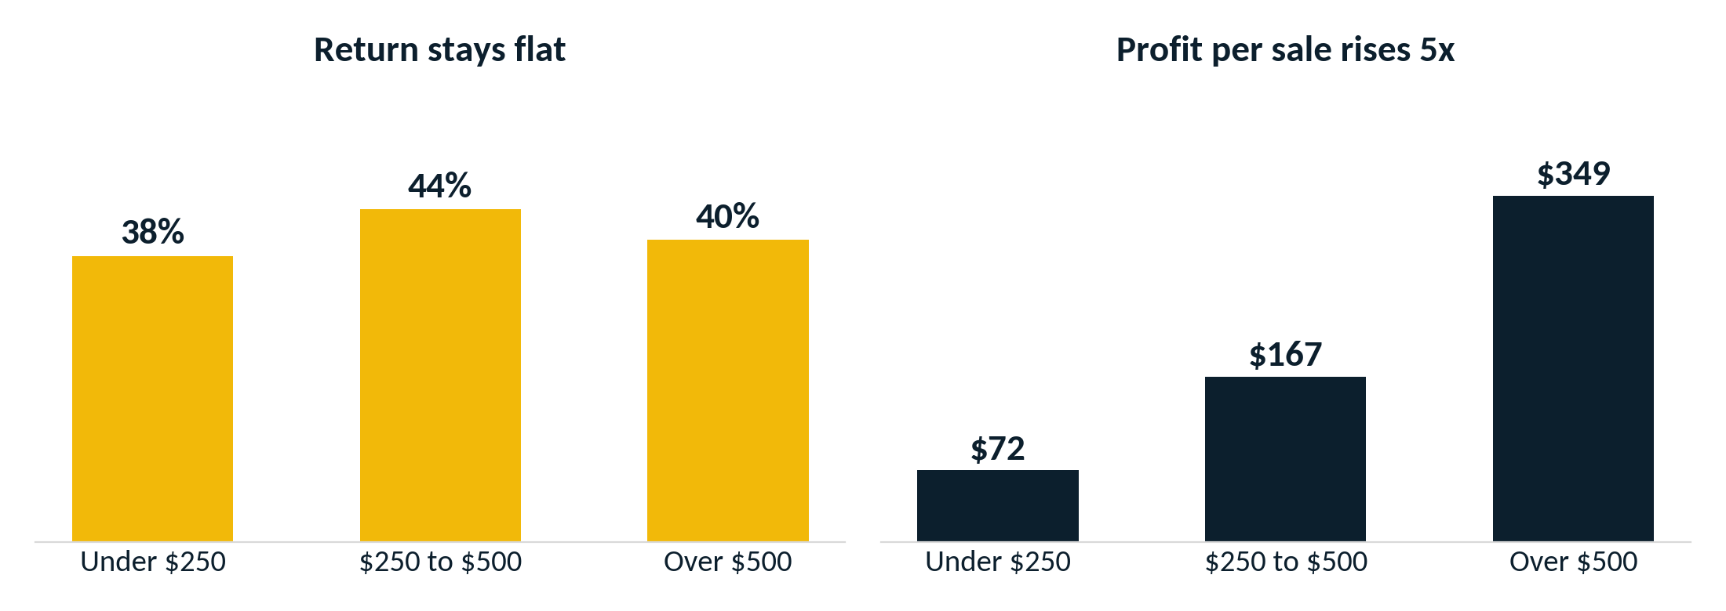
A $1,000 meter earns the same rate as a $200 one
Return by ticket size
What it means
Return barely moves: 38%, 44%, 40%. Hold time stays near two days.
Profit per sale: $72 → $167 → $349.
Every sale costs the same search.
Against the research
AI-run arbitrage margins are “not sustainable when the scale… is significantly increased” (Tanlamai et al., 2024).
Mine held across a 10x range: I buy in an inefficient market and sell in an efficient one.
7 sales under $250 · 9 between $250 and $500 · 3 above $500
KEY TAKEAWAY
Hours are the ceiling, not cash. At a two-day hold I need money for one meter at a time so I should raise the price of the meter.
Profitability review
Fluke case study
4

Slide 5
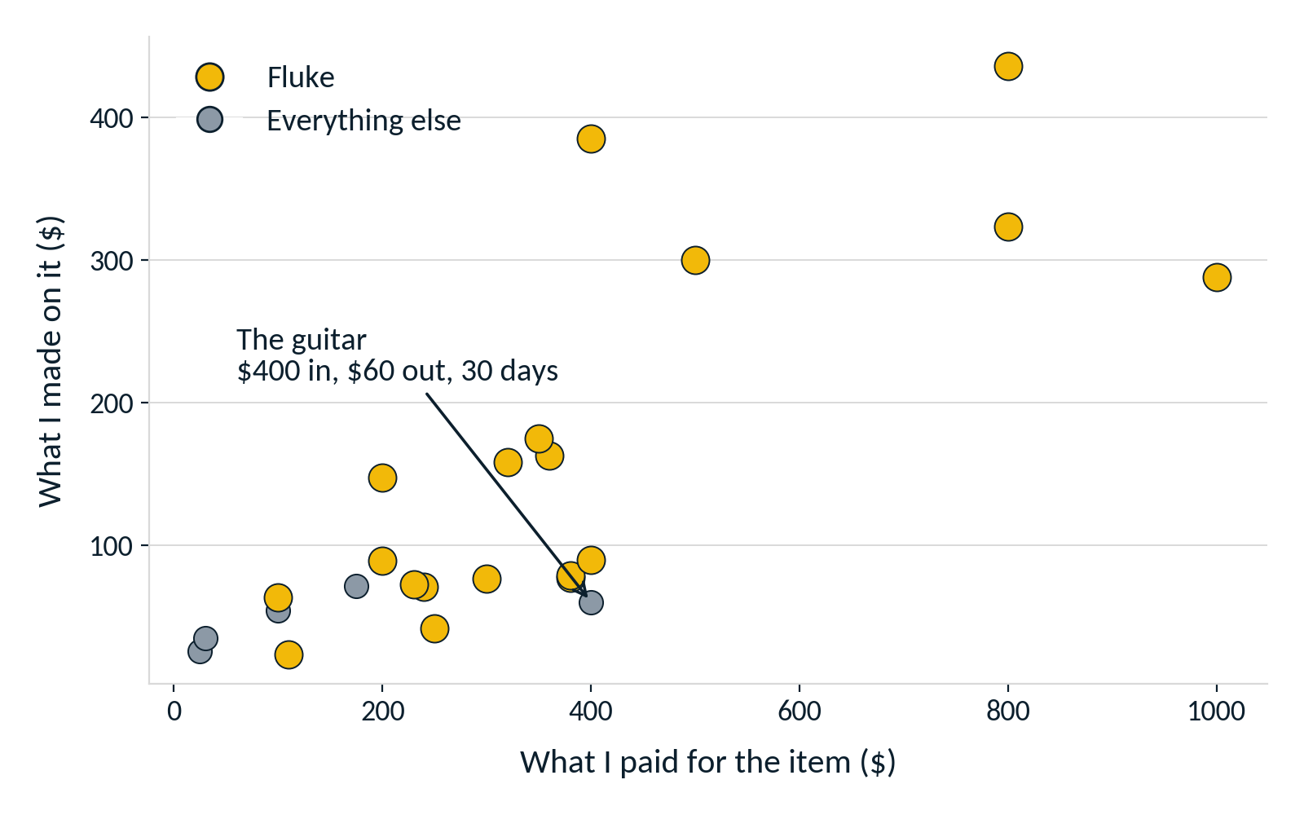
Cash that comes back in two days
Research: turnover falls as demand uncertainty rises (Hançerlioğulları et al., 2016), and margin usually costs speed.
Fluke pays me both. Highest margin, 29.5%. Fastest sale, 1.9 days.
I look the price up, then buy under it.
The one that did not work
One guitar: $400 in, $60 out, and 30 days of held cash against a three-day average everywhere else. Never a loss, but rather just dollars that could not move. The same $400 in a Fluke pays about $167 and is back in two days.
Meters cluster tight and return fast. The guitar sits alone: the most cash committed, near the least made.
Profitability review
Fluke case study
5

Slide 6
The Fluke case study
Profitability review
Fluke case study
7

Slide 7
Fluke sells trust. I resell it.
A multimeter is safety equipment and Fluke is one of the best manufacturers. Fluke competes on trust and longevity, never on price, which is a deliberate strategy. “Budget meters often fail within 2-5 years” (Revine, 2025). A Fluke runs fifteen to twenty-five, and “many electricians are still using Fluke meters from the 1990s” (SparkShift, 2026). A product that refuses to wear out is why a ten-year-old unit sells for real money. Their strategy is my margin: used, a Fluke competes only with other Flukes.
What this means for me
The buyer cannot test a used meter before it ships. The Fluke name does the testing. So I buy from a seller who wants it gone, or doesn’t know its value, and sell to an electrician who needs it Monday. No other meter brand carries trust across a resale. That is the entire niche.
Monopoly?
Fluke is not a monopoly. Klein sells credible meters for less and many electricians carry both. Fluke owns the premium, industrial end that holds value.
Profitability review
Fluke case study
8

Slide 8
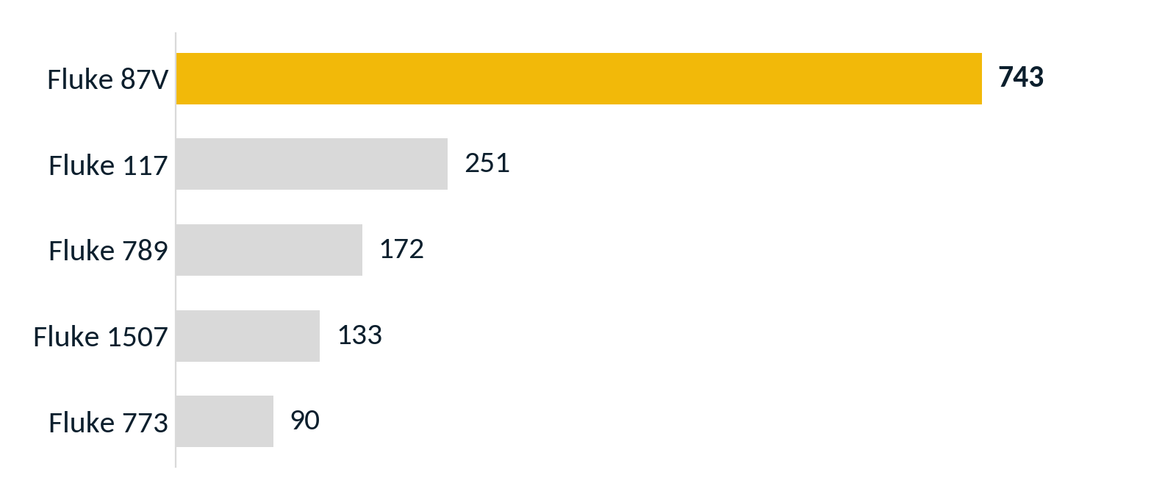
Demand is not what limits me. I am 1% of it.
19
Fluke sales sold
Anthidote: Fluke
Recent sold listings on eBay, five models I trade
More thoughts
1,389
41.8%
return on capital
eBay reports these as “recently ended”, not a fixed window. 1,389 is a floor on demand and 1.4% a ceiling on my share.
recent sales across those five models
1.9 days
average hold
Buyers are not my problem.
I could sell ten times today's volume and still not press against this market.
Even if all nineteen of my sales landed in that window, I am 1.4% of it.
Profitability review
Fluke case study
9

Slide 9
Increase the hours and size of the meters.
Profit a month, at a 41.8% return
Scale it.
Demand is 1,389 recent sales. I am 1.4% of it. Returns hold at 40% to $1,000 a unit. Nothing here is close to full.
Hours | Ticket | Profit
3 hrs | $385 | $482
5 hrs | $385 | $804
3 hrs | $600 | $752
5 hrs | $600 | $1,253
Both levers, not one.
Five hours at a $600 ticket: about $482 to about $1,253 a month. Hours alone $804, ticket alone $752.
What kills this
Fund it with $3,000.
A dead meter — condition risk scales with the ticket; the test rule matters more at $1,000.
Five meters a month at $600. At a two-day hold I never hold all five at once.
Other resellers finding the same gap on Marketplace.
Track the hours starting now.
Every number above rests on a find rate I have never measured.
My own time. Five hours is my ceiling during the summer, not the semester
Sources: Hançerlioğulları, Şen & Ağca Aktunç (2016), IJPDLM · Tanlamai, Khern-am-nuai & Adulyasak (2024), AI & Society · Revine (2025) · SparkShift (2026).
Profitability review
Fluke case study
11

Slide 10
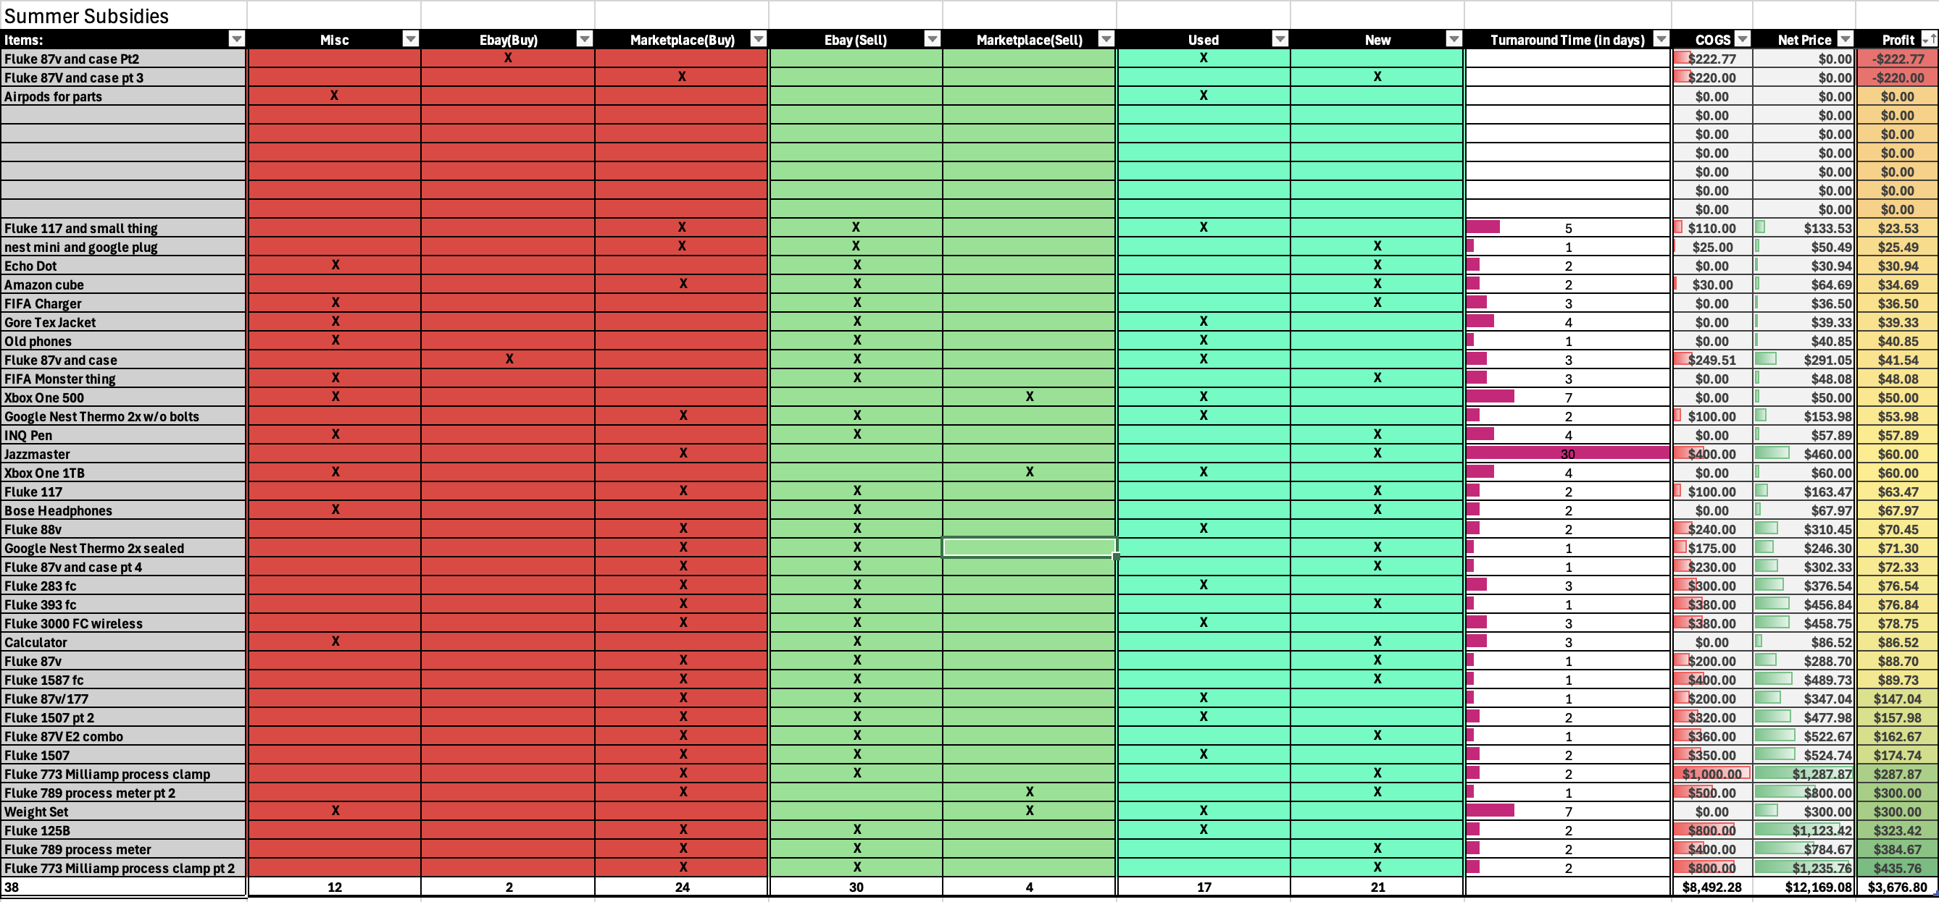
Tracker Overview

