Slide 1

ANÁLISIS DE DATOS ESPACIALES
EDIER V. ARISTIZÁBAL G.
Ing. Geólogo (Universidad Nacional de Colombia)
Esp. en Gestión de Riesgos Geológicos (Universidad de Ginebra – Suiza)
MSc. en Geociencias (Universidad de Shimane – Japón)
PhD. en Ingeniería (Universidad Nacional de Colombia)
Universidad Nacional de Colombia
Facultad de Minas
Departamento de Geociencias

Slide 2
CLUSTERING

Slide 3

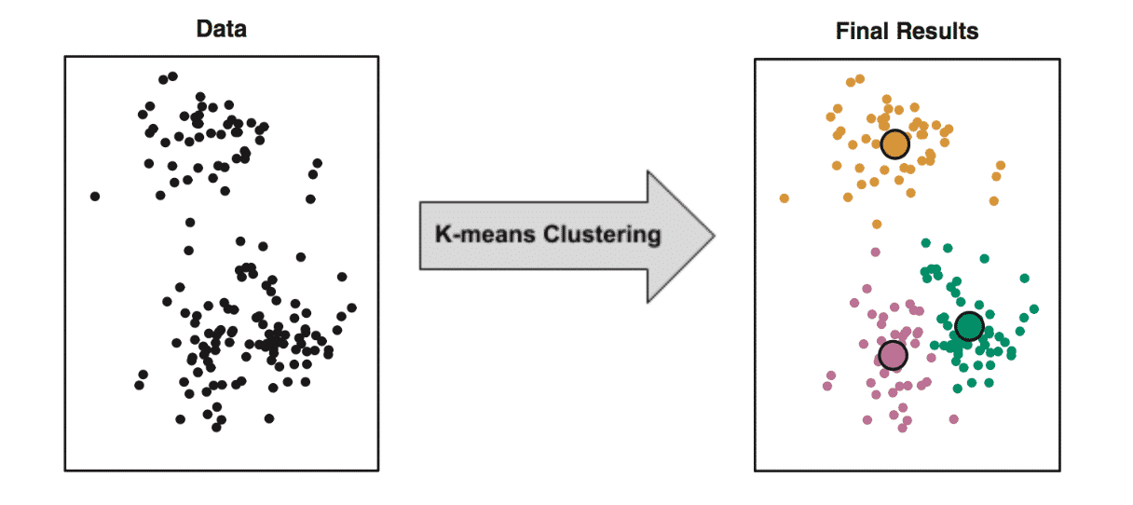
CLUSTERING
El objetivo es identificar subgrupos en los datos, de tal forma que los datos en cada subgrupo (clusters) sean muy similares, mientras que los datos en diferentes subgrupos sean muy diferentes.

Slide 4
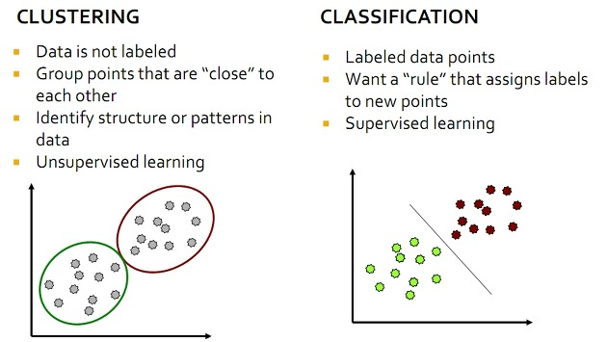
CLUSTERING

Slide 5
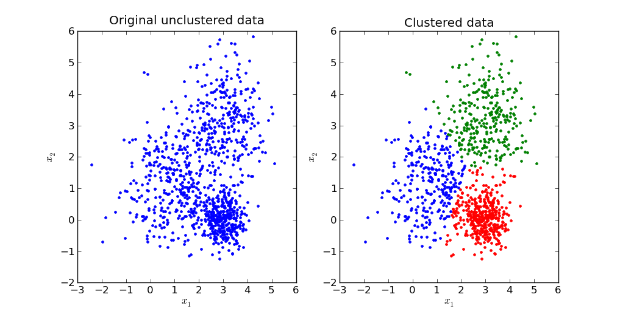
CLUSTERING

Slide 7
TIPOS DE CLUSTERING
Hierarchical Clustering: descomposición jerárquica utilizando algún criterio, pueden ser aglomerativos (bottom-up) o de separación (top-down). No necesitan K al inicio.
Partitioning Methods (k-means, PAM, CLARA): se construye a partir de particiones, las cuales son evaluadas por algún criterio. Necesitan K al inicio.
Density-Based Clustering: basados en funciones de conectividad y funciones de densidad.
Model-based Clustering: se utiliza un modelo para agrupar los modelos.
Fuzzy Clustering: A partir de lógica difusa se separan o agrupan los clusters.

Slide 8
DISTANCIAS EN CLUSTERING

Slide 9
DISTANCIAS EN CLUSTERING

Slide 10
DISTANCIAS EN CLUSTERING

Slide 11
DISTANCIAS EN CLUSTERING

Slide 12
KMEANS CLUSTERING

Slide 13
KMEANS CLUSTERING

Slide 14
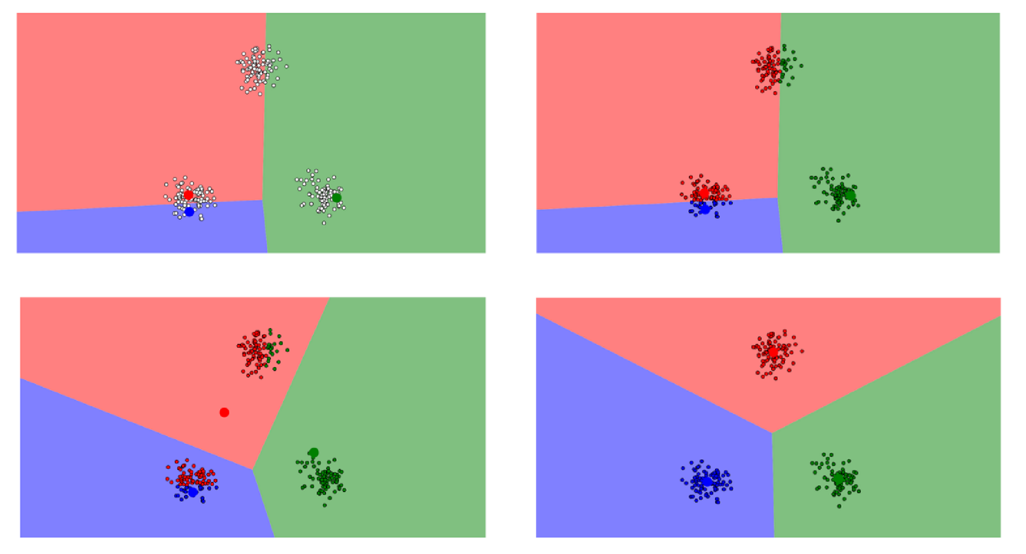
KMEANS CLUSTERING

Slide 15
JERARQUICAL CLUSTERING

Slide 16
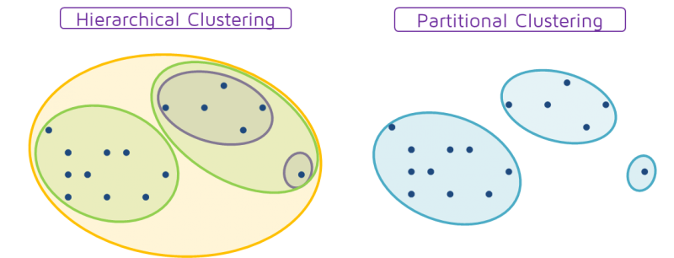
JERARQUICAL vs PARTITIONAL CLUSTERING

Slide 17
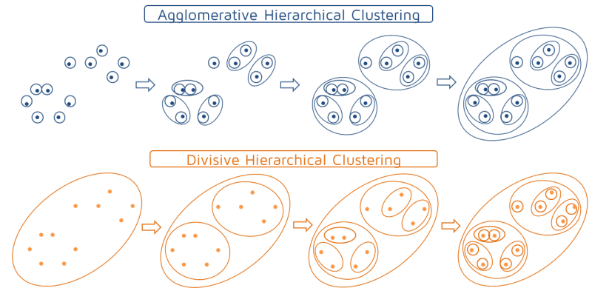
JERARQUICAL CLUSTERING

Slide 18
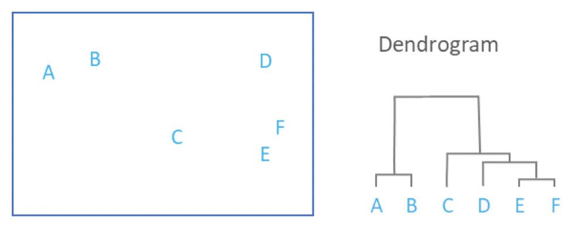
JERARQUICAL CLUSTERING

Slide 19
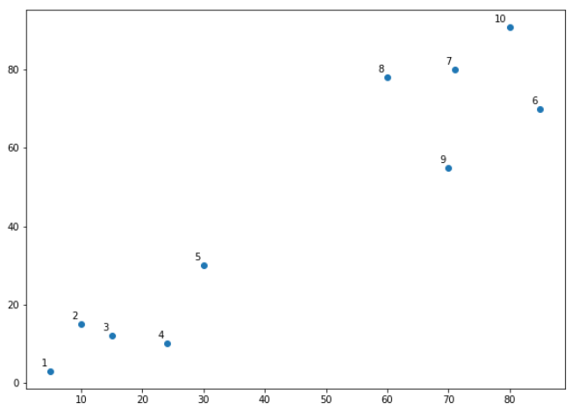
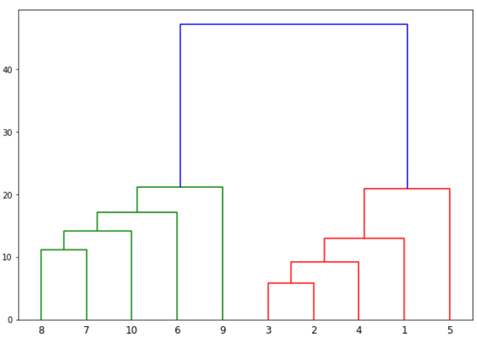
JERARQUICAL CLUSTERING

Slide 20
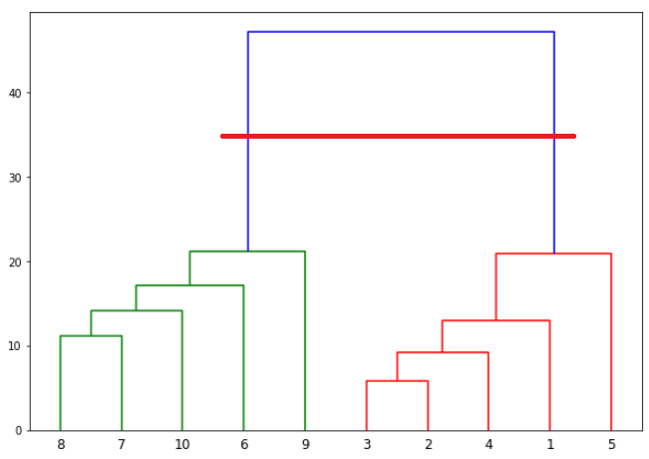
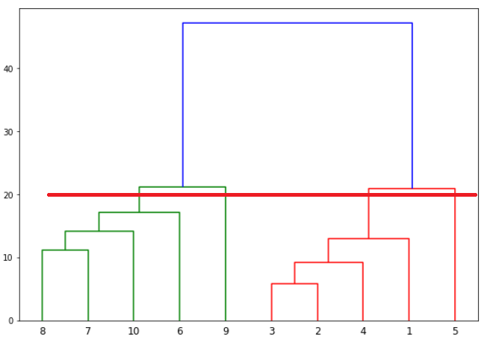
JERARQUICAL CLUSTERING
K=2
K=4

Slide 21
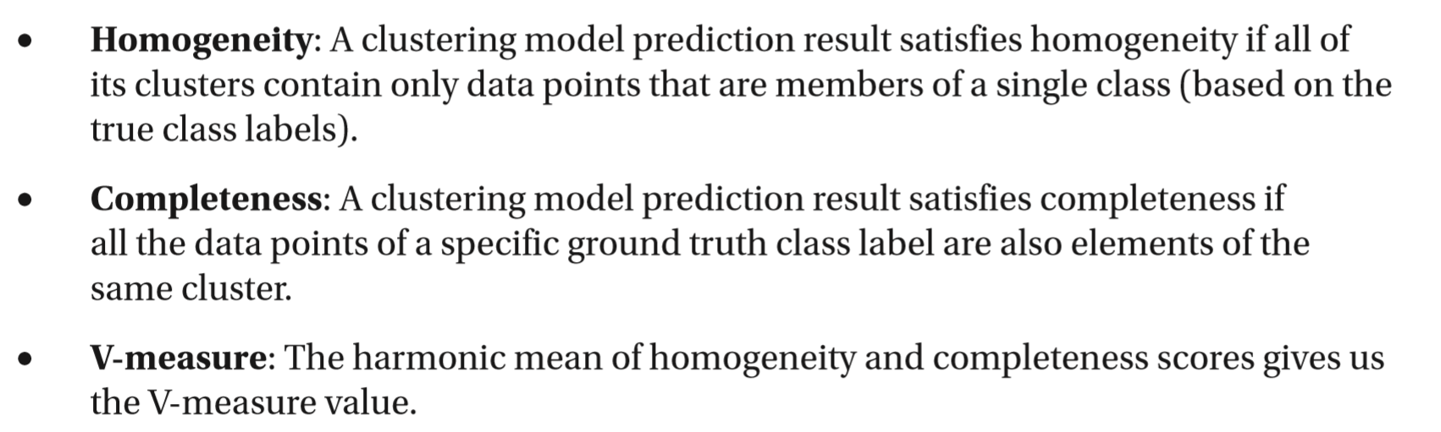
MÉTRICA EN CLUSTERING
Un buen método de clustering debe producir clusters en los cuales:
La similaridad en Intra – cluster es alta
La similaridad entre – cluster es baja

Slide 22
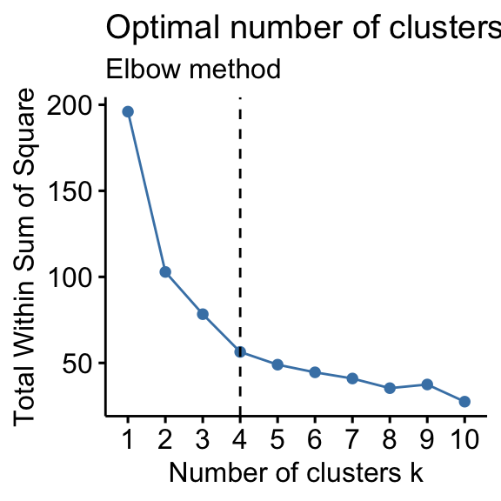
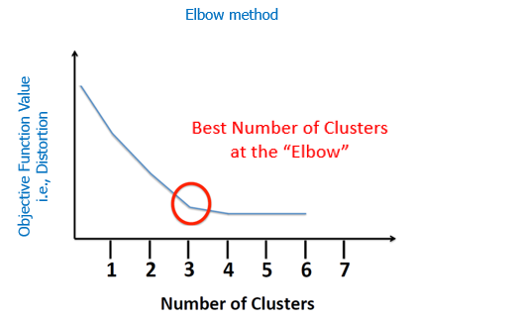
MÉTODO ELBOW
Probably the most well known method, the elbow method, in which the sum of squares at each number of clusters is calculated and graphed, and the user looks for a change of slope from steep to shallow (an elbow) to determine the optimal number of clusters.
This method is inexact, but still potentially helpful. The Elbow Curve method is helpful because it shows how increasing the number of the clusters contribute separating the clusters in a meaningful way, not in a marginal way.
The bend indicates that additional clusters beyond the third have little value. The Elbow method is fairly clear, if not a naïve solution based on intra-cluster variance.

Slide 23
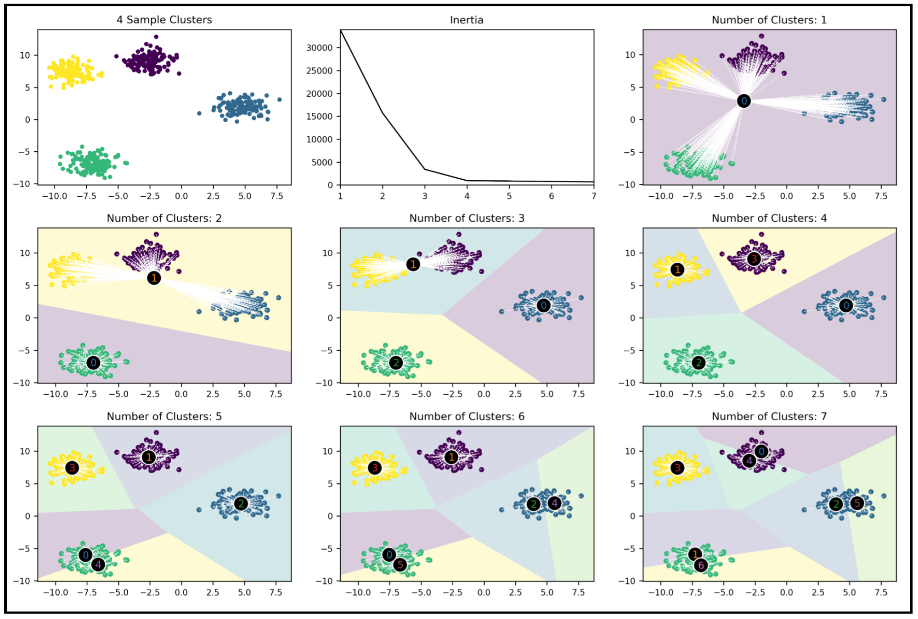
MÉTODO ELBOW

Slide 24
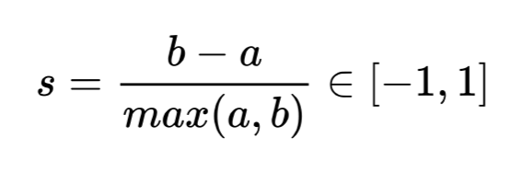
MÉTODO SILHOUETTE
The silhouette coefficient provides a more detailed picture of cluster quality. It answers the question: how far are the points in the nearest cluster, relative to the points in the assigned cluster?
To this end, it compares the mean intra-cluster distance (a) to the mean distance of the nearest cluster (b) and computes the following score s:
The score can vary from between -1 and 1, but negative values are unlikely in practice because they imply that the majority of points are assigned to the wrong cluster. A useful visualization of the silhouette score compares the values for each data point to the global average because it highlights the coherence of each cluster relative to the global configuration. The rule of thumb is to avoid clusters with mean scores below the average for all samples.

Slide 25
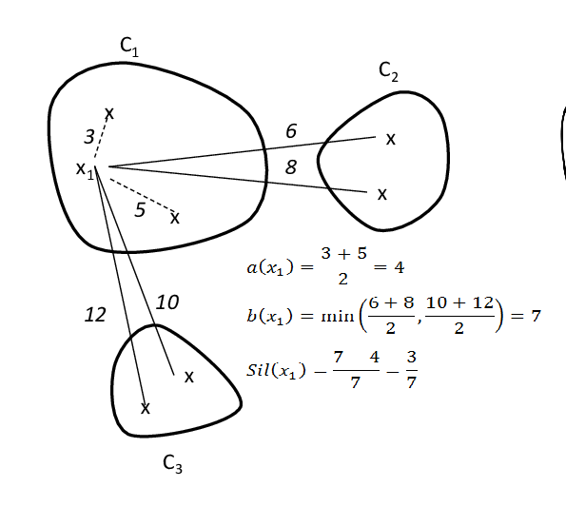
MÉTODO SILHOUETTE

Slide 26
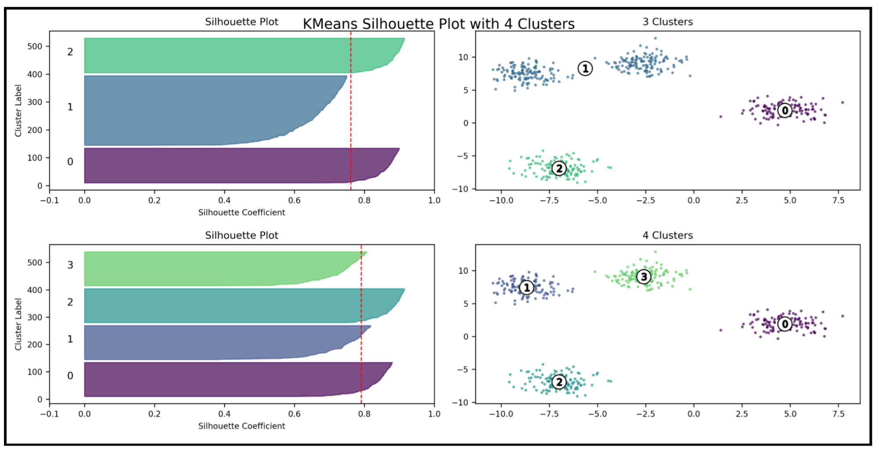
MÉTODO SILHOUETTE

Slide 27
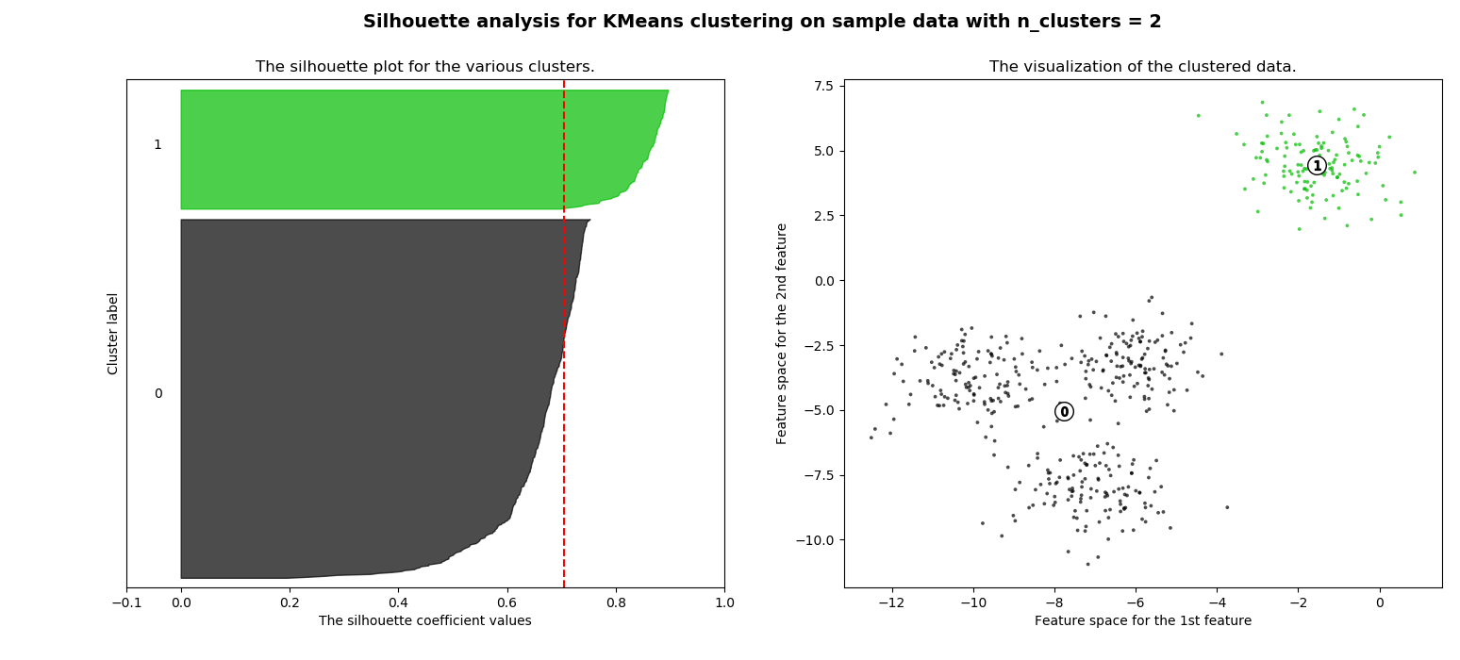
MÉTODO SILHOUETTE
For n_clusters = 2 The average silhouette_score is : 0.7049787496083262

Slide 28
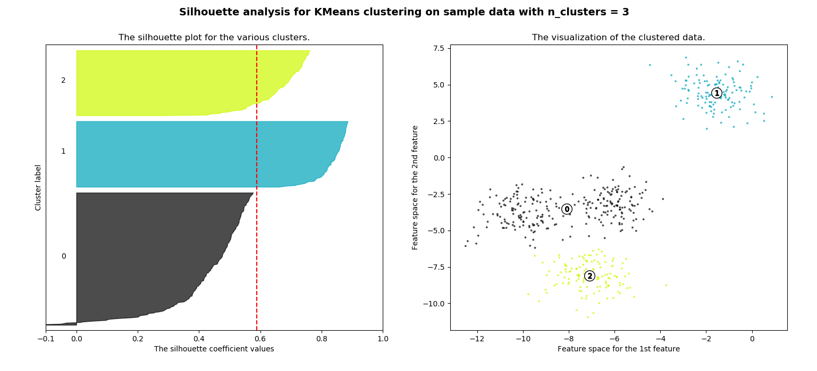
MÉTODO SILHOUETTE
For n_clusters = 3 The average silhouette_score is : 0.5882004012129721

Slide 29
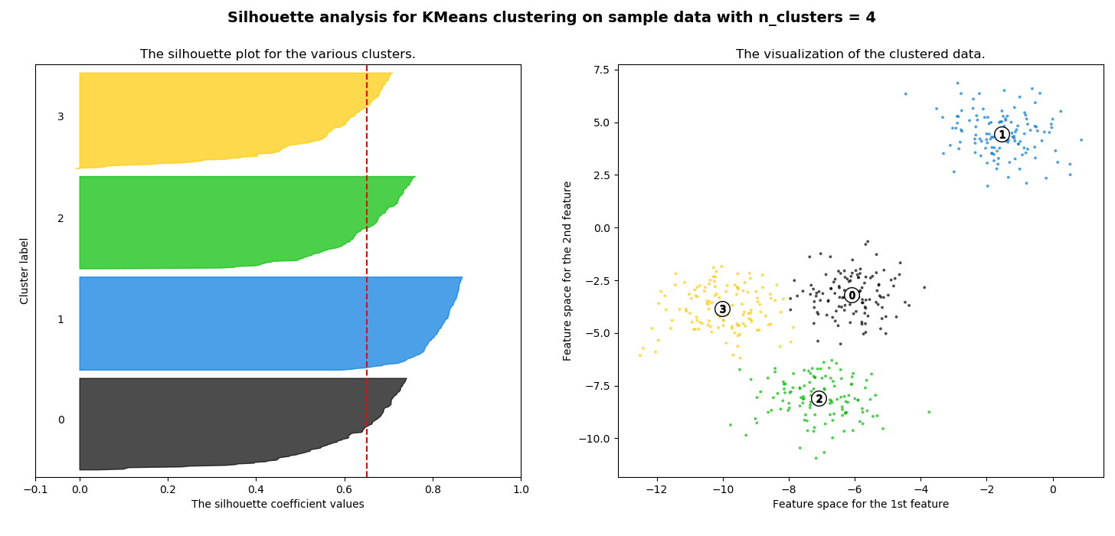
MÉTODO SILHOUETTE
For n_clusters = 4 The average silhouette_score is : 0.6505186632729437

Slide 30
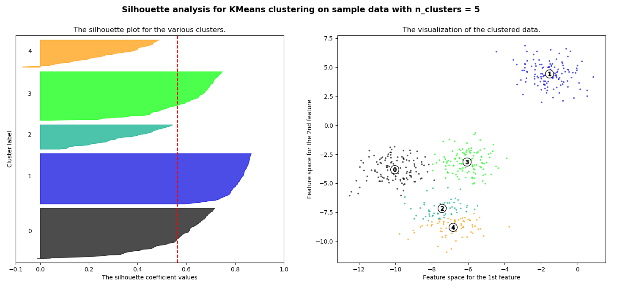
MÉTODO SILHOUETTE
For n_clusters = 5 The average silhouette_score is : 0.56376469026194

Slide 31
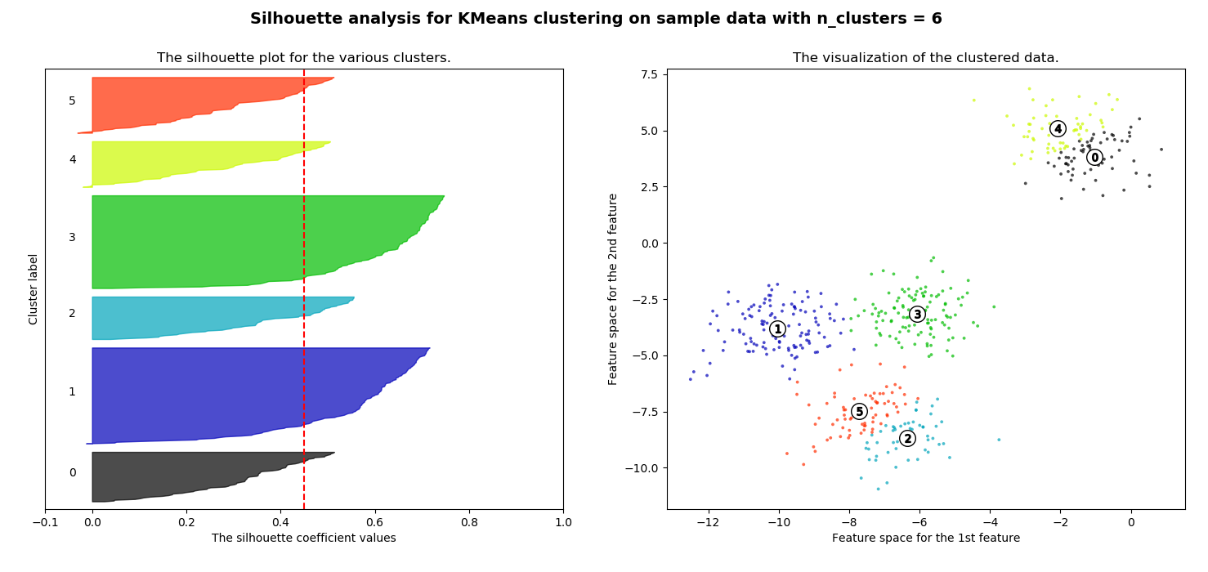
MÉTODO SILHOUETTE
For n_clusters = 6 The average silhouette_score is : 0.4504666294372765

Slide 32
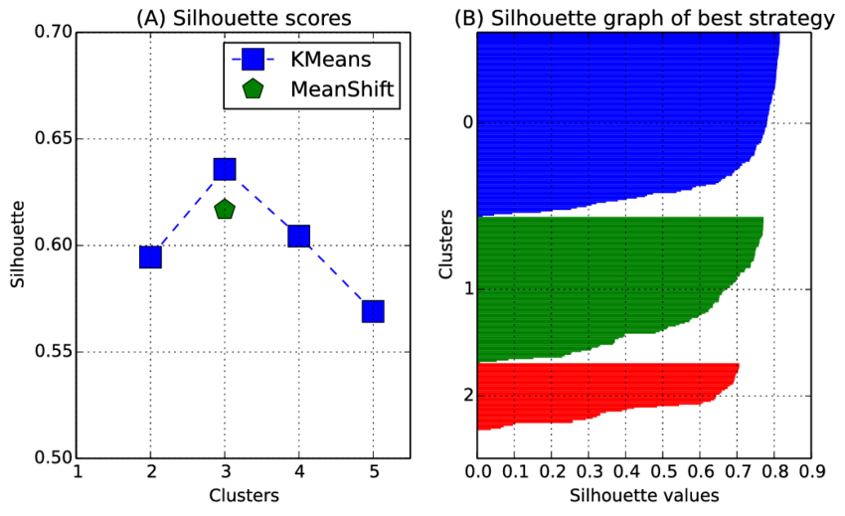
MÉTODO SILHOUETTE

Slide 33
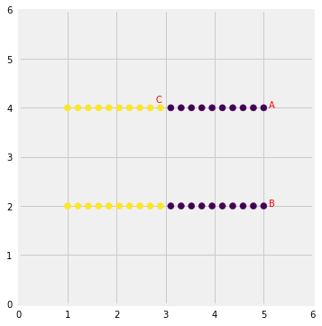
CONSIDERACIONES

Slide 34
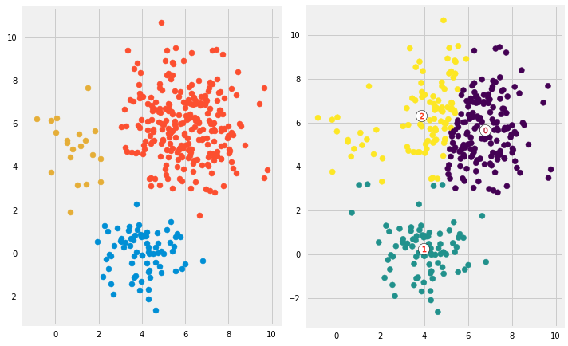
CONSIDERACIONES

