Slide 1


AI workshop
Introduction to Python
Itzel Muro Puente
May 13th, 2026

Slide 2
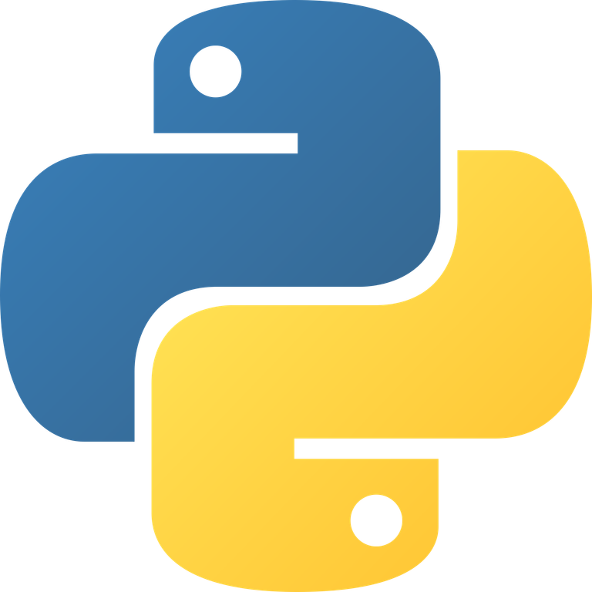
Python
Definition
Easy to interpret and high-level object-oriented programming language with easy-to-read syntax.

Slide 3
Python
Definition
Easy to interpret and high-level object-oriented programming language with easy-to-read syntax.
Why Python?
Simplicity
Easy interface
Big toolkit available (modules/packages)

Slide 4
What is a module?
A module is a python file that contains code that define functions, classes and variables.

Slide 5
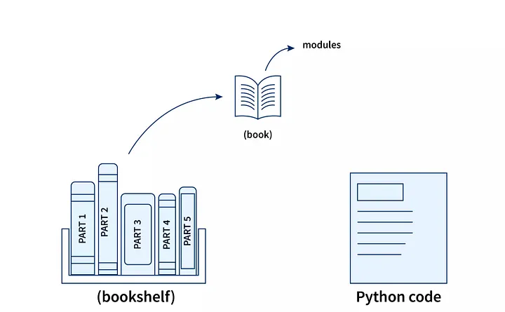
What is a module?
A module is a python file that contains code that define functions, classes and variables.

Slide 6
Common scientific packages
Basics
NumPy (array data)
Pandas (tabular data)
Matplotlib (data visualization)
Seaborn (data visualization)

Slide 7
Common scientific packages
Basics
NumPy (array data)
Pandas (tabular data)
Matplotlib (data visualization)
Seaborn (data visualization)
Chemistry
RDKit (cheminformatics and ML)
Open Babel (conversion of chemical file formats)
PyMOL (molecular graphics tool)
ChemPy (physical chemistry)

Slide 8
Common scientific packages
Basics
NumPy (array data)
Pandas (tabular data)
Matplotlib (data visualization)
Seaborn (data visualization)
Chemistry
RDKit (cheminformatics and ML)
Open Babel (conversion of chemical file formats)
PyMOL (molecular graphics tool)
ChemPy (physical chemistry)
Machine Learning
TensorFlow
Scikit-learn

Slide 9
Virtual environments
A virtual environment is an isolated directory tree that contains a specific Python version and its own libraries/packages.

Slide 10
Virtual environments
A virtual environment is an isolated directory tree that contains a specific Python version and its own libraries/packages.
Mainly used:
to avoid dependency conflicts
for reproducibility

Slide 11
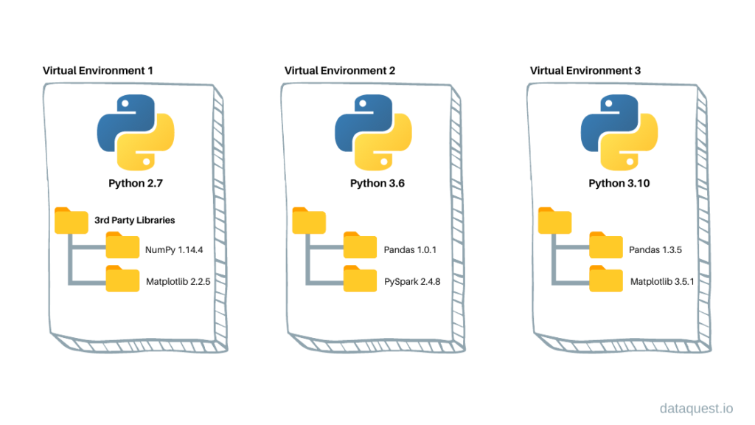
Virtual environments
A virtual environment is an isolated directory tree that contains a specific Python version and its own libraries/packages.
Mainly used:
to avoid dependency conflicts
for reproducibility

Slide 12
Virtual environment example
Python | Real life example

Slide 13
Virtual environment example
Python | Real life example
Virtual environment | Personal fumehood

Slide 14
Virtual environment example
Python | Real life example
Virtual environment | Personal fumehood
Packages | Reagents

Slide 15
Virtual environment example
Python | Real life example
Virtual environment | Personal fumehood
Packages | Reagents
Versions | Condutions

Slide 16
Virtual environment example
Python | Real life example
Virtual environment | Personal fumehood
Packages | Reagents
Versions | Condutions
Requirements (yaml) | Lab notebook

Slide 17
Virtual environment example
Python | Real life example
Virtual environment | Personal fumehood
Packages | Reagents
Versions | Condutions
Requirements (yaml) | Lab notebook
Other examples
cheminf

