Slide 1
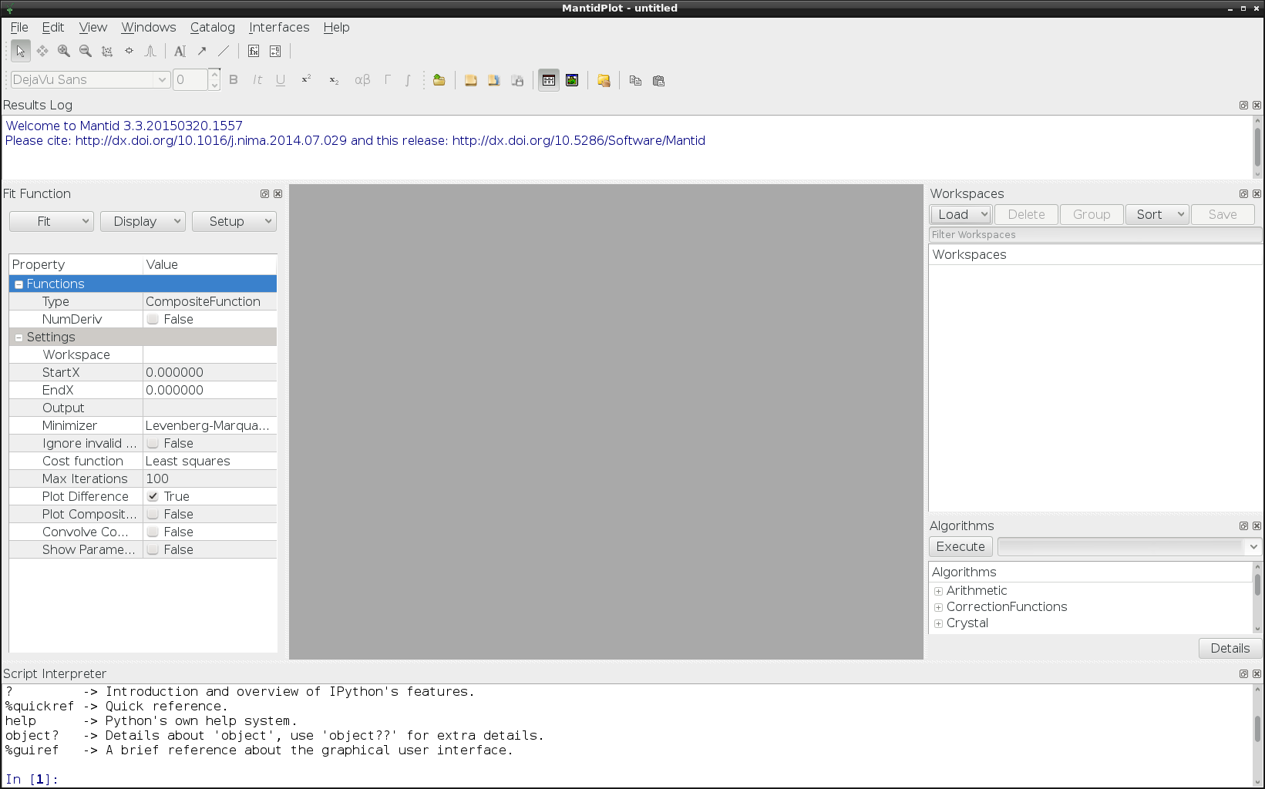
log window
Fit wizard
Workspaces
Algorithms
Python interpreter

