Slide 1


Dakota for CAMM
Vickie E Lynch
November 20, 2012

Slide 2
Computing Resources
Where should first optimization runs be tested?
Directors Discretionary allocation: Jaguar, Smoky, Lens
Judy Hill will help install Dakota
NAMD module for Jaguar and Lens
NERSC allocation: Hopper
Dakota installed in project area
NAMD module for Hopper
NDAV clusters: Fermi, Chadwick
Mantid module for Fermi; installed on Chadwick
Testing on 8 node workstation
Dakota & Mantid installed
1404 Phonon Line Width evaluation
472 min using 1 core
38 min using 8 cores (speedup 12.4)

Slide 3
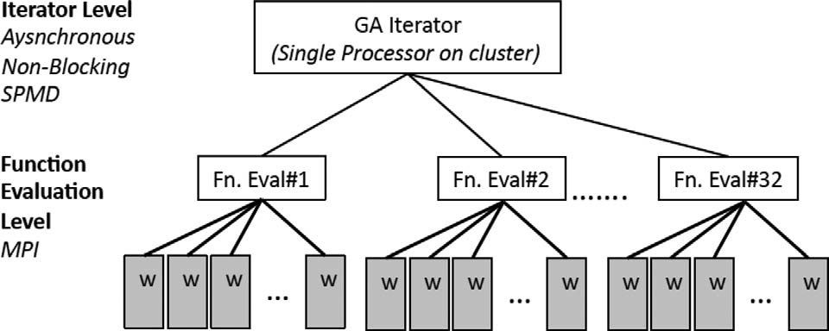
Dakota running parallel codes
From Narayanan et. al., Int. J. High Perf. Comp. App., July 2012:
Dakota

Slide 4
## DAKOTA INPUT FILE
#
# execute as:
# $(DAKOTA_PATH)/bin/dakota dakota_param_8d.in
#
strategy,
single_method
graphics,tabular_graphics_data
method,
multidim_parameter_study
partitions = 1 1 1 1 1 1 1 1
output verbose
model,
single
variables,
continuous_design = 8
lower_bounds = 50. 500. .59 4. 70. 500. .59 4.
upper_bounds = 150. 800. .61 6. 250. 800. .61 6.
descriptors = 'mu_a_healthy' 'mu_s_healthy' 'k_0_healthy' 'w_0_healthy' 'mu_a_tumor' 'mu_s_tumor' 'k_0_tumor' 'w_0_tumor'
# should run on 6 procs total
# dakota is run in SERIAL but each forked function evaluation will run in parallel
# asynchronous evaluation_concurrency = 3 will allow all 3 function evals at the same time
# fork w/ mpirun -n 2 will run 2 procs per function eval
interface,
fork
analysis_driver = 'mpirun -n 2 python /data/fuentes/mdacc/uqModelStudy/deltapModeling.py'
parameters_file = 'params.in'
results_file = 'results.out'
asynchronous evaluation_concurrency = 3
file_save file_tag
responses,
num_objective_functions = 1
no_gradients
no_hessians

Slide 5
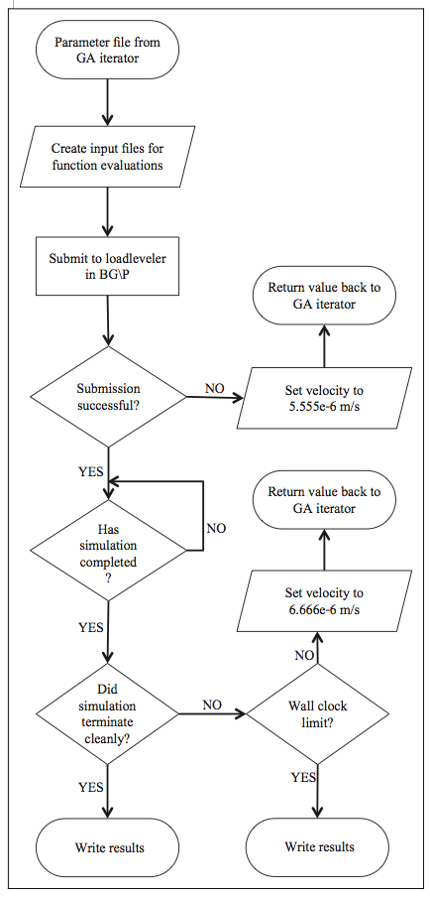
Dakota Function Evaluation Script:
Parameter file from Dakota
Coupling script for Dakota and NAMD
Parallel MD code and Dakota node must share file system
Dakota node must be able to submit and check status of batch
Submit NAMD to batch
Return value back to Dakota
Error code
Return value back to Dakota
Error code
Compare model with experiment;
Return fitness to Dakota
Compare model with experiment;
Return fitness to Dakota

Slide 6
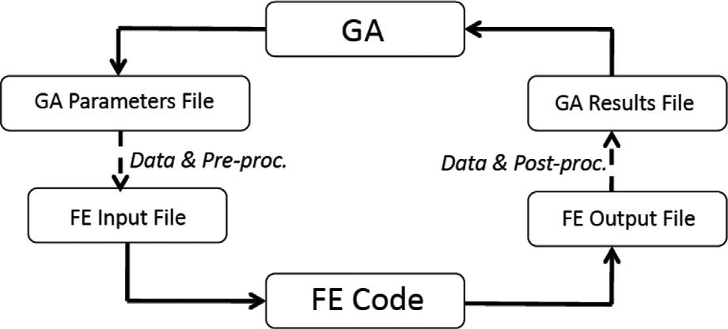
Fitness of Model Parameters
Dakota Function Eval
Experimental Results
Mantid script
NAMD
NAMD
NAMD Code

Slide 7
Mantid Fitting Script (Jose)
strT=kwargs[‘Temperature’]
model= kwargs['model']
LoadEugeneData( strT )
LoadSassenaOutput( strT )
CostFunction(kwargs['outFile'])
def LoadEugeneData( strT, Qval ):
"""load files into Mantid workspaces"""
for Qval in ( '3', '5', '7', '9' ):
fname = 'LiCl_0_%s_%sK_ForDAVE.TXT' % ( Qval, strT )
mapi.LoadAscii( Filename = kwargs['dataDir'] + '/' + fname, Unit = 'DeltaE',
Separator='Tab', OutputWorkspace = 'data_0_%s_%s' % ( Qval, strT ) )
fname = 'LiCl_0_%s_006K_ForDAVE.TXT' % Qval
mapi.LoadAscii( Filename = kwargs['dataDir'] + '/' + fname, Unit = 'DeltaE',
Separator='Tab', OutputWorkspace = 'data_0_%s_006' % Qval )
def LoadSassenaOutput( strT ):
"""load Sassena hdf5 files, perform Fourier transform"""
for Hq in ( '32', '34', '36', '38', '40', '42', '44', '46', '48', '50' ):
fname = kwargs['simDir']+'/Q%s/T%s/production/fqt.hd5' % ( Hq, strT )
mapi.LoadSassena( Filename = fname, OutputWorkspace = 'Hq%s_T%s' % ( Hq, strT ), TimeUnit = 1.0 )
mapi.SassenaFFT(InputWorkspace= 'Hq%s_T%s' % ( Hq, strT ),detailedBalance=True,Temp=float(strT))

Slide 8
def CostFunction(outFile):
cumChi2 = None
strOut = '#T=%s\n#Q-val Hyd-q Chi2\n' % strT
for Qval in ( '3', '5', '7', '9' ):
datW = 'data_0_%s_%s' % ( Qval, strT ) #data
resW = 'data_0_%s_006' % Qval #resolution
Hqx = ( '320', '340', '360', '380', '400', '420', '440', '460', '480', '500' )
if not cumChi2: cumChi2 = [0.] * len(Hqx) #initialize for the first time
iHq = 0
for Hq in Hqx:
simW = 'Q%s_Hq%s_T%s_sqw' % ( Qval, Hq, strT )
mapi.Scale( InputWorkspace = simW, OutputWorkspace = simW, Factor = 1e-12, Operation = 'Multiply' )
Chi2 = fitSimToDat( simW, datW, resW, model=model )
mapi.DeleteWorkspace( simW )
for suffix in ( 'NormalisedCovarianceMatrix', 'Parameters', 'Workspace'): mapi.DeleteWorkspace(
datW+'_'+suffix)
strOut += '0.%s %f\n' % ( Hq, Chi2 )
cumChi2[ iHq ] += Chi2 #Chi2 for all Q-values
iHq += 1
strOut += '&\n'
open( kwargs['outFile'], 'w' ).write( strOut)

Slide 9
def fitSimToDat( simW, datW, resW, model='model1' ):
"""fit simulation spectra to data spectra.
model2: elastic_line + FlatBkg + resolution x simulated
"""
mapi.ScaleX(InputWorkspace=resW, OutputWorkspace='resolution',factor=-1)
funcStr = ''
funcStr += '(composite=Convolution'
funcStr += ';name=TabulatedFunction,FileName="",Workspace=%s,Scaling=1,ties=(Scaling=1)' % 'resolution'
funcStr += ';name=TabulatedFunction,FileName="",Workspace=%s,Scaling=1e-10)' % simW #resolution x simulated
funcStr += ';name=TabulatedFunction,FileName="",Workspace=%s,Scaling=1' % resW #elastic line
funcStr += ';name=FlatBackground,A0=0.001,constraints=(0<A0)' #flat background
#trace()
gfit = mapi.Fit( funcStr, datW, StartX=-50.0, EndX=50.0, CreateOutput='1' )
parW = mapi.mtd[ datW + '_Parameters' ] #retrieve the cost of the fitting
mapi.DeleteWorkspace('resolution') #clean-up
return parW.column(1)[-1]

Slide 10
What parameters to optimize?
Hydrogen charge
Shift
Instrument resolution parameters

Slide 11
Workflow
Mantid Gui
Mantid
Reduction
Mantid Visualization
Dakota
Intelligent Script
Experimental Data
Change Instrument Resolution Only
Cost Function
Theory Data
Mantid convert to SQE optimizes bkg and scale factor
Run MD in Batch
Parameters
chisq

Slide 12
Problems
Reduce expensive function evaluations
What if variable is only epsilon away from previous
If fitness is same will optimization assume this is minimum

Slide 13
Intelligent script
Make temporary directory that includes function evaluation #
Copy dakota input file to that directory
Check if parameters have been run before (dakota.rst)
If fitness of parameters exists in dakota.rst
Get SQE from temporary directory for that function evaluation
Else
Create simulation input file from dakota input file
Submit simulation to batch
Check for completion
Compare to experimental data using Mantid
Output chisq to file for Dakota

