Slide 1
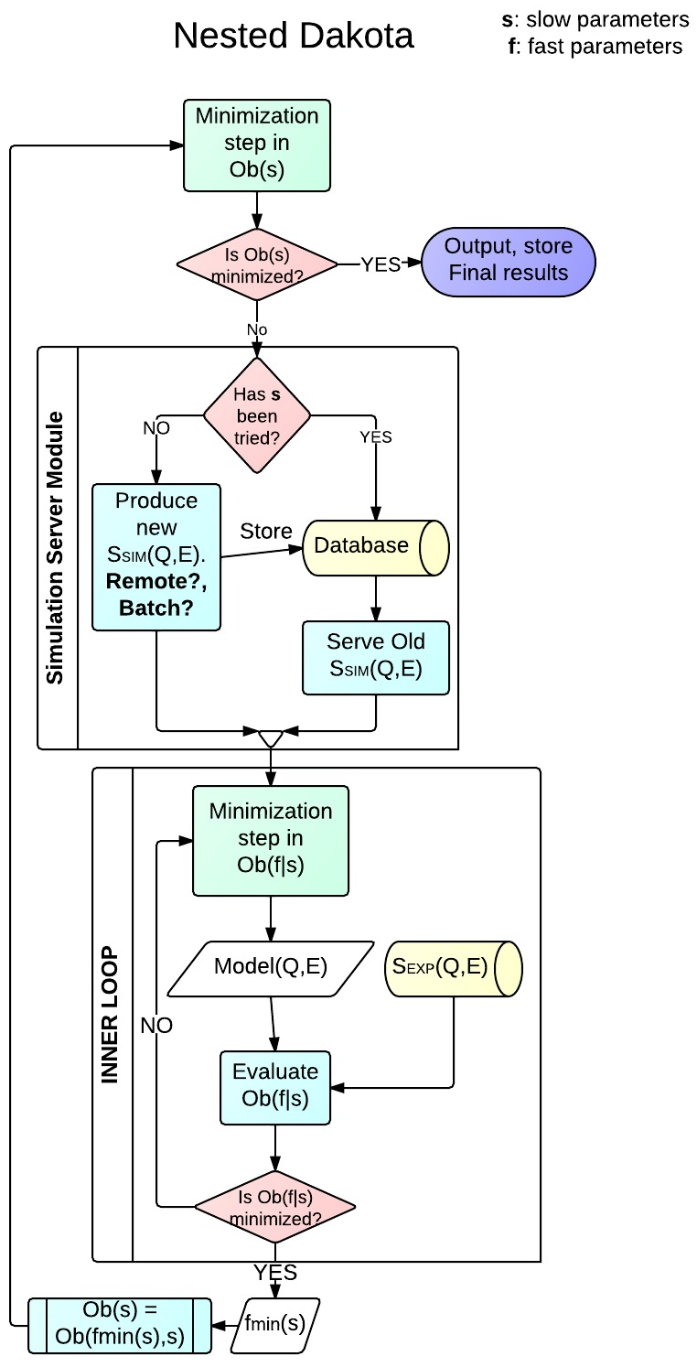
Minimization Workflow
Intel
Script
Strategy
Script

Slide 2
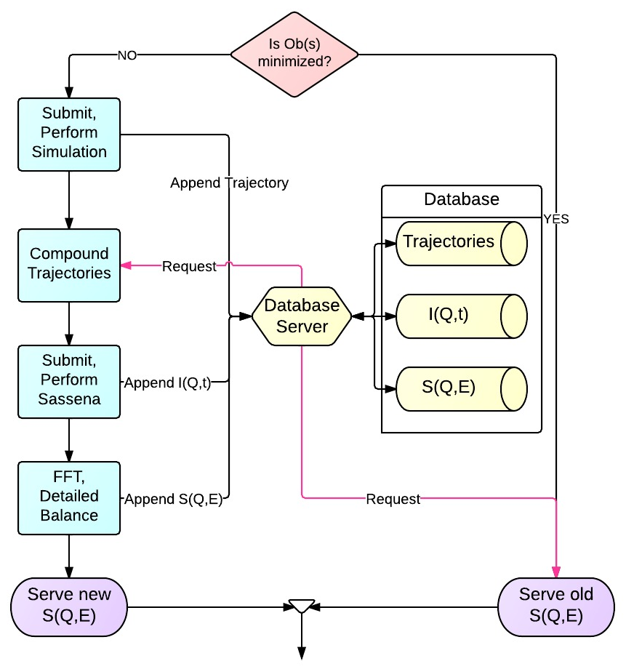
Simulation Server Module

Slide 3
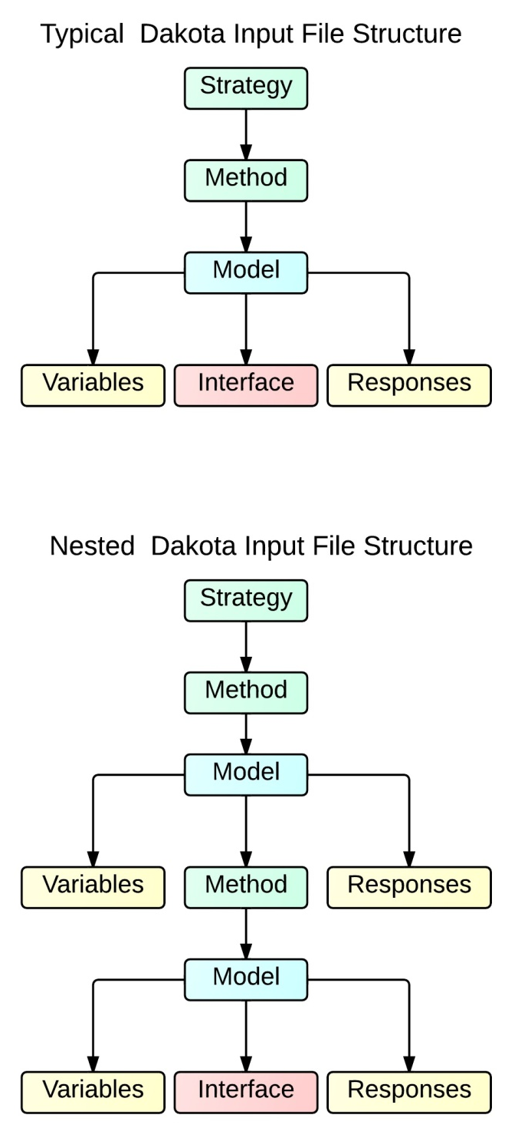
Dakota Input File Structure

Slide 4
Example: Dakota_uq_cantilever_sop_rel.in
strategy,
single_method
method_pointer = 'EPISTEMIC'
method,
id_method = 'EPISTEMIC'
model_pointer = 'EPIST_M'
...
model,
id_model = 'EPIST_M'
nested
variables_pointer = 'EPIST_V'
sub_method_pointer = 'ALEATORY'
responses_pointer = 'EPIST_R'
...
variables,
id_variables = 'EPIST_V'
...
responses,
id_responses = 'EPIST_R'
...
method,
id_method = 'ALEATORY'
model_pointer = 'ALEAT_M'
...
model,
id_model = 'ALEAT_M'
single
variables_pointer = 'ALEAT_V'
interface_pointer = 'ALEAT_I'
responses_pointer = 'ALEAT_R'
...
variables,
id_variables = 'ALEAT_V'
...
interface,
id_interface = 'ALEAT_I'
...
responses,
id_responses = 'ALEAT_R'
1
2

Slide 5
Dakota Strategy Input File

Slide 6
Title

Slide 7
Title

Slide 8
Title

Slide 9
Title

Slide 10
Minimization Components
Minimizer Algorithm
Cost Function
Fit Model
Experimental Data
Dakota Minimizer
Least Squares
S^{SIM}(Q,ω)+Beamline
S^{EXP}(Q,ω)
Dakota Client object
(request)
Cost Function Object
Exper. Data Object
Fit Model Server Object

Slide 11
Fit Models involving MD:
a “Born-Oppenheimer” Scenario
Example from Physics: Solid in an annealing process
Nuclear degrees of freedom relax ‘slowly’
Electronic degrees of freedom ‘instantaneously’ relax to a given set of nuclear degrees of freedom.
Minimization involving MD simulations
MD Force-Field parameters
beamline parameters
Fitting parameters can be divided into
As the minimization progresses (annealing), changing the MD Force-Field parameters involve hour-long MD simulations (nuclear deg.) . Changing beamline parameters involve mili-second evaluation (electronic deg.).
Minimization Split strategy:
Minimize (adapt) the bemaline parameters for a given MD Force-Field parameters
Run a minimization step of the MD Force-Field parameters
Repeat step 1

Slide 12
Minimization Split Strategy 1
Dakota minimizes only MD force-field parameters
Mantid minimizes only beamline parameters
Mantid
Mantid
Dakota
Mantid
Mantid
Mantid
Byproduct
Classes created will be reused when fitting Simulated and Reduced Data to standard QuasiElastic models within Mantid. These classes have to be written, anyway.

Slide 13
Minimization Split Strategy 2
f: MD Force-Field parameters
b: beamline parameters
Fit Model: F( f, b)
A fast Dakota minimization freezes the MD Force-Field parameters → F(b|f)→ b_{min}(f)
The Fit Model involving MD uses the optimized beamline params. b→ F( b_{min}(f), f)
Dakota Client object
(request)
Cost Function Object
Exper. Data Object
F(b_{min}(f),f) Fit Model Server Object
slow
minimiz
Dakota Client object
fast
minimiz
(request)
Cost Function Object
Exper. Data Object
F(b|f) Fit Model Server Object

Slide 14
Question on the Intelligent Script
Dakota Client object
Intelligent Script
Bypassing MD implies . Thus, Dakota will interpret that it reached a saddle point along f, so it will freeze f parameters and thus optimize F(b|f) instead of F(b,f), then exit. Is this conclusion correct?
MD
beamline

Slide 15
MD Simulations
Composition of objects
System Configuration Update
Run MD
Each one an interface.
Each MD flavor defines one strategy
Collect results

Slide 16
Sassena
Same design as running MD simulations
Composition of objects
System Configuration Update
Run Sassena
Each one an interface.
Each MD flavor defines one strategy
Collect results

Slide 17
Title

