Slide 1
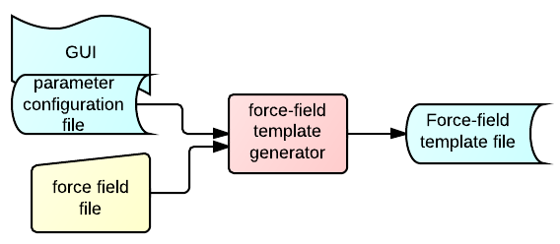
Force Field Template Creator
FF2,-2*FF1,309,1
FF1, ,310,1,0.3,0.45,0.6,0.01
FF1, ,311,1
<?xml version="1.0" ?><root>
<!--Force field template file-->
<FFParams>
<FFParam constraint="-2*FF1" name="FF2"/>
<FFParam initial="0.45" maximum="0.6" minimum="0.3" name="FF1" tolerance="0.01"/>
</FFParams>
<FFTemplate>PSF
5 !NTITLE
REMARKS original generated structure x-plor psf file
REMARKS topology crd.md18_vmd_autopsf-temp.top
REMARKS segment O1 { first NONE; last NONE; auto angles dihedrals }
REMARKS segment O2 { first NONE; last NONE; auto angles dihedrals }
REMARKS segment W1 { first NONE; last NONE; auto angles dihedrals }
3692 !NATOM
1 O1 1 LIT LIT LIT 1.000000 6.9410 0
...
309 W1 309 TIP3 OH2 OT _FF2_(%-12.3f) 15.9994 0
310 W1 309 TIP3 H1 HT _FF1_(%-12.3f) 1.0080 0
311 W1 309 TIP3 H2 HT _FF1_(%-12.3f) 1.0080 0

Slide 2
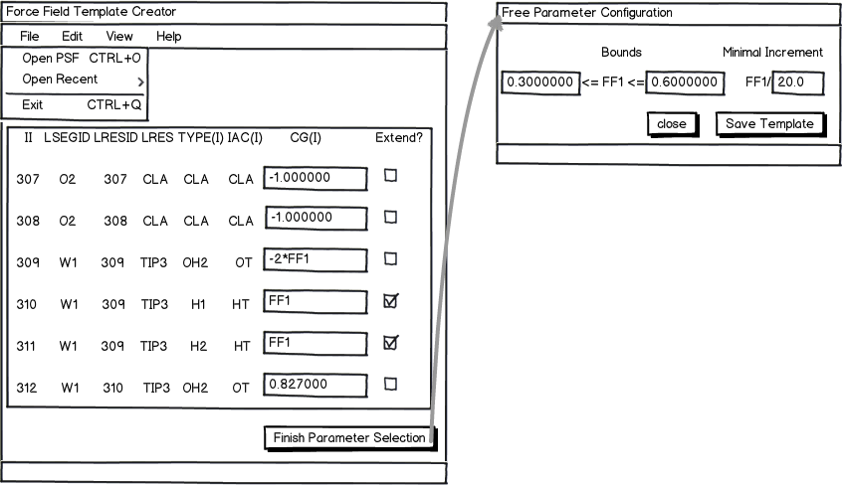
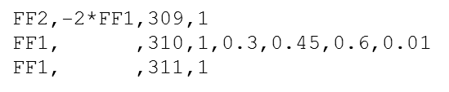
Force Field Template Creator (II)
Simple GUI to select and configure parameters to fit partial charges from a PSF CHARMM or NAMD topology file
Ability to input simple constraints among parameters
Contents of the PSF file

Slide 3
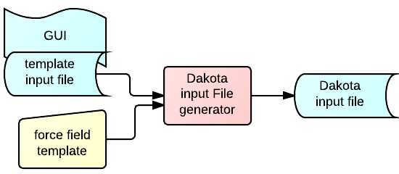
Dakota Input File Generator
Offer a limited library of template user files to the user
Allow user to pass its own template
...
method,
dot_mmfd,
max_iterations = 20
variables,
continuous_design = 2
descriptors FF1
initial_point 0.45
lower_bounds 0.3
upper_bounds 0.6
max_step 0.01
interface,
fork
...
<?xml version="1.0" ?><root>
<!--Force field template file-->
<FFParams>
<FFParam constraint="-2*FF1" name="FF2"/>
<FFParam initial="0.45" maximum="0.6" minimum="0.3" name="FF1" tolerance="0.01"/>
</FFParams>
<FFTemplate>PSF

Slide 4
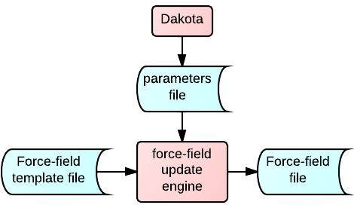
Force Field Update Script

Slide 5
Title

Slide 6
Force Field Template File
Contents divided into:
a “mapping” section describing the parameters
the force-field where keywords substitute values
!FFPARAMS
#Force Field Parameters
FF1 # partial charge at oxygen atom in water molecule
FF2 # partial charge at hydrogen atom in water molecule
!FREEPARAMS
#Dakota Parameters
FF2
!CONSTRAINTS
#Constraints in explicit form for each non-free parameter
FF1=-2*FF2 # each water molecule is electrically neutral
!FFFORMAT
#Format Force Field Parameters (in C's printf style)
%9.3f
%9.3f

Slide 7
Force Field Template File (II)
PSF
5 !NTITLE
REMARKS original generated structure x-plor psf file
REMARKS topology crd.md18_vmd_autopsf-temp.top
REMARKS segment O1 { first NONE; last NONE; auto angles dihedrals }
REMARKS segment O2 { first NONE; last NONE; auto angles dihedrals }
REMARKS segment W1 { first NONE; last NONE; auto angles dihedrals }
3692 !NATOM
1 O1 1 LIT LIT LIT 1.000000 6.9410 0
2 O1 2 LIT LIT LIT 1.000000 6.9410 0
……
307 O2 307 CLA CLA CLA -1.000000 35.4500 0
308 O2 308 CLA CLA CLA -1.000000 35.4500 0
309 W1 309 TIP3 OH2 OT _FF1_____ 15.9994 0
310 W1 309 TIP3 H1 HT _FF2_____ 1.0080 0
311 W1 309 TIP3 H2 HT _FF2_____ 1.0080 0
312 W1 310 TIP3 OH2 OT _FF1_____ 15.9994 0
313 W1 310 TIP3 H1 HT _FF2_____ 1.0080 0
314 W1 310 TIP3 H2 HT _FF2_____ 1.0080 0
315 W1 311 TIP3 OH2 OT _FF1_____ 15.9994 0
…..

Slide 8
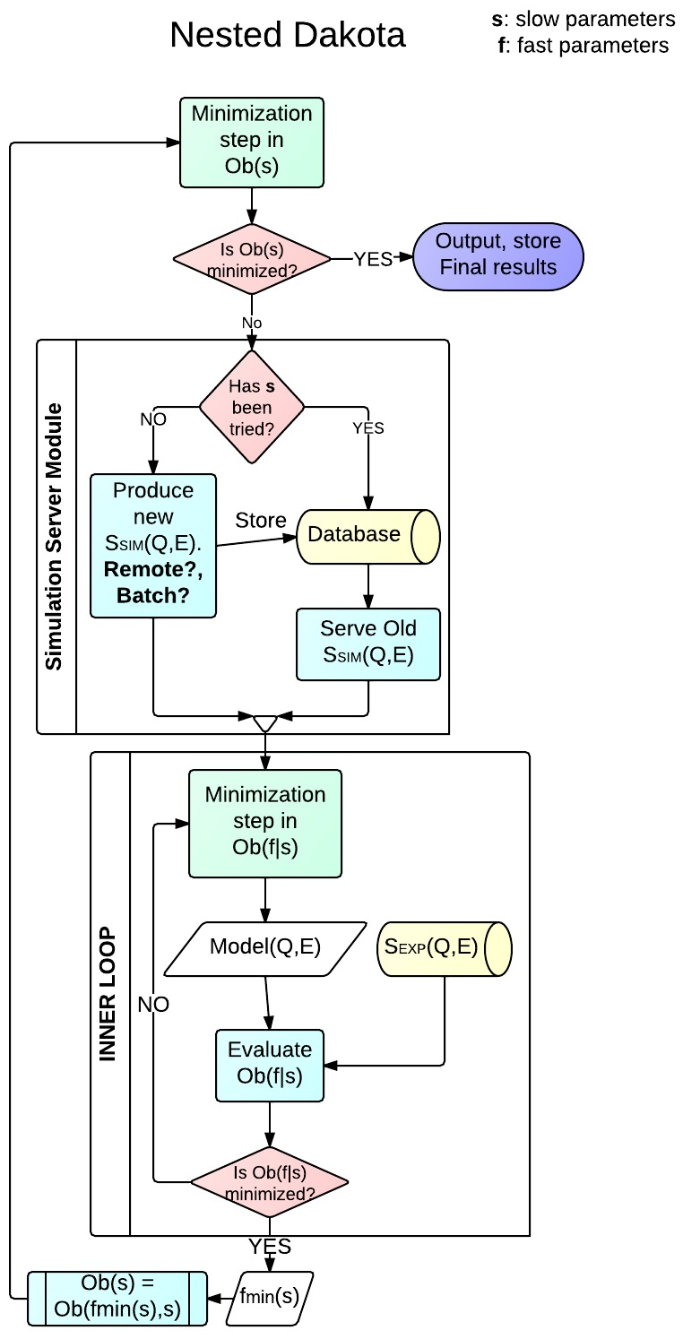
Minimization Workflow
Intel
Script
Strategy
Script

Slide 9
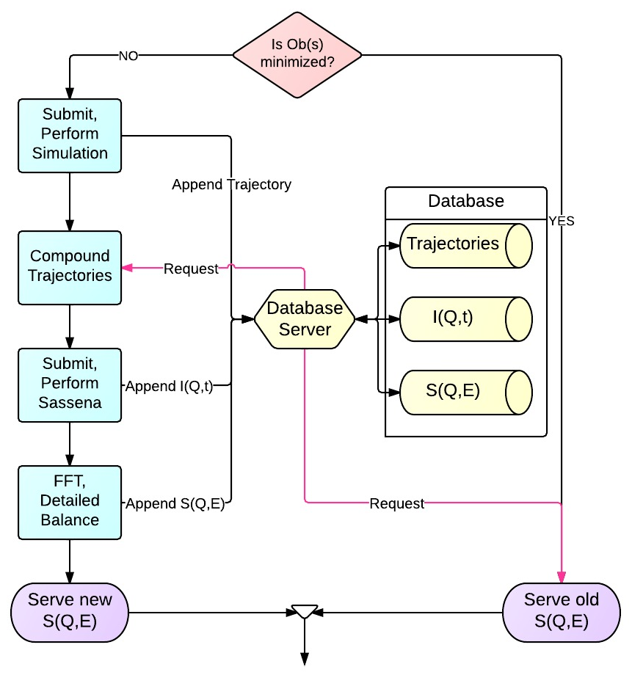
Simulation Server Module

Slide 10
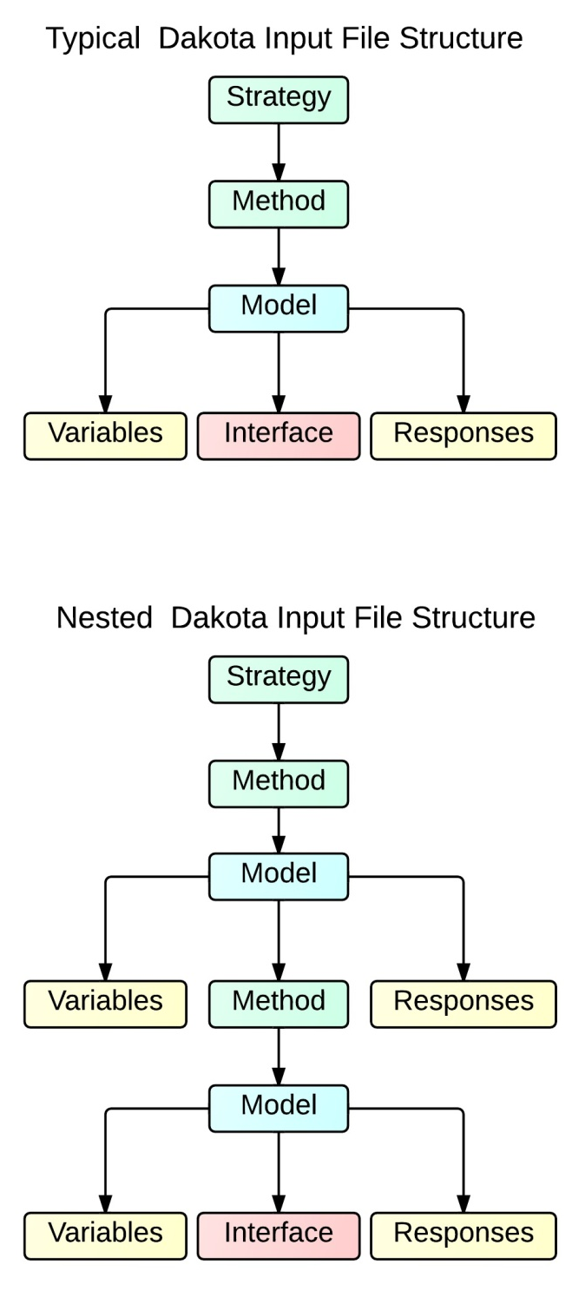
Dakota Input File Structure

Slide 11
Example: Dakota_uq_cantilever_sop_rel.in
strategy,
single_method
method_pointer = 'EPISTEMIC'
method,
id_method = 'EPISTEMIC'
model_pointer = 'EPIST_M'
...
model,
id_model = 'EPIST_M'
nested
variables_pointer = 'EPIST_V'
sub_method_pointer = 'ALEATORY'
responses_pointer = 'EPIST_R'
...
variables,
id_variables = 'EPIST_V'
...
responses,
id_responses = 'EPIST_R'
...
method,
id_method = 'ALEATORY'
model_pointer = 'ALEAT_M'
...
model,
id_model = 'ALEAT_M'
single
variables_pointer = 'ALEAT_V'
interface_pointer = 'ALEAT_I'
responses_pointer = 'ALEAT_R'
...
variables,
id_variables = 'ALEAT_V'
...
interface,
id_interface = 'ALEAT_I'
...
responses,
id_responses = 'ALEAT_R'
1
2

Slide 12
Title

Slide 13
Minimization Components
Minimizer Algorithm
Cost Function
Fit Model
Experimental Data
Dakota Minimizer
Least Squares
S^{SIM}(Q,ω)+Beamline
S^{EXP}(Q,ω)
Dakota Client object
(request)
Cost Function Object
Exper. Data Object
Fit Model Server Object

Slide 14
Fit Models involving MD:
a “Born-Oppenheimer” Scenario
Example from Physics: Solid in an annealing process
Nuclear degrees of freedom relax ‘slowly’
Electronic degrees of freedom ‘instantaneously’ relax to a given set of nuclear degrees of freedom.
Minimization involving MD simulations
MD Force-Field parameters
beamline parameters
Fitting parameters can be divided into
As the minimization progresses (annealing), changing the MD Force-Field parameters involve hour-long MD simulations (nuclear deg.) . Changing beamline parameters involve mili-second evaluation (electronic deg.).
Minimization Split strategy:
Minimize (adapt) the bemaline parameters for a given MD Force-Field parameters
Run a minimization step of the MD Force-Field parameters
Repeat step 1

Slide 15
Minimization Split Strategy 1
Dakota minimizes only MD force-field parameters
Mantid minimizes only beamline parameters
Mantid
Mantid
Dakota
Mantid
Mantid
Mantid
Byproduct
Classes created will be reused when fitting Simulated and Reduced Data to standard QuasiElastic models within Mantid. These classes have to be written, anyway.

Slide 16
Minimization Split Strategy 2
f: MD Force-Field parameters
b: beamline parameters
Fit Model: F( f, b)
A fast Dakota minimization freezes the MD Force-Field parameters → F(b|f)→ b_{min}(f)
The Fit Model involving MD uses the optimized beamline params. b→ F( b_{min}(f), f)
Dakota Client object
(request)
Cost Function Object
Exper. Data Object
F(b_{min}(f),f) Fit Model Server Object
slow
minimiz
Dakota Client object
fast
minimiz
(request)
Cost Function Object
Exper. Data Object
F(b|f) Fit Model Server Object

Slide 17
Question on the Intelligent Script
Dakota Client object
Intelligent Script
Bypassing MD implies . Thus, Dakota will interpret that it reached a saddle point along f, so it will freeze f parameters and thus optimize F(b|f) instead of F(b,f), then exit. Is this conclusion correct?
MD
beamline

Slide 18
MD Simulations
Composition of objects
System Configuration Update
Run MD
Each one an interface.
Each MD flavor defines one strategy
Collect results

Slide 19
Sassena
Same design as running MD simulations
Composition of objects
System Configuration Update
Run Sassena
Each one an interface.
Each MD flavor defines one strategy
Collect results

Slide 20
Title

