Slide 1

Fantasy Baseball Player Tracker
Keep up to date with all your fantasy baseball news
Cameron MacQuarrie and Jonathan Rizzo

Slide 2
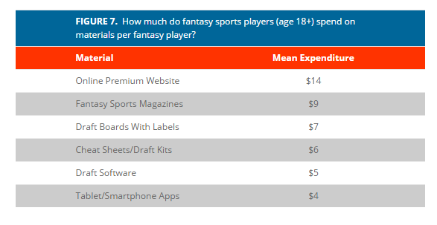
Fantasy Sports: by the numbers
57.4 million people played fantasy baseball in 2017
Players spend an average of $502 per year on fantasy buy ins
Spend and average of $46 per year on fantasy related materials
http://fsta.org/research/industry-demographics/

Slide 3
What’s required: Baseball
750 active players in the MLB
Fantasy teams generally carry 20 players
Average 3 teams per fantasy player
Thousands of writers, blogs and websites

Slide 4
Our solution: Fantasy Baseball Tracker
Log in with Yahoo to add your team information
Follow stats, updates and transactions for all your players
View news about all available players in your leagues
Search specific players

Slide 5
How we do it: Overview
Gather – Crawl predetermined resources(websites, twitters, forums) using Crawler4j
Store – MongoDB backend storing as documents. Lucene to Index
Analyze – Assign score based on source, player and quality of document
Filter – Yahoo Fantasy API to gather information for users teams
Display – Restful web service using Tomcat server

Slide 6
How we do it: Gathering
Collect and maintain a list of trusted resources (twitter users, forums, websites, etc.)
Continuously crawl searching for new information
Maintain a list of up to date player statistics and transaction data from Yahoo API

Slide 7


How we do it: Store
MongoDB document based storage
Collections for documents, players, and users
Index documents using Lucene

Slide 8
How we do it: Analyze
Assign score based on source of the document
Weight the score based on the players involved
Categories as good, neutral or bad news
Depreciate the score over time to ensure up to date news

Slide 9
How we do it: Filter
Queries resolved using Lucene
Get users team and player information using Yahoos Fantasy API
Filter by team, query a player, or view all available players.
Organize based on document’s relevancy value

Slide 10


How we do it: Display
RESTful web service using Jersey
Hosted on Apache Tomcat Server
Displays in HTML or returns API calls in JSON and XML

Slide 11
Advantages
Save time
Get the jump on players on the up
Keep track of injuries

Slide 12
Where do we go next?

