Slide 1
HomeAutomation
By: Christopher Matthews

Slide 2
HomeAutomation
Project Goals
Setup Home Automation using Alexa Device or Web Interface
Purpose
Create a voice controlled device that does not require some subscription, signup or any other action other than connect and operate

Slide 3
Circuit Diagram
Red: Live Wire
Blue: Comms Connection
Black: Ground Wire
Components:
ESP8266 MicroController
Relay Controlled Switch
Power Converter
Mains Power

Slide 4
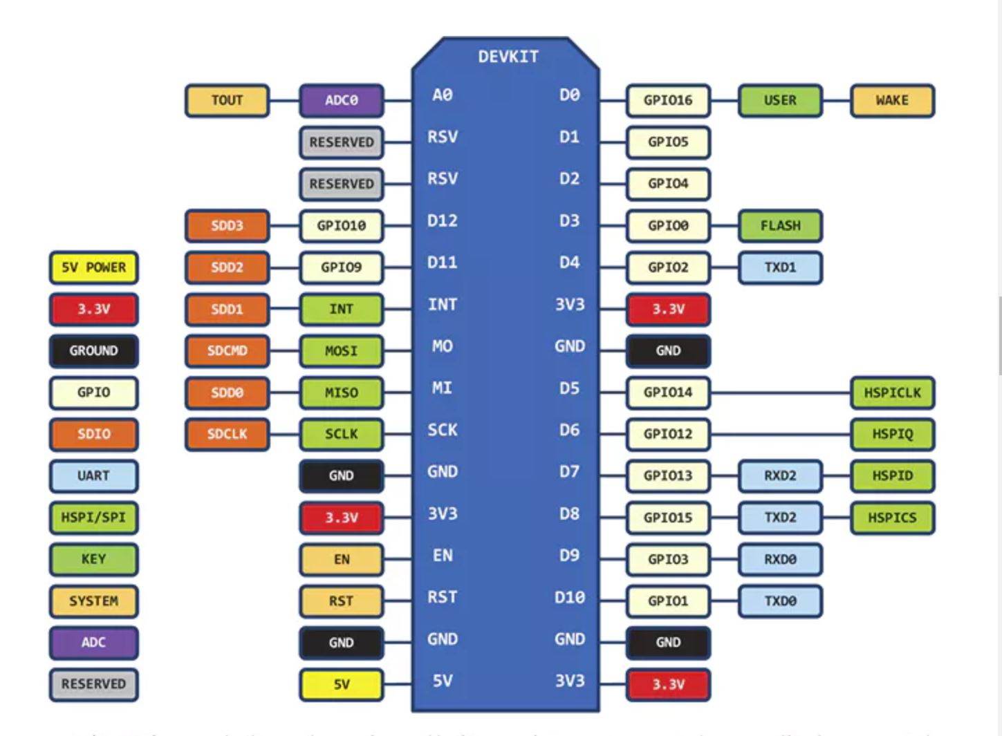
ESP8266 Microcontroller
ESP8266
Wireless interface
Bluetooth
Programmable through Arduino IDE
C and C++ programming

Slide 5
HomeAutomation
Libraries
#include "ESP8266WiFi.h“ -> Enables the WiFi on the Chip
#include "ESP8266WebServer.h“ ->WebServer setting
#include "WiFiManager.h“ ->Control WiFi Settings on Boot
#include "DNSServer.h“ -> To setup DNS name
#include "fauxmoESP.h“ -> Allows for Alexa Integration

Slide 6
HomeAutomation
Setting up the ports and control commands
fauxmoESP homeDevice; ->Starts the service for Alexa App
uint8_t relay =14; -> Sets GPIO pin 14 as the DO for the Relay
ESP8266WebServer server; ->Starts the webserver
DNSServer dnsServer; ->Sets up the DNS Server
WiFiClient espClient; ->Creates the WIFI Client object
#define switch “light“ ->Sets the listening command
pinMode(relay, OUTPUT); ->Sets the pin mode of the DI/DO to DO
digitalWrite(relay, LOW); ->Sets the relay to low at start which is off

Slide 7
HomeAutomation
Setting up the WiFi Automatically
Serial.begin(115200); -> For debugging purposes only
WiFiManager wifiManager; ->Creates a WiFi Manager object
wifiManager.resetSettings(); -> set to default
wifiManager.autoConnect("LightingPLC");->creates name
Serial.print("IP Address: "); >output IP to Console
Serial.println(WiFi.localIP()); -> output IP to Console
Serial.println(WiFi.subnetMask());->outputs Subnet to console

Slide 8
HomeAutomation
Setting up the server and services
homeDevice.createServer(true);
homeDevice.setPort(80); ->Using HTTP protocol
server.on("/", handleRoot); -> Sets homepage for Internal Server
server.on("/toggle", toggleRelay); ->Calls toggle Function to switch on/off
server.begin(); ->Starts the Internal Server
homeDevice.enable(true);
homeDevice.addDevice(switch);

Slide 9
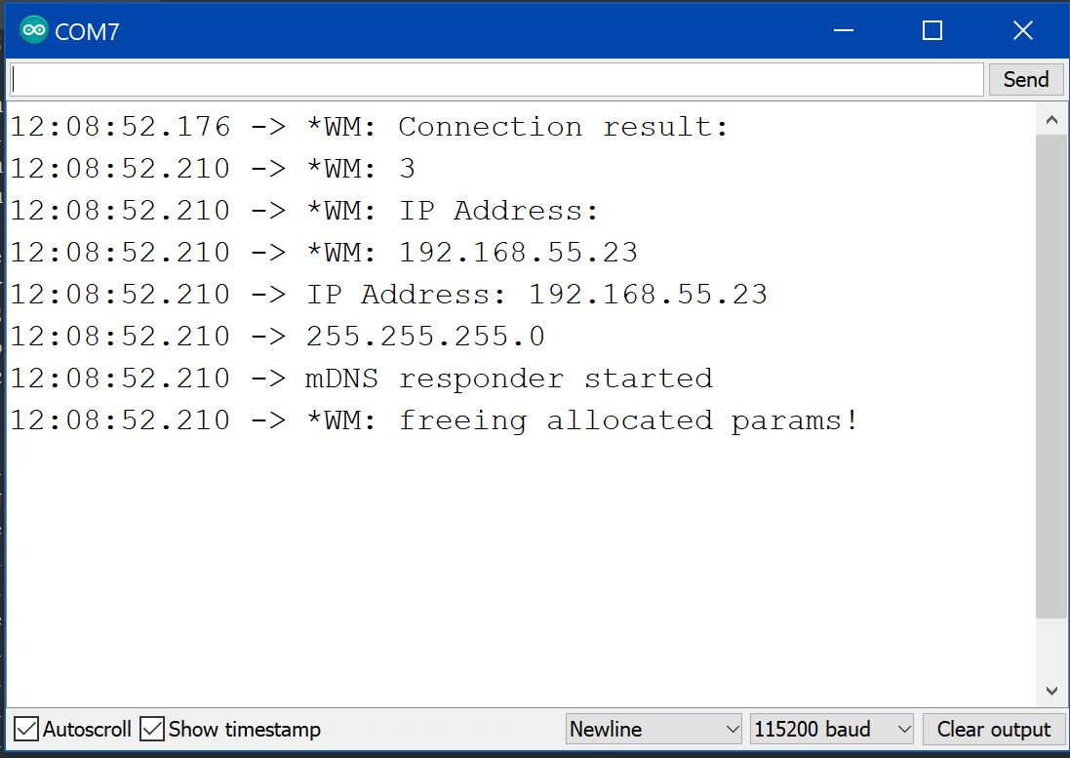
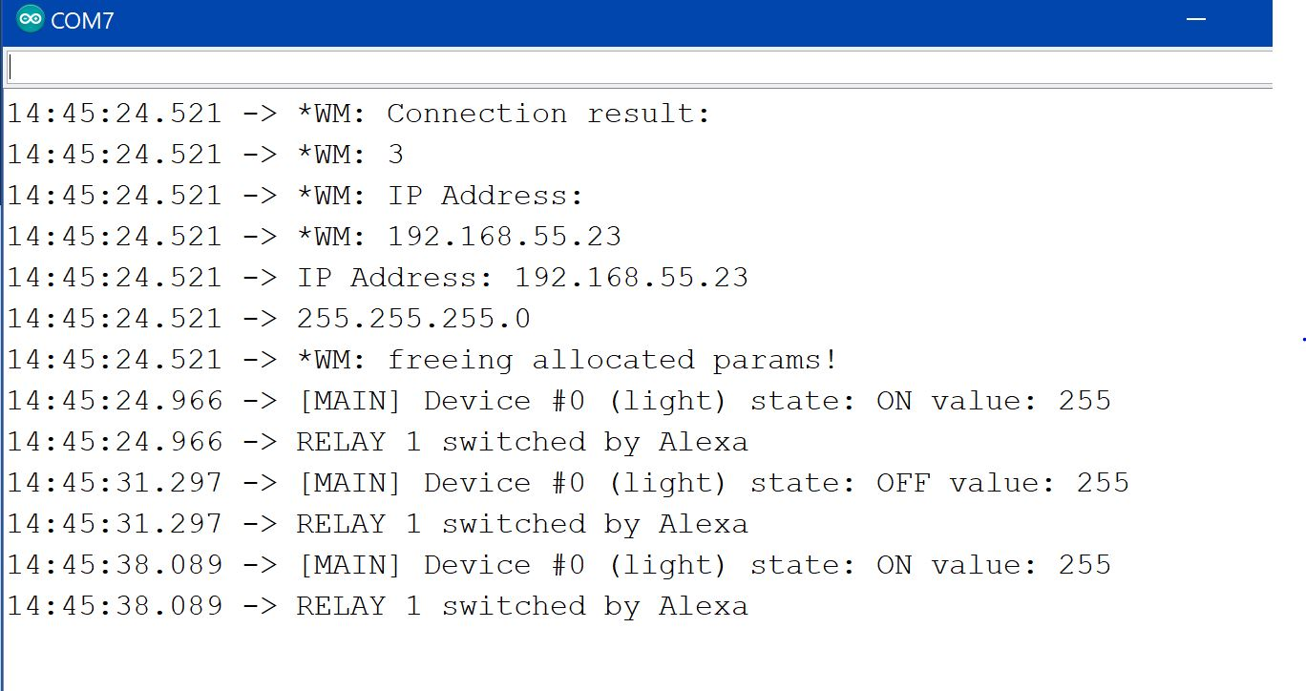
HomeAutomation

Slide 10
HomeAutomation

