Slide 1
Overview: The Mental Landscape
ICS 211
Cam Moore
Information and Computer Sciences
University of Hawaii, Manoa

Slide 2
Computer Fundamentals
A modern computer is a device with three parts:

Slide 3
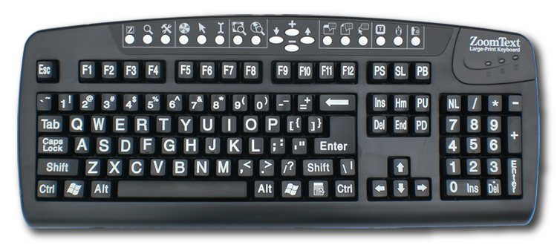
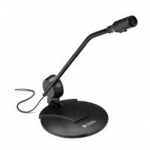
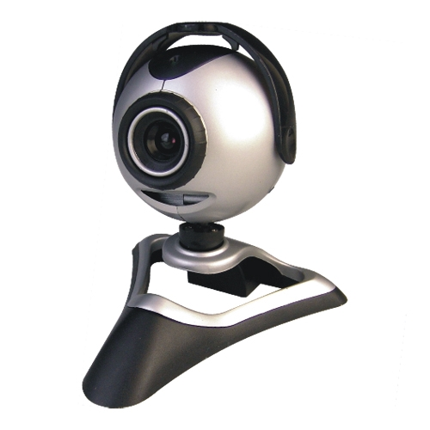
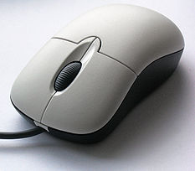
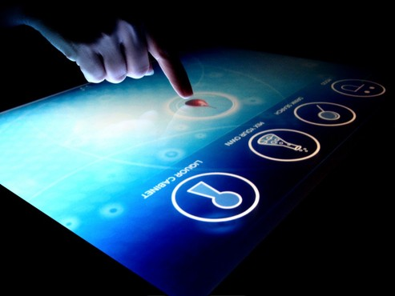
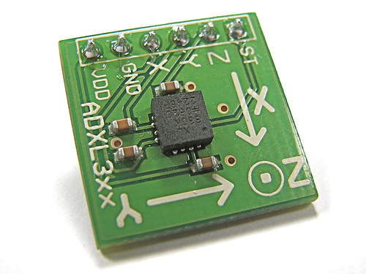
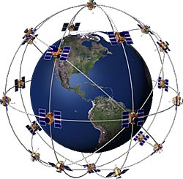
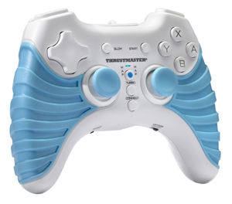
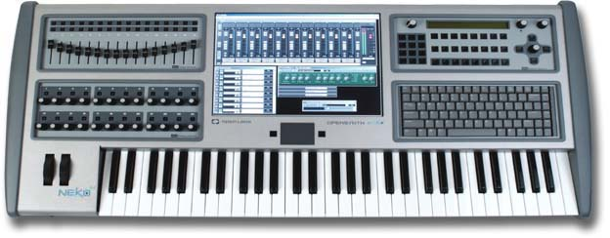
Computer Fundamentals
A modern computer is a device with three parts:
Input

Slide 4
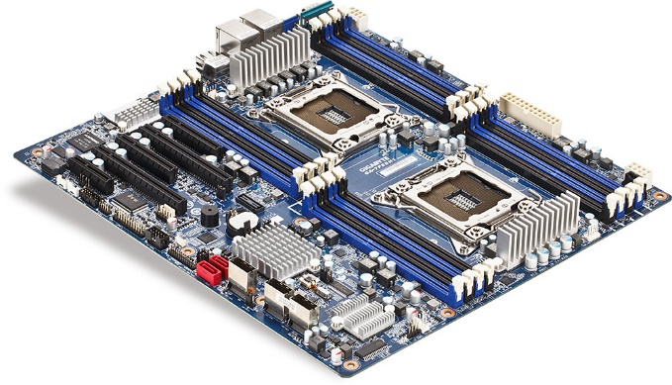
Computer Fundamentals
A modern computer is a device with three parts:
Input
Processing

Slide 5
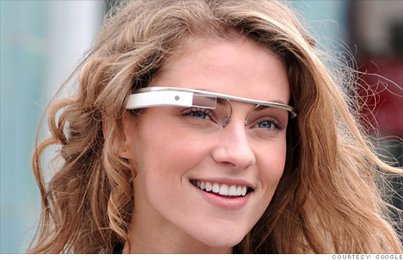
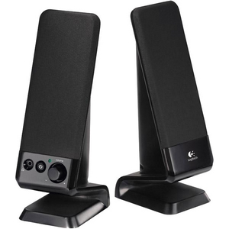
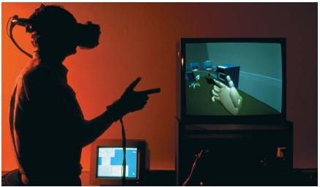
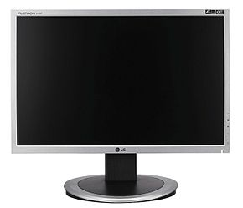
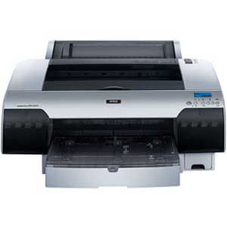
Computer Fundamentals
A modern computer is a device with three parts:
Input
Processing
Output

Slide 6
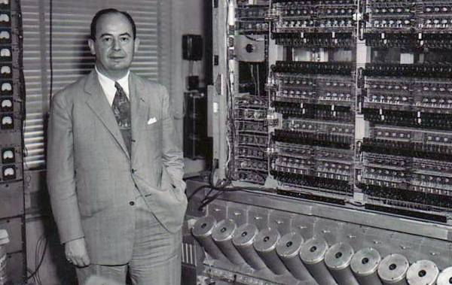
Processing
Von Neumann Architecture
Central Processing Unit
Control Unit
John von Neumann
EDVAC
Arithmetic/Logic Unit
Input
Device
Output
Device
Memory Unit

Slide 7
Processing
Memory
CPU
10001010
Location 0
00110100
Location 1
Arithmetic/Logic Unit
01110111
Location 2
10100100
Location 3
Register
11010010
Location 4
Register
10000110
Location 5
01001111
Location 6
Register
10100000
Location 7
00000010
Location 8
10100010
Location 9
Control Unit
00010100
Location 10
11111010
Location 11
Register
10100000
Location 12
Program Counter
. . .
0000000000000110
10100000
Location N

Slide 8
Fetch Execute Cycle
Fetch the Instruction
Memory
CPU
10001010
Location 0
00110100
Location 1
Arithmetic/Logic Unit
01110111
Location 2
10100100
Location 3
Register
11010010
Location 4
Register
10000110
Location 5
01001111
Location 6
Register
10100000
Location 7
00000010
Location 8
10100010
Location 9
Control Unit
00010100
Location 10
11111010
Location 11
Register
01001111
10100000
Location 12
Program Counter
. . .
0000000000000110
10100000
Location N

Slide 9
Fetch Execute Cycle
Decode the Instruction
Memory
CPU
10001010
Location 0
00110100
Location 1
Arithmetic/Logic Unit
01110111
Location 2
10100100
Location 3
Register
11010010
Location 4
Register
10000110
Location 5
01001111
Location 6
Register
10100000
Location 7
00000010
Location 8
10100010
Location 9
Control Unit
00010100
Location 10
11111010
Location 11
Register
11001111
10100000
Location 12
Program Counter
. . .
0000000000000110
10100000
Location N

Slide 10
Fetch Execute Cycle
Execute the Instruction
Memory
CPU
10001010
Location 0
00110100
Location 1
Arithmetic/Logic Unit
01110111
Location 2
10100100
Location 3
Register
11010010
Location 4
Register
10000110
Location 5
01001111
Location 6
Register
10100000
Location 7
00000010
Location 8
10100010
Location 9
Control Unit
00010100
Location 10
11111010
Location 11
Register
11001111
00100110
Location 12
Program Counter
. . .
0000000000000111
10100000
Location N

Slide 11
Fetch Execute Cycle
Fetch the Instruction
Memory
CPU
10001010
Location 0
00110100
Location 1
Arithmetic/Logic Unit
01110111
Location 2
10100100
Location 3
Register
11010010
Location 4
Register
10000110
Location 5
01001111
Location 6
Register
10100000
Location 7
00000010
Location 8
10100010
Location 9
Control Unit
00010100
Location 10
11111010
Location 11
Register
10100000
10100000
Location 12
Program Counter
. . .
0000000000000111
10100000
Location N

Slide 12
Asynchronous Events
How does CPU know data is available?
Polling
CPU
Memory
Disk Drive
I/O
Controller
Data
Address
Control
Display
Keyboard
Network
Interface

Slide 13
Asynchronous Events
How does CPU know data is available?
Polling
Check each device for data
CPU
Memory
Disk Drive
I/O
Controller
Data
Address
Control
Display
Keyboard
Network
Interface

Slide 14
Asynchronous Events
How does CPU know data is available?
Polling
Check each device for data
Very inefficient
CPU
Memory
Disk Drive
I/O
Controller
Data
Address
Control
Display
Keyboard
Network
Interface

Slide 15
Asynchronous Events
How does CPU know data is available?
Interrupts
CPU
Memory
Disk Drive
I/O
Controller
Data
Address
Control
Display
Keyboard
Network
Interface

Slide 16
Asynchronous Events
How does CPU know data is available?
Interrupts
Device signals when ready
CPU
Memory
Disk Drive
I/O
Controller
Data
Address
Control
Display
Keyboard
Network
Interface

Slide 17
Asynchronous Events
How does CPU know data is available?
Interrupts
Device signals when ready
CPU stores current state
CPU
Memory
Disk Drive
I/O
Controller
Data
Address
Control
Display
Keyboard
Network
Interface

Slide 18
Asynchronous Events
How does CPU know data is available?
Interrupts
Device signals when ready
CPU stores current state
CPU handles interrupt
CPU
Memory
Disk Drive
I/O
Controller
Data
Address
Control
Display
Keyboard
Network
Interface

Slide 19
Asynchronous Events
How does CPU know data is available?
Interrupts
Device signals when ready
CPU stores current state
CPU handles interrupt
CPU resumes work
CPU
Memory
Disk Drive
I/O
Controller
Data
Address
Control
Display
Keyboard
Network
Interface

Slide 20
Two Types of Languages
Computers only understand Machine Language
Different Machine Languages
Binary

Slide 21
Two Types of Languages
Computers only understand Machine Language
Different Machine Languages
Binary
High-level Programming Languages
Java, Fortran, C++, COBOL, LISP, etc.
Compiler – converts High-level language to machine language
Interpreter – translates High-level instruction by instruction

Slide 22
Java
Java combines both
Compilation
Interpolation
Provides
Flexibility
Security
Java Program
> javac
.java
> java
Compiler
Java
Byte code
Program
.class
Java Virtual Machine
Java Virtual Machine
Java Virtual Machine
Mac OS
Windows OS
Linux OS

Slide 23
Building Blocks of Programs
Two basic aspects of Programming
Data
Instructions

Slide 24
Building Blocks of Programs
Memory
Two basic aspects of Programming
Data
Variables
Names that point to memory locations
Think of them as boxes that hold things
10001010
Location 0
00110100
Location 1
01110111
Location 2
10100100
Location 3
principal
11010010
Location 4
10000110
Location 5
01001111
Location 6
10100000
Location 7
00000010
Location 8
10100010
Location 9
00010100
Location 10
interest
11111010
Location 11
10100000
Location 12
. . .
10100000
Location N

Slide 25
Building Blocks of Programs
Memory
Two basic aspects of Programming
Data
Variables
Types
Kind of data, int, double, char, etc.
10001010
Location 0
00110100
Location 1
01110111
Location 2
10100100
Location 3
principal
11010010
Location 4
10000110
Location 5
01001111
Location 6
10100000
Location 7
00000010
Location 8
10100010
Location 9
00010100
Location 10
interest
11111010
Location 11
10100000
Location 12
. . .
10100000
Location N

Slide 26
Building Blocks of Programs
Memory
Two basic aspects of Programming
Data
Variables
Types
Assignment
10001010
Location 0
00110100
Location 1
01110111
Location 2
10100100
Location 3
principal
11010010
Location 4
10000110
Location 5
01001111
Location 6
interest = principal * 0.07;
10100000
Location 7
00000010
Location 8
10100010
Location 9
00010100
Location 10
interest
11111010
Location 11
10100000
Location 12
. . .
10100000
Location N

Slide 27
Building Blocks of Programs
Two basic aspects of Programming
Instructions
Computers execute sequence of instructions
float principal = 1000.00;
float interest = principal * 0.05;
System.out.println(“You earned “ + intrest + “ this month”);

Slide 28
Building Blocks of Programs
Two basic aspects of Programming
Instructions
Control Structures: Change the “flow of control”

Slide 29
Building Blocks of Programs
Two basic aspects of Programming
Instructions
Control Structures: Change the “flow of control”
Loops
while (principal < 10000) {
interest = principal * 0.05;
principal = principal + interest;
}

Slide 30
Building Blocks of Programs
Two basic aspects of Programming
Instructions
Control Structures: Change the “flow of control”
Loops
Branches
if (principal > 10000) {
interest = principal * 0.05;
}
else {
interest = principal * 0.04;
}

Slide 31
Building Blocks of Programs
Two basic aspects of Programming
Instructions
Control Structures
Subroutines: Break a program into “chunks”
drawHouse();

Slide 32
Program Structure
Programs must be designed
Structured Programming
Solve a large problem by breaking it into smaller problems

Slide 33
Program Structure
Programs must be designed
Structured Programming
Solve a large problem by breaking it into smaller problems
Solve each smaller problem by breaking it down

Slide 34
Program Structure
Programs must be designed
Structured Programming
Solve a large problem by breaking it into smaller problems
Solve each smaller problem by breaking it down
Repeat until can solve problem directly

Slide 35
Program Structure
Programs must be designed
Structured Programming
Solve a large problem by breaking it into smaller problems
Solve each smaller problem by breaking it down
Repeat until can solve problem directly
Top-down programming

Slide 36
Program Structure
Programs must be designed
Structured Programming
Top-down programming
Bottom-up design
Start at the bottom with solutions
Combine to solve bigger problems
Build or re-use Modules

Slide 37
Program Structure
Programs must be designed
Structured Programming
Top-down programming
Bottom-up design
Modules
Well defined interface
Details of how it works is unimportant “information hiding”

Slide 38
Object-oriented Programming
Programs must be designed
Structured Programming
Top-down programming
Bottom-up design
Modules
Object-Oriented Programming (OOP)
Object is a Module
State or the data in the object
Messages calls to its Subroutines (Methods)

Slide 39
Object-oriented Programming
Programs must be designed
Structured Programming
Top-down programming
Bottom-up design
Modules
Object-Oriented Programming (OOP)
Object is a Module
Classes
Objects with the same type of data and respond to the same messages

Slide 40
Object-oriented Programming
Programs must be designed
Structured Programming
Top-down programming
Bottom-up design
Modules
Object-Oriented Programming (OOP)
Object is a Module
Classes
Inheritance
Relationships between classes

Slide 41
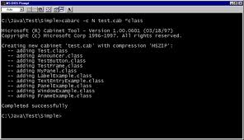
The Modern User Interface
Early computers used terminals
Command line interface

Slide 42
The Modern User Interface
Early computers used terminals
Command line interface
Most modern computers use
Graphical User Interface

Slide 43
The Internet and Beyond
Computers are often connected together on Networks
Largest network is the Internet
Packets
Internet Protocol (IP)
IP Address
Transmission Control Protocol (TCP)
Simple Mail Transfer Protocol (SMTP)
HyperText Transfer Protocol (HTTP)
Java understands the Internet

