Slide 1
GUI Programming Ch. 6.7
ICS 111
Cam Moore
Information and Computer Sciences
University of Hawaii, Manoa

Slide 2

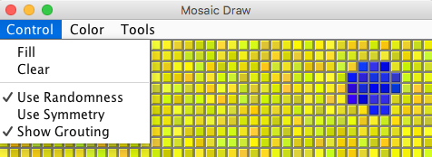
Menus and Menubars
JFrames can have menubars
Menubars can have several menus
Menus can have several menu items

Slide 3
Menu Items
Menu items are represented by JMenuItem
JMenuItems are similar to JButtons
Create ActionEvents
Need ActionListeners
Can be enabled / disabled
Can change text
JMenuItem fillCommand = new JMenuItem(“Fill”);
fillCommand.addActionListener(listener);
fillCommand.setEnabled(false);
fillCommand.setText(“Clear”);

Slide 4
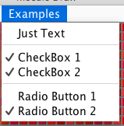
Types of Menu Items
JMenuItem
Normal text menu item
JCheckBoxMenuItem
Menu item with a check box
JRadioButtonMenuItem
Menu item with radio button
Separator
menu.addSeparator();

Slide 5
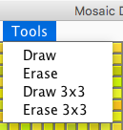
Menus
Menus are represented by JMenu
JMenu toolsMenu = new JMenu(“Tools”);
JMenuItem drawCommand = new JMenuItem(“Draw”);
drawCommand.addActionListener(listener);
toolsMenu.add(drawCommand);
JMenuItem eraseCommand = new JMenuItem(“Erase”);
eraseCommand.addActionListener(listener);
toolsMenu.add(eraseCommand);
.
.
.

Slide 6
Menu Bar
Menus must be added to the Menu Bar
JMenuBar
Add JMenuBar to JFrame
JMenuBar menuBar = new JMenuBar();
menuBar.add(controlMenu);
menuBar.add(colorMenu);
menuBar.add(toolsMenu);
JFrame window = new JFrame(“Mosaic Draw”);
. . .
window.setJMenuBar(menuBar);

Slide 7
Dialogs
New window for user input or information
Dialogs have a parent frame / window
Dialogs can be modal or modeless
Swing provides several useful Dialogs

Slide 8
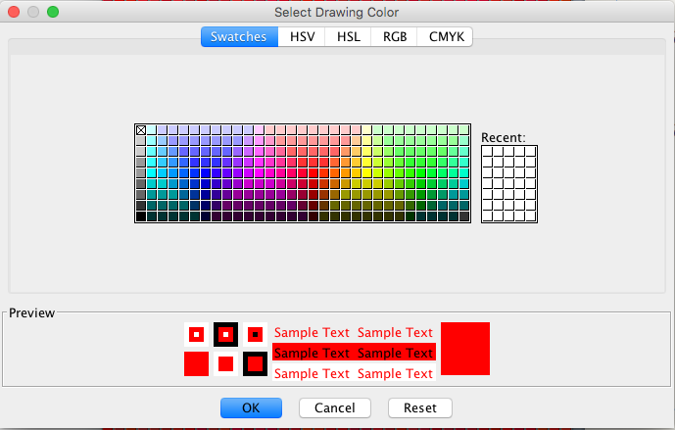
JColorChooser
Color c = JColorChooser.showDialog(mosaic,
“Select Drawing Color”,
c);

Slide 9
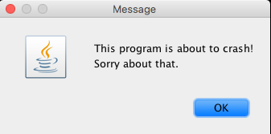
JOptionPane
JOptionPane.showMessageDialog(this,
“This program is about to crash!\n”
+ “Sorry about that.”);

Slide 10
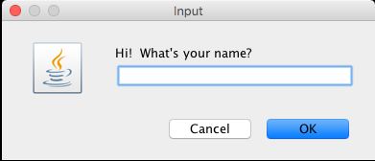
JOptionPane
String name = JOptionPane.showInputDialog(this,
“Hi! What’s your name?”);

Slide 11
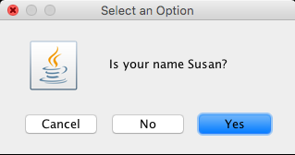
JOptionPane
int ans = JOptionPane.showConfirmDialog(this,
“Is your name Susan?”);
Returns
JOptionPane.YES_OPTION,
JOptionPane.NO_OPTION,
JOptionPane.CANCEL_OPTION, or
JOptionPane.CLOSE_OPTION

Slide 12
Centering a Window
JFrame window = new JFrame();
. . .
Dimension screenSize = Toolkit.getDefaultToolkit()
.getScreenSize();
window.setLocation((screenSize.width – window.getWidth())/2,
(screenSize.height – window.getHeight())/2);

