Slide 1
Java Review
ICS 211
Cam Moore
Information and Computer Sciences
University of Hawaii, Manoa

Slide 2
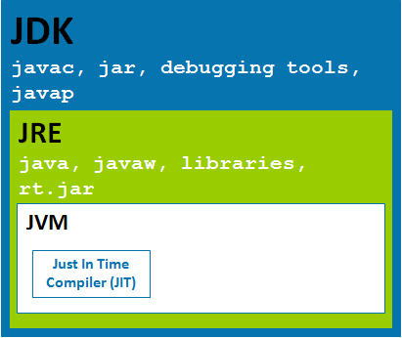
Java Environment

Slide 3
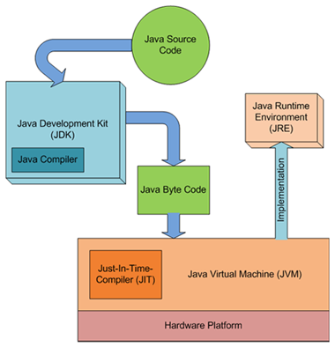
Creating Java Programs

Slide 4
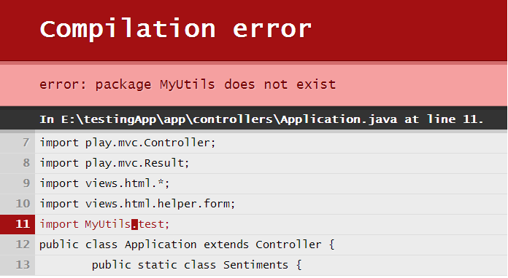
Java Compiler Errors

Slide 5
Java Exceptions
Throwable
Error
Exception
RuntimeException
NullPointerException
NumberFormatException
ClassCastException
IndexOutOfBoundsException
…
IOException
SQLException
MalformedURLException
…

Slide 6
Handling Exceptions
try {
// The code being monitored for Exceptions
// When an Exception is encountered or thrown
// The code that is skipped during an exception
}
catch (Exception e) {
// The code to execute when an Exception is encountered
}
finally {
// The code independent of Exception occurrence
}

Slide 7
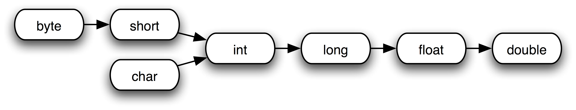
Java Data Types
Primitives
Objects
Variables
(state)
Methods
(behavior)

Slide 8
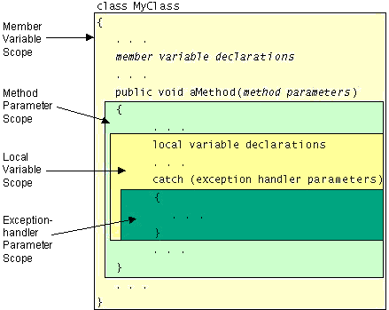
Variable Scope

Slide 9
Java Arrays
String [] a = new String[10];
a[3] = “hello”;
a
0
1
2
3
4
5
6
7
8
9
Indices
“hello”
System.arraycopy(sourceArray, sourcePos, destArray, destPos, elementCount);
Notes:
Arrays are objects
They hold other objects
Each element is identified by it’s index (0 – array.size -1)
Arrays must be declared and initialized
Access value using [] operator
Initializing the array does not initialize the elements
You must initialize the array elements
System.arraycopy is your friend

Slide 10
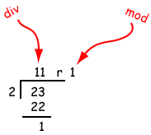
Integer Division
int q = 23 / 2;
int r = 23 % 2;
Notes:
Dividing 2 Integers gives two results:
Quotient
Remainder
Quotient is given by the division operator /
Remainder is given by the modulo operator %
Modulo operator is used often in this class

Slide 11
Modulo Example
String [] lights = { "green", "yellow", "red" };
int lightIsNow = 2;
lights
0
1
2
“green”
“red”
“yellow”
lightIsNow = (lightIsNow + 1) % lights.length;
lightIsNow = 0;
lightIsNow = 3 % 3;
lightIsNow = (2 + 1) % 3;
Notes:
I want to cycle through the values of a traffic light signal
To cycle through the values we just need
If lightIsNow is 2 the calculation is:

Slide 12

Java Booleans and Boolean Expressions
Several different operators return Boolean values
Arithmetic: <, <=, ==, !=, >=, >
Objects: ==, .equals()

Slide 13
If Conditional
if (condition1) {
// body
}
test
false
true
body

Slide 14
If Else Conditional
if (condition) {
// body
} else {
// else body
}
test
false
true
body
else body

Slide 15
Switch Statement
switch (selector) {
case label1:
statements1;
break;
case label2:
statements2;
break;
…
default: statements;
}
select
label1
statements1
label2
statements2
…
default
statements

Slide 16
While Loop
while (condition) {
body;
}
test
true
body
false

Slide 17
Do While Loop
do {
body;
} while (condition);
body
test
true
false

Slide 18
For Loop
for(initialization; test; increment) {
body;
}
initialization
increment
test
true
body
false

Slide 19
Summary
You should be familiar with:
Developing Java programs
Java primitives
Control statements
Loops
Exceptions
Understand Appendix A in the textbook

