Slide 1
Testing
ICS 211
Cam Moore
Information and Computer Sciences
University of Hawaii, Manoa

Slide 2
Testing Levels
Coding
Unit
Testing

Slide 3
Testing Levels
Design
Integration Testing
Coding
Unit
Testing

Slide 4
Testing Levels
Requirements
System
Testing
Design
Integration Testing
Coding
Unit
Testing

Slide 5
Testing Levels
Acceptance
Testing
Requirements
System
Testing
Design
Integration Testing
Coding
Unit
Testing

Slide 6
Testing Types
Black Box
/** Resizable-array implementation of the List interface. */
public class ArrayList<E> extends AbstractList<E> implements
List<E> {
boolean add(E element) {…} // add element at the end of the list
boolean contains(Object o) {…} // returns true if o is in the list.
Iterator<E> iterator() {…} // returns an Iterator over the elements in this list.
int size() {…} // returns number of elements in list
E get(int index) {…} // returns object at given position
E set(int index, E element) {…} // sets element, returns old value
int indexOf(Object o) {…} // returns index of object in list
E remove(int index) {…} // removes object at the given position
void add(int index, E element) {…} // add element at given position
}

Slide 7
Testing Types
Black Box
No knowledge of implementation
/** Resizable-array implementation of the List interface. */
public class ArrayList<E> extends AbstractList<E> implements
List<E> {
boolean add(E element) {…} // add element at the end of the list
boolean contains(Object o) {…} // returns true if o is in the list.
Iterator<E> iterator() {…} // returns an Iterator over the elements in this list.
int size() {…} // returns number of elements in list
E get(int index) {…} // returns object at given position
E set(int index, E element) {…} // sets element, returns old value
int indexOf(Object o) {…} // returns index of object in list
E remove(int index) {…} // removes object at the given position
void add(int index, E element) {…} // add element at given position
}

Slide 8
Testing Types
Black Box
Test the behavior
/** Resizable-array implementation of the List interface. */
public class ArrayList<E> extends AbstractList<E> implements
List<E> {
boolean add(E element) {…} // add element at the end of the list
boolean contains(Object o) {…} // returns true if o is in the list.
Iterator<E> iterator() {…} // returns an Iterator over the elements in this list.
int size() {…} // returns number of elements in list
E get(int index) {…} // returns object at given position
E set(int index, E element) {…} // sets element, returns old value
int indexOf(Object o) {…} // returns index of object in list
E remove(int index) {…} // removes object at the given position
void add(int index, E element) {…} // add element at given position
}

Slide 9
Testing Types
Black Box
Test the input parameters
/** Resizable-array implementation of the List interface. */
public class ArrayList<E> extends AbstractList<E> implements
List<E> {
boolean add(E element) {…} // add element at the end of the list
boolean contains(Object o) {…} // returns true if o is in the list.
Iterator<E> iterator() {…} // returns an Iterator over the elements in this list.
int size() {…} // returns number of elements in list
E get(int index) {…} // returns object at given position
E set(int index, E element) {…} // sets element, returns old value
int indexOf(Object o) {…} // returns index of object in list
E remove(int index) {…} // removes object at the given position
void add(int index, E element) {…} // add element at given position
}

Slide 10
Testing Types
White Box
/** Adds the entry to the end of the List.
* @param entry the element to add.
* @return true.
*/
public boolean add(E entry) {
if (size == data.length) {
reallocate();
}
data[size] = entry;
size++;
return true;
}

Slide 11
Testing Types
White Box
Know the implementation
/** Adds the entry to the end of the List.
* @param entry the element to add.
* @return true.
*/
public boolean add(E entry) {
if (size == data.length) {
reallocate();
}
data[size] = entry;
size++;
return true;
}

Slide 12
Testing Types
White Box
Test different branches of the code
/** Adds the entry to the end of the List.
* @param entry the element to add.
* @return true.
*/
public boolean add(E entry) {
if (size == data.length) {
reallocate();
}
data[size] = entry;
size++;
return true;
}

Slide 13
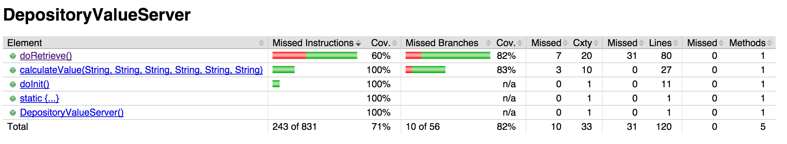
Testing Types
White Box
Code coverage

Slide 14
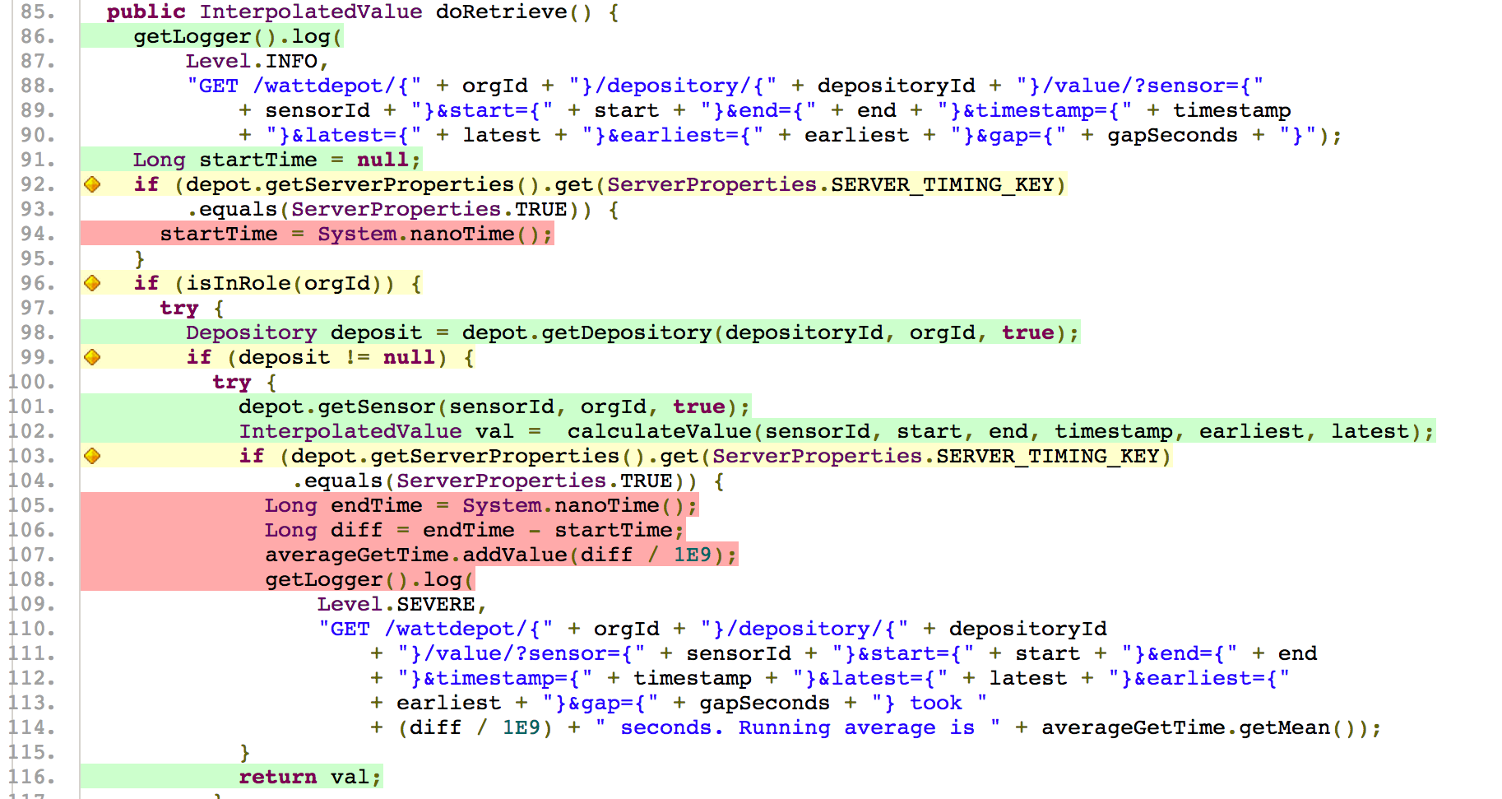
Testing Types
White Box
Code coverage

Slide 15
Testing
Use JUnit

Slide 16
Testing
Use both Black and White Box

Slide 17
Testing
Test all classes

Slide 18
Testing
Know your code works

