Slide 1
GUI Programming Ch. 6.1 & 6.2
ICS 111
Cam Moore
Information and Computer Sciences
University of Hawaii, Manoa

Slide 2
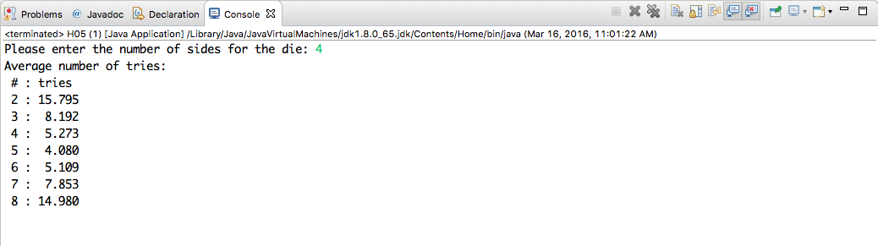
Graphical User Interface GUI
So far Command-Line programs

Slide 3
Graphical User Interface GUI
So far Command-Line programs
But this is in a GUI, the Eclipse IDE
Java supports building GUIs

Slide 4
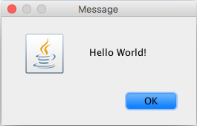
GUI “Hello World”
import javax.swing.JOptionPane;
public class HelloWorldGUI1 {
public static void main(String[] args) {
JOptionPane.showMessageDialog( null, “Hello World!” );
}
}

Slide 5
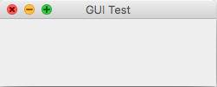
Java GUI
Each GUI component is an instance
Fundamental GUI component is the window
JFrame class
Title bar
window or content pane
JFrame window = new JFrame(“GUI Test”);
// window.setContentPane(content);
window.setSize(250, 100);
window.setLocation(100, 100);
window.setVisible(true);

Slide 6
JPanel
Another fundamental GUI component
Blank rectangle
Can draw on it
private static class HelloWorldDisplay extends JPanel {
public void paintComponent(Graphics g) {
super.paintComponent(g);
g.drawString(“Hello World!”, 20, 30);
}
}

Slide 7
JPanel cont.
JPanel is also a container for other components
Need a layout manager to arrange where to components go
Java has many layout managers
JPanel content = new JPanel();
content.setLayout(new BorderLayout());
CENTER
NORTH
WEST
EAST
SOUTH
content.add(displayPanel, BorderLayout.CENTER);
content.add(okButton, BorderLayout.SOUTH);

Slide 8
GUI Behavior
GUIs are event-driven
Events are generated by user actions
Program responds by using event-handling methods
Java commonly uses event listeners
Listeners must register with the component that generates the events
private static class ButtonHandler implements ActionListener {
public void actionPerformed(ActionEvent e) {
System.exit(0);
}
}
ButtonHandler listener = new ButtonHander();
okButton.addActionListener(listener);

Slide 9
Graphics and Painting
Everything on the computer screen is drawn
JComponent is base class for most Java GUI components
paintComponent is called by Java
We use repaint
The system will call paintComponent later
public void paintComponent(Graphics g) {
// Draw the content of the component.
}
public void repaint();

Slide 10
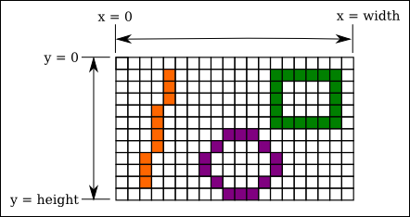
Coordinates
Computer screen is a grid of pixels
Pixels may be set individually
public void paintComponent(Graphics g) {
super.paintComponent(g);
int width = getWidth();
int height = getHeight();
. . . // Draw the content
}

Slide 11
Colors
Java uses the RGB color system
Red, Green, and Blue
Values range from 0 to 255
Common colors
Java also supports HSB
Graphics object has current drawing color
Components have foreground and background colors
Color myColor = new Color(r, g, b);
Color.WHITE, Color.BLACK, Color.RED, Color.GREEN, Color.BLUE,
Color.CYAN, Color.MAGENTA, Color.YELLOW, Color.PINK,
Color.ORANGE, Color.LIGHT_GRAY, Color.GRAY, Color.DARK_GRAY
Color myColor = Color.getHSBColor(h, s, b);

Slide 12
Fonts
Fonts represent a size and style of text
Name – “Serif”, “SansSerif”, “Monospaced”, and “Dialog”
Style – PLAIN, ITALIC, BOLD, or BOLD + ITALIC
Size
Font plainFont = new Font(“Serif”, Font.PLAIN, 12);
Font bigBoldFont = new Font(“SanSerif”, Font.BOLD, 24);

Slide 13
Shapes
Graphics class has many instance methods for drawing
g.drawString(String str, int x, int y)
g.drawLine(int x1, int y1, int x2, int y2)
g.drawRect(int x, int y, int width, int height)
g.drawOval(int x, int y, int width, int height)
g.drawRoundRect(int x, int y, int width, int height,
int xdiam, int ydiam)
g.draw3DRect(int x, int y, int width, int height,
boolean raised)
g.drawArc(int x, int y, int width, int height,
int startAngle, int arcAngle)
g.fillRect(int x, int y, int width, int height)
g.fillOval(int x, int y, int width, int height)
g.fillRoundRect(int x, int y, int width, int height,
int xdiam, int ydiam)
g.fill3DRect(int x, int y, int width, int height,
boolean raised)
g.fillArc(int x, int y, int width, int height,
int startAngle, int arcAngle)

