Slide 1
Big O Notation
ICS 211
Cam Moore
Information and Computer Sciences
University of Hawaii, Manoa

Slide 2
Comparing Implementations
How do we compare different implementations?
Size
Time
Stopwatch?
Code Analysis

Slide 3
Runtime Analysis
/** Fills the Bottle. */
public void fill (double amount) {
int p = amount;
int i = 1;
int j = 1;
p = p * j;
j++;
}
c₁
c₂
c₂
c₃
c₄
total = c₁ + 2c₂ + c₃ + c₄
f(n) = c_{T}

Slide 4
Runtime Analysis
/** Fills the Bottle. */
public void fill (double amount) {
int p = amount;
int i = 1;
int j = 1;
while (i < n) {
p = p * j;
i++;
}
j++;
}
c₁
c₂
c₂
c₃ x n
c₄ x n
c₅ x n
c₄
total = c₁ + 2c₂ + (c₃ + c₄ + c₅)n + c₄
f(n) = c_{T1}n + c_{T2}

Slide 5
Runtime Analysis
/** Fills the Bottle. */
public void fill (double amount) {
int p = amount;
int i = 1;
while (i < n) {
int j = 1;
while (j < i) {
p = p * j;
j++;
}
j++;
}
}
c₁
c₂
c₃ x n
c₂ x n
c₃ x n x n
c₅ x n x n
c₄ x n x n
c₄ x n
total = c₁ + c₂ + (c₃ + c₂ + c₄)n + (c₃ + c₅ + c₄)n²
f(n) = c_{T1}n² + c_{T2}n + c_{T3}

Slide 6
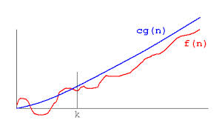
Limiting Behavior
f(n) = c_{T} => O(1)
f(n) = c_{T1}n + c_{T2} => O(n)
f(n) = c_{T1}n² + c_{T2}n + c_{T3} => O(n²)

Slide 7
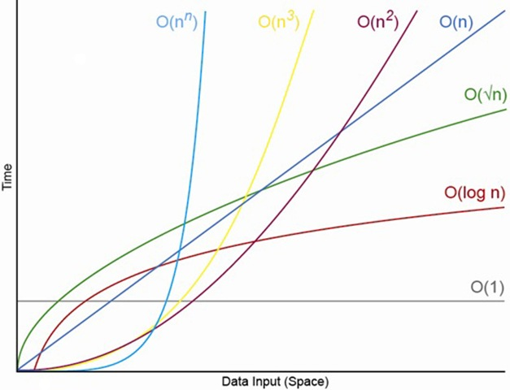
Big O

