Slide 1
Summary of: Stable Flocking of Mobile Agents Part I & II: Fixed and Dynamic Topology
Written by: Herbert G. Tanner, Ali Jadbabaie, George J. Pappas
Presented by: Matthew Osburn
Tanner, Herbert G., Ali Jadbabaie, and George J. Pappas. "Stable flocking of mobile agents, Part I: Fixed topology." 42nd IEEE International Conference on Decision and Control (IEEE Cat. No. 03CH37475). Vol. 2. IEEE, 2003.
Tanner, Herbert G., Ali Jadbabaie, and George J. Pappas. "Stable flocking of mobile agents part I: dynamic topology." 42nd IEEE International Conference on Decision and Control (IEEE Cat. No. 03CH37475). Vol. 2. IEEE, 2003.

Slide 2
Outline: Fixed Topology
Problem Statement
Prior Work
Lyapunov Stability
LaSalle’s Invariance Theorem
Fixed Topology Flocking
Control Law Derivation
Simulation Results

Slide 3
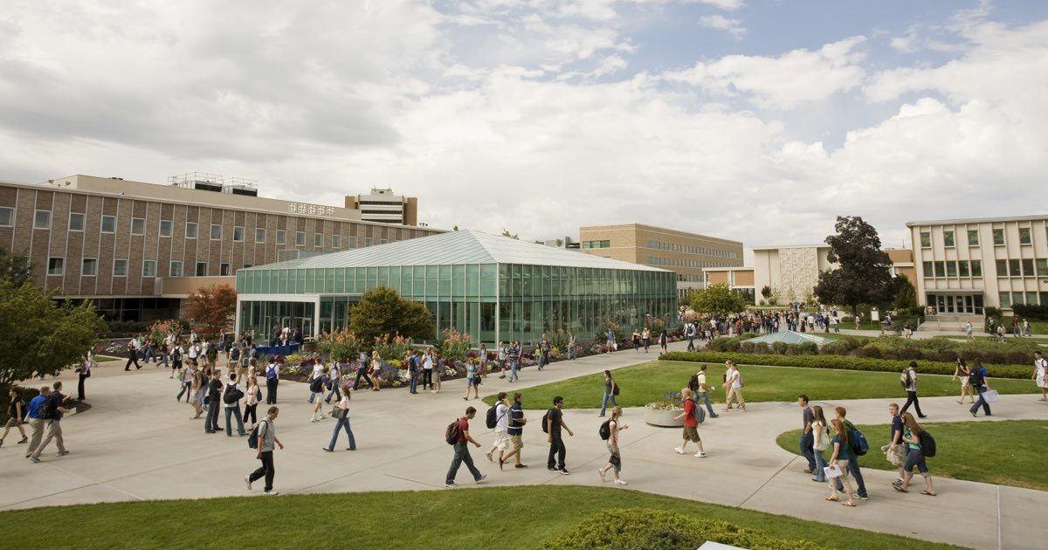
Motivation / Problem Statement
How do flocks of people, animals, autonomous systems cluster without centralized coordination and planning?
Flocks of birds
Schools of fish
People in traffic/ crows
Watch how people group between classes at BYU, incredible that there are almost no collisions!
Can we model this?

Slide 4
Relevant Background Literature
C. Reynolds. Flocks, birds, and schools: a distributed behavioral model. Computer Graphics, 21:25–34, 1987
3 Rules: Separation, Alignment, Cohesion all produced convergent results, which was surprising
A. Jadbabaie, J. Lin, and A. S. Morse. Coordination of groups of mobile autonomous agents using nearest neighbor rules. IEEE Transactions on Automatic Control, 48(6):988–1001, July 2002.
Proved why the 3 rules caused convergence
Nag, Aneek, and Kaoru Yamamoto. "Distributed control for flock navigation using nonlinear model predictive control." Advanced Robotics (2024): 1-13.
Example of using the 3 rules for MPC with obstacle avoidance. These ideas are still being researched today.
C. M. Breder. Equations descriptive of fish schools and other animal aggergations. Ecology, 35:361– 370, 1954.
E. Rimon and D. Koditschek. Exact robot navigation using artificial potential functions. IEEE Transactions on Robotics and Automation
Main Contribution:
Analysis of the stability of flocking systems using Lyapunov theory and control methods.

Slide 5
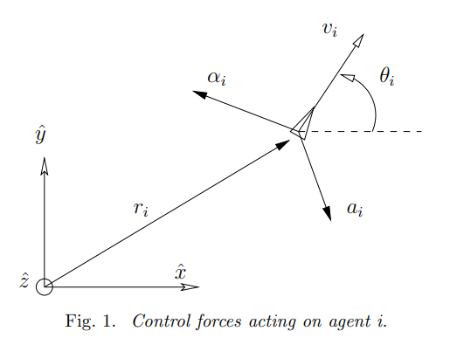
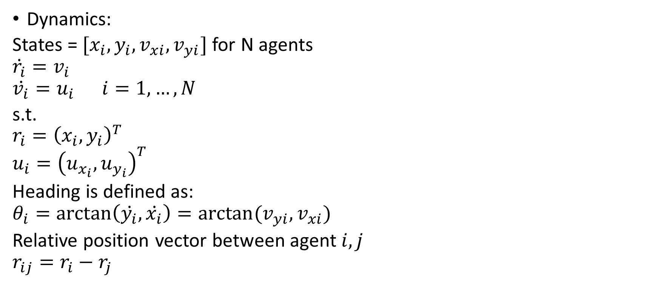
Model (double integrator)
Dynamics:
States = $[x_{i},y_{i},v_{xi},v_{yi}]$ for N agents
$$\dot{r_{i}}=v_{i}$$
$$\dot{v_{i}}=u_{i} i=1,…,N$$
s.t.
$$r_{i}={\left(x_{i},y_{i}\right)}^{T}$$
$$u_{i}={\left(u_{x_{i}}, u_{y_{i}}\right)}^{T}$$
Heading is defined as:
$$θ_{i}=\arctan\left(\dot{y_{i}},\dot{x_{i}}\right)=arctan⁡(v_{yi},v_{xi})$$
Relative position vector between agent $i,j$
$$r_{ij}=r_{i}−r_{j}$$

Slide 6
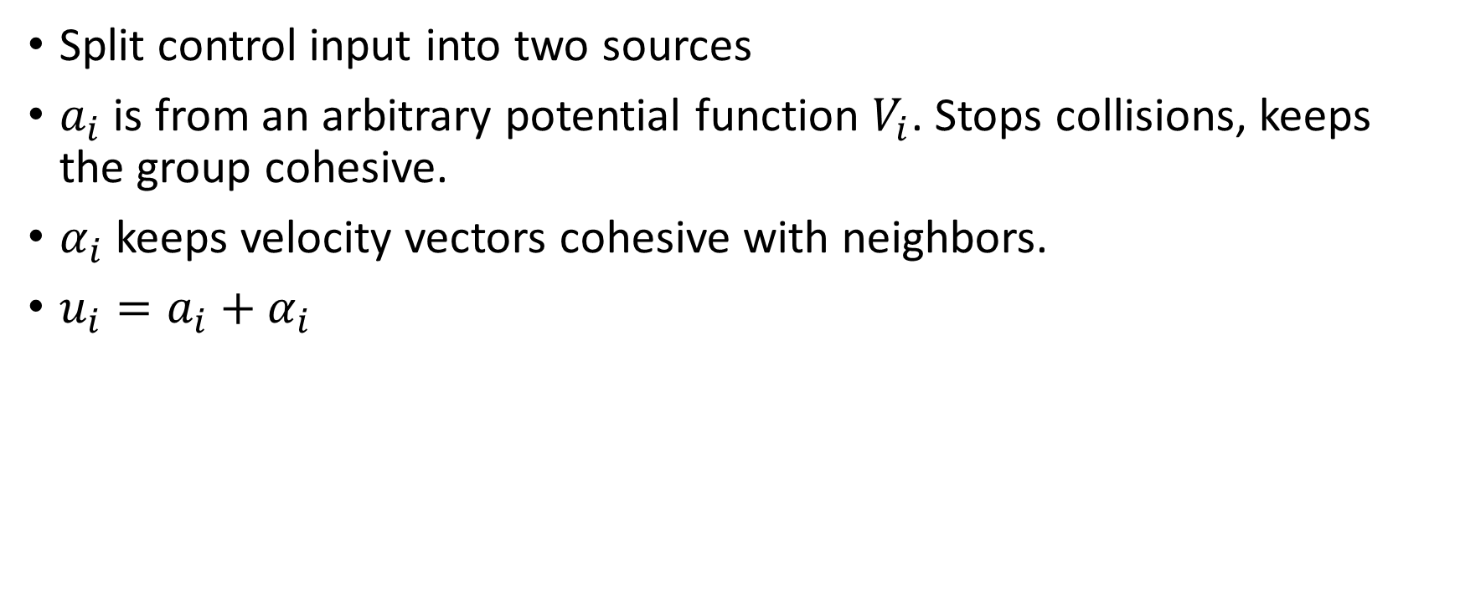
Control Forces
Split control input into two sources
$a_{i}$ is from an arbitrary potential function $V_{i}$. Stops collisions, keeps the group cohesive.
$α_{i}$ keeps velocity vectors cohesive with neighbors.
$u_{i}=a_{i}+α_{i}$

Slide 7
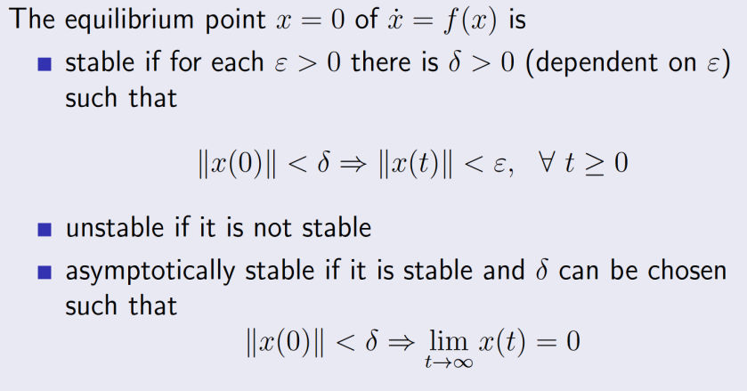
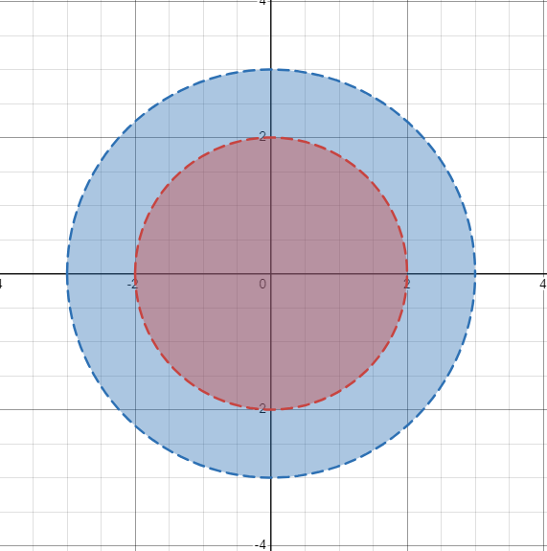
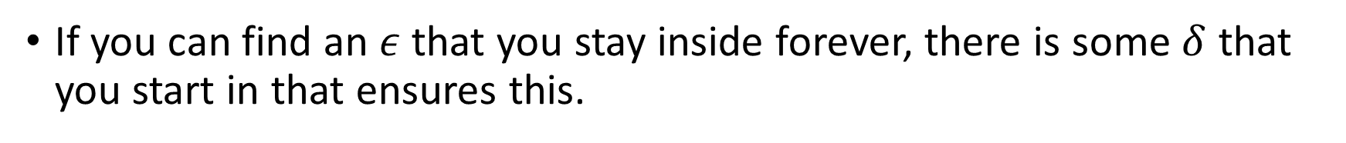


Side Quest: Lyapunov Stability (Simplified)
If you can find an $ε$ that you stay inside forever, there is some $δ$ that you start in that ensures this.
$$x$$
$$\dot{x}$$

Slide 8

Side Quest: Lyapunov Stability (Simplified)
Asmyptotic Stability implies that as $t→ ∞, x\left(t\right)→$equilibrium
Unstable is when a system is not stable

Slide 9
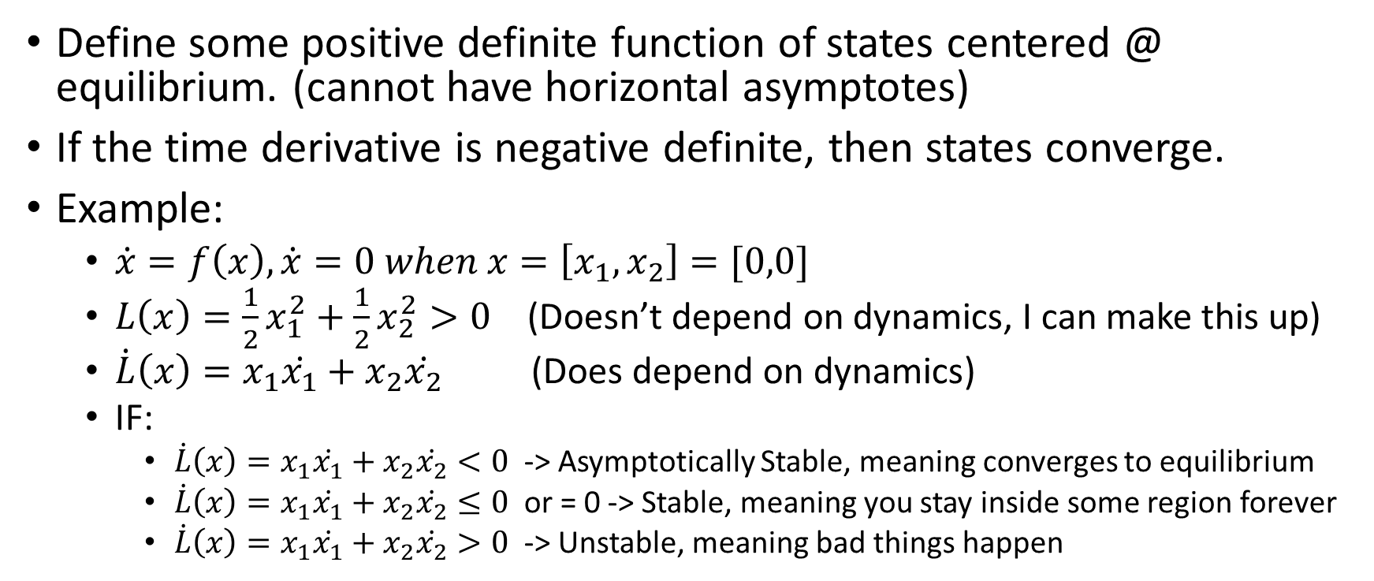
Side Quest: Lyapunov Stability (Simple)
Define some positive definite function of states centered @ equilibrium. (cannot have horizontal asymptotes)
If the time derivative is negative definite, then states converge.
Example:
$\dot{x}=f\left(x\right), \dot{x}=0 when x=\left[x_{1}, x_{2}\right]=[0,0]$
$L\left(x\right)=\frac{1}{2}x_{1}^{2}+{\frac{1}{2}x}_{2}^{2}>0$ (Doesn’t depend on dynamics, I can make this up)
$\dot{L}\left(x\right)=x_{1}\dot{x_{1}}+x_{2}\dot{x_{2}}$ (Does depend on dynamics)
IF:
$\dot{L}\left(x\right)=x_{1}\dot{x_{1}}+x_{2}\dot{x_{2}}<0$ -> Asymptotically Stable, meaning converges to equilibrium
$\dot{L}\left(x\right)=x_{1}\dot{x_{1}}+x_{2}\dot{x_{2}}≤0$ or = 0 -> Stable, meaning you stay inside some region forever
$\dot{L}\left(x\right)=x_{1}\dot{x_{1}}+x_{2}\dot{x_{2}}>0$ -> Unstable, meaning bad things happen

Slide 10
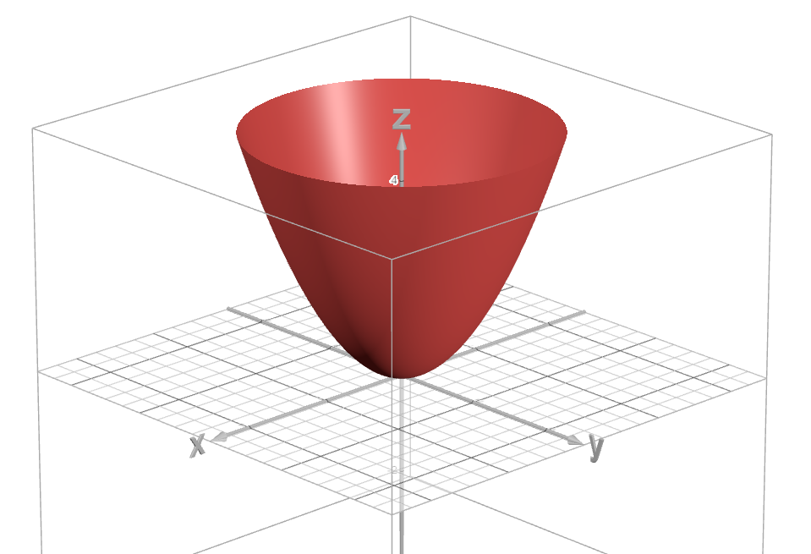
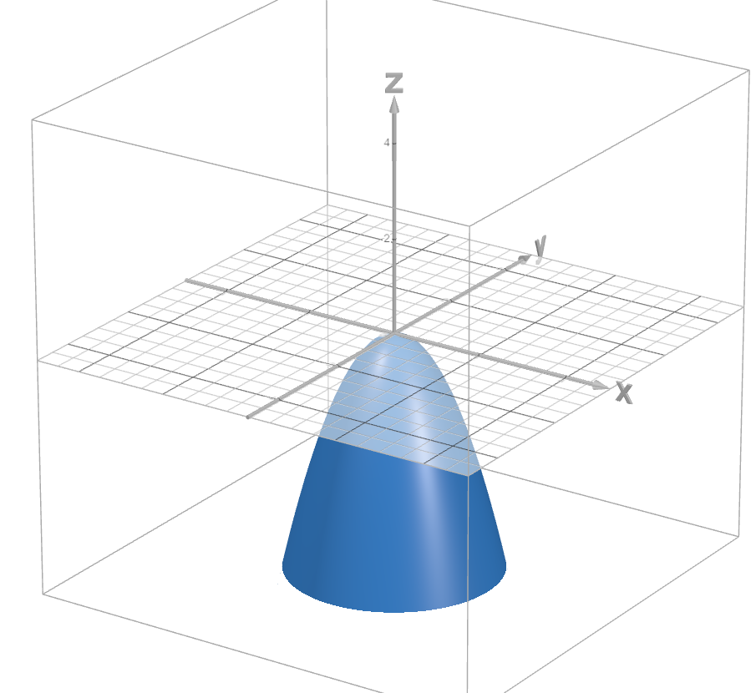

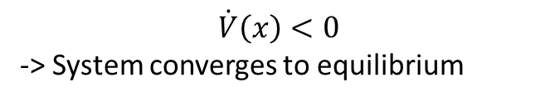
Side Quest: Lyapunov Stability (Simple) cont.
$V(x)$>0
$$\dot{V}\left(x\right)<0$$
-> System converges to equilibrium

Slide 11
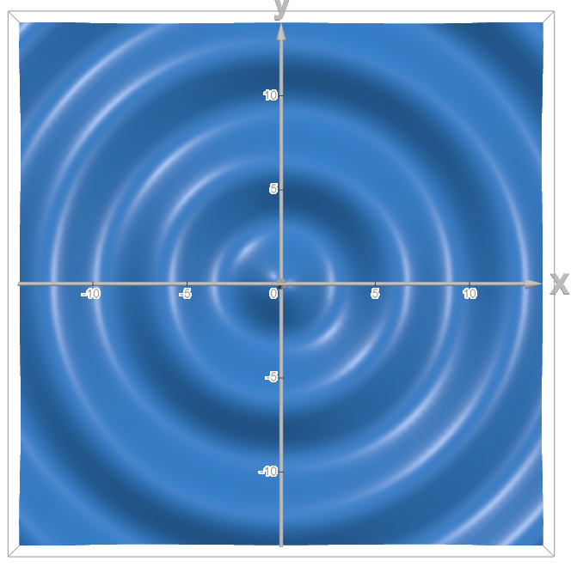
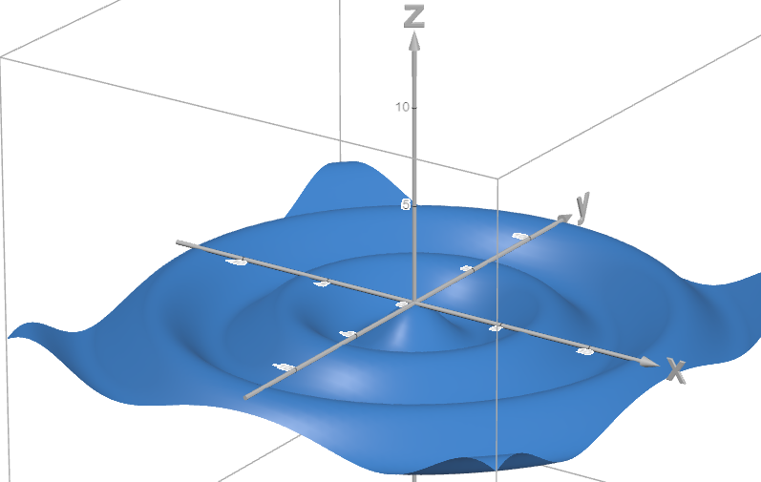
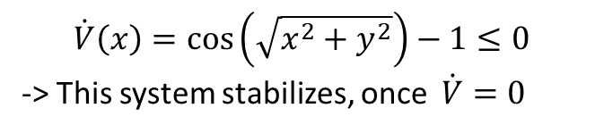
Side Quest: Lyapunov Stability (Simple) cont.
$V(x)$>0
$$\dot{V}\left(x\right)=cos\left(\sqrt{x^{2}+y^{2}}\right)−1≤0$$
-> This system stabilizes, once $\dot{V}=0$

Slide 12
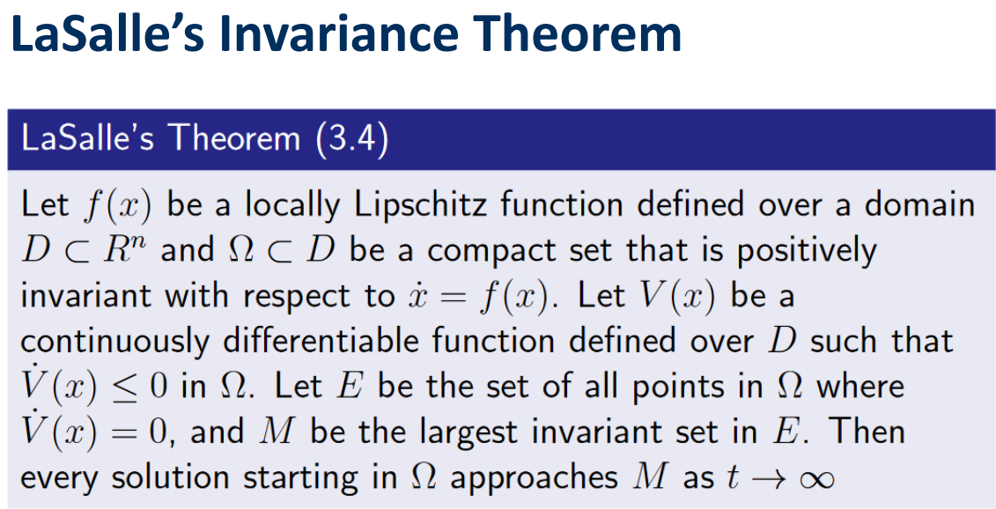
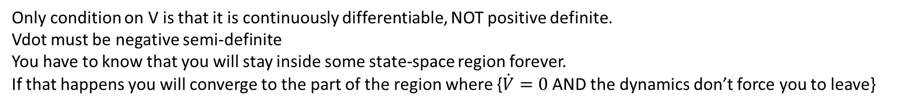
Only condition on V is that it is continuously differentiable, NOT positive definite.
Vdot must be negative semi-definite
You have to know that you will stay inside some state-space region forever.
If that happens you will converge to the part of the region where {$\dot{V}=0$ AND the dynamics don’t force you to leave}

Slide 13
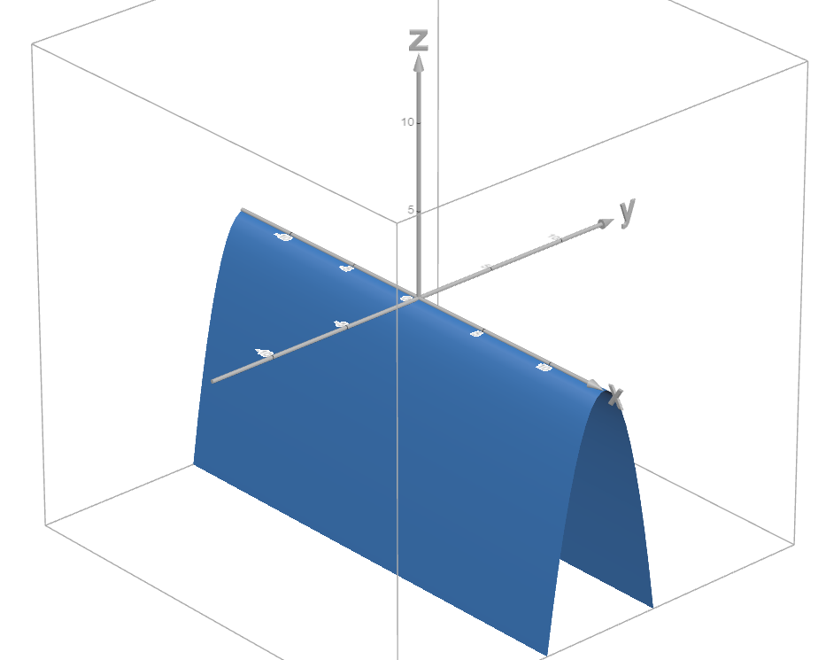
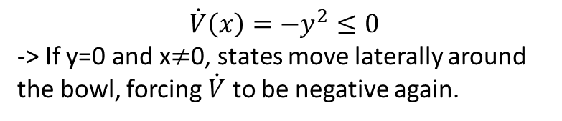
Side Quest: Lyapunov Stability (Simple) cont.
$V(x)$>0
$$\dot{V}\left(x\right)=−y^{2}≤0$$
-> If y=0 and x$≠$0, states move laterally around the bowl, forcing $\dot{V}$ to be negative again.

Slide 14
Oooof, that was a lot
Yes, but…
Can be used to design a controller that forces the distances, orientations, and velocities to converge.

Slide 15
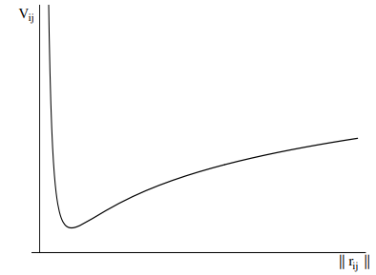
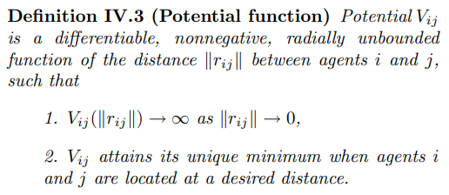

Potential Function
$V_{ij}\left(\left\|r_{ij}\right\|\right)=−\log\left(\left\|r_{ij}\right\|\right)+2\sqrt{\left\|r_{ij}\right\|}$
As two agents get close, potential becomes infinite. This will determine the control value $a_{i}$.

Slide 16





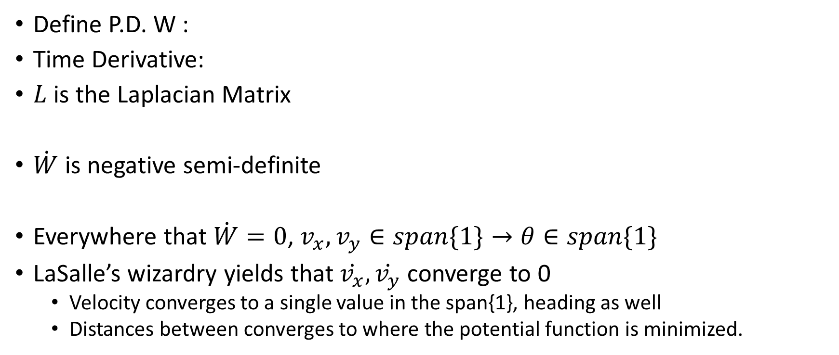
Build a Lyapunov Function
Define P.D. W :
Time Derivative:
$L$ is the Laplacian Matrix
$\dot{W}$ is negative semi-definite
Everywhere that $\dot{W}=0$, $v_{x},v_{y}∈span\{1\}→θ∈span\{1\}$
LaSalle’s wizardry yields that $\dot{v_{x}},\dot{v_{y}}$ converge to 0
Velocity converges to a single value in the span{1}, heading as well
Distances between converges to where the potential function is minimized.

Slide 17

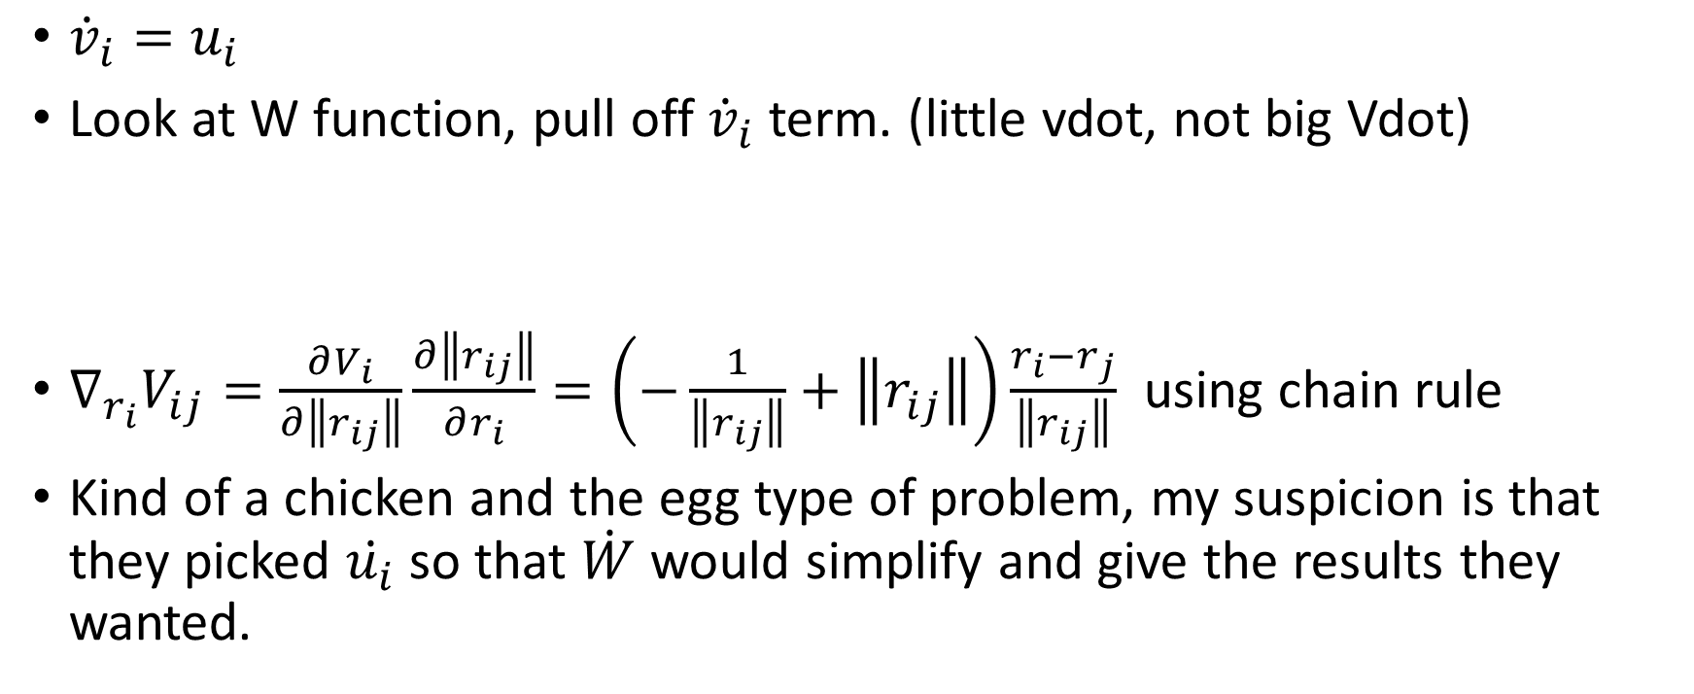
Build Controller
${\dot{v}}_{i}=u_{i}$
Look at W function, pull off ${\dot{v}}_{i}$ term. (little vdot, not big Vdot)
$∇_{r_{i}}V_{ij}=\frac{∂V_{i}}{∂\left\|r_{ij}\right\|}\frac{∂\left\|r_{ij}\right\|}{∂r_{i}}=\left(−\frac{1}{\left\|r_{ij}\right\|}+\left\|r_{ij}\right\|\right)\frac{r_{i}−r_{j}}{\left\|r_{ij}\right\|}$ using chain rule
Kind of a chicken and the egg type of problem, my suspicion is that they picked $\dot{u_{i}}$ so that $\dot{W}$would simplify and give the results they wanted.

Slide 18
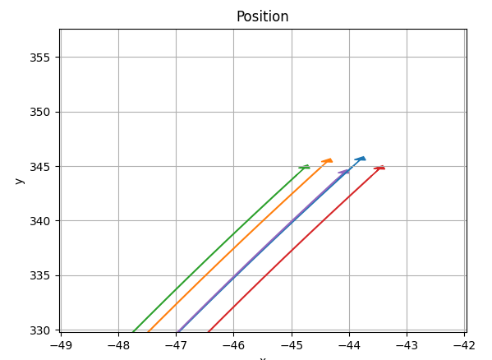
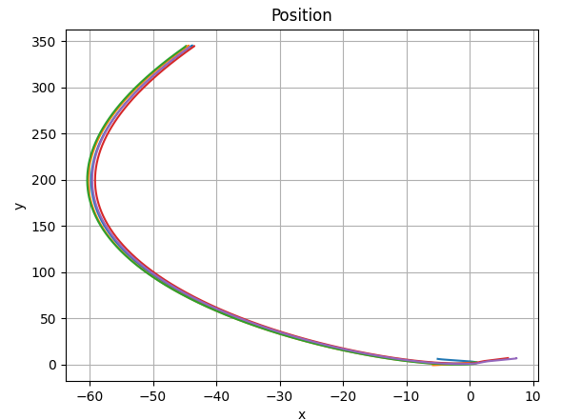
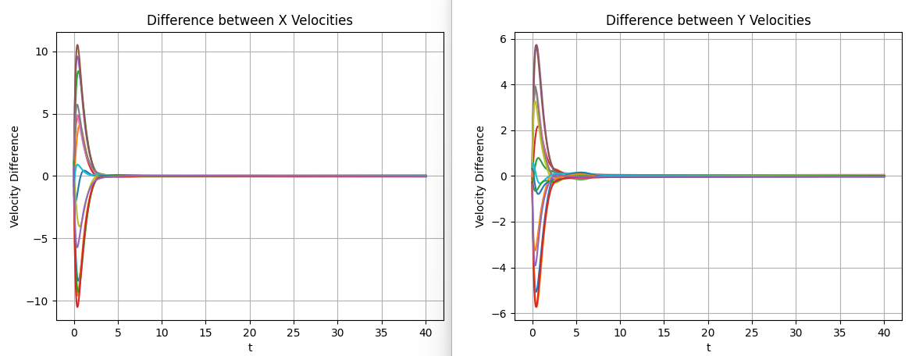
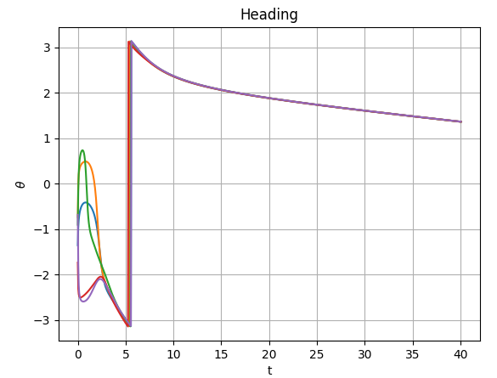
Results!

Slide 19
Assumptions
Graph stays connected
Neighbors don’t change, Laplacian doesn’t change
System can actuate with the control law

Slide 20
Outline: Dynamic Topology
Graph Adjustments
Control Law Adjustments
Simulation Results

Slide 21
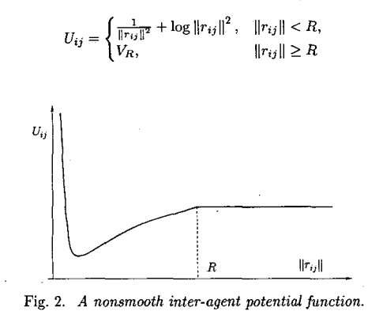

Changes
Graph neighbors are based on the k-nearest neighbors to the agent.
Graph changes in time
New Potential Function:
New Control Law:

Slide 22

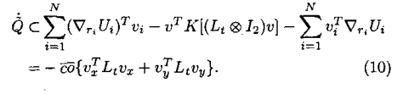
Stability Proof Summary
Q is continuous
Use math wizardry and generalized gradients of the function to derive a generalized time derivative of Q that is negative semi-definite. This all has to do with Lie algebras and such, which I am still pretty iffy on.

Slide 23
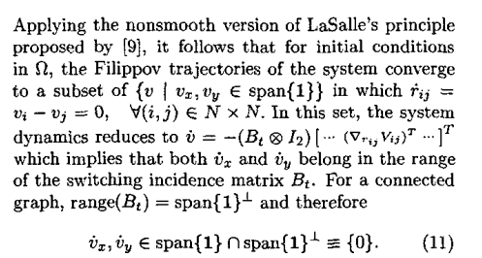
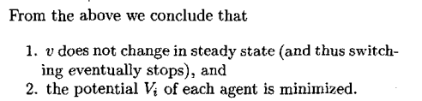
Stability Proof Summary Cont.

Slide 24
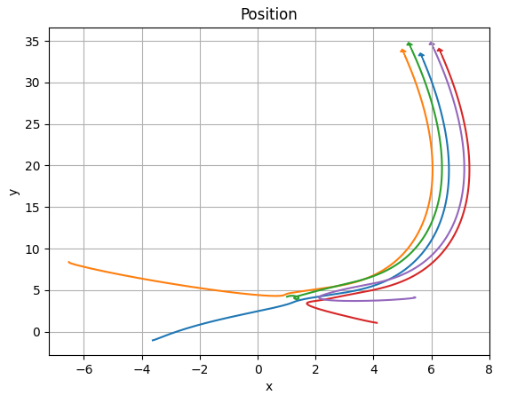
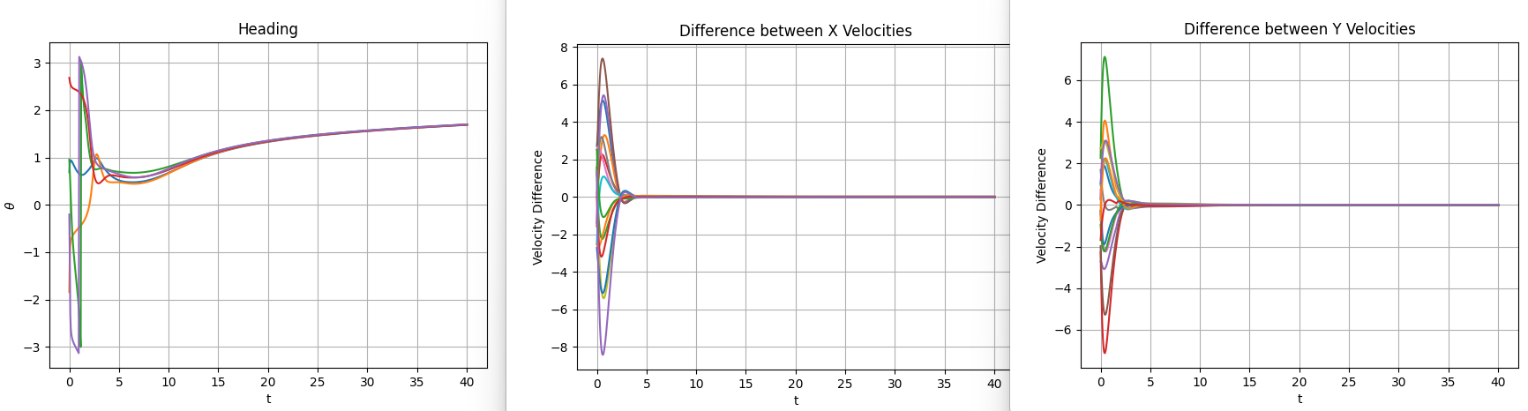
Results (k=3)

Slide 25
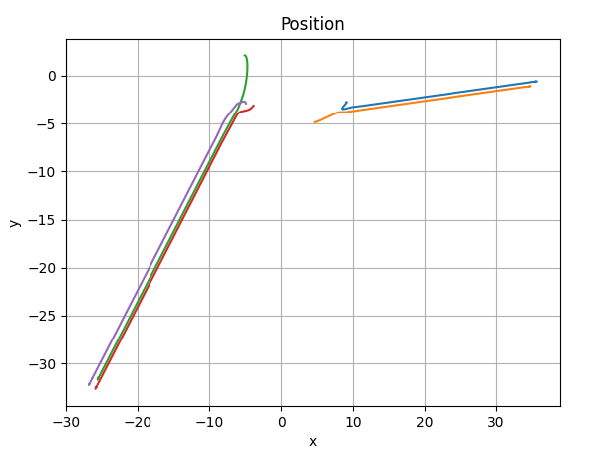
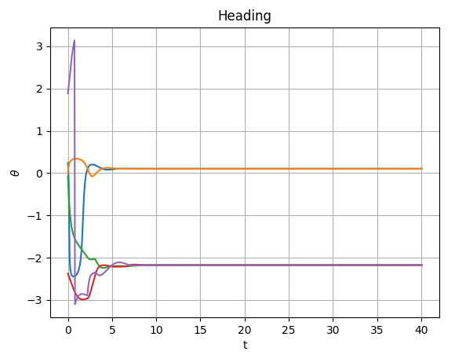
Results (k=1)

Slide 26
Summary
Implementing controller is easy
Proving the controller converges and is stable is hard
Serious math background required
As long as graphs stay connected, topology change won’t affect stability properties.
Changing topology requires much deeper math tools.

Slide 27
Future Work
Flock direction could be an additional control term. So if we want theta to converge to a pre-set value instead of some weighted average value, then we could add an additional control term to try to push all agents in a certain direction.
Proving that it works could be hard (or exciting, depending on who you are)
It would be interesting to analyze how well this works with actuator saturation.
Hard or exciting
How does consensus or error in your neighbor’s velocity hurt convergence?

