Slide 1
Video Scene Boundary Detection
CSE 495
First Presentation
Serkan Efe Çamoğlu
Advisor: Dr. Gökhan KAYA
October 2025

Slide 2
Contents
Project Overview & Definitions
Project Design Plan
Project Requirements
Success Criteria
References

Slide 3
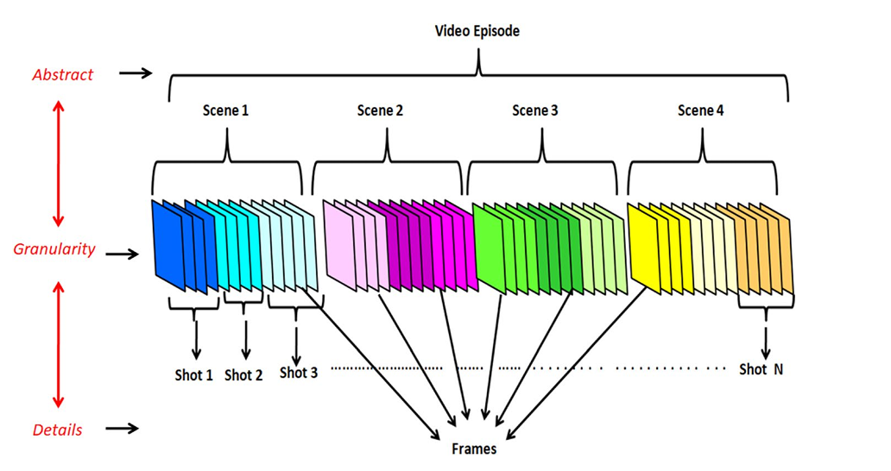
Project Overview & Definitions
Video Hierarchy Definitions
Frame: The smallest single image that makes up a video
Shot: A sequence of frames from a single, continuous camera recording.
Scene: A collection of related shots that form a semantic unit.
What is Scene Boundary Detection?
It is the process of automatically identifying the points where one semantic scene ends and another begins.
The goal of this project is to build a system that segments a long video into these meaningful units called scenes.
It's the first and most critical step for video summarization, indexing, and content-based search.

Slide 4
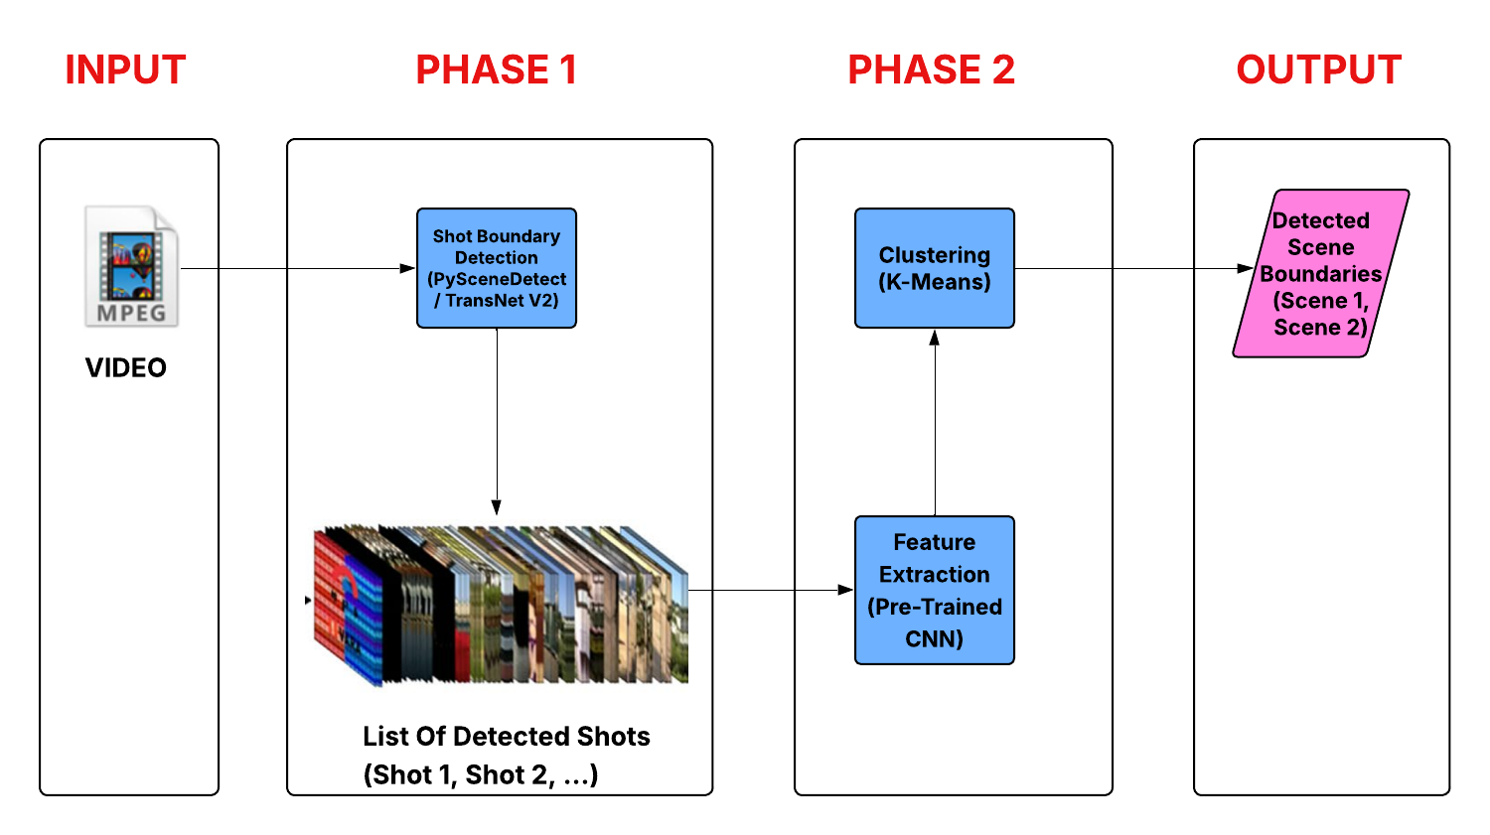
Project Design Plan
My design follows a two-phase approach as shown in the diagram:
Phase 1 - Shot Detection: First, I will segment the video into technical "shots". I plan to use a reliable tool like PySceneDetect or a SOTA model like TransNet V2 for this step.
Phase 2 - Scene Clustering (Main Task): To form scenes, I will first extract content features from each shot using a powerful pre-trained CNN.
Then, a clustering algorithm like K-Means will group the shots with similar content into the final scenes.

Slide 5
Project Requirements
Software Requirements
Primary Programming Language: The project will be developed using Python 3.
Shot Detection: I am planning to use the PySceneDetect library for the initial phase of detecting shot boundaries. For higher precision, SOTA models like TransNet V2 will also be considered.
Video Processing: OpenCV will be used for core tasks like reading videos frame by frame.
Feature Extraction: TensorFlow and Keras libraries will be used to load a pre-trained CNN model for semantic feature extraction from shot keyframes.
Clustering: Scikit-learn will be used to implement the K-Means algorithm to group shots into scenes.
Data Requirements
Various types of video files (movies, documentaries, TV shows) will be used for testing the system.
Manually annotated ground truth data will be created for a small set of videos to evaluate clustering performance.

Slide 6
Success Criteria
Criterion 1: Accurate Shot Detection (Phase 1)
  The first phase must be reliable. Established tools like PySceneDetect can reach F1-Scores of 80-95% on standard datasets, while models like TransNet V2 can reach F1-Scores of 91-96%.
  My goal for this phase is to achieve an F1-Score in the 85-90% range, which will provide a strong foundation for clustering.
Criterion 2: Meaningful Scene Clustering (Phase 2)
  This is the main project goal. I will evaluate my clustering performance using Average Precision (AP).
  My target for AP score is 50-60%. This range is competitive with recent SOTA models for scene detection.
Criterion 3: Overall System F1-Score
  This metric measures the final, end-to-end performance of the system.
  Considering the high accuracy of Phase 1 and the semantic complexity of Phase 2, an overall F1-Score in the 55-70% range is a strong and realistic target.

Slide 7
References
Kar, T., Kanungo, P., Mohanty, S. N., Groppe, S., & Groppe, J. (2024). Video shot-boundary detection: issues, challenges and solutions. Artificial Intelligence Review, 57(1), 104.
Gushchin, A., Antsiferova, A., & Vatolin, D. (2021). Shot Boundary Detection Method Based on a New Extensive Dataset and Mixed Features. In CEUR Workshop Proceedings (Vol. 3027, pp. 18-28).
Benoughidene, A. H., & Titouna, F. (2020). Shot Boundary Detection: Fundamental Concepts and Survey. In CEUR Workshop Proceedings (Vol. 2589, pp. 58-64).
Akewar, M. (n.d.). Scene Boundary Detection Approaches: A Review.
Cooper, M., & Foote, J. (n.d.). Scene Boundary Detection via Video Self-Similarity Analysis.

