Slide 1
EE136IU • CAPSTONE MINI-PROJECT DEFENSE
TOPIC 04: Data Augmentation &
Noise Resilience for Low-SNR
Enhancing Deep Receiver Sensitivity in Noise-Limited Regimes (−10 dB → +18 dB)
👥 Team Members & Speaking Roles
• Thành viên 1 — Team Lead: Signal Processing · Preprocessing Pipeline · RMS Normalization
• Thành viên 2 — ML Engineer: 1D CNN Architecture · RF Augmentation PyTorch Pipeline
• Thành viên 3 — Demo & Eval: SNR Benchmarking · Failure Analysis · Streamlit Web UI
EE136: Machine Learning for Wireless Communications | Capstone Mini-Project Brief
Slide 1 of 12

Slide 2
TABLE OF CONTENTS
Agenda — 5 Main Sections
01. 🔍 Vấn Đề — Channel Physics · Low-SNR Limitations · Why Baseline Fails (Slide 3)
02. 💡 Giải Pháp & Khái Niệm — Technical Foundation · Data Augmentation · Key Concepts (Slides 4–5)
03. ⚙️ Implementation — 1D CNN Architecture · Training Setup & Convergence (Slides 6–7)
04. 📊 Kết Quả & Demo Sản Phẩm — Accuracy vs. SNR · Confusion Matrix · Interactive Demo (Slides 8–10)
05. ❓ Q&A — Conclusion · Engineering Takeaways · Open Questions (Slide 11)
EE136: Machine Learning for Wireless Communications | Topic 4 Capstone Defense
Slide 2 of 12

Slide 3
01 • VẤN ĐỀ
Channel Physics & Low-SNR Limitations
Why Modulation Classification Fails in Noise-Limited Regimes
📡 Baseband Signal Model
• Model: r[n] = h · s[n] + w[n]
• w[n]: AWGN: w[n] ~ CN(0, σ²) — complex Gaussian noise
• Phase shift: CFO causes rotation e^(jθ), θ ∈ [0, 2π)
• Problem: At −10 dB, noise > signal → constellation collapses
💥 Why Baseline Fails
• Phase overfitting: Baseline locks to fixed phase orientation in training
• Accuracy collapse: Baseline < 25% accuracy at SNR = −10 dB
• Boundary overlap: AWGN smears 16QAM & 64QAM into each other
• Topic 4 solution: Stochastic RF augmentation → phase-invariant model
EE136: Machine Learning for Wireless Communications | Topic 4 Capstone Defense
Slide 3 of 12

Slide 4
02 • GIẢI PHÁP & KHÁI NIỆM
Technical Foundation & Key Concepts
Standardized I/Q Tensor · RMS Normalization · 8-Class Classification
📦 Baseband Tensor Specification
• Input tensor: [N_batch, 2, 128] — float32
• Channel layout: Row 0: I[n] | Row 1: Q[n]
• RMS Normalization: r_norm[n] = r[n] / √mean(I²+Q²)
• 8 Classes: BPSK · QPSK · 8PSK · 16QAM · 64QAM · PAM4 · CPFSK · GFSK
📏 Evaluation Protocol
• SNR Grid: 15 points: −10 dB to +18 dB (step 2 dB)
• Data split: 70% Train / 15% Val / 15% Test (zero leakage)
• Dataset: 18,000 bursts total — 150 × 8 classes × 15 SNR
• Metrics: Accuracy vs. SNR · Macro-F1 · Row-normalized Confusion Matrix
EE136: Machine Learning for Wireless Communications | Topic 4 Capstone Defense
Slide 4 of 12

Slide 5
02 • GIẢI PHÁP & KHÁI NIỆM
Topic 04 — RF Data Augmentation Pipeline
4 Physical Transforms Applied Per Training Batch to Force Noise Robustness
🔄 RFAugmentationPipeline — 4 Transforms
• Phase rotation: θ ~ U[0, 2π) → rotate (I, Q) by θ
• AWGN injection: std ~ U[0.01, 0.08] — low-SNR sensitivity
• Time-shift jitter: Circular shift k ~ U[−8, +8] samples
• Amplitude scale: Multiply by α ~ U[0.85, 1.15]
🎯 Key Insight
• Model A — Baseline: Standard 1D CNN, no augmentation
• Model B — Augmented: Same 1D CNN + RFAugmentationPipeline
• Fair comparison: 100% identical hyperparameters across both models
• Result: Physical augmentation acts as domain-aware regularizer
EE136: Machine Learning for Wireless Communications | Topic 4 Capstone Defense
Slide 5 of 12

Slide 6
03 • IMPLEMENTATION
3-Block Deep 1D Convolutional Neural Receiver
Input: [N_batch, 2, 128] → Output: [N_batch, 8]
🏗️ 1D Convolutional Feature Extractor
• Block 1: Conv1D(2→64, k=7) → BN → ReLU → MaxPool [128→64]
• Block 2: Conv1D(64→128, k=5) → BN → ReLU → MaxPool [64→32]
• Block 3: Conv1D(128→256, k=3) → BN → ReLU → AvgPool [32→1]
🧠 Classifier Head
• Flatten: [N, 256, 1] → [N, 256] feature vector
• FC 1: Linear(256→128) → ReLU → Dropout(0.3)
• FC 2: Linear(128→8) — class logits
• Config: 175,432 params · Adam · CosineAnnealingLR
EE136: Machine Learning for Wireless Communications | Topic 4 Capstone Defense
Slide 6 of 12

Slide 7
03 • IMPLEMENTATION
Training Convergence — Baseline vs. Topic 04
25 Epochs · 18,000 Bursts · Identical Hyperparameters for Fair Comparison
🔴 Model A — Baseline (No Augmentation)
• Train accuracy: 76.95% | Train Loss: 0.4774
• Val accuracy: 65.33% | Val Loss: 0.8757
• Overfit gap: Δ Loss = 0.399 — large overfitting detected
• Problem: Accuracy collapses under unseen phase offsets
🔵 Model B — Augmented (Topic 04)
• Train accuracy: 63.13% | Train Loss: 0.8069
• Val accuracy: 66.07% | Val Loss: 0.7670
• Overfit gap: Δ Loss = 0.107 — much tighter generalization
• Key win: Val Loss 0.1087 lower than Baseline → better robustness
EE136: Machine Learning for Wireless Communications | Topic 4 Capstone Defense
Slide 7 of 12

Slide 8
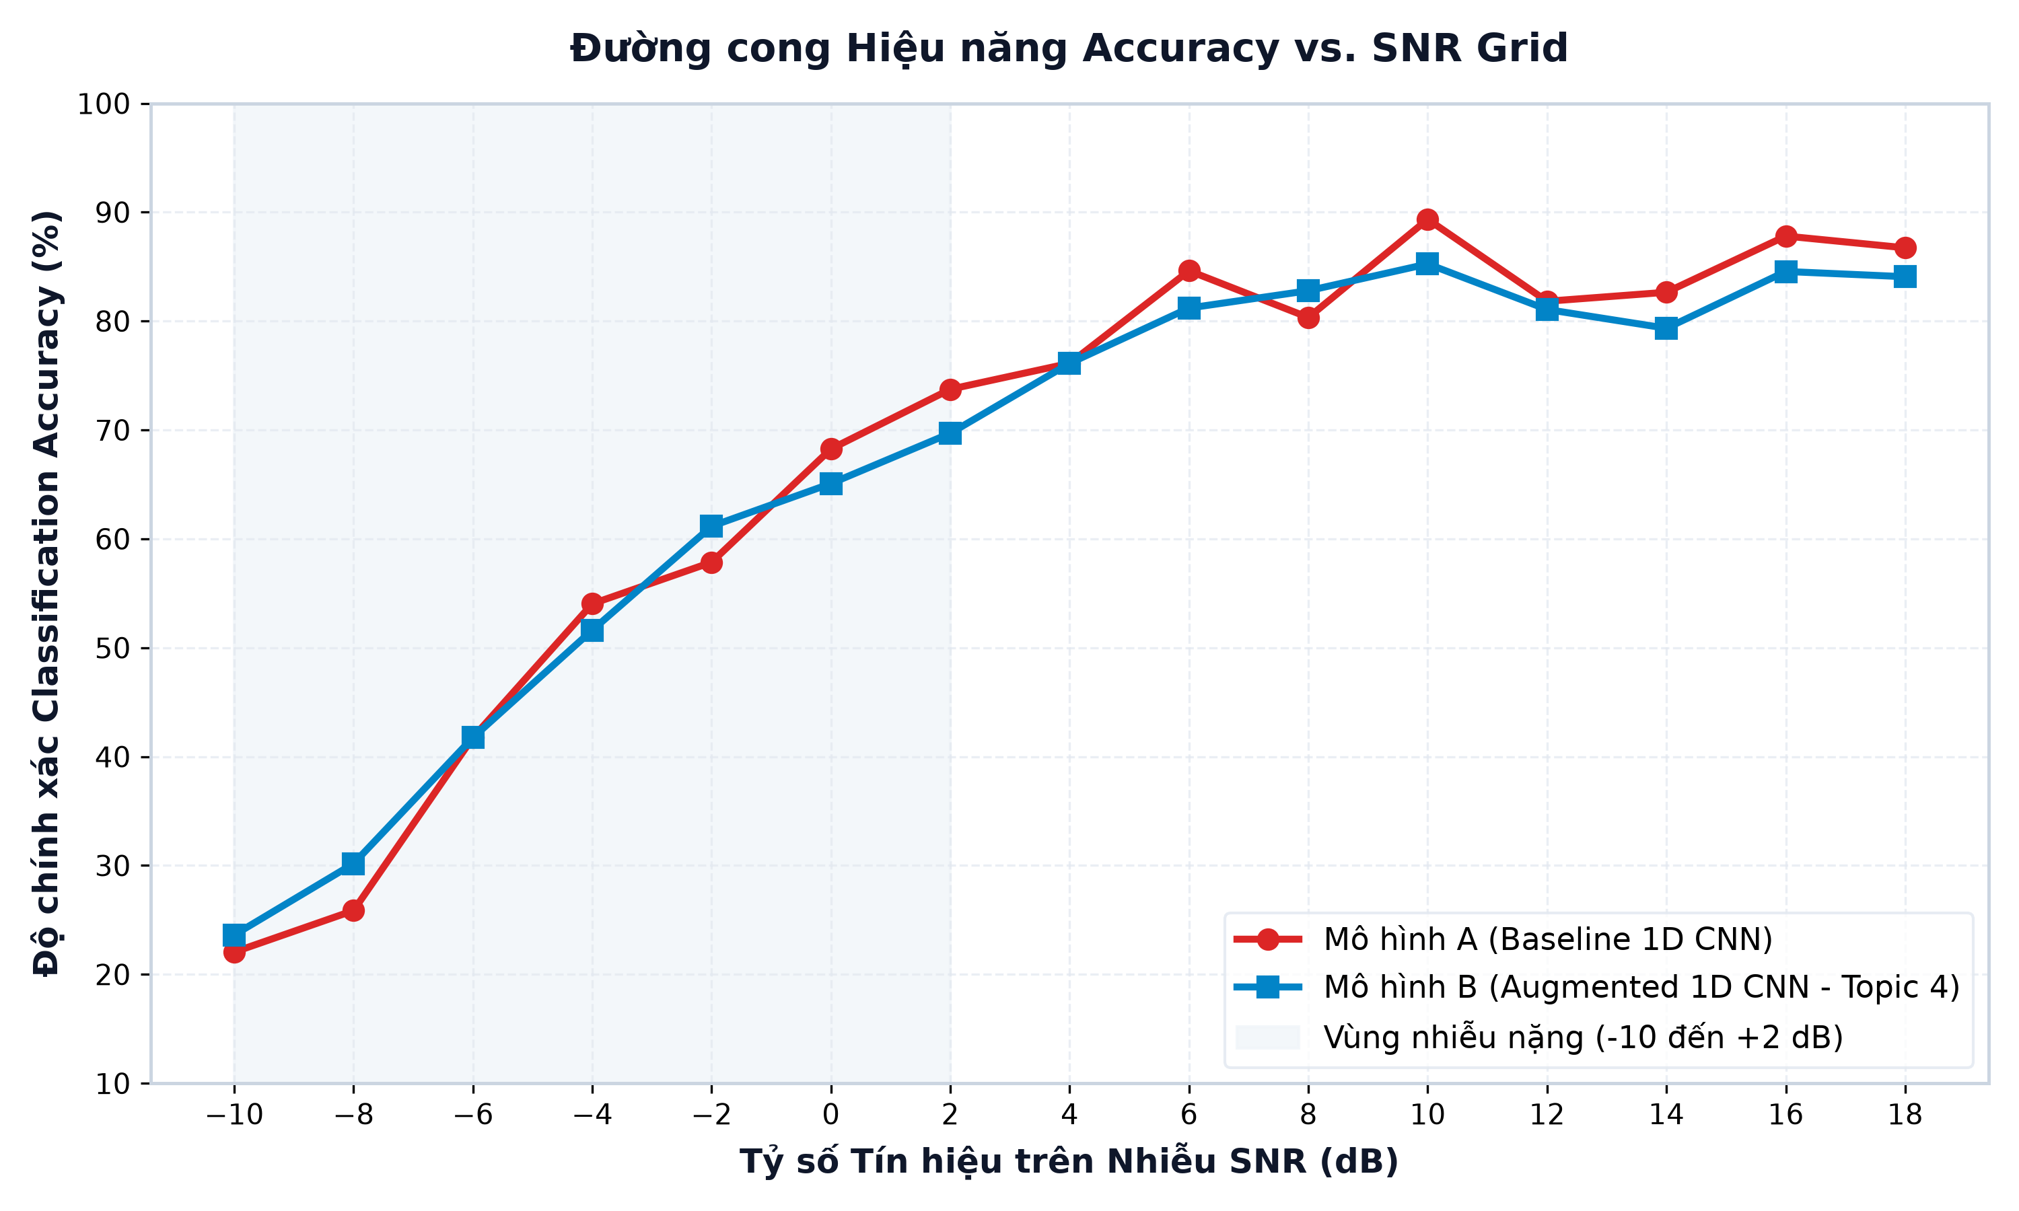
04 • KẾT QUẢ & DEMO
Accuracy vs. SNR Grid — Baseline vs. Topic 04
Progressive Recovery from Noise-Limited to High-SNR Asymptote
📈 Quantitative Gains
• SNR = −8 dB: 25.86% → 30.17% (+4.31% gain)
• SNR = −2 dB: 57.85% → 61.16% (+3.31% gain)
• Val Loss: Baseline 0.8757 vs Augmented 0.7670 (↓ 0.1087)
• Summary: Topic 4 consistently wins at −10 dB to 0 dB regime
EE136: Machine Learning for Wireless Communications | Topic 4 Capstone Defense
Slide 8 of 12

Slide 9
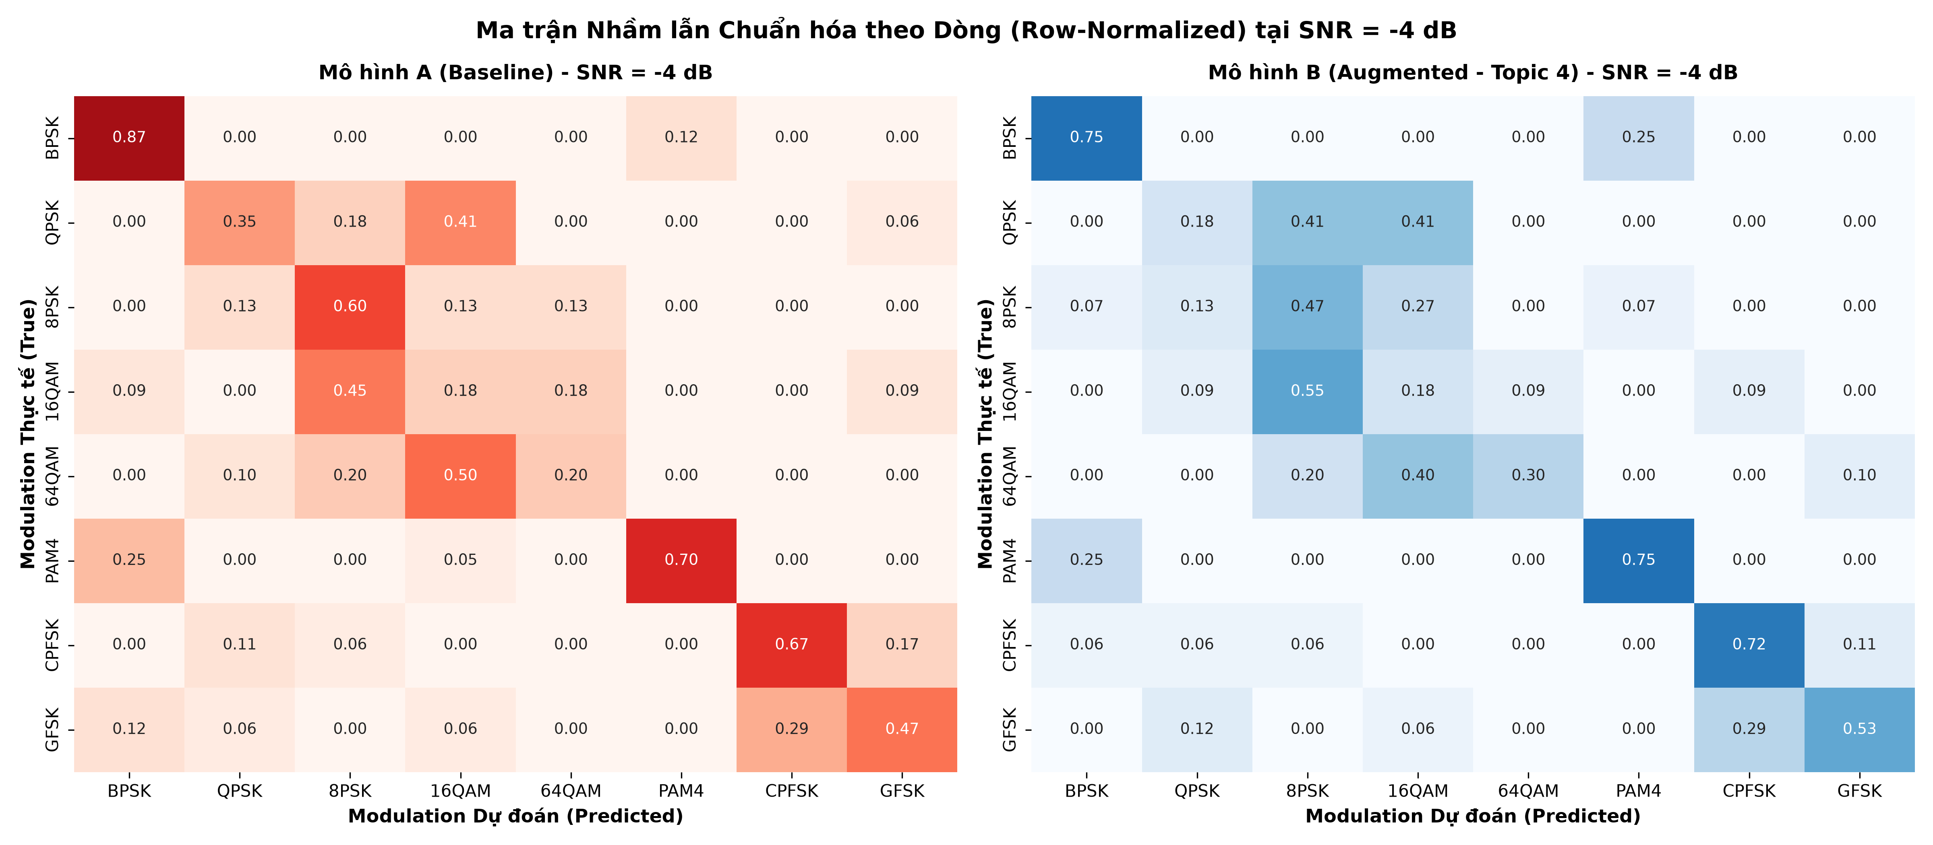
04 • KẾT QUẢ & DEMO
Confusion Matrix & Root-Cause Failure Analysis
Row-Normalized at Low SNR (−4 dB) — Class-Level Misclassification Breakdown
🔬 Failure Analysis
• 16QAM vs 64QAM: Multi-ring amplitude smear under high AWGN power
• QPSK vs 8PSK: Phase noise pushes across adjacent decision boundaries
• Root cause: Baseline anchors to fixed phase — fails under CFO
• Topic 4 fix: Phase rotation training → radial density features learned
EE136: Machine Learning for Wireless Communications | Topic 4 Capstone Defense
Slide 9 of 12

Slide 10
04 • KẾT QUẢ & DEMO
Interactive Demo & Fail-Safe Video Backup
py -m streamlit run app.py → http://localhost:8501
📹 Fail-Safe Video [EMBED MP4 HERE]
• Backup purpose: 30–60s screen-recording embedded in this slide
• Crash shield: Guards against terminal crash / GPU OOM during defense
• Content: 16QAM @ −4 dB: Baseline ❌ vs Topic 4 ✅
🎛️ Streamlit Web UI
• SNR Slider: Real-time adjustment −10 dB to +18 dB
• Modulation selector: Ground-truth class for all 8 modulation types
• Side-by-side result: Baseline prediction vs. Topic 4 prediction live
• Launch: py -m streamlit run app.py
EE136: Machine Learning for Wireless Communications | Topic 4 Capstone Defense
Slide 10 of 12

Slide 11
05 • Q&A
Conclusion & Open Technical Q&A
Rigorous Engineering · Physical Grounding · Professional Delivery
💡 Core Takeaways
• Physics first: Every decision anchored in wireless physical reality
• Sensitivity gains: +4.31% @ −8 dB | +3.31% @ −2 dB | Val Loss ↓ 0.1087
• Phase invariance: Augmented model robust to arbitrary CFO offsets
• Reproducibility: seed=42 · 1-command demo · full modular codebase
📊 Summary Metrics
• Architecture: 3-Block 1D CNN | 175,432 params | [N, 2, 128]
• Best Val Acc: Augmented 66.07% vs Baseline 65.33%
• Best Val Loss: Augmented 0.7670 vs Baseline 0.8757
• Floor is open: Ready to defend all algorithmic & design decisions ✅
EE136: Machine Learning for Wireless Communications | Topic 4 Capstone Defense
Slide 11 of 12

Slide 12
Thank You
for your time & attention!
We are happy to answer any questions about our implementation, results, or design decisions.
📡 Topic
Data Augmentation & Noise Resilience for Low-SNR
🏫 Course
EE136IU — ML for Wireless Communications
🚀 Demo
py -m streamlit run app.py
EE136: Machine Learning for Wireless Communications | Topic 4 Capstone Defense
Slide 12 of 12

