Slide 1
JavaScript Bingo
Pete Campbell
pete@sumirolabs.com
@sumirolabs
github.com/campbell

Slide 2
Welcome To The USA!

Slide 3
Welcome To The USA!
(His name is not Roy)

Slide 4
Welcome To The USA!
(His name is not Roy)
(Well played, sir!)

Slide 5
The 90’s Were Good To Me
(MicroStrategy)

Slide 6
The 90’s Were Good To Me
(MicroStrategy)
(He once gave a 90 minute speech
about his summer vacation)

Slide 7
The 90’s Were Good To Me
(MicroStrategy)
(He once gave a 90 minute speech
about his summer vacation)
Ninety

Slide 8
The 90’s Were Good To Me
(MicroStrategy)
(He once gave a 90 minute speech
about his summer vacation)
Ninety
Minutes….

Slide 9
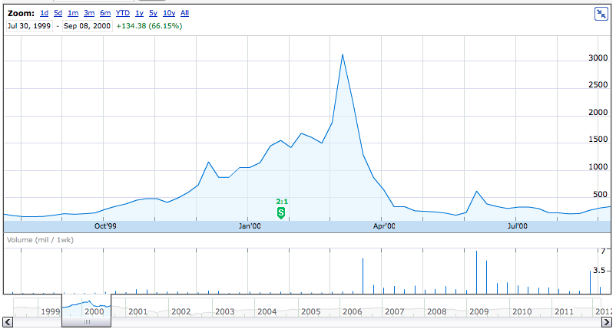
MicroStrategy Stock Chart
95% Drop

Slide 10
self.inspect (this.toString?)
Started in chip design at IBM
Web developer since 2000
Ruby since 2008
Freelance since 2009
Notes:
So I’ve been coding for awhile and recently started to do more JavaScript work and I have a confession to make.

Slide 11
Confession

Slide 12
Confession
My JavaScript code stinks…

Slide 13
Confession
My JavaScript code stinks…
Your code probably stinks too…

Slide 14
Confession
My JavaScript code stinks…
Your code probably stinks too…
But its not your fault…

Slide 15
Confession
My JavaScript code stinks
Your code probably stinks too…
But its not your fault…
Its your parents fault

Slide 16


Parents Just Don’t Understand
JavaScript’s parents

Slide 17
Parents Just Don’t Understand
Netscape and Microsoft intentionally disagreed
Notes:
Let me diverge once again and ask a simple question: which way do bubbles float, up or down?
Just give me an answer, either one is going to be wrong.

Slide 18
Parents Just Don’t Understand
Netscape and Microsoft intentionally disagreed
Events bubble down!

Slide 19
Parents Just Don’t Understand
Netscape and Microsoft intentionally disagreed
Events bubble down!
You fool! Events bubble up!

Slide 20
Resolution
Notes:
Then Javascript entered the dark ages where we muddled through without much hope. And then a savior appeared and showed us the light.

Slide 21
Salvation
Notes:
He gave us hope, he spoke about what was good, he had a beard, and his name ended with an ‘S’.

Slide 22
Salvation
Douglas Crockford, JavaScript: The Good Parts

Slide 23
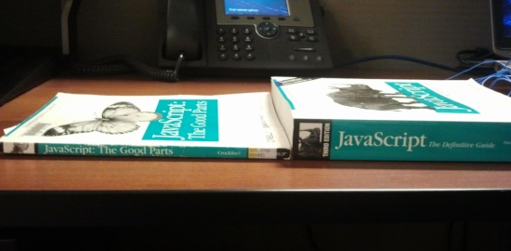
Salvation
Douglas Crockford, JavaScript: The Good Parts

Slide 24
I Believe I Can Fly…
I knew how to write better JavaScript
In the JavaScript community, there was lots of info about good practices
This would be just like learning Ruby

Slide 25
I Believe I Can Fly…
I knew how to write better JavaScript
In the JavaScript community, there was lots of info about good practices
This would be just like learning Ruby
That is a problem…

Slide 26
TMI!
Too much information!
Too many libraries, projects, terms
What is important?
Why do I care?
Notes:
Learning Ruby and Rails is hard in part because there are so many projects and names to know. It takes awhile to become familiar with all of the terms, acronyms and other parts of the Ruby ecosystem.
When I started to do more work in Javascript, I had the same overwhelmed feeling that I had back in the early days of learning Ruby. There has been so much activity in the Javascript world that its nearly impossible to keep up. Every Tuesday a new framework is announced, or there is a new HTML5 library, or now there is a new hot design pattern.
So I started to track these developments more closely so I could understand them, and hopefully this talk will help you to get up to speed more quickly, or at least identify what you're interested in.

Slide 27
Why Are We Here?
JavaScript jumpstart
Describe* many JavaScript & related frameworks, libraries, terms, thingys
Help you figure out what you should be watching in the JS world
Try to keep you from slipping into a food-coma from lunch
* Guaranteed to be mostly-correct

Slide 28
JavaScript Bingo Rules
Get a card, cross off a term when I say it (wait for it…)
When you get 5 in a row, scream BINGO! loud enough to wake the person next to you from their food-coma
Get a prize*
In case of a tie, there will be a dance-off…
* Warning: Recipient may not consider it a prize

Slide 29
Our Journey
Server
Browser
Libraries
Neat Stuff
Bonus Round Dance Party

Slide 30
Server
Node.js
Wins award for the most hype
“Non-blocking”, so more efficient use of resources
Powered by V8
Makes asynchronous, event-driven programming much simpler
NPM – Node Package Manager
Install, manage & publish Node programs
Notes:
Node.js is Javascript on the server, but for good and not evil. It makes it easier to write asynchronous code to handle a large number of requests, uses a single thread and is non-blocking, so you can handle many more concurrent connections than in Ruby or Java.
The secret sauce here is the event-driven model that uses callbacks. When a request needs some resource, the resource request is offloaded to the system and processing continues. When the resource is available, it re-enters the processing queue by calling the callback. Other requests aren't blocked while your request waits for its data.

Slide 31
Server
Connect
Middleware HTTP framework (logger, CSRF, cookie & JSON parser…)
Express
Lightweight web development framework
Inspired by Sinatra
Geddy, Locomotive, RailwayJS
Frameworks that look like Rails

Slide 32
JavaScript Engines
V8
From Google
Compiles to machine-code
SpiderMonkey
From Mozilla
Compiles to byte code
Hot-spots compiled to machine code
TraceMonkey
Compiles to machine code

Slide 33
JavaScript Engines
Rhino
Mozilla
Java implementation, intended for embedding
PhantomJS
Headless WebKit with a JS API
Useful for testing

Slide 34
Browser
Design Patterns
Frameworks
HTML5

Slide 35
Frameworks <3 Design Patterns
Over 20 JavaScript frameworks… (21…22…23…)
Very hard to compare at a glance
Design patterns help us understand

Slide 36
Model-View-Controller
User Interaction
View
Controller
Model

Slide 37
Model2
Web Browser
Web Server
Controller
Model
View

Slide 38
Model-View-Presenter
No View-Model Connection
Presenter updates the View via an API
User Interaction
View
Controller
Model

Slide 39
MVVM
Model-View-ViewModel
Almost identical to MVP
Tight binding between view-model and model
User Interaction
Fire
Events
View
Controller
Model

Slide 40
Frameworks
Backbone (Jeremy Ashkenas)
Lightweight (600 LOC)
More of a library than a framework
Very flexible, very DIY (e.g. templating)
Ember.JS (Yehuda Katz)
Second-coming of Sproutcore
Not lightweight (6000LOC?)
Complete opinionated solution, harder to customize

Slide 41
Frameworks
JavaScriptMVC
More mature, jQueryMX
KnockoutJS
MVVM, awkward syntax
AngularJS
Similar to Knockout, easier syntax, more testable
ExtJS4
Sencha, lots of UI widgets
Batman.js
CoffeeScript, from Shopify, developer ‘happiness’
Spine.js
Lightweight (500LOC), CoffeeScript
Notes:
JavaScriptMVC
A collection of tools for building apps using jQueryMX (jQuery MVC extensions). One of the older frameworks but still quite active.
KnockoutJS
MVVM framework so there is tight & automatic binding between the view and model. Declarative data-binding but the syntax is a bit awkward.
AngularJS
Uses declarative binding like KnockoutJS but with less awkward syntax and simpler JavaScript code. Dependency Injection helps to make code more modular and testable.
ExtJS4
MVC from Sencha with lots of UI widgets. License required for commercial use.
Batman.js
From the lightest and heavier frameworks, we now move to the one with the coolest name. Batman was created by Shopify. It is a fairly lightweight (2000 LOC) MVC framework written in CoffeeScript, claims to look like Rails and wants to promote "developer happiness". It is tightly integrated with Node.js, though this seems to be optional.
Spine.js
Another lightweight MVC framework (500LOC) built upon CoffeeScript. This is probably the most lightweight "framework" but that also means you need to do more to get it working (such as adding in templates).
Google Web Toolkit
Compiles Java to JavaScript, large library, templates...but who wants to work with Java?

Slide 42
Templates
MustacheJS
Logic-less templates
HandlebarsJS
Mustache with better options for larger projects
Jade
Node templates, can be compiled for the browser
HAML-ish
LiquidJS
Port of Liquid safe templates from Shopify
Notes:
mustacheJS
MustacheJS is the same as Mustache in Ruby. It is is a logic-less templating system that actively prevents you from including application logic in your views.
handlebarsJS
HandlebarsJS is an extension to Mustache that provides things like compiled templates, global helpers and access to variables further up the call stack.
jade
Template engine for Node and used in the Express framework, can also be used client-side by precompiling the templates. It is heavily influenced by HAML
liquidJS
Port of Liquid safe templates created by Shopify.

Slide 43
Problem
We’ve got a framework
We’ve got templates
We’ve got 106 miles to Chicago, a full tank of gas, its dark out…oh wait….
We’ve got lotsa files…how do we get them to the client?

Slide 44
Script Loaders & Packagers
LabJS
Dependency management, non-blocking
ControlJS
Minimal documentation
Script.JS
Lightweight
StealJS
Component of JavascriptMVC
Dependency, package management, more…
Ender
Client-side packager, command-line, like NPM for browsers

Slide 45
New Problem
We’ve got lots of files…
We’ve got lots of code…
Now we’ve got lots of name collisions

Slide 46
Module Pattern
Use a closure to hide your privates
Expose only what you want
var MyModule = function() {
var private_counter = 0;
return {
count: function() {
private_counter += 1;
return “Count is “ + private_counter;
}
}
}
m = MyModule();
m.count #=> “Count is 1”
m.count #=> “Count is 2”

Slide 47
Module Pattern Warz!
CommonJS (actually CommonJS Modules)
Aimed at server-side applications, doesn’t support asynchronous loading, dependency resolution
API exported via a variable called ‘exports’
Modules imported using ‘require’
Parent.js
exports.says = function() { return ‘Hi Mom!’ }
Child.js
var child =require(‘parent.js’)
child.says() //=> ‘Hi Mom’

Slide 48
AMD (not that AMD)
Asynchronous Module Definition
Aimed at the browser, provides dependency resolution
Can load other types of resources (images, CSS…)
‘define’ function specifies name, dependencies, callback
RequireJS, CurlJS
var get_started= function(mod1, mod2) { … }
define(‘my_module’, [‘mod_x’,‘mod_y’], get_started);

Slide 49
HTML5
Modernizr
Feature detection, conditional loading
Polyfills
JavaScript shims for missing features

Slide 50
Graphics
RaphaelJS
SVG graphics, very responsive, great animations, sparse documentation
Paper.js
Vector graphics scripting language using Canvas
FabricJS, EaselJS
Libraries for working with Canvas
Processing.JS
Port of the Processing visual programming language
3D, shading, lighting

Slide 51
CSS
Why CSS in JavaScript?
Node apps can use it natively
Compiled versions for client
Sass.js
Stylus
newer version of Sass.js
Less.js
Port of LessCSS

Slide 52
Libraries
UglifyJS
Parses into an AST that can be manipulated (minify, beautify)
Node / CommonJS
Socket.io
Realtime sync with fallbacks (web sockets, AJAX, flash, JSONP…)
Lots of browsers (IE5+)

Slide 53
I <3 Ruby Libraries
UnderscoreJS
60+ features that will make Rubyists happy (map, select, each…)
Included with Backbone
Classify.JS
Rubyish modules, classes, inheritance, type-checking
Classified.JS
Rubyish extensions, similar to underscore

Slide 54
Testing
Jasmine
RSpec-like BDD, standalone / CI / CLI, not well integrated with Node
Mocha
Node-based, similar to Jasmine
Combine with an assertion library (Chai, Should.js, Expect.js)
Zombie.js
Headless browser for testing client-side code
Fast, lightweight, requires Node (V8)

Slide 55
Game Engines
ImpactJS
commercial, can publish to Apple App store
LimeJS
Box2D physics engine
CraftyJS
Lightweight (14.5kb)
Spaceport.io
Mobile gaming
RPG JS
based on EaselJS Canvas library
Entity.js
Ruby GEM, provides generators

Slide 56
Physics Engines
Box2DJS
Port of Box2D
Bullet.js
Port of Bullet 3D
Ammo.js
Port of Bullet 3D via Emscripten
CannonJS
3D, lightweight
Microphysics.js
very lightweight (500LOC)
Chipmunk.js
Port of Chipmunk 2D

Slide 57
3D Graphics
Three.js
Renders to Canvas, WebGL, SVG
C3DL (Canvas 3D Library)
WebGL, provides math, scene & object classes
CopperLicht
Imports a lot of 3D file formats
J3D
Can use Unity3D models*

Slide 58
3D Graphics
Three.js
Renders to Canvas, WebGL, SVG
C3DL (Canvas 3D Library)
WebGL, provides math, scene & object classes
CopperLicht
Imports a lot of 3D file formats
J3D
Can use Unity3D models*
Free Unity3D License
http://store.unity3d.com

Slide 59
Transpilers
CoffeeScript
Pyjamas
Dart
“Hello World” in only 17,259 LOC
GWT
ClojureScript
Emscripten
LLVM to JS
Way too many to list here, Google ‘javascript transpilers’

Slide 60
Transpilers
CoffeeScript
Pyjamas
Dart
“Hello World” in only 17,259 LOC
GWT
ClojureScript
Emscripten
LLVM to JS
Source Maps

Slide 61
Other Thingys
Google Closure Tools
JS optimizer, large library, templates
NaCl
Google’s Native Client, C++ in the browser
Haxe, Monkey
Multiplatform languages, compilable to JS, Flash, C++, Java (and then to iOS, Android…)
Adds non-native features (type checking, classes, packages for JS)

Slide 62
How To Keep Up
JavaScript Weekly
@jsgoodies
@JavaScriptDaily
Javascript Jabber

Slide 63

Wake Up!
pete@sumirolabs.com
@sumirolabs
github.com/campbell/presentations
Thanks for
the prizes!

