Slide 1
Getting Started
Starting with Python

Slide 2
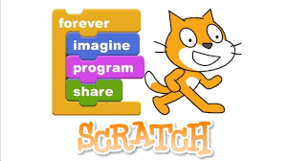
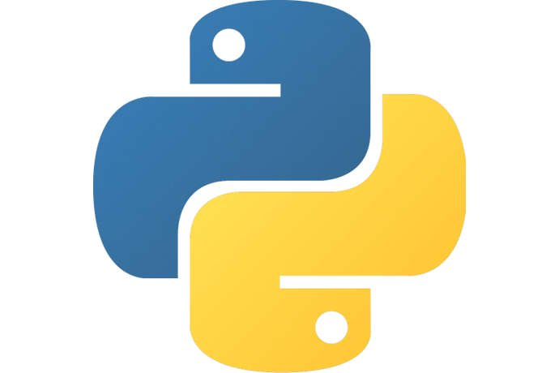
What is coding?
A computer is a dumb box
In order to tell a computer what to do, you need to learn a programming language
Scratch
Visual Programming Language
Python
Text based programming language
Anyone can code, you just need to learn a few basic rules:
Think logically
If the instructions aren’t quite right or the steps are in the wrong order, a program will not work correctly
Pay attention to detail
Important skill is spotting mistakes in your code. These mistakes are called bugs, and event tiny bugs can cause big problems.
Get coding
Secret! - Get stuck in.

Slide 3
Meet Python
Why Python?
Many schools and universities use it to teach.
Easy to read and write
You write the instructions using a mixture of English words, punctuation, symbols & numbers
Batteries included
It comes with everything you need to get coding straight away.
Handy tools
Is packed with lots of useful tools and code pre-packaged into libraries.
Works everywhere
You can write and run Python code on lots of different computers.
Great support
Python has well-written documentation, including a comprehensive reference section.
Python in action
Python is powerful to be used with interesting and exciting tasks within business, medicine and science.
Crawling the Web
Parts of Google’s search engine is written in Python. YouTube is also built using Python.
Medical marvels
A python-programmed robot can perform better, more accurate than a human
Serious business
Python is implemented into banks and big store chains to help manage financial aspects
Out of this world
Software engineers use Python to create tools for NASA’s Mission control
In the movies
Disney uses Python to automate repetitive parts of animation process

Slide 4
Installing Python (Windows)
Before you install Python -
Click “Start”
Right-click “Computer”
Left click “Properties”
Select “System”
1) Go to Python Website
Open a web browser
Enter https://www.python.org
Click “Downloads” to open Downloads page
2) Download Python
Click latest version starting with 3
Installer file will download automatically
Select “executable installer” from installer options
3) Run the installer
Double-click installer file to install Python
Choose “install for all users”
Click “next” at each prompt - keep default
4) Check Python is installed
Click “Start”
Type “cmd” - hit enter
Type “python” - hit enter
If exists will display - else be an error I tell ya
5) Open IDLE
When installation finished open IDLE
Click “Start”
Click “All Apps”
Select “IDLE”
IDLE will open

Slide 5
Your first program
Extra tasks
Ask the user for their age
Output required “Hello, Johnny. You are 21 years old.”
Ask the user for their address
Output required “Hello, Johnny. Your address is: ”
Ask the user for their phone number
Output required “Hello, Johnny. Your mobile no is: ”
Start
Say hello
Ask user to type their name
Say hello, adding user’s name
End

