Slide 1


SECTION 1 OF 5
ADSP 32021 · MLOPS FINAL PROJECT
Student Performance
Risk Monitoring System
Predicting Academic Performance and Monitoring Model Drift with MLOps
University of Chicago · May 28, 2026
Andrew Castillo · Campbell Taylor · Cicily Mathew · Sagana Ondande
github.com/campbelltaylor32/ML_OPS

Slide 2

OUR JOURNEY
From Legal NLP to Student Risk Monitoring
We started with an ambitious cloud-native legal-document enrichment platform — here's what we built, what we learned, and why we pivoted.
Original project
Why we pivoted
Legal Document Enrichment Platform
Predict precedent & citation impact of U.S. court opinions — classify as low, medium, or high precedential influence using NLP.
What we built
• Full GCP: Composer, Cloud Run, Cloud SQL, MLflow
• AutoGluon MultiModal + ELECTRA-small backbone
• Terraform IaC (10 modules), WIF auth, least-privilege SAs
• Evidently drift monitoring with JSD alerting
• CI/CD via GitHub Actions + Cloud Build
• Front end dashboard that allowed inference on recent court opinions
TIMELINE
GCP provisioning and API rate limits consumed weeks — leaving too little runway for model iteration and demo prep.
COST
Vertex AI GPU quota zero by default; Cloud Composer alone ~$300/mo for a student project.
SCOPE
70-file codebase across Terraform, Airflow, Docker, FastAPI, React.
Student Performance Risk Monitoring · MLOps Final Project · ADSP 32021

Slide 3
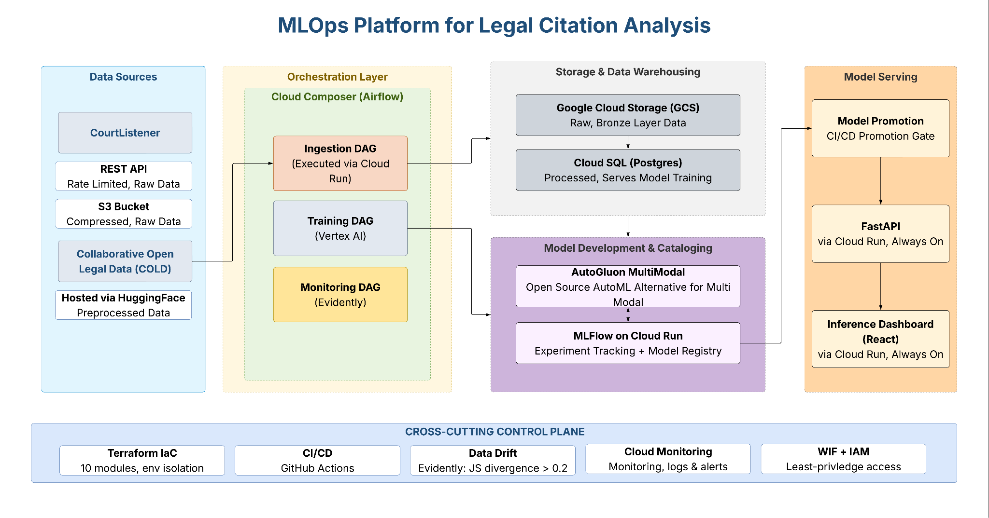
GCP ARCHITECTURE
Cloud-native MLOps platform on GCP
Single VPC · Terraform-provisioned · Scaled resources · 10 IaC modules · 70 files
TOOLS
Terraform
Cloud Run
Composer
Cloud SQL
GCS
MLflow
GitHub Actions
Student Performance Risk Monitoring · MLOps Final Project · ADSP 32021

Slide 4

GCP Model Serving Front End
Cloud-native front-end for inference
Student Performance Risk Monitoring · MLOps Final Project · ADSP 32021

Slide 5
CHALLENGES & LESSONS
What we learned building the legal NLP platform
Premature Infrastructure Build-Out
We provisioned the full GCP stack (Composer, Cloud SQL, Cloud Run, Terraform modules) before validating our data source or target variable
Target Variable Evolution
Precedential Status (Binary): messy, failed to serve use case
Citation Impact Tier (3-Class): derived from objective citation_count in the Harvard COLD Cases dataset - measures how influential a case actually became rather than how it was filed.
Data Sourcing — CourtListener Rate Limits
CourtListener API enforces 5 req/min with a 125 call/day hard cap
Provisioning Challenges
Composer 2 environments take 20–30 min to provision, making iteration painful during debugging
CI/CD configuration for GitHub actions, involved process
Less support for AutoML solutions that leverage multimodal data (text + tabular)
Data Sizing — BZ2 Bulk Exports
CourtListener bulk exports are BZ2-compressed (~50 GB across two files), slow decompression
Required a two-pass relational join (clusters CSV then opinions CSV) in Cloud SQL before training data was usable
Student Performance Risk Monitoring · MLOps Final Project · ADSP 32021

Slide 6





SECTION 1 OF 5
INTRO & PROBLEM STATEMENT
Business Problem & Use Case
Advisors often learn a student is struggling only after final grades are posted. At that point, intervention opportunities are limited. This project builds an early-warning model that uses student background, academic behaviors, and support-access indicators to predict performance risk earlier in the term.
Student signals
Predicted risk
Advisor action
Study time, sleep, stress, attendance, demographics & background
Model returns a Performance Score and an At-Risk flag
A ranked shortlist of students to reach out to early
Goal: augment advisors with an early, prioritized signal — not replace them or auto-grade students.
Student Performance Risk Monitoring · MLOps Final Project · ADSP 32021

Slide 7

SECTION 1 OF 5
INTRO & PROBLEM STATEMENT
Dataset, Target & Modeling Decision
1,000
student records · 0 missing values
Behavior
Demographics
Study hrs · Sleep hrs · Attendance · Stress level
Age · Gender · Major
0–100
Target: continuous Performance Score
< 60
At-Risk threshold on predicted score
Background
Academic context
Living area · Parent education · Scholarship · Part-time job
Extracurriculars · Internet access · Exam proximity
14
behavior, demographic & background inputs
No target leakage: subject scores and final grade are excluded. Average Score is computed from subject scores, so including them would let the model trivially reconstruct the target. We learn only from advisor-actionable signals.
Student Performance Risk Monitoring · MLOps Final Project · ADSP 32021

Slide 8
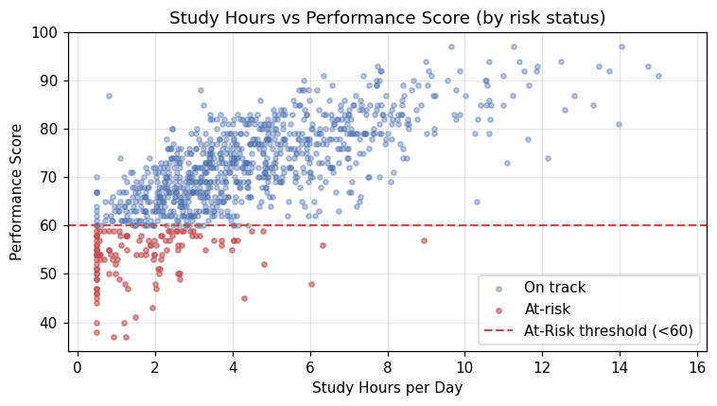
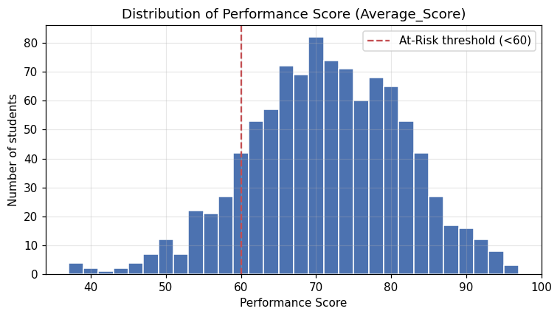
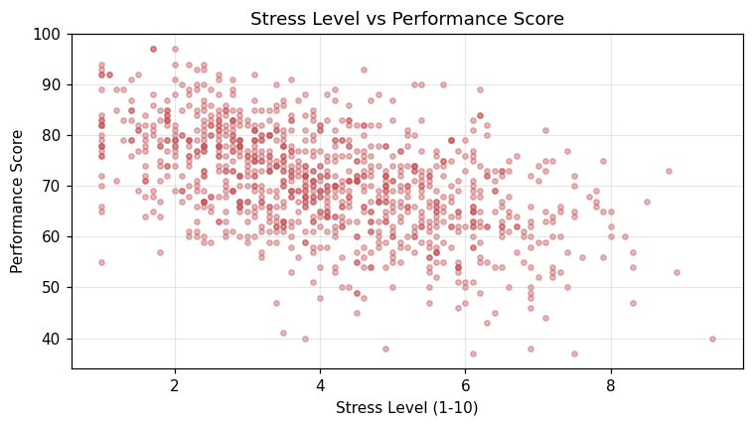
SECTION 2 OF 5
DATAFLOW
EDA Highlights
Features Interactions with Performance Score
Target Performance Score distribution
Performance varies widely — a measurable, learnable target.
Behavioral features (study, attendance, stress) carry the strongest, actionable signal.
The 60-point threshold turns a continuous score into an advisor decision.
Student Performance Risk Monitoring · MLOps Final Project · ADSP 32021

Slide 9






SECTION 2 OF 5
DATAFLOW
Dataflow & Lineage
PILLAR 1
Staged transforms; each table is contract-validated before the next stage runs.
Data Lineage
contract
contract
contract
Raw CSV
Staging
Intermediate
Marts
Source records,
as collected
Hygiene only —
dedupe · typing · drop nulls
Drop leakage & IDs ·
add derived features
Fixed-seed split →
training + serving
Two derived features added
study-to-sleep ratio · stress-adjusted attendance
Governed lineage
Every table is versioned; a contract check gates each stage, and the lineage DAG is saved as a build artifact.
TOOLS
dbt-style transforms
pandas
Parquet
scikit-learn split
data contracts
Student Performance Risk Monitoring · MLOps Final Project · ADSP 32021

Slide 10
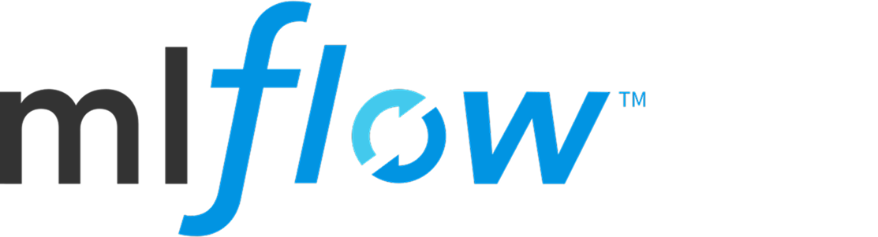


SECTION 2 OF 5
DATAFLOW
Feature Versions & Experiment Tracking
PILLAR 2
Versioned feature sets make model comparisons reproducible.
Feature Store + Experiment Tracking w/ MLFlow
Feature Version 1
Original behavioral & background features
Experiment Tracking
Reproducible
Model Comparison
Feature Version 2
Grid across feature versions × hyper-parameters
Logs metrics · training time · latency · emissions
Every run is re-runnable and rankable — no one-off training.
Adds engineered signals: study-to-sleep ratio · stress-adjusted attendance
TOOLS
pandas
Parquet
scikit-learn
LightGBM
MLflow
CodeCarbon
Student Performance Risk Monitoring · MLOps Final Project · ADSP 32021

Slide 11

SECTION 3 OF 5
ARCHITECTURE
AutoML Training & Model Selection
PILLAR 3
AutoML compared model families and selected the strongest deployable model.
AutoML Optimization
Approach | RMSE | R² | Latency
Baseline LightGBM | 4.70 | 0.80 | ~1 ms
FLAML AutoML (XGBoost) ★ | 4.08 | 0.85 | ~2 ms
Top-5 feature model | 5.18 | 0.76 | ~0.5 ms
FLAML AutoML
XGBoost family · best predictive performance among working approaches
Selected by lowest hold-out RMSE while keeping interactive-grade latency.
TOOLS
FLAML
LightGBM
XGBoost
random forest
extra trees
H2O AutoML
MLflow
Student Performance Risk Monitoring · MLOps Final Project · ADSP 32021

Slide 12

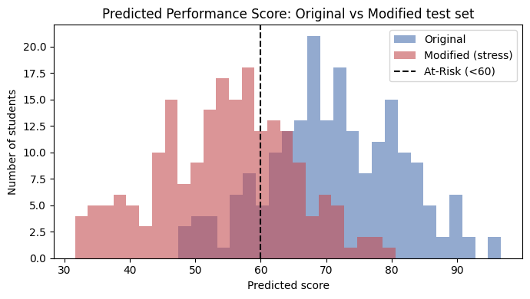

SECTION 4 OF 5
TOOLS & PILLARS
Monitoring & Changed-Test Validation
PILLAR 4
An academic-stress scenario tests whether the model & monitoring respond to shifted data.
Drift Monitoring
Changed features: study hrs −50% · stress +3 · sleep −1.5 hrs · attendance −15 pts
Original test set
Changed test set
RMSE
4.08
RMSE
19.6
R²
0.85
R²
−2.4
Prediction drift PSI
3.97
Mean predicted
71.2
Mean predicted
53.2
MAJOR DRIFT ( > 0.25 )
At-Risk rate
14%
At-Risk rate
70%
TOOLS
PSI
Evidently
Streamlit
scikit-learn metrics
Student Performance Risk Monitoring · MLOps Final Project · ADSP 32021

Slide 13







SECTION 3 OF 5
ARCHITECTURE
End-to-End MLOps Architecture
Data preparation → model selection → deployment → monitoring, as one connected system.
Student
dataset
Staged Data Lineage
Feature
versioning
MLflow
experiments
AutoML
selection
Selected
model artifact
FastAPI +
Streamlit
Evidently /
PSI monitoring
Advisor /
model review
TOOLS
Python
pandas
scikit-learn
MLflow
FLAML
FastAPI
Streamlit
Evidently
GitHub
Student Performance Risk Monitoring · MLOps Final Project · ADSP 32021

Slide 14

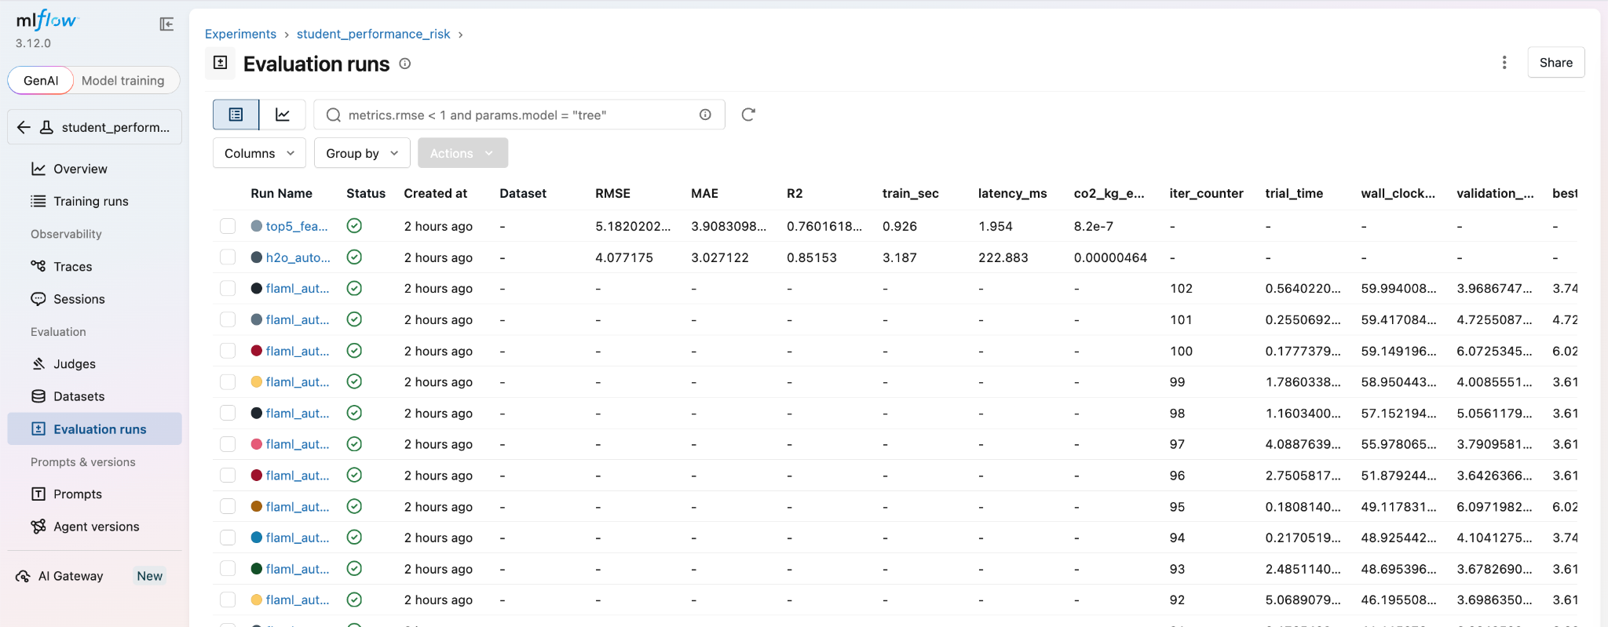
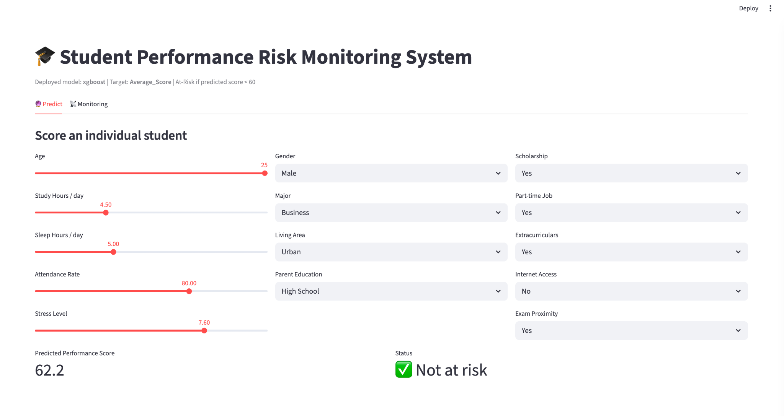
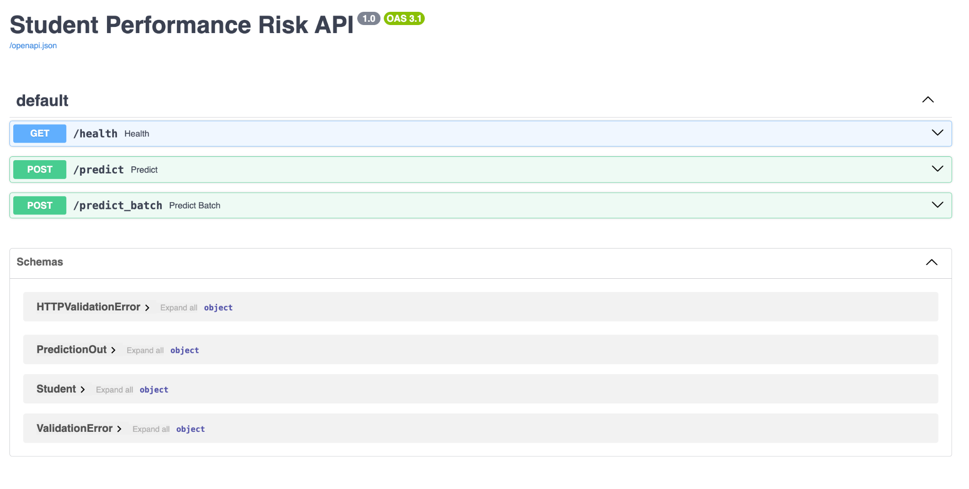
SECTION 3 OF 5
ARCHITECTURE
Deployment for Inference & Demo Touchpoints
Raw student
profile
Inference
service
Selected
model
Score +
At-Risk flag
Student scoring +
Monitoring
Student Performance Risk Monitoring · MLOps Final Project · ADSP 32021
Notes:
Streamlit

Slide 15
SECTION 4 OF 5
TOOLS & PILLARS
Four Pillars & Tool Stack
1
2
3
4
Data Lineage
Feature Store + Experiment Tracking
AutoML Optimization
Drift Monitoring
Data Prep
Python · pandas · NumPy
Emissions
CodeCarbon
Storage / Artifacts
Parquet · DVC-style versioning
Deployment
FastAPI · Streamlit
Modeling
scikit-learn · LightGBM
Monitoring
Evidently · PSI
AutoML
FLAML · H2O AutoML
Validation
pytest
Tracking
MLflow
Source Control
GitHub
Student Performance Risk Monitoring · MLOps Final Project · ADSP 32021

Slide 16
Q&A
SECTION 5 OF 5
Team Contributions · Questions
AC
CT
CM
SO
Andrew Castillo
Campbell Taylor
Cicily Mathew
Sagana Ondande
Data preparation, EDA & train/test split
Feature engineering, feature versioning & experiment tracking
AutoML, model evaluation & model selection
Deployment, monitoring dashboard, demo & documentation
github.com/campbelltaylor32/ML_OPS
Questions?
Thank you — full MLOps workflow, from data to deployment to monitoring.

